Slide 1
Programming Languages: Scratch
Intro to Scratch

Slide 2
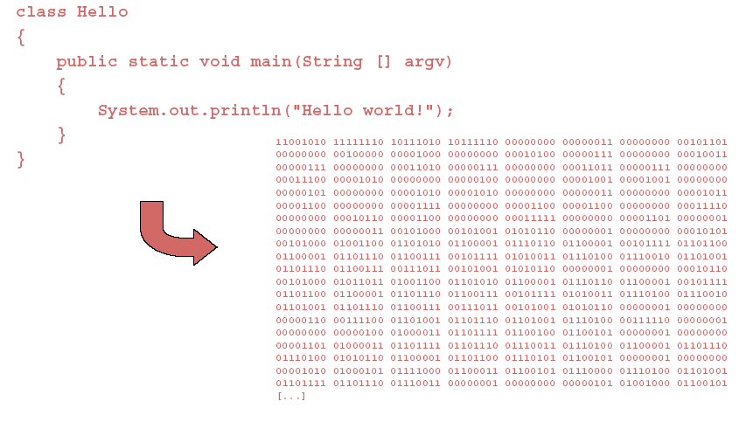
Lower level versus high level
Clearly, lower level languages can be tedious
Higher level languages quickly developed to make programming faster

Slide 3
Which language?
There are numerous languages to choose from
Examples include:
  C/C++
  Java
  Python
  Ruby
  Ada
  ML
  Prolog
  Matlab
  …

Slide 4
Different considerations
Different languages are good for different tasks!
Examples:
  C/C++ is extremely fast, but also takes longer to learn or code in
  Matlab is much slower, but is optimized for being easy and (relatively) fast on matrix operations
  Java will run on any machine (without the full packages being installed), but is slow in comparison to C/C++

Slide 5
Scratch
We’ll start with a programming language that is relatively easy to learn and use immediately
(It’s also free - you can download it at home)
Advantage: while the syntax is similar to other programming languages (while, if, etc.), it is also a bit easier to use

Slide 6
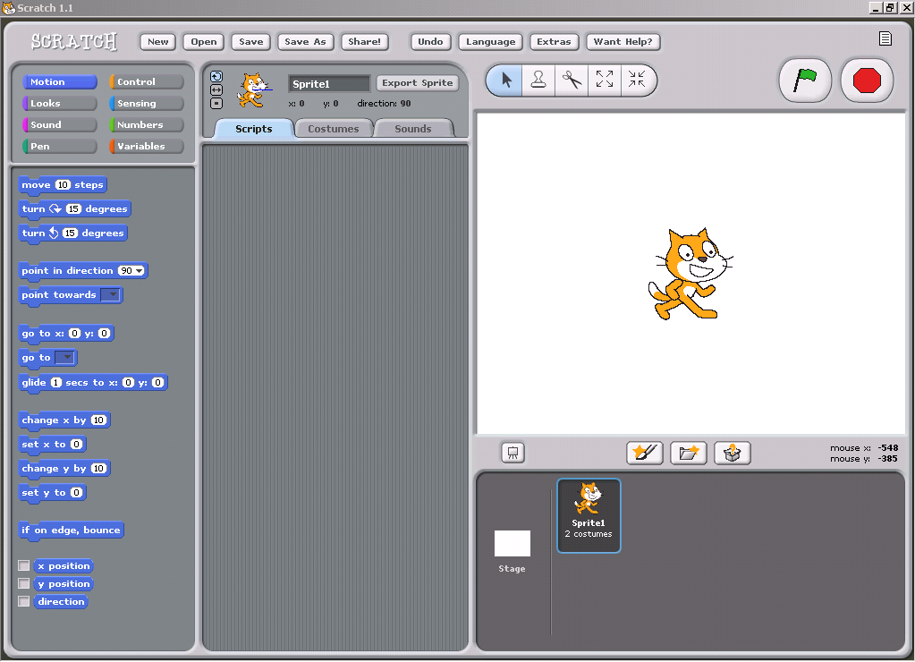
Getting started
So - find scratch on the computer in front of you.
Open it.

Slide 7
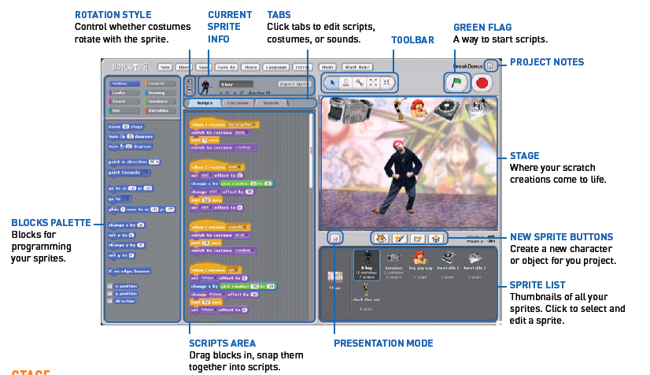
Quick overview

Slide 8
Getting started
For the rest of today, we’ll work through the “getting started with scratch” guide
Experiment and have fun!
Next week, we’ll explore scratch syntax a bit more in depth, and talk about programming in scratch

