Slide 1
Programming Languages: Scratch
Control structures

Slide 2
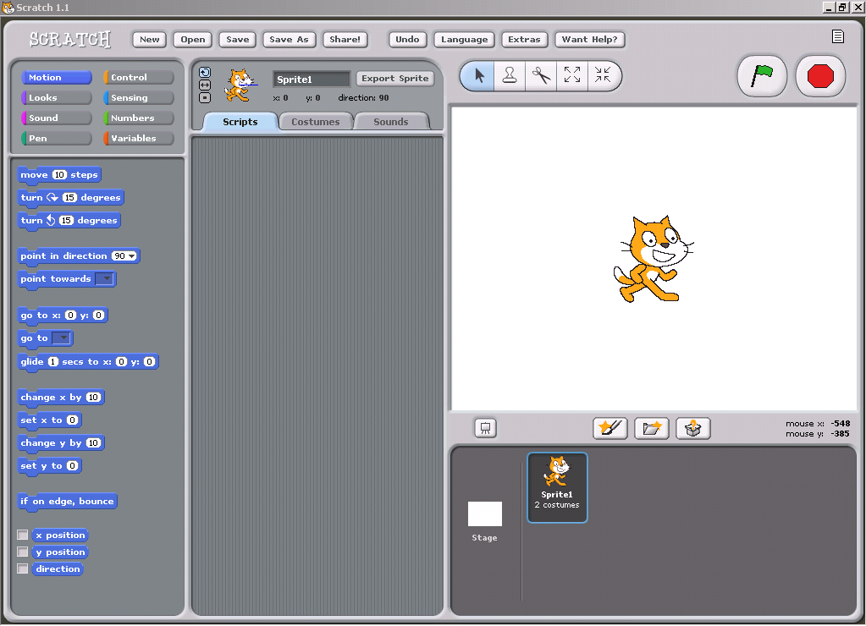
Last time
Talked about high level versus low level languages (more on this later)
Saw basic idea of using sprites

Slide 3
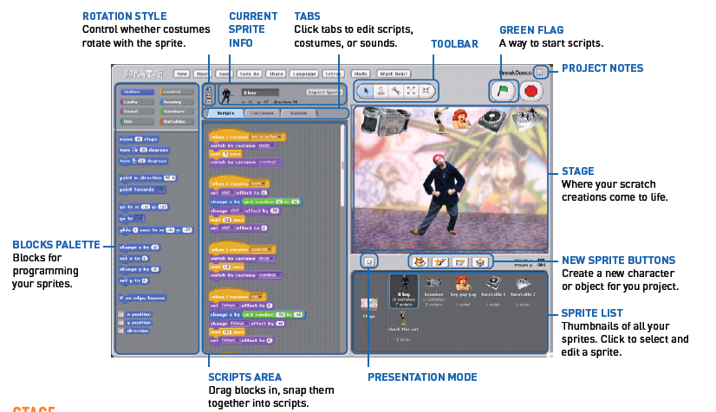
Quick overview

Slide 4
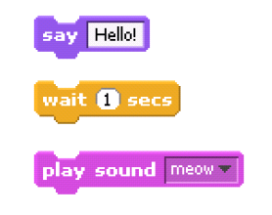
Statements
In programming, a statement is simply a directive that tells the computer to do something. Think of it as a command or an instruction.
In Scratch, any block whose label reads like a command is a statement.

Slide 5


Booleans
Sometimes, you only want a statement to be executed under certain conditions. Such conditions are defined in terms of Boolean expressions.
In programming, a Boolean expression is an expression that is either true or false. In Scratch, any block shaped like an elongated diamond is a Boolean expression.

Slide 6
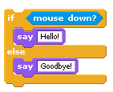


Conditionals
In programming, a condition is something that must be true in order for something to happen.
A condition is thus said to "evaluate to true" or "evaluate to false."
In Scratch, any block whose label says "if," "when," or "until" is a sort of conditional construct.

Slide 7


Loops
In programming, a loop can induce multiple executions of statements.
In Scratch, any block whose label begins with "forever" or "repeat" is a looping construct.

Slide 8
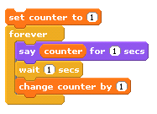
Variables
As we discussed before, variables are placeholders for some value, much like x and y are popular variables in algebra.
This is just like the “.word” command from our assembly chapter.
In Scratch, variables are represented with blocks shaped like elongated circles, uniquely labeled by you.

Slide 9
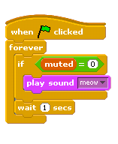
Threads
In programming, a thread is like a mini-program within a program that can execute at the same time as other threads.
In Scratch, any block whose label begins with "when" essentially demarks the start of a thread.

Slide 10
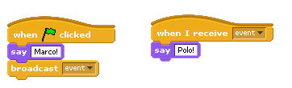
Events
An event is a signal from one thread to another.
Blocks whose labels begin with "broadcast" signal events whereas blocks whose labels begin with "when" handle events.

Slide 11
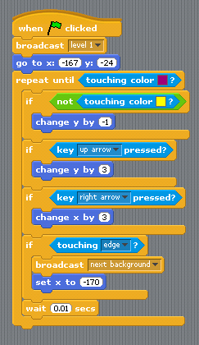
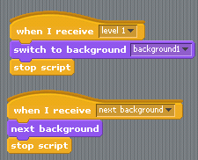
Using events
In a game (for example), events can be used to change levels.

Slide 12
Today - homework day
Your next homework will be to write a program in scratch.
The only formal requirement is to use at least 3 control structures and at least 5 other (different) commands.
The details are up to you! I would like a proposal for this assignment - at least 1 paragraph describing your plan - to be submitted by the end of the day on Wednesday (via email).

