Slide 1
Computer Security
An overview of terms and key concepts

Slide 2
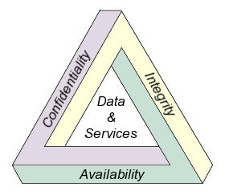
What is security?
Security is about protecting something.
Three aspects:
  Confidentiality
  Integrity
  Availability

Slide 3




Sounds kinda boring…

Slide 4
Fiction versus reality!
In reality, most of computer security has with:
  Advanced mathematics
  Highly technical programming issues (usually without a gun in sight)
  Resetting passwords
  Convincing users that they really do need to be careful!

Slide 5
Malicious Code
Defined as any code that attempts to bypass functionality
Examples include:
  Virus: a program that embeds a copy of itself in another program
  Worm: runs independently to propogate a working copy of itself onto other machine
  Trojan horse: has useful functionality as well as hidden, malicious functionality
  Logic bomb: embedded code that lies dormant until some condition is met

Slide 6
Types of Attacks: Spoofing
Password guessing: pretending to log into a system as a valid user in order to “guess” their password
Phishing: using a webpage that mimics an official webpage, but actually collects information for malicious purposes
Man-in-the-middle attack: someone in the intermediate network path between two computers either listens to or modifies the data being sent between the computers

Slide 7
Types of Attacks
Denial of Service: does not directly corrupt data or get access, but instead tries to keep valid users from utilizing resources
Buffer overflows: Exploits vulnerabilities in several common programming languages in order to run unauthorized code or gain access to a system (often inside a virus or worm)
Backdoor: a deliberate vulnerability in a program that allows administrative access for either testing or for more unscrupulous purposes.

Slide 8
Access control
The central element of computer security:
  The prevention of unauthorized use of a resource, including prevention of using a resource in an unauthoized manner
Incorporates:
  Authentication
  Authorization
  Audit

Slide 9
Access Control Policies
Access rights define ways that subjects interact with objects in a computer.
3 main industry standards:
  Discretionary Access Control (DAC)
  Mandatory Access Control (MAC)
  Role-Based Access Control (RBAC)
These aren’t mutually exclusive at all!

Slide 10
Discretionary Access Control
Most common in modern operating systems
For example: in unix, if you create a file, you can set permissions which set if other people can view/edit/execute it
An access control matrix lists which users have access to which files, and what permissions they own

Slide 11
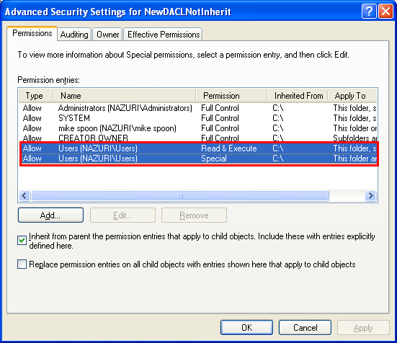
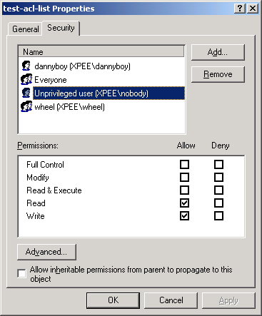
Windows DAC
Windows stores a list for every file with permissions rights

Slide 12
Linux DAC
In Linux (or MAC) systems, permissions are based around ownership.
Each user has a user id (uid) and at least one group id (gid)
At time of creation, a file is set to its creator’s uid and either its owner’s gid or its parent directory’s gid (depending on setup of the parent directory)
9 bits for each file determine read, write and execute abilities:
  Owner, group, world
  111, 101, 100

Slide 13
Linux permissions (cont)
A user can view this permissions using ls at a command prompt, and can change them using the command chmod
For example, “chmod 777 myfile” makes the file readable, writeable and executable by anyone
Why? 777 = 111 111 111
rwx rwx rwx
owner group world

Slide 14
Super user accounts
Both windows and linux have administor (windows) or root (linux) accounts
In windows, administor has access to almost everything - can view all files and run almost anything, but (at least in most recent versions) some system level things are restricted.
In linux, root can do anything. This makes some things easier, but is also a huge security vulnerability.

Slide 15
Running programs
In both windows and linux, a program which begins to run will run with it’s owners privileges by default. Why is this a security issue?
Case study: I put an executable on my webpage. What happens when you run it? (Do students and faculty have same access permissions?)

Slide 16
Mandatory Access Control
MAC is based on comparing security labels with security settings.
Evolved in military/government settings:
  Top secret, secret, unclassified
Mandatory means that a subject with access to an object can NOT necessarily share access to that object, even if they are its creator.

Slide 17
MAC: an example
Bell-Lapadula model: each object gets a classification and each subject gets a security clearance
Two main principles:
  No “read up”: subjects can not access objects with a higher security clearance
  No “write down”: subjects can not write anything with a lower security classification than their own clearance, so they cannot “unclassify” anything
Many other types of MAC models exist, targeting to various settings (banking, etc), all designed to restrict who can access information

Slide 18
MAC in windows
Windows Vista and 7 actually incorporate some mandatory access controls to secure the OS.
A user or process can only alter a file with an equal or lower integrity level.
By default, all created files are set at medium (as are ALL users).
System level files vital to the OS are set at high, so no user can alter them.

Slide 19
Role Based Access Control
Access rights are based on current role, not identity
  Example: doctor’s office
RBAC is the newest, and has been incorporated to systems on top of existing access control

Slide 20
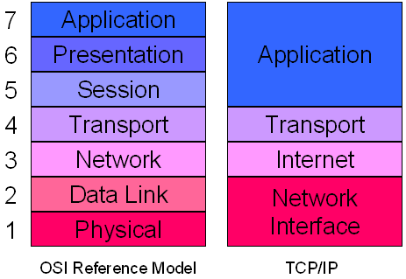
Networks and security
Recall the OSI layers:

Slide 21
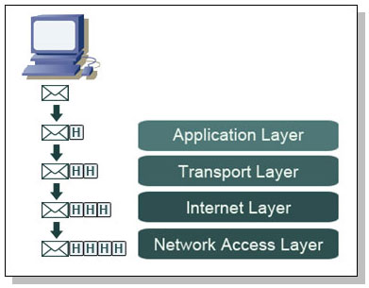
Packets
Each layer adds it own information to network packets
From a security standpoint, certain portions of information are more interesting than others.

Slide 22
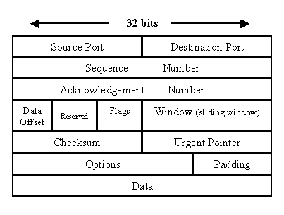
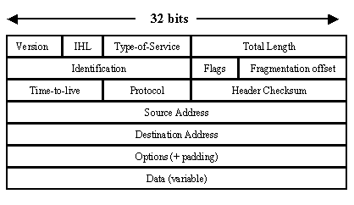
Packets: a closer look
What data might be useful to an attacker?
TCP Packet
IP Packet

Slide 23
Fundamentally insecure
There is no way to prevent information from leaking out. Packets by definition give information about what services are running on a given computer.
The key is to minimize vulnerability and (possibly) protect the actual information that is being transmitted.
So the two main goals:
  Protect your systems
  Protect your information

Slide 24
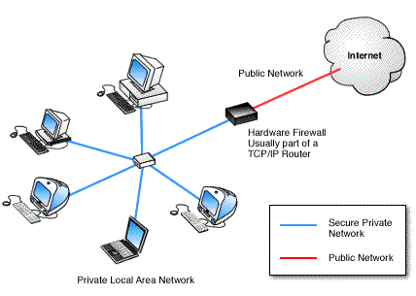
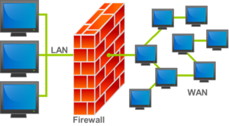
Firewalls
Basic idea: All network traffic must pass through the firewall computer.
Ideally the firewall will protect the internal network from attacks. Can also set policies to not allow certain types of connections out of the network.

Slide 25
Different firewalls
Host-based firewalls versus personal firewalls
Dedicated hardware versus standard computer
Packet filtering firewalls: rules are based on those packet headers
  Ex: allow all traffic to port 80, allow traffic to port 23 only from ip address 137.54.24.74, etc
Stateful firewalls: track established TCP connections and only allow those to come through for the duration of that one connection

Slide 26
Firewalls: pros and cons
Depending on type, your network can get significantly slower or faster.
Dedicated hardware is faster but more expensive.
The firewall itself can be attacked, especially if it runs many services.

