Slide 1
Final bits of OS
Secure storage and TPM
Auditing and logging

Slide 2
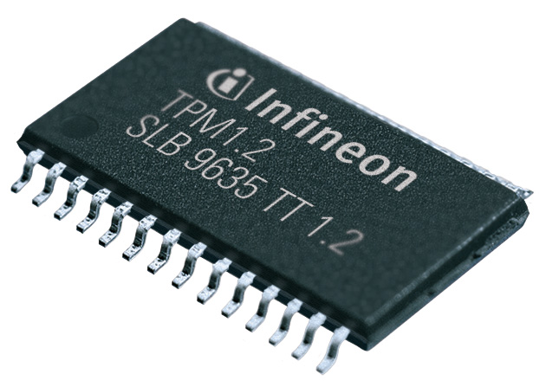
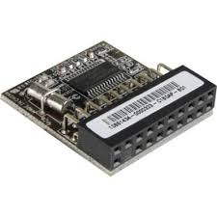
TPM and Trusted Computing
Goal: incorporate specialized hardware to improve security.
Basically, this is just a chip that’s part of your motherboard – usually soldered on, and included in many standard processors these days.
Largely invisible: you just enter your usual password, and the OS does the rest

Slide 3
How TPM works
The TPM stores encryption keys on it
In order to access information on the disk, but be connected to the processor
Can’t remove either the chip or the hard drive and use them to access the data
Three basic functionalities:
Secure storage and use of keys
Secure software attestations
Secured data

Slide 4
How TPM works
Each TPM chip contains an RSA key pair called the “endorsement key” – EK.
Cannot be accessed by software
The Storage Root Key (SRK) is created when an admin takes ownership of the system
Generated by the TPM based on the EK and an owner password
A second key, the Attestation Identity Key (AIK) protects the device against installation of any software or firmware by hashing critical sections of the firmware before execution.
When the system attempts to connect to network, hashes are checked on a sever, and if they fail, the system is locked out.

Slide 5
Examples
Intel: Trusted Execution Technology (TXT)
Hardware included on most commercial chips these days
Used by many systems and applications:
Linux Unified Key Setup (LUKS)
Microsoft BitLocker drive encrypter
Encryption applications: SecureDoc, cm-crypt in Linux
Even applications preventing cheating in online games can make use of this functionality

Slide 6
TPM Key Storage
All crypto keys are stored in a tamperproof area
TPM hardware generates RSA keys pairs using “true” random number generators.
Each TPM chip has a permanent key (the EK), and others are generated as needed.
The permanent key can be used to sign and prove where things come from.
Actually a private/public key pair, and the private part never leaves the dedicated hardware.

Slide 7
TMP and Crypto
Hardware includes encryption and decryption functions, so that keys never leave the hardware.
Data comes in and is encrypted or decrypted locally.
Users have only limited interaction with crypto components in order to minimize issues.

Slide 8
TPM Attestations
Essentially provides proof that a particular piece of software is funning on the machine.
Really a signature on a hash of the software.
Why?
Can guarantee certain level of software or OS is running.
One way to enforce security standards on both sides of a communication, or to require certain levels and standards.
Example: boot loader can require a check that the OS is the one it intends to load, and quit if not.
Prevents attacker from loading a corrupted kernel.

Slide 9
TPM and Data Security
Can encrypt data with keys on one machine.
Data can then ONLY be decrypted on that machine.
Can even be sealed so that one a particular application can access it.
This technology is the basis for many secure encryption devices. (Very popular on TV these days.)

Slide 10
TPM controversies
“Who’s computer is this, anyway?”
Many critics worry about DRM issues
Companies are using it to block competition in some settings
Practicality issues: patching, releases, etc.

Slide 11
Attacks on TPM
Some new research is focusing on how to attack these systems
Example: TPM Reset Attack:
Focuses on resetting the TPM without restarting the system, so it can be brought into “trusted” state in any configuration
Uses only a 3 inch piece of wire (go check video)
Example: Evil Maid attacks
Attacker writes hacked bootloader to your shut down computer (by booting from separate volume)
When you boot, you enter your key, and once unlocked the hacked bootloader can cause problems.

Slide 12
Defenses and TPM
Really need 2 factor authentication: a token you can’t leave behind for someone to find.
Machine can still be corrupted
In the end, encryption can protect against someone stealing your laptop, but not perfect protection against someone who has repeated access to your machine while you are using it also.

Slide 13
Computer forensics
Computer forensics is the science of attempting to recover evidence on a computer system.
Complex area:
Legal issues heavily weigh in here.
Technical tools are likewise complex, since a chain of evidence must be preserved.
(We’ll see more in the next lab on this)
However, much of this boils down to an area called auditing. As a result, we must discuss what audit tools are included (and appropriate) on various systems.
Notes:
Reviewing the functionality suggested by Figures 18.1 and 18.3 , we can develop a
set of requirements for security auditing. The first requirement is event definition .
The security administrator must define the set of events that are subject to audit.
We go into more detail in the next section, but we include here a list suggested in
[CCPS04a]:
• Introduction of objects within the security-related portion of the software into
a subject’s address space
• Deletion of objects
• Distribution or revocation of access rights or capabilities
• Changes to subject or object security attributes
• Policy checks performed by the security software as a result of a request by a subject
• The use of access rights to bypass a policy check
• Use of identification and authentication functions
• Security-related actions taken by an operator and/or authorized user (e.g.,
suppression of a protection mechanism)
• Import/export of data from/to removable media (e.g., printed output, tapes,
disks)

Slide 14
Anatomy of an audit system
Logger: a mechanism to record information. Generally built into the system, but can be tailored by administrator.
Analyzer: Takes a log as input. Result of the analysis may lead either to changes in the data being recorded or to detection of problem/event.
Notifier: Takes output of analyzer and takes appropriate action, such as notifying user or admin.

Slide 15
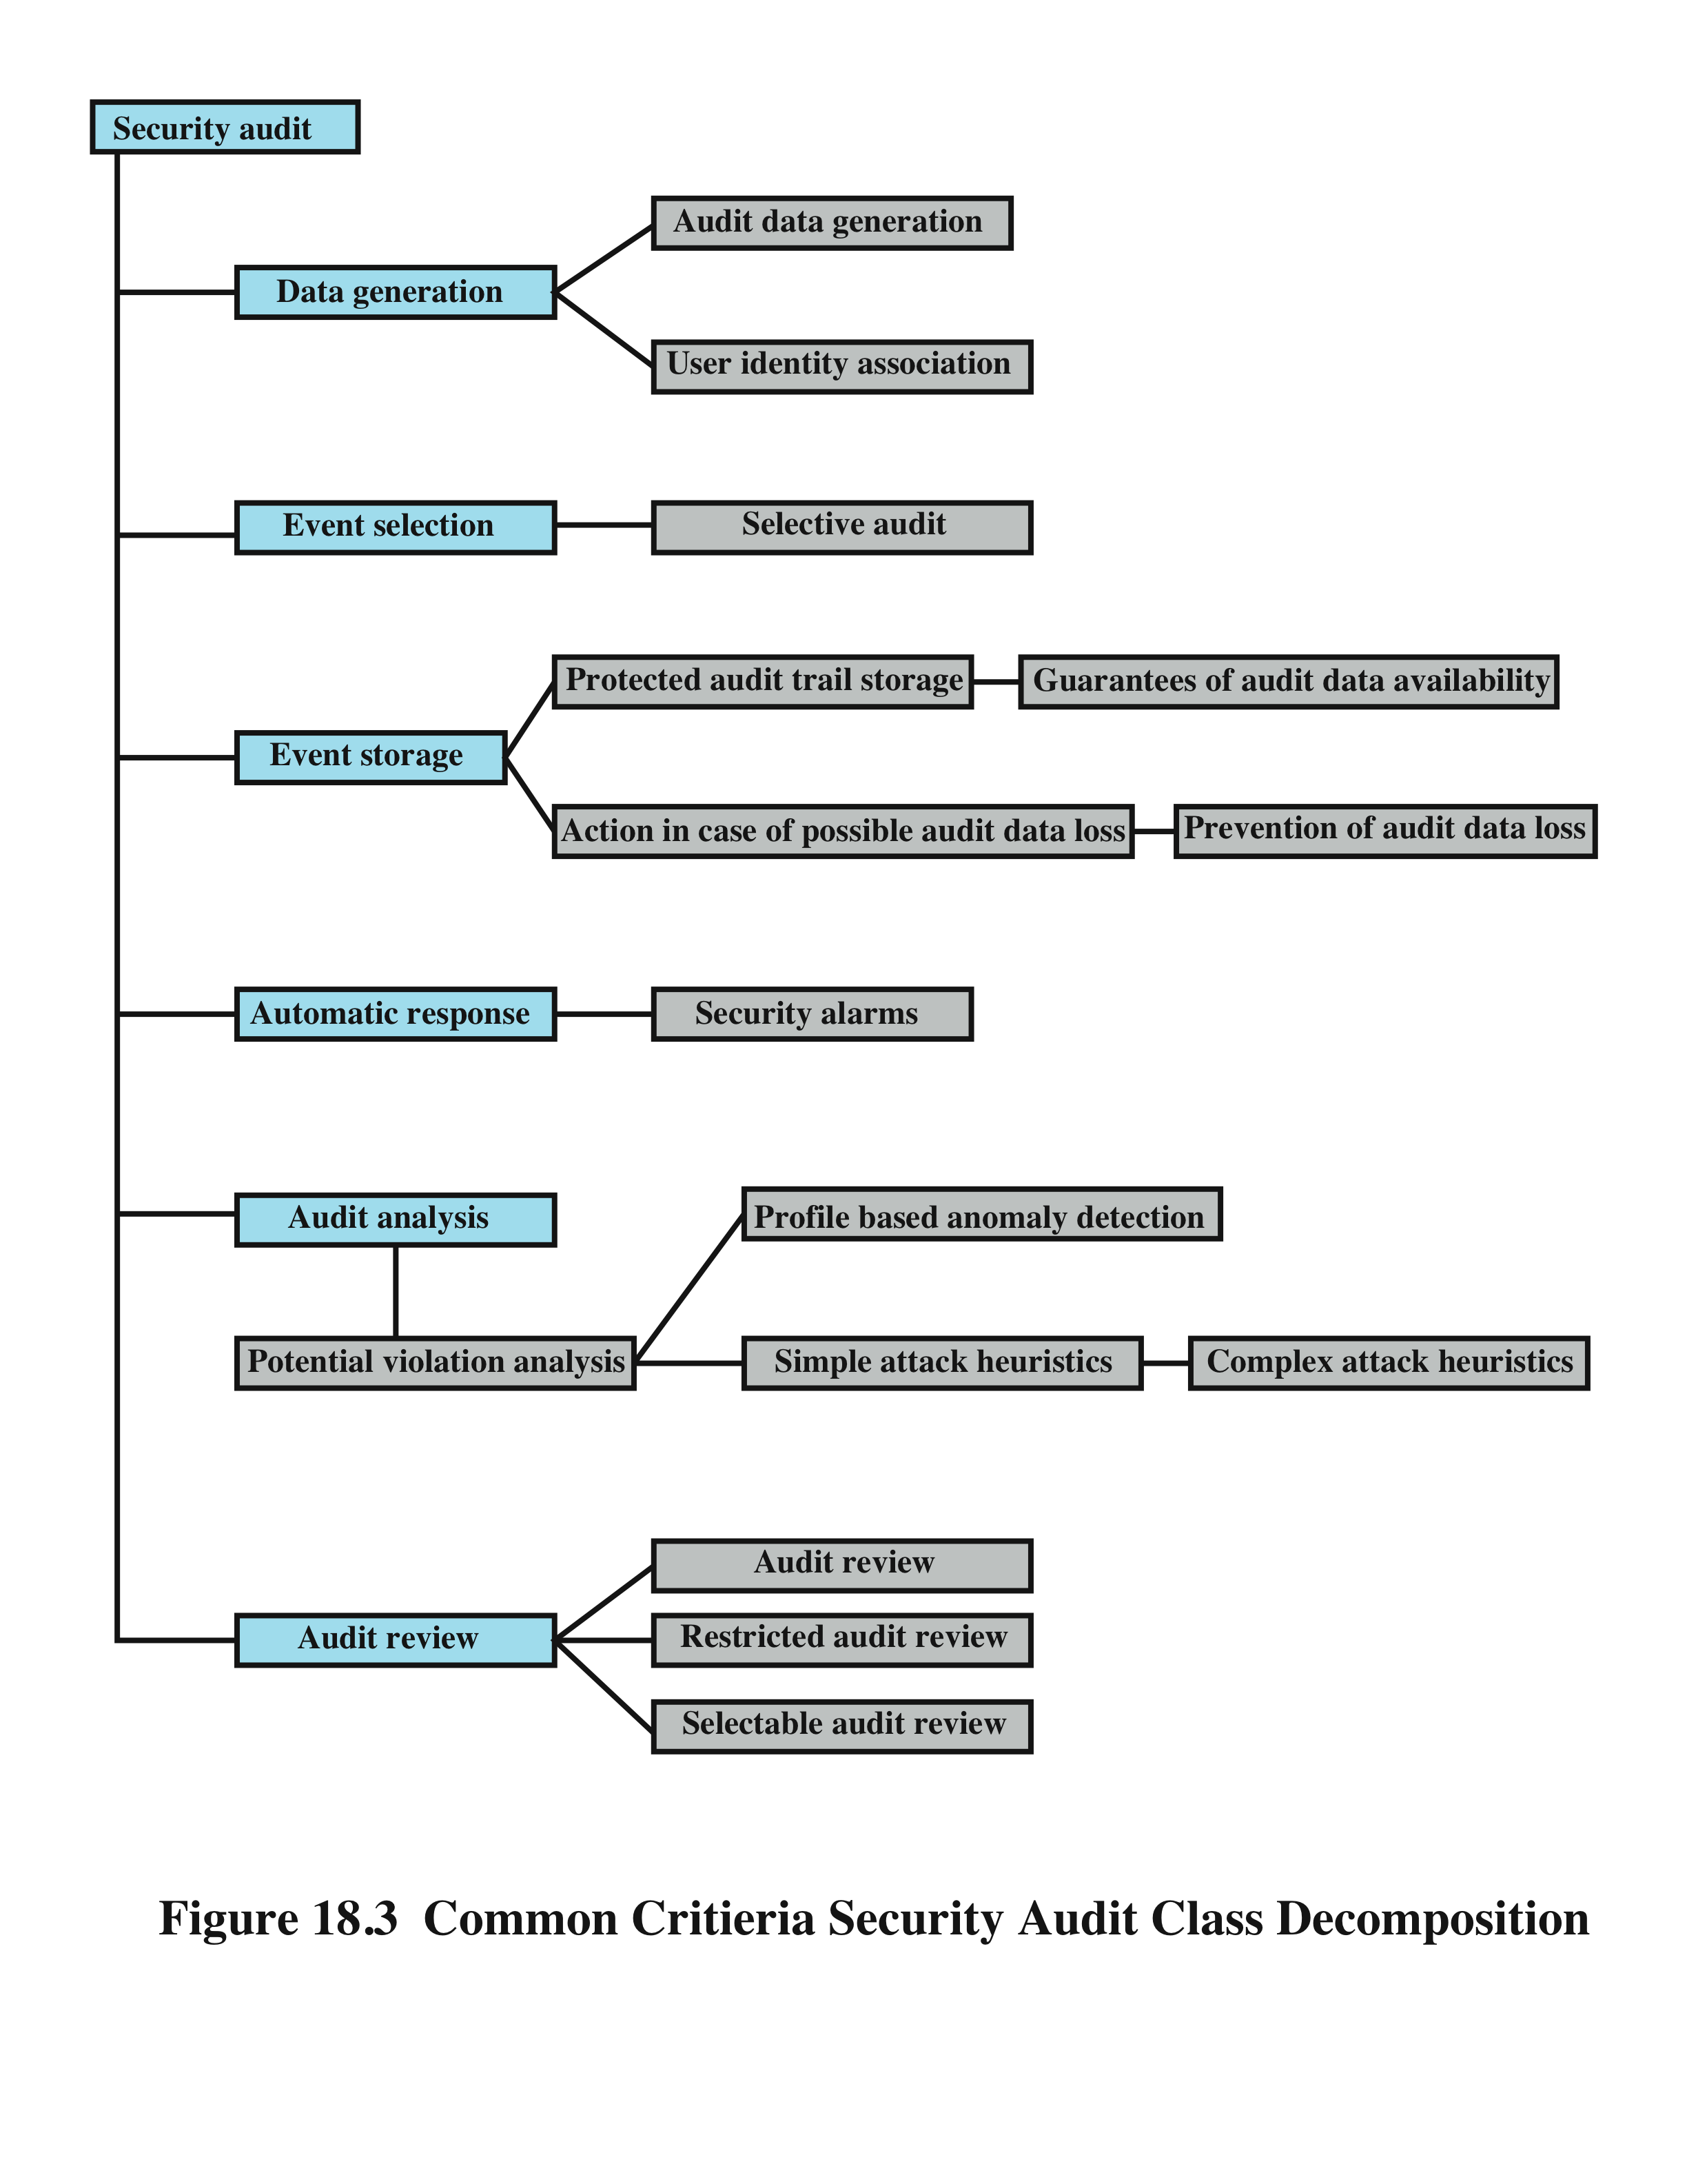
Security Auditing Functions (from Stallings and Brown)
Notes:
It is useful to look at another breakdown of the security auditing function, developed
as part of the Common Criteria specification [CCPS04a]. Figure 18.3 shows a
breakdown of security auditing into six major areas, each of which has one or more
specific functions:
• Data generation: Identifies the level of auditing, enumerates the types of
auditable events, and identifies the minimum set of audit-related information
provided. This function must also deal with the conflict between security and
privacy and specify for which events the identity of the user associated with an
action is included in the data generated as a result of an event.
• Event selection: Inclusion or exclusion of events from the auditable set. This
allows the system to be configured at different levels of granularity to avoid
the creation of an unwieldy audit trail.
• Event storage: Creation and maintenance of the secure audit trail. The storage
function includes measures to provide availability and to prevent loss of data
from the audit trail.
• Automatic response: Defines reactions taken following detection of events
that are indicative of a potential security violation.
• Audit analysis: Provided via automated mechanisms to analyze system activity
and audit data in search of security violations. This component identifies the
set of auditable events whose occurrence or accumulated occurrence indicates
a potential security violation. For such events, an analysis is done to determine
if a security violation has occurred; this analysis uses anomaly detection and
attack heuristics.
• Audit review: As available to authorized users to assist in audit data review.
The audit review component may include a selectable review function
that provides the ability to perform searches based on a single criterion or
multiple criteria with logical (i.e., and/or) relations, sort audit data, and filter
audit data before audit data are reviewed. Audit review may be restricted to
authorized users.

Slide 16
Event Definition
must define the set of events that are subject to audit
common criteria suggests:
introduction of objects
deletion of objects
distribution or revocation of access rights or capabilities
changes to subject or object security attributes
policy checks performed by the security software
use of access rights to bypass a policy check
use of identification and authentication functions
security-related actions taken by an operator/user
import/export of data from/to removable media
Notes:
Reviewing the functionality suggested by Figures 18.1 and 18.3 , we can develop a
set of requirements for security auditing. The first requirement is event definition .
The security administrator must define the set of events that are subject to audit.
We go into more detail in the next section, but we include here a list suggested in
[CCPS04a]:
• Introduction of objects within the security-related portion of the software into
a subject’s address space
• Deletion of objects
• Distribution or revocation of access rights or capabilities
• Changes to subject or object security attributes
• Policy checks performed by the security software as a result of a request by a subject
• The use of access rights to bypass a policy check
• Use of identification and authentication functions
• Security-related actions taken by an operator and/or authorized user (e.g.,
suppression of a protection mechanism)
• Import/export of data from/to removable media (e.g., printed output, tapes,
disks)

Slide 17
What to Collect
events related to the use of the auditing software
events related to the security mechanisms on the system
events that are collected for use by the various security detection and prevention mechanisms
events related to system management and operation
operating system access
application access for selected applications
remote access
Notes:
The choice of data to collect is determined by a number of requirements. One
issue is the amount of data to collect, which is determined by the range of areas of
interest and by the granularity of data collection. There is a trade-off here between
quantity and efficiency. The more data are collected, the greater is the performance
penalty on the system. Larger amounts of data may also unnecessarily burden the
various algorithms used to examine and analyze the data. Further, the presence of
large amounts of data creates a temptation to generate security reports excessive in
number or length.
With these cautions in mind, the first order of business in security audit trail
design is the selection of data items to capture. These may include
• Events related to the use of the auditing software (i.e., all the components of
Figure 18.1 ).
• Events related to the security mechanisms on the system.
• Any events that are collected for use by the various security detection and
prevention mechanisms. These include items relevant to intrusion detection
(e.g., Table 8.2 ) and items related to firewall operation (e.g., Tables 9.3 and 9.4 ).
• Events related to system management and operation.
• Operating system access (e.g., via system calls).
• Application access for selected applications.
• Remote access.

Slide 18
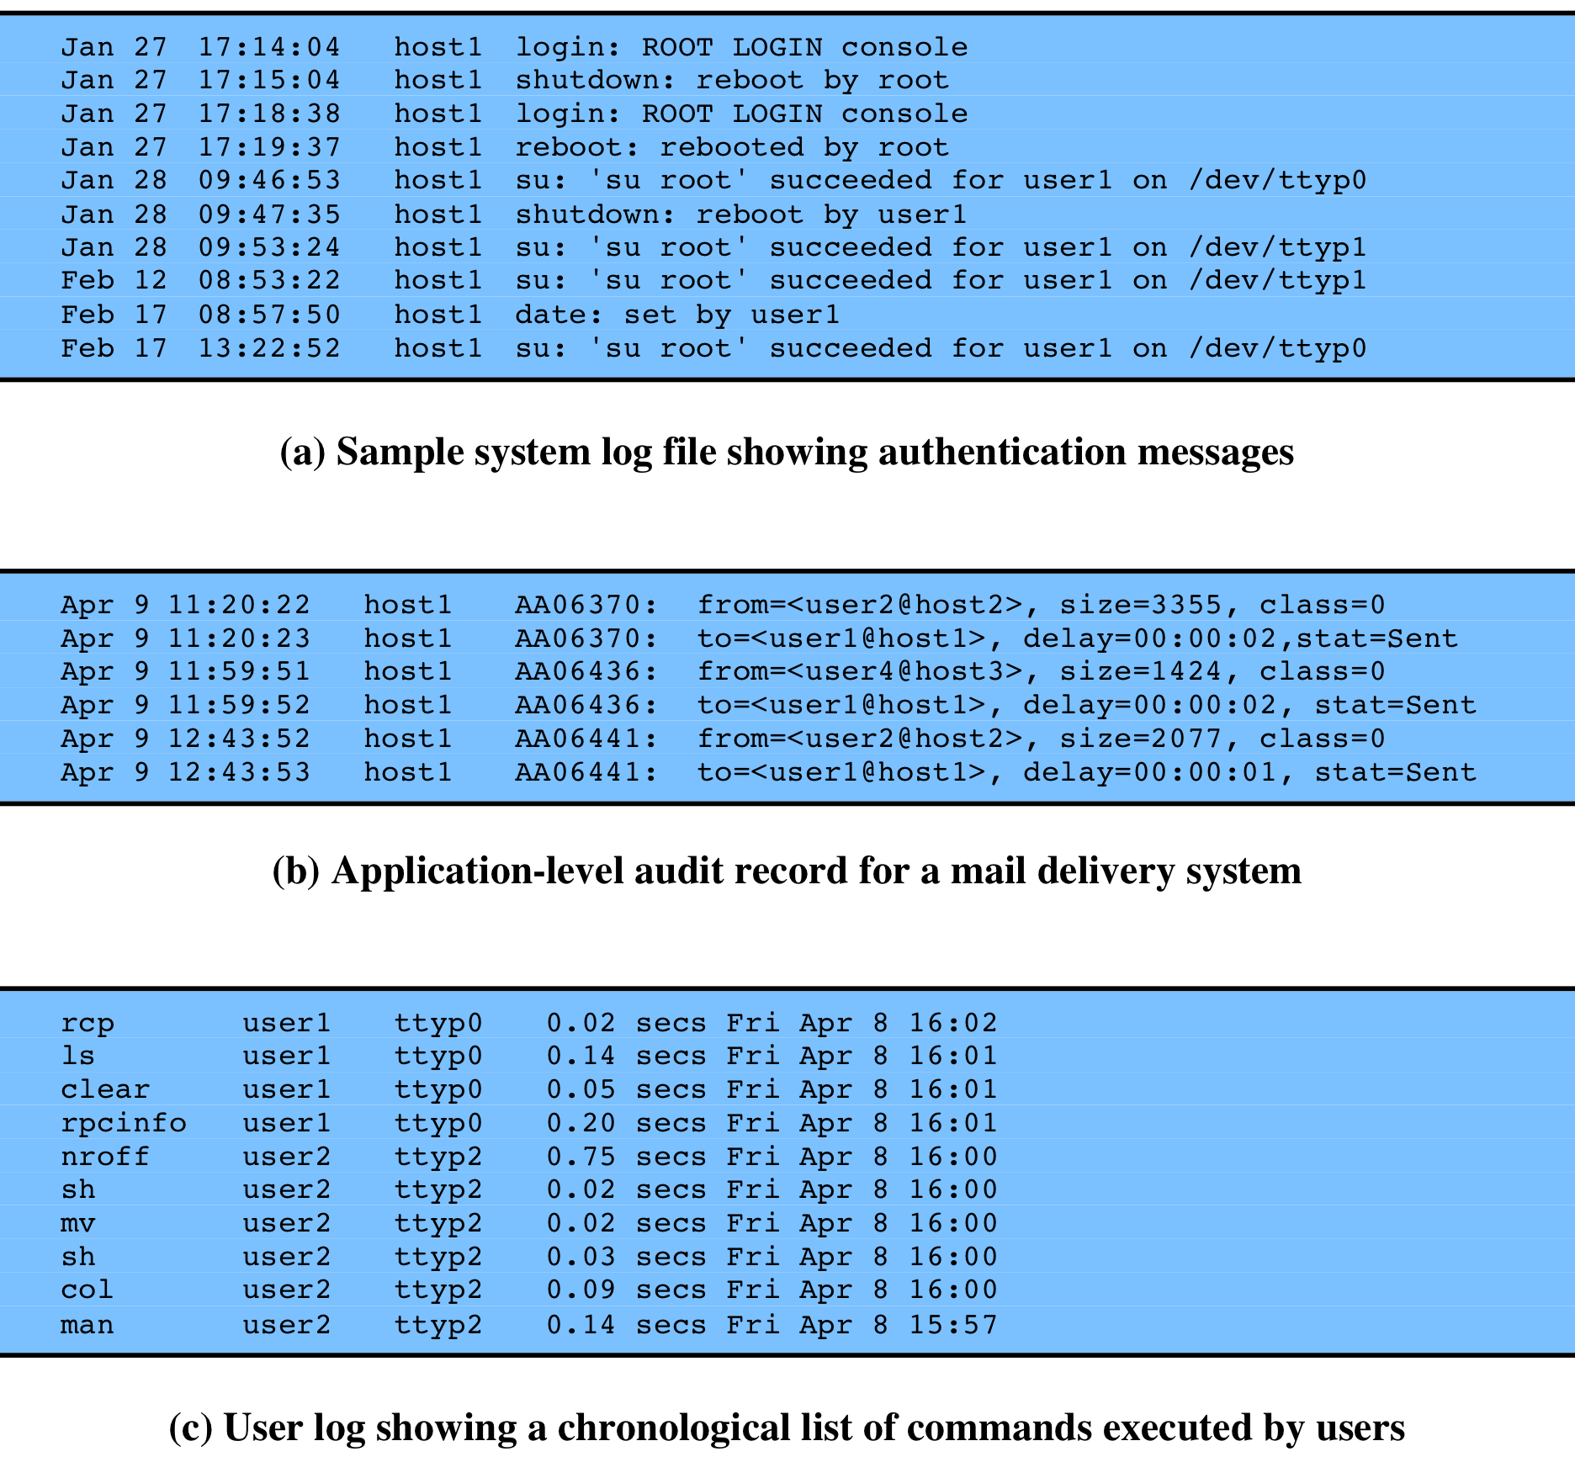
Figure 18.4 - Examples of Audit Trails
figure 18.4a is an example of a system-level audit trail on a UNIX system
figure 18.4b is an example of an application-level audit trail for a mail delivery system
figure 18.4c is an example of a user-level audit trail on a UNIX system
Notes:
System-level audit trails are generally used to
monitor and optimize system performance but can serve a security audit function
as well. The system enforces certain aspects of security policy, such as access to the
system itself. A system-level audit trail should capture data such as login attempts,
both successful and unsuccessful, devices used, and OS functions performed. Other
system-level functions may be of interest for auditing, such as system operation and
network performance indicators.
Figure 18.4a , from [NIST95], is an example of a system-level audit trail on
a UNIX system. The shutdown command terminates all processes and takes the
system down to single-user mode. The su command creates a UNIX shell.
Application-level audit trails may be used to
detect security violations within an application or to detect flaws in the application’s
interaction with the system. For critical applications, or those that deal with sensitive
data, an application-level audit trail can provide the desired level of detail to assess
security threats and impacts. For example, for an e-mail application, an audit trail
can record sender and receiver, message size, and types of attachments. An audit
trail for a database interaction using SQL (Structured Query Language) queries can
record the user, type of transaction, and even individual tables, rows, columns, or
data items accessed.
Figure 18.4b is an example of an application-level audit trail for a mail delivery
system.
A user-level audit trail traces the activity of individual
users over time. It can be used to hold a user accountable for his or her actions. Such
audit trails are also useful as input to an analysis program that attempts to define
normal versus anomalous behavior.
A user-level audit trail can record user interactions with the system,
such as commands issued, identification and authentication attempts, and
files and resources accessed. The audit trail can also capture the user’s use of
applications.
Figure 18.4c is an example of a user-level audit trail on a UNIX system.

Slide 19
Implementing Logging
The foundation of security auditing facility is the initial capture of the audit data
All software must include hooks (capture points) that trigger data collection and storage as preselected events occur
This is dependent on the nature of the software
varies depending on operating system and applications involved
Notes:
The foundation of a security auditing facility is the initial capture of the audit
data. This requires that the software include hooks, or capture points, that trigger
the collection and storage of data as preselected events occur. Such an audit
collection or logging function is dependent on the nature of the software and will
vary depending on the underlying operating system and the applications involved.
In this section, we look at approaches to implementing the logging function for
system-level and user-level audit trails on the one hand and application-level audit
trails on the other.

Slide 20
Windows event log
In windows, an event is an entity that describes some interesting occurrence
contains:
a numeric identification code
a set of attributes
optional user-supplied data
three types of event logs:
system: system related apps and drivers
application: user-level apps
security: Windows LSA
Notes:
An event in Windows Event Log is an entity that describes
some interesting occurrence in a computer system. Events contain a numeric
identification code, a set of attributes (task, opcode, level, version, and keywords),
and optional user-supplied data. Windows is equipped with three types of event logs:
• System event log: Used by applications running under system service accounts
(installed system services), drivers, or a component or application that has
events that relate to the health of the computer system.
• Application event log: Events for all user-level applications. This log is not
secured and it is open to any applications. Applications that log extensive
information should define an application-specific log.
• Security event log: The Windows Audit Log. This event log is for exclusive use
of the Windows Local Security Authority. User events may appear as audits if
supported by the underlying application.

Slide 21
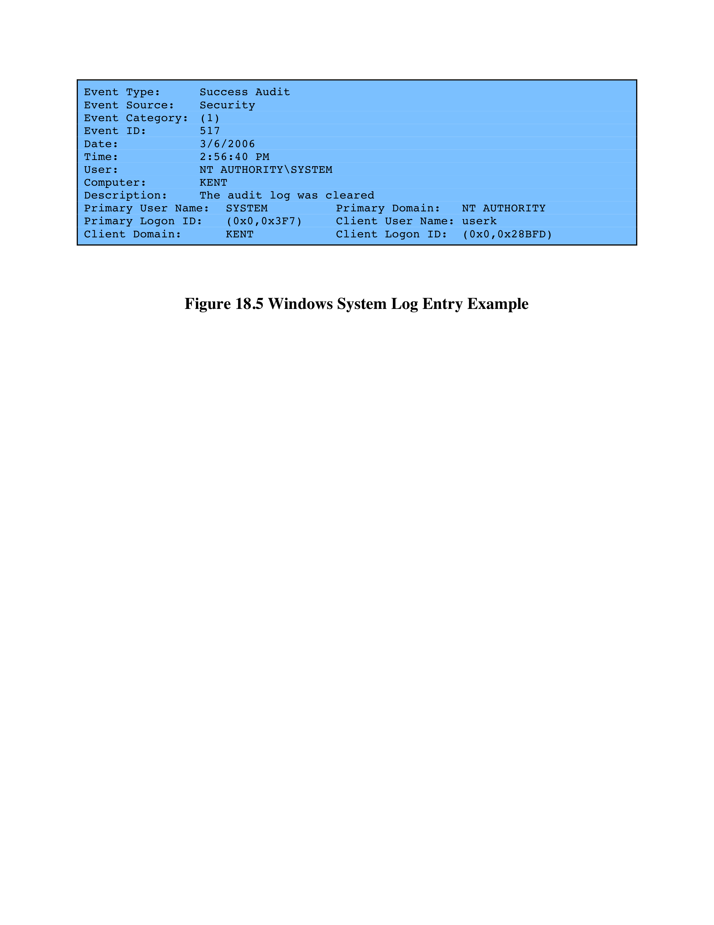
Windows System Log Example
Notes:
Figure 18.5 is an example of data exported from a Windows system event log.

Slide 22
UNIX syslog
UNIX's general-purpose logging mechanism
(found on all UNIX / Linux variants)
elements:
syslog()
API referenced by several standard system utilities and available to application programs
logger
command used to add single-line entries to the system log
/etc/syslog.conf
configuration file used to control the logging and routing of system log events
syslogd
daemon to receive/route log events
Notes:
Syslog is UNIX’s general-purpose logging mechanism found on all UNIX
variants and Linux. It consists of the following elements:
• syslog() : An application program interface (API) referenced by several
standard system utilities and available to application programs
• logger: A UNIX command used to add single-line entries to the system log
• /etc/syslog.conf: The configuration file used to control the logging and
routing of system log events
• syslogd: The system daemon used to receive and route system log events
from syslog() calls and logger commands.
Different UNIX implementations will have different variants of the syslog
facility, and there are no uniform system log formats across systems. Chapter 25
examines the Linux syslog facility. Here, we provide a brief overview of some
syslog-related functions and look at the syslog protocol.

Slide 23
Syslog Protocol
In 2009, the IETF standardized a syslog protocol, formalizing a message format for communication and logging of events across networks.
Result: a transport allowing hosts to send IP event notification messages to syslog servers
provides a very general message format
allowing processes and applications to use suitable conventions for their logged events
The common version of the syslog protocol was originally developed on the University of California Berkeley Software Distribution (BSD) UNIX/TCP/IP system implementations
Messages in the BSD syslog format consist of:
PRI - facilities / severity code
header – timestamp and hostname/IP address
Msg - program name and content
Notes:
The syslog protocol provides a transport to allow a machine to send event
notification messages across IP networks to event message collectors—also
known as syslog servers. Within a system, we can view the process of capturing
and recording events in terms of various applications and system facilities sending
messages to syslogd for storage in the system log. Because each process, application,
and UNIX OS implementation may have different formatting conventions
for logged events, the syslog protocol provides only a very general message format
for transmission between systems. A common version of the syslog protocol was
originally developed on the University of California Berkeley Software Distribution
(BSD) UNIX/TCP/IP system implementations. This version is documented in RFC
3164, The BSD Syslog Protocol . Subsequently, IETF issued RFC 5424, The Syslog
Protocol , which is intended to be an Internet standard and which differs in some
details from the BSD version. In what follows, we describe the BSD version.
Messages in the BSD syslog format consist of three parts:
• PRI: Consists of a code that represents the Facilities and Severity values of the
message, described subsequently.
• Header: Contains a timestamp and an indication of the hostname or IP address
of the device.
• Msg: Consists of two fields: The TAG field is the name of the program or
process that generated the message; the CONTENT contains the details of the
message. The Msg part has traditionally been a free-form message of printable
characters that gives some detailed information of the event.

Slide 24
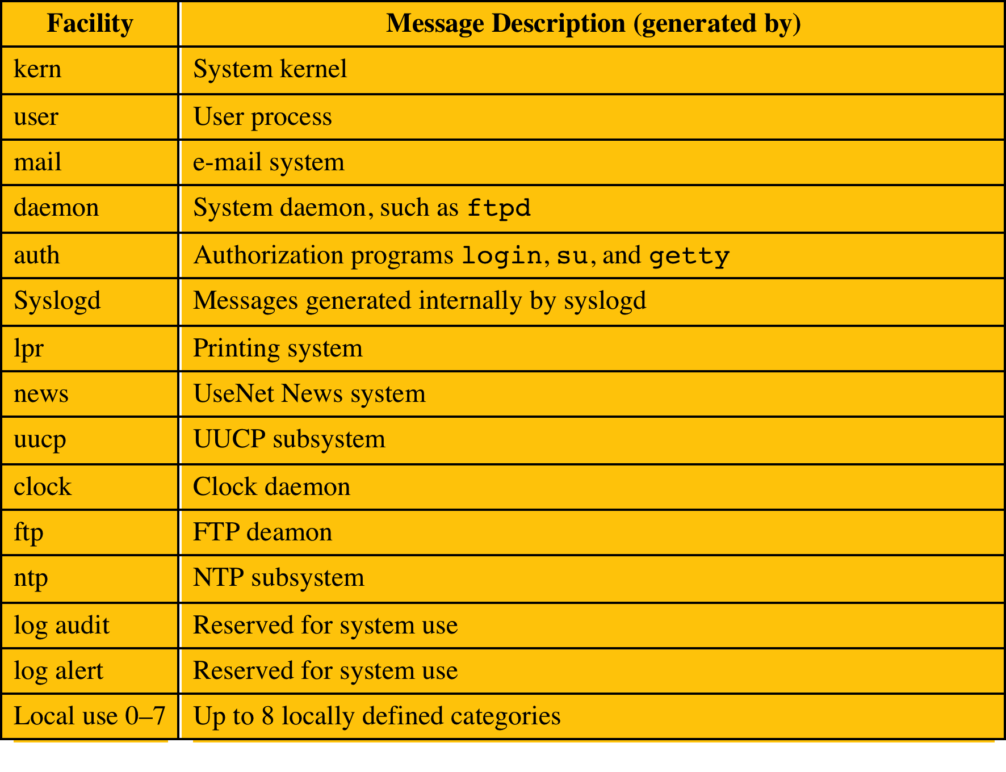
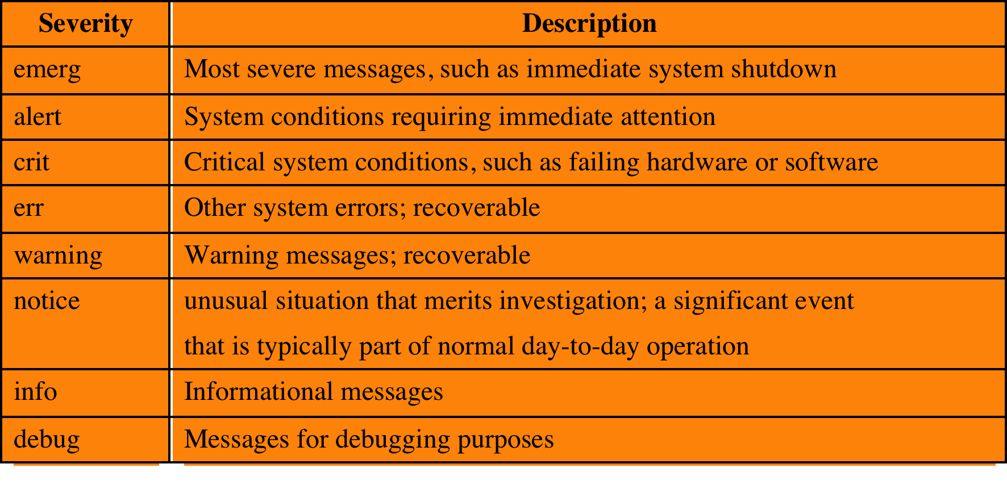
Syslog Facilities and Severity Levels
(a) Syslog Facilities
(b) Syslog Severity Levels
Notes:
All messages sent to syslogd have a facility and a severity ( Table 18.5 ).
The facility identifies the application or system component that generates the
message. The severity, or message level, indicates the relative severity of the
message and can be used for some rudimentary filtering.

Slide 25
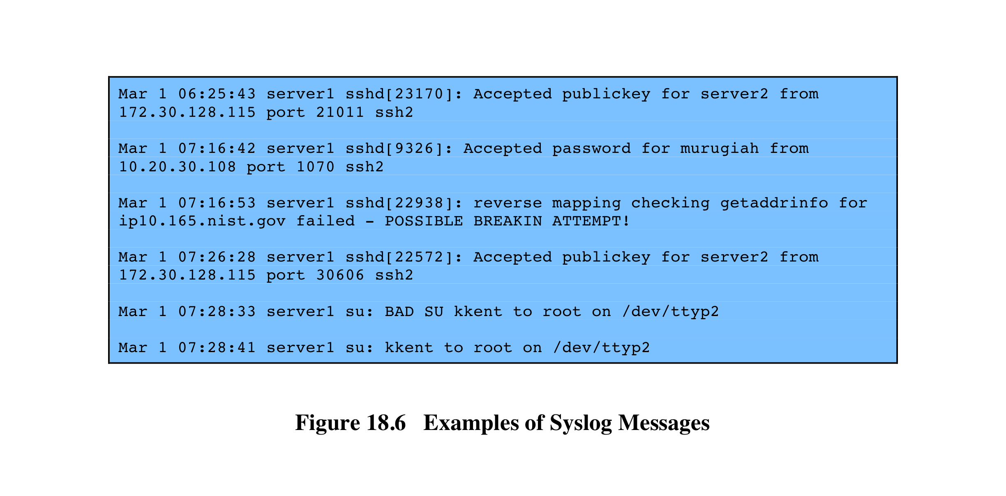
Syslog Examples
Notes:
Figure 18.6 shows several examples of syslog messages, excluding the
PRI part.

Slide 26
Logging at Application Level
privileged applications present security issues
may not be captured by system/user-level audit data
constitute a large percentage of reported vulnerabilities
vulnerabilities exploited:
lack of dynamic checks on input data
errors in application logic
may be necessary to capture behavior of application beyond its access to system services and file systems
two approaches to collecting audit data:
interposable libraries
dynamic binary rewriting
Notes:
Applications, especially applications with a certain level of privilege, present
security problems that may not be captured by system-level or user-level auditing
data. Application-level vulnerabilities constitute a large percentage of reported
vulnerabilities on security mailing lists. One type of vulnerability that can be
exploited is the all-too-frequent lack of dynamic checks on input data, which
make possible buffer overflow (see Chapter 10 ) and format string attacks. Other
vulnerabilities exploit errors in application logic. For example, a privileged application
may be designed to read and print a specific file. An error in the application
might allow an attacker to exploit an unexpected interaction with the shell environment
to force the application to read and print a different file, which would result in
a security compromise.
Auditing at the system level does not provide the level of detail to catch
application logic error behavior. Further, intrusion detection systems look for
attack signatures or anomalous behavior that would fail to appear with attacks
based on application logic errors. For both detection and auditing purposes, it
may be necessary to capture in detail the behavior of an application, beyond
its access to system services and file systems. The information needed to detect
application-level attacks may be missing or too difficult to extract from the
low-level information included in system call traces and in the audit records
produced by the operating system.
In the remainder of this section, we examine two approaches to collecting
audit data from applications: interposable libraries and dynamic binary rewriting.

Slide 27
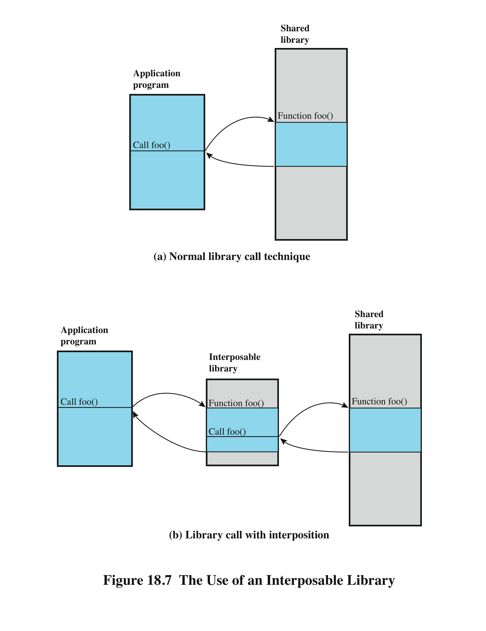
Use of an Interposable Library
Notes:
Figure 18.7a indicates the normal mode of
operation when a program invokes a routine in dynamically linked shared libraries.
At load time, the reference to routine foo in the program is resolved to the virtual
memory address of the start of the foo in the shared library.
With library interpolation, a special interposable library is constructed so that
at load time, the program links to the interposable library instead of the shared
library. For each function in the shared library for which auditing is to be invoked,
the interposable library contains a function with the same name. If the desired
function is not contained in the interposed library, the loader continues its search in
the shared library and links directly with the target function.
The interposed module can perform any auditing-related function, such
as recording the fact of the call, the parameters passed and returned, the return
address in the calling program, and so forth. Typically, the interposed module will
call the actual shared function ( Figure 18.7b ) so that the application’s behavior is
not altered, just instrumented.
This technique allows the interception of certain function calls and the storage
of state between such calls without requiring the recompilation of the calling
program or shared objects.

Slide 28
Audit Trail Analysis
analysis programs and procedures vary widely
must understand context of log entries
relevant information may reside in other entries in the same logs, other logs, and nonlog sources
audit file formats contain mix of plain text and codes
must decipher manually / automatically
ideally regularly review entries to gain understanding of baseline

Slide 29
Types of Audit Trail Analysis
audit trails can be used in multiple ways
this depends in part on when done
possibilities include:
audit trail review after an event
triggered by event to diagnose cause and remediate
focuses on the audit trail entries that are relevant to the specific event
periodic review of audit trail data
review bulk data to identify problems and behavior
real-time audit analysis
part of an intrusion detection function
Notes:
Audit trails can be used in multiple ways. The type of analysis depends, at least in
part, on when the analysis is to be done. The possibilities include the following:
• Audit trail review after an event: This type of review is triggered by an
observed event, such as a known system or application software problem, a
known violation of existing security policy by a user, or some unexplained
system or user problem. The review can gather information to elaborate on
what is known about the event, to diagnose the cause or the problem, and
to suggest remedial action and future countermeasures. This type of review
focuses on the audit trail entries that are relevant to the specific event.
• Periodic review of audit trail data: This type of review looks at all of the audit
trail data or at defined subsets of the data and has many possible objectives.
Examples of objectives include looking for events or patterns that suggest a
security problem, developing a profile of normal behavior and searching for
anomalous behavior, and developing profiles by individual user to maintain a
permanent record by user.
• Real-time audit analysis: Audit analysis tools can also be used in a real-time
or near-real-time fashion. Real-time analysis is part of the intrusion detection
function.

Slide 30
Audit Review
audit review capability provides administrator with information from selected audit records
actions of one or more users
actions on a specific object or resource
all or a specified set of audited exceptions
actions on a specific system / security attribute
may be filtered by time / source / frequency
used to provide system activity baseline
level of security related activity
Notes:
Distinct from an analysis of audit trail data using data reduction and analysis tools
is the concept of audit review. An audit review capability enables an administrator
to read information from selected audit records. The Common Criteria specification
[CCPS04a] calls for a capability that allows prestorage or poststorage audit
selection and includes the ability to selectively review the following:
• The actions of one or more users (e.g., identification, authentication, system
entry, and access control actions)
• The actions performed on a specific object or system resource
• All or a specified set of audited exceptions
• Actions associated with a specific system or security attribute
Audit review can be focused on records that match certain attributes, such as
user or user group, time window, type of record, and so forth.
One automated tool that can be useful in audit review is a prioritization of
audit records based on input from the administrator. Records can be prioritized
based on a combination of factors. Examples include the following:
• Entry type (e.g., message code 103, message class CRITICAL)
• Newness of the entry type (i.e., has this type of entry appeared in the logs
before?)
• Log source
• Source or destination IP address (e.g., source address on a blacklist,
destination address of a critical system, previous events involving a particular
IP address)
• Time of day or day of the week (e.g., an entry might be acceptable during
certain times but not permitted during others)
• Frequency of the entry (e.g., x times in y seconds)
There may be a number of possible purposes for this type of audit review.
Audit review can enable an administrator to get a feel for the current operation of
the system and the profile of the users and applications on the system, the level of
attack activity, and other usage and security-related events. Audit review can be
used to gain an understanding after the fact of an attack incident and the system’s
response to it, leading to changes in software and procedures.

Slide 31
Integrated Approaches
volume of audit data means manual analysis and baselining is impractical
need a Security Information and Event Management (SIEM) system
a centralized logging and analysis package
agentless or agent-based
normalizes a variety of log formats
analyzes combined data
correlates events among the log entries
identifies and prioritizes significant events
can initiate responses
Notes:
[KELL06] is a report by an information security officer at a government agency on her
attempts to get a handle on the vast amount of security audit data generated by her
agency’s networks, servers, and hosts. The systems are configured to generate audit
data, including security-related audit data, for management, auditors, and attorneys.
So much data is generated that it makes it difficult for the security officer to extract
timely and useful information. She needs to get and analyze security-related data
from hosts, servers, routers, intrusion detection systems, firewalls, and a multitude of
other security tools. The load is so great that one large server is dedicated solely to
housing security analysis software and audit files.
The problem came to a head when the security officer realized that it had
become impossible to perform one of the basic tasks of security audit analysis:
baselining. The security officer needs to be able to characterize normal activity
and thresholds so that the system will generate alerts when anomalies or malicious
patterns are detected. Because of the volume of data, a human-generated or
even human-assisted baseline generation was impractical. And with the broad mix
of audit data sources and formats, there seemed to be no obvious way to develop
automated baseline generation.
The type of product that can address these issues has been referred to
as a security information management (SIM) system or a security information
and event management (SIEM) system. As these products move into the third
and fourth generations, a number of other names have proliferated, with none
commonly accepted across product lines. Before looking at the specific solution
adopted by this security officer, we provide a brief general overview of SIEM
systems.

Slide 32
Example: Cisco MARS
example of SIEM product
supports a wide variety of systems
agentless with central dedicated server
wide array of analysis packages
an effective GUI
server collects, parses, normalizes, correlates and assesses events to then check for false positives, vulnerabilities, and profiling
Notes:
After reviewing several alternatives, the security officer chose the Cisco Systems’ MARS
product as being the most cost-effective. The MARS product supports a variety of
systems. Of course, all of the Cisco products on site were compatible with the product,
including NetFlow and syslog data from Cisco routers, firewalls, switches, concentrators,
IDSs, and so on. In addition, MARS can pull data from almost any SNMP- and
syslog-enabled device, as well as from a wide range of vulnerability and antivirus systems,
host operating systems, Web servers, Web proxy devices, and database servers. The
following is a list of the devices and software packages supported at that time by MARS:
• Network: Cisco IOS Software; Cisco Catalyst OS; Cisco NetFlow; and Extreme
Extremeware
• Firewall/VPN: Cisco ASA Software; Cisco PIX Security Appliance; Cisco
IOS Firewall; Cisco Firewall Services Module (FWSM); Cisco VPN 3000
Concentrator; Checkpoint Firewall-1 NG and VPN-1 versions; NetScreen
Firewall; and Nokia Firewall
• Intrusion detection: Cisco IDS; Cisco IDS Module; Cisco IOS IPS; Enterasys
Dragon NIDS; ISS RealSecure Network Sensor; Snort NIDS; McAfee
Intrushield NIDS; NetScreen IDP; OS; and Symantec ManHunt
• Vulnerability assessment: eEye REM, Qualys QualysGuard, and FoundStone
FoundScan
• Host security: Cisco Security Agent; McAfee Entercept; and ISS RealSecure
Host Sensor
• Antivirus: Symantec Antivirus, Cisco Incident Control System (Cisco ICS),
Trend Micro Outbreak Prevention Service (OPS), Network Associates
VirusScan, and McAfee ePO
• Authentication servers: Cisco Secure ACS
• Host log: Windows NT, 2000, and 2003 (agent and agentless); Solaris; and Linux
• Application: Web servers (Internet Information Server, iPlanet, and Apache);
Oracle audit logs; and Network Appliance NetCache
• Universal device support: To aggregate and monitor any application syslog
MARS works in an agentless configuration, with a centralized dedicated
server. In general terms, the server performs the following steps:
1. Events come into the MARS server from devices and software modules
throughout the network.
2. Events are parsed to locate and identify each field in the entry.
3. MARS normalizes each entry into a uniform audit trail entry format.
4. MARS performs a correlation function to find events that are related and
defines sessions. Each session is a related set of events. For example, if a worm
is detected, the detected occurrences across all devices are correlated into a
single session for this worm attack.
5. Sessions and uncorrelated events are run against a rule engine and each is
assessed. Some events and sessions are dropped as irrelevant. The others are
reclassified as incidents to be logged in the incident database.
6. A false-positive analysis is run on the data to catch known false positive
reports for IDS and other systems in the network.
7. A vulnerability assessment is performed against suspected hosts to determine
the urgency of the data.
8. Traffic profiling and statistical anomaly detection programs are run against
the data.
MARS provides a wide array of analysis packages and an effective graphical
user interface. Preliminary indications are that this product will meet the needs of
the security officer.

Slide 33
Computer Forensics
Computer forensics is an area devoted to answering questions about computer actions in a court of law
Incorporates good sys admin skills as well as analysis skills
Analyzing logs is often the heart of this area, but goes considerably beyond:
Network analysis
Maintenance of crypto authentication
Data recovery
Laws and precedents change quite often in this area!

Slide 34
Next lab overview
In your next lab, you’ll be playing the part of a forensics expert.
The assignment will give you 3 different images, and your job is to play the part of a security analyzer to discover and report what happened.
Have some fun with this one – the only thing you’ll hand in is a report.
Obviously, your grade will depend on whether you can accurately determine what happened.
However, some extra credit for creativity in what you submit (at my discretion).

