Slide 1
Operating systems and security
Trusted computing
Access control

Slide 2
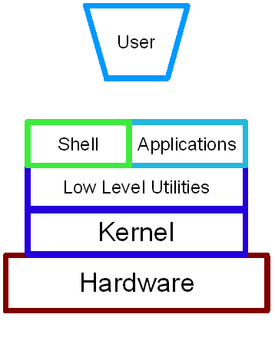
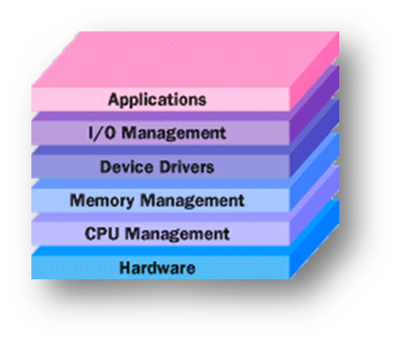
Operating system structure
An OS is the interface between users and hardware
Key components:
Kernal, which runs various processes
Device drivers
API, which allows applications to communicate with the kernal
Bios, which governs loading and startup

Slide 3
Process security
The boot sequence is a key component of the OS, since initially all code is stored on harddrive
The BIOS is stored on a firmware component, so automatic on startup
From a security component, this is the most vulnerable stage
Physical access means a user can tell the BIOS to load from a CD, at which point the attacker has full access
Only real protection is a BIOS password

Slide 4
Hibernation
Surprisingly, hibernation actually is a vulnerability also, for much the same reason.
When a machine hibernates, entire contents (including any sensitive information) are stored to a file for quick recovery
If an attacker can access the hiberfil.sys file, a forensic attack is quite possible
Windows does not delete this file after resuming, so even a problem after rebooting

Slide 5
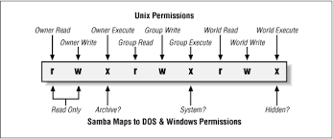
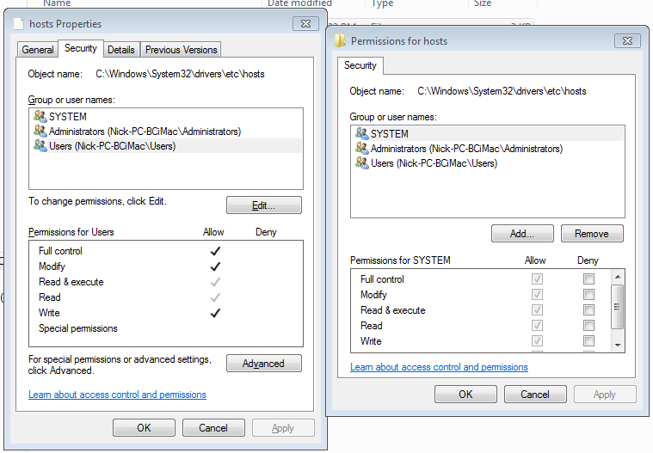
File systems
One of the most important OS features governs access control, primarily of files
Set differently in various OSes, although some commonalities

Slide 6
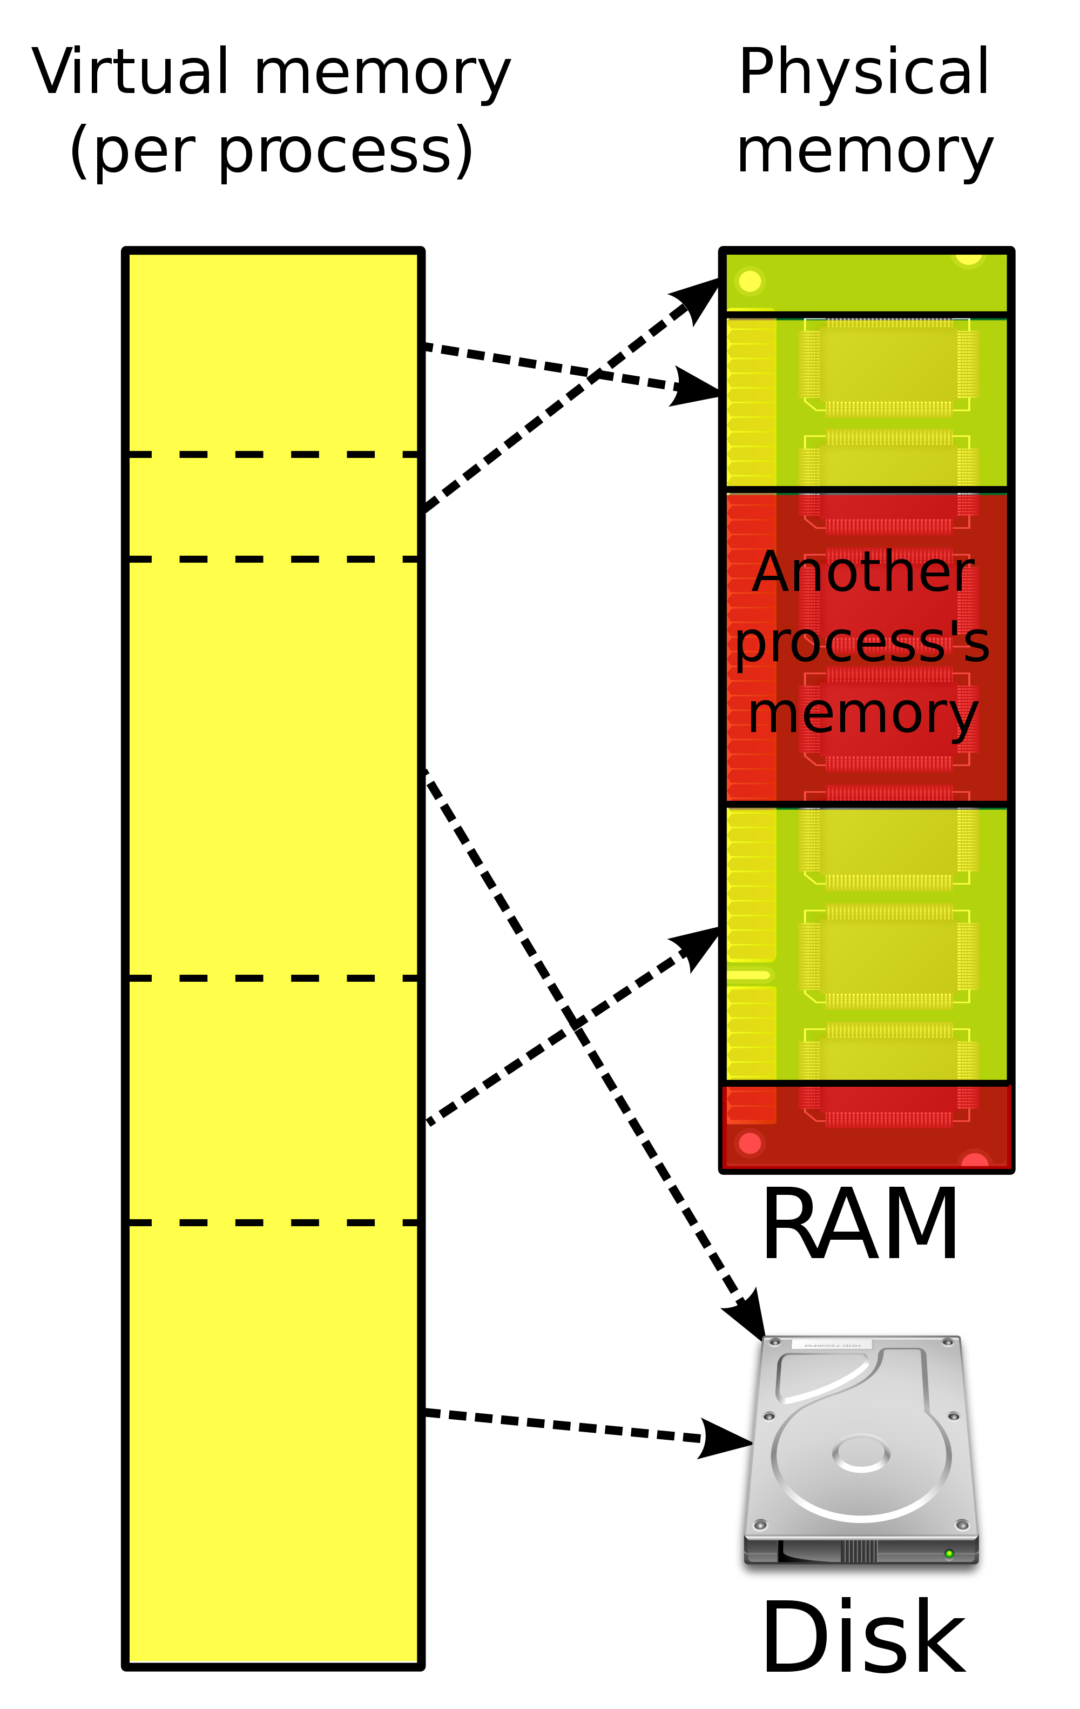
Virtual memory
All architectures use some notion of virtual memory
Key idea: each process can only “see” a portion of the computer’s memory
The memory management unit converts all requests automatically
This actually adds quite a bit of security right away!

Slide 7
Access control
Security policies govern both process and file system access
Terminology:
Subject
Object
Action
Permissions
Protections

Slide 8
Recap of access control
Three main types of access control exit:
DAC
MAC
RBAC
We talked about (and are probably most familiar with) DAC, which is standard on most OSes.
Want to examine the other two more carefully.

Slide 9
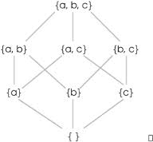
Mandatory Access Control
Most MAC models are focuses on protecting information and classification levels.
Inspired by government classifications: top secret, secret, unclassified.
But might not be these! Just a set of levels
MAC assumes a partially ordered set on levels:
Think something like <=, but
two things might not be
comparable

Slide 10
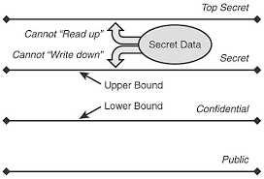
Bell-La Padula Model
Two rules:
Simple security property: a user u can read an object o only if L(o) ≤ L(u)
*-property: A user can write (edit/create) an object only if L(u) ≤ L(o)
Essentially, this protects information from “leaking down”
Note: communication is one way in this model

Slide 11
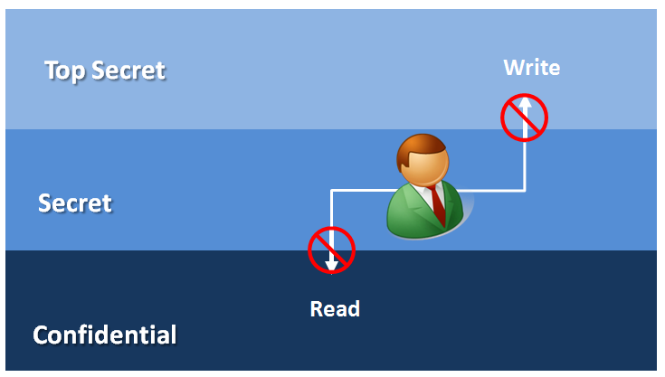
Biba Model
Addresses integrity rather than confidentiality
Reverses the rules from BLP: no read down, no write up
Idea is that data at a higher level is more likely to be secure:
Example: a data center
is less likely to be
compromised than a
laptop

Slide 12
Clark-Wilson model
Rather than security levels, this model deals with integrity in a system with transactions.
Integrity constraints for the system that must be satisfied for the state to be valid.
Certification methods that verify that transactions meet integrity constraints.
Separation of duty so that a user cannot both execute a transaction and certify it.
Primary use is in something like banking.

Slide 13
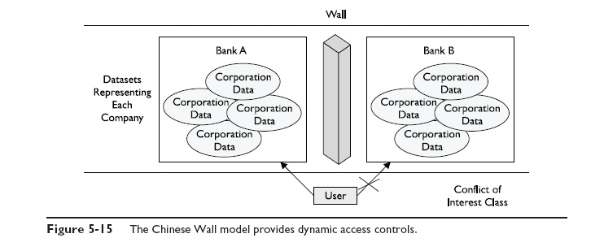
Chinese Wall model
The Brewer and Nash (or Chinese wall) model is used to eliminate conflicts of interest among classes of data/groups.

Slide 14
Uses of MAC
By themselves, we don’t often see pure MAC
Too rigid
Difficult to make usable
But more often, it is used in combination with DAC on modern operating systems
And is still seen in specialized systems, where data confidentiality is the key concern

Slide 15
RBAC
Role based access control defines role hierarchies and constraints.
Roles can be inherited, with junior/senior relationships.
Often roles are constrained, so that users cannot have conflicts of interest.
Example: a grader shouldn’t also be a student in a class.
Can be dynamic or static in setup.
Example: Windows security levels

Slide 16
Back to operating systems
“Normal” operating systems must have:
User authentication
Memory protection
File and I/O access control
General object access control
Enforcement of sharing and fairness guarantees
A “trusted” OS builds upon these to give better security constraints

Slide 17
Trusted OS extra features
MAC (in addition to DAC)
Object re-use protection
An attacker should not be able to gather information from resusable objects (such as disk memory)
Complete mediation
All objects access requests are checked each time (no caching)
Audit capabilities
Intruder detection capabilities

Slide 18
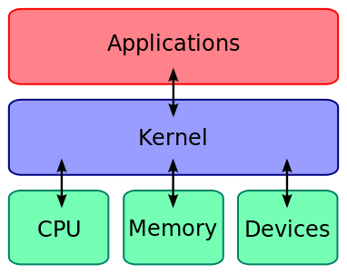
Secure OS Kernels
The fundamental idea in a secure kernel is to specify a core set of OS functions.
Small and carefully built
Key idea: if the kernel is safe, things built on top of it will be better off.

Slide 19
Kernelization pros and cons
Advantages:
Smaller amount of trusted code
Easier to check every access
Separates this piece from more complex portions of the system
Easier to maintain and modify security features
Disadvantages:
Introduces boundaries
Temptation is to move as much as possible in (especially since inside tends to be faster and cheaper to work with)

Slide 20
Major challenge in kernalization
Need to decide which functions are in or out.
What must be trusted in order to ensure security for the rest of the system?
Answer: depends on definition of “secure”
Certain types of attacks are still possible against “secure” systems
Those attacks were just left off of the definition

Slide 21
Layered OS design
This concept essentially generalized that of kernelization.
Define an inner layer with high security.
Each next layer builds on that, with lower security options.
Outer layers use the inner ones through a strong interface.
Example: Multics
Pre-UNIX (and arguably more sophisticated and powerful)
Key element was layered security model
Still considered one of the most sophisticated secure OS designs

Slide 22
Separation and Isolation
Divide the system into components
Define a secure interface for each, and allow communication ONLY over interfaces
Goal: Ensure nothing “bad” crosses the boundaries
The OS can separate based on either user or process boundaries, not just functionality
Overall, extremely successful OS security approach.

Slide 23
Separation and Isolation: Examples
This is the core idea behind virtual memory processes and how they are set up to run securely.
Key elements of several more secure OS designs, such as such as domain and type enforcement in SELinux.
Domain and Type Enforcement (DTE) allows the system to specify security domains for processes and security types for objects.
Restrict types available to specific domains, and only allow access in specified ways
Very successful in SELinux.

Slide 24
DTE Example
Example: FTP daemon and buffer overflows
Create FTP domain, and only FTP daemon and files in FTP directory can be executed in this domain.
These executables may not be written within this domain.
So what happens for a buffer overflow?
The buffer overflow might allow the attacker to try to execute a program (say, /bin/sh).
But the FTP daemon program was in the FTP domain
/bin/sh is of a type not executable from this domain
And so the buffer overflow can’t fork a shell successfully

Slide 25
Example of DTE in SELinux
Files in /etc are mostly limited to access by a few sysadmin process types
But /etc also contains /etc/aliases, which the mail program must access
(And everyone uses the mail program!)
So rules are set up to allow the sendmail process’ type to access /etc/aliases
Sendmail process: type sendmail_t
The /etc/aliases file gets type etc_aliases_t

Slide 26
SELinux sendmail rule
The following rules allows processes of sentmail_t type to access files of etc_aliases_t type for read and write – without regard for which user started the process:
allow sendmail_t etc_aliases_t:file { read write };
Permissions must be sufficient to allow normal work (read/write) but not too much to allow anyone to read and write everything in there.

Slide 27
Unix solution
In contrast, in most linux distributions, sendmail is just set with setuid to a special user named “mail” (or something similar).
Then /etc/aliases can be owned by mail user.
Same result: any user can run the sendmail program, and sendmail can then access necessary data.
So why is the SELinux approach better?

Slide 28
Unix versus SELinux approach
Well, no need for fake users
Central location for security-critical access control rules
So no worries that a file somewhere may have incorrect permissions set.
The sendmail process can now run under the identity of caller.
In general, just a cleaner and nicer abstraction, although need to set up rules correctly.

Slide 29
Virtualization
A technology that provides an abstraction of the resources used by some software which runs in a simulated environment called a virtual machine (VM)
Simply run all untrusted things in a virtual machine, which can’t access critical security elements.
There are some security pros and cons here, though. (More in a few slides.)
Can be used to run different OS applications, as well as tools such as Java.
Notes:
Virtualization refers to a technology that provides an abstraction of the computing
resources used by some software, which thus runs in a simulated environment
called a virtual machine (VM). There are many types of virtualization; however, in
this section we are most interested in full virtualization. This allows multiple full
operating system instances to execute on virtual hardware, supported by a hypervisor
that manages access to the actual physical hardware resources. Benefits arising
from using virtualization include better efficiency in the use of the physical system
resources than is typically seen using a single operating system instance. This is particularly
evident in the provision of virtualized server systems. Virtualization can
also provide support for multiple distinct operating systems and associated applications
on the one physical system. This is more commonly seen on client systems.
There are a number of additional security concerns raised in virtualized systems,
as a consequence both of the multiple operating systems executing side by side
and of the presence of the virtualized environment and hypervisor as a layer below
the operating system kernels and the security services they provide. [CLEE09]
presents a survey of some of the security issues arising from such a use of virtualization,
a number of which we will discuss further.

Slide 30
Virtualization Alternatives
application virtualization
allows applications written for one environment to execute on some other operating system
full virtualization
multiple full operating system instances execute in parallel
virtual machine monitor (VMM)
hypervisor
coordinates access between each of the guests and the actual physical hardware resources
Notes:
There are many forms of creating a simulated, virtualized environment. These
include application virtualization , as provided by the Java Virtual Machine environment.
This allows applications written for one environment, to execute on some
other operating system. It also includes full virtualization , in which multiple full
operating system instances execute in parallel. Each of these guest operating systems,
along with their own set of applications, executes in its own VM on virtual
hardware. These guest OSs are managed by a hypervisor , or virtual machine monitor
(VMM), that coordinates access between each of the guests and the actual physical
hardware resources, such as CPU, memory, disk, network, and other attached
devices. The hypervisor provides a similar hardware interface as that seen by operating
systems directly executing on the actual hardware. As a consequence, little if
any modification is needed to the guest OSs and their applications. Recent generations
of CPUs provide special instructions that improve the efficiency of hypervisor
operation.

Slide 31
Native Virtualization Security Layers
Notes:
Full virtualization systems may be further divided into native virtualization
systems, in which the hypervisor executes directly on the underlying hardware, as
we show in Figure 12.2 , and hosted virtualization systems, in which the hypervisor
executes as just another application on a host OS that is running on the underlying
hardware, as we show in Figure 12.3 .
Native virtualization systems are typically
seen in servers, with the goal of improving the execution efficiency of the hardware.
They are arguably also more secure, as they have fewer additional layers than the
alternative hosted approach.

Slide 32
Hosted Virtualization Security Layers
Notes:
Hosted virtualization systems are more common in
clients, where they run along side other applications on the host OS, and are used
to support applications for alternate operating system versions or types. As this
approach adds additional layers with the host OS under, and other host applications
beside, the hypervisor, this may result in increased security concerns.
In virtualized systems, the available hardware resources must be appropriately
shared between the various guest OSs. These include CPU, memory, disk, network,
and other attached devices. CPU and memory are generally partitioned between
these, and scheduled as required. Disk storage may be partitioned, with each guest
having exclusive use of some disk resources. Alternatively, a “virtual disk” may be
created for each guest, which appears to it as a physical disk with a full file-system,
but is viewed externally as a single “disk image” file on the underlying file-system.
Attached devices such as optical disks or USB devices are generally allocated to a
single guest OS at a time. Several alternatives exist for providing network access.
The guest OS may have direct access to distinct network interface cards on the
system; the hypervisor may mediate access to shared interfaces; or the hypervisor
may implement virtual network interface cards for each guest, routing traffic
between guests as required. This last approach is quite common, and arguably the
most efficient since traffic between guests does not need to be relayed via external
network links. It does have security consequences in that this traffic is not subject
to monitoring by probes attached to networks, such as we discussed in Chapter 9 .
Hence alternative, host-based probes would be needed in such a system if such
monitoring is required.

Slide 33
Virtualization Issues
Guest OS isolation
Must ensure that programs executing within a guest OS may only access and use the resources allocated to it.
Often, there are ways for the code to get out.
Proper allocation of processes and resources.
Put all related things in same VM?
If not, must share data between them.
Efficiency can be an issue.
Notes:
[CLEF09] and [NIST11] both detail a number of security concerns that result from
the use of virtualized systems, including:
• guest OS isolation, ensuring that programs executing within a guest OS may
only access and use the resources allocated to it, and not covertly interact with
programs or data either in other guest OSs or in the hypervisor.
• guest OS monitoring by the hypervisor, which has privileged access to the
programs and data in each guest OS, and must be trusted as secure from
subversion and compromised use of this access
virtualized environment security, particularly as regards image and snapshot
management, which attackers may attempt to view or modify
These security concerns may be regarded as an extension of the concerns we have
already discussed with securing operating systems and applications. If a particular
operating system and application configuration is vulnerable when running directly
on hardware in some context, it will most likely also be vulnerable when running
in a virtualized environment. And should that system actually be compromised, it
would be at least as capable of attacking other nearby systems, whether they are
also executing directly on hardware or running as other guests in a virtualized environment.
The use of a virtualized environment may improve security by further
isolating network traffic between guests than would be the case when such systems
run natively, and from the ability of the hypervisor to transparently monitor activity
on all guests OS. However, the presence of the virtualized environment and the
hypervisor may reduce security if vulnerabilities exist within it which attackers may
exploit. Such vulnerabilities could allow programs executing in a guest to covertly
access the hypervisor, and hence other guest OS resources. This is known as VM
escape, and is of concern, as we discussed in Section 6.8 . Virtualized systems also
often provide support for suspending an executing guest OS in a snapshot, saving
that image, and then restarting execution at a later time, possibly even on another
system. If an attacker can view or modify this image, they can compromise the security
of the data and programs contained within it.
Thus the use of virtualization adds additional layers of concern, as we have
previously noted. Securing virtualized systems means extending the security process
to secure and harden these additional layers. In addition to securing each guest
operating system and applications, the virtualized environment and the hypervisor
must also be secured.

Slide 34
Assurance and testing in the OS
Testing: run a bunch of tests to see if it is secure.
But what tests? When are we sure?
Not really a strong proof of security, although it is the most used.
Formal verification: define goals formally and mathematically
Use formal methods to “prove” that system meetings goals.
Often difficult to map real system to formal statements, and difficult to prove anything for real systems.

Slide 35
Validation
Define desired security in terms of:
Features provided
Architectural design
Processes used in creation of system
Evaluation methodology
Then use a standardized procedure to demonstrate that your system fits the profile of a level of security.
Usually done against a pre-defined standard, which you can then label your system as.

Slide 36
Validation: pros and cons
The good:
Allows easy comparisons of systems.
Easy to have security “grades” for systems.
Relatively open and fair process.
The bad:
Doesn’t actually really prove anything – only as good as the standards set by the system.
Can be expensive.

Slide 37
Secure OS standards
There are national and international standards on what counts as a “secure” OS.
We’ve talked about SELinux here, but many types of secure OSes, since there is a market.
Common ones:
U.S. Orange Book
European ITSEC
U.S. Combined Federal Criteria
Common Criteria for IT Security Evaluation

Slide 38
The Orange Book
First evaluation standard – developed by DoD in late 70’s.
Now largely historical artifact, although terminology is still around.
Levels A,B,C, and D, in decreasing order of security, with important subdivisions in each (1,2,3…)
Required formal certification from government for anything above the D level.

Slide 39
Orange Book classes
C2 example: Windows NT
DAC at fairly low granularity
Access auditing
Password authentication and protection of reused objects
B1 example: PitBull variant of Solaris
Includes MAC using Bell-La Padula model
This is the highest classification that a standard OS with extra security added can get – much harder to go higher.

Slide 40
Orange Book classes (cont)
The B3 class (example: Trusted Mach)
Requires more careful security design as well as some level of verification
No formal verification, but needs a “convincing argument”
Extensive testing required
In general, the OS is designed with security in mind from the beginning.
(In general, less user friendly and much more expensive.)

Slide 41
Failure of the Orange Book
Expensive
Didn’t meet industry needs – was focused more on military requirements, and so was fairly inflexible.
Certified products were not marketed quickly.
Wasn’t clear that certification meant much.
Windows NT was definitely not secure.
Review was tied to the government.

Slide 42
The Common Criteria
Current international standard (for many aspects of computer security, not just OS)
Basics (with many TLAs):
Evaluation Assurance Levels (EAL)
Common Evaluation Methodology (CEM)
Essentially gives a very detailed methodology for specifying:
Security goals
Operating environment
Desired mechanisms
Measures of success

Slide 43
The CC in practice
You need a secure system, and so specify requirements using the CC methodology.
Then you can look for products that meet these requirements or else develop one that does.
Generally, independent labs then verify that the product meets the desired profile.
In practice, a few are commonly used, and you generally select one that meets your needs from the list.

Slide 44
CC status
Wide usage in many countries
Including agreements in many places to honor other countries’ certifications
Many products already certified
Remaining issues:
Still expensive and slow
Unclear how meaningful certifications are
Example: Windows 2000 was certified EAL4+ (in a range of 1-7), but needed a ton of patches and was not regarded as “secure”.

