Slide 1
Access control and Authentication

Slide 2
Recap of Crypto
Two main variants:
Symmetric
AES, DES, 3DES
Asymmetric
RSA, DH, ECDH
Tradeoffs: speed, security, cost
Big takeaway: Don’t ever implement these on your own!
Also, be careful which implementation you choose.
Also: don’t design them on your own, either!

Slide 3
Access control
Definition: The prevention of unauthorized use of a resource, including the prevention of use in an unauthorized manner
Probably the central element of computer security!
Incorporates:
Authentication
Authorization
Audit

Slide 4
Authentication
4 basic strategies:
Something you know
Something you possess
Something you are
Something you do
Which is the most commonly used in your experience?

Slide 5
Passwords
Many common attacks:
Brute force or dictionary attacks
Key loggers
Shoulder surfing
Social engineering
Protocol specific attacks
Also many defenses:
cap the number of logins
force secure passwords
change passwords often
incorporate challenge questions
picture recognition
educate your user base

Slide 6
Hashed password files
To increase security, only hashed versions of passwords are EVER saved.
Why – and is this enough?
Suppose I get a encrypted password file. How could I attack it, assuming I know the hash function used?
(This is reasonable, by the way – all Linux systems use the same one, for example.)

Slide 7
Solution: salts
The system chooses a random number s, called the salt, for each use
computes h(p,s) and stores that result
Note that this salt must then be stored in order to re-compute the hashed value at time of login
Usually stored in plaintext, in fact
So what does this protect against?

Slide 8
Passwords in Unix
User passwords are often 8 digits, so a 56 bit value
12 bit salt value is added, usually based on account creation time
so not really random, but “random enough”
Hash function is based on DES, run 25 times
Resulting 64 bit value is converted to an 11 character sequence
Sounds impressive, right?

Slide 9
Fast attacks
In 2003, a supercomputer managed over 500 million password tguesses in 80 minutes
(Back then, a regular machine could have don the same in a month of so)
Stronger variants of password verification essentially just use stronger and slower hashing algorithm
One even just runs a dummy for loop to slow down automated attacks

Slide 10
The weakest link: users
User education is the most important component
In 2012, Ars Technica challenged 3 hackers to crack 16,000 hashed and salted passwords
They got over 90% of them in 20 hours using straight dictionary attacks
Numerous reports have been released indicating that many users choose dictionary words, or awful passwords like 123456 (the most commonly used password according to a number of studies)

Slide 11
Password checkers
Because of people’s tendency towards bad passwords, algorithms to allow or reject passwords based on how likely they are to be cracked have become common
Various common types:
Rule enforcement
Markov models
Bloom filters

Slide 12
Rule enforcement
This is the simplest type of checker, and the most common
Based on simple rules
at least 8 characters
at least 1 letter and special symbol
no substrings that are in a stored dictionary

Slide 13
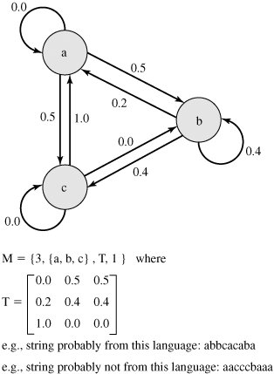
Markov model
Markov models start with a dictionary of passwords
Transitions are based on how common small letter sequences are
For example, in the one here, there is a 50% chance that a will be followed by b in a word
This is know as a first order model, since it only looks at pairs
Catches most dictionary passwords, and still fast and fairly use friendly

Slide 14
Bloom filters
Another method of attempting to filter out dictionary passwords: Take k independent hash functions.
Hash all of the dictionary passwords and store the records
When a new password is given, its k hash values are computed.
If all of them equal 1, then it is rejected.
Note: Could reject good passwords, but will reject bad ones

Slide 15
Bloom filters continued
The math behind them draws on probability and the assumption that we have “good” hash functions, but in the end:
P[false positive] = (1-e^{(kD/N)})^{k}
Where k = the number of hash functions
N = the number of bits in the hash table
and D = the number of words in the dictionary

Slide 16
Why bother?
Bloom filters will save time and space:
A simple example: consider a dictionary of 1 million words
Takes about 8MB of storage
Suppose we use a Bloom filter and want a at most a 1% chance of rejecting a password not in the database, and decide on 6 hash functions
Only need a hash table of 9.6*10^6 bits, or around 1.2 MB

Slide 17
Other alternatives: token based authentication
Otherwise known as something you possess
Examples:
RSA fobs
id cards
text message authentication
Attacks
Mainly theft
Loss is also a problem

Slide 18
Biometric authentication
Something you are or do
voice authentication
fingerprints
retina scans
Hard to steal
Expensive
People do change, so can be hard to make this effective
Possible (although not easy) to fool

Slide 19
Access Control Policies
There are 3 main types of access control policies used in modern computing systems
Discretionary Access Control
Mandatory Access Control
Role Based Access Control
(These aren’t necessarily mutually exclusive, either – modern OSes often use a hybrid of these.)

Slide 20
Terminology
A subject is either a process or a user
An object is a resource
Definition: Access rights describe ways in which subjects may interact with objects
Note: often 3 classes: owner, group, and world, which subjects may belong to

Slide 21
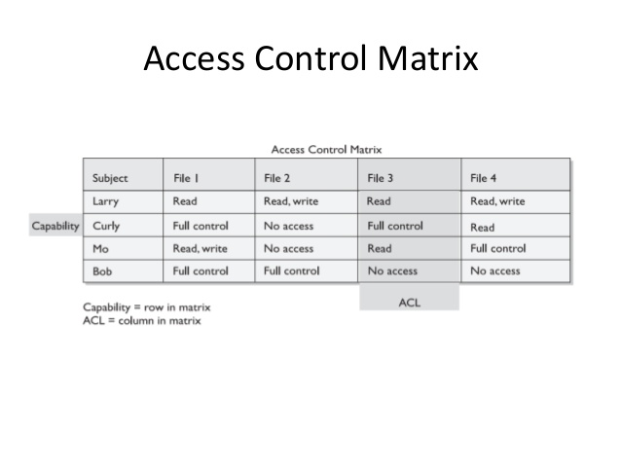
Discretionary Access Control
Most common in modern OS
Based on a subject’s identity combined with access rights stating what each subject is allowed to do
In this model, an entity may be given access rights which allow it to give another subject access rights
These rights are often encoded in a matrix representation, proposed by Lawson in 1971.

Slide 22
Implementation
In practice, these matrices tend to be very sparse.
Think about how many users or files there are even our our linux servers
Option 1: access control lists (as in Windows)
Each file stores a list of user access entries
Option 2: capability lists
Each user has a list of objects along with access rights
Pros and cons?

Slide 23
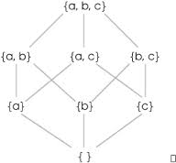
Mandatory Access Control
Most MAC models are focuses on protecting information and classification levels.
Inspired by government classifications: top secret, secret, unclassified.
But might not be these! Just a set of levels
MAC assumes a partially ordered set on levels:
Think something like <=, but
two things might not be
comparable

Slide 24
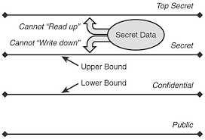
Bell-La Padula Model
Two rules:
Simple security property: a user u can read an object o only if L(o) ≤ L(u)
*-property: A user can write (edit/create) an object only if L(u) ≤ L(o)
Essentially, this protects information from “leaking down”
Note: communication is one way in this model

Slide 25
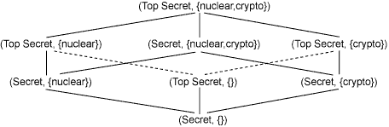
BLP Model in practice
In practical applications, implemented as follows:
Define a set of basic levels B with a linear order
Define a collection of categories (or compartments) S
A security level L(x) is now a pair (b(x), S(x)), where b(x) is in B and S(x) is a subset of S
Level of x precedes level of y if the b(x) ≤ b(y) and S(x) is a subset of S(y)
Example:

Slide 26
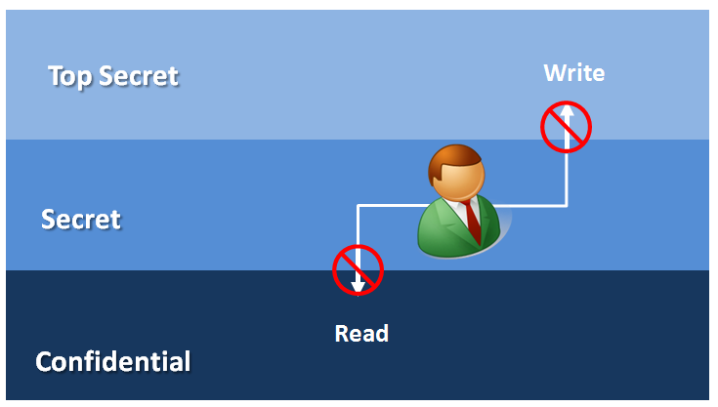
Biba Model
Addresses integrity rather than confidentiality
Reverses the rules from BLP: no read down, no write up
Idea is that data at a higher level is more likely to be secure:
Example: a data center
is less likely to be
compromised than a
laptop

Slide 27
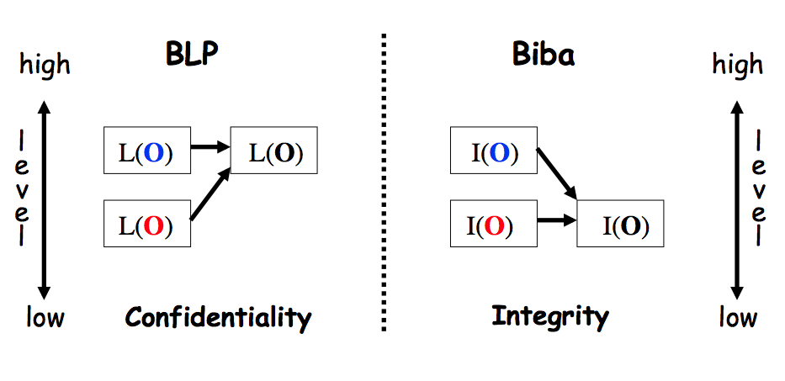
BLP versus Biba
In a real sense, BLP is just concerned with protecting the confidentiality of data, where Biba is worried about integrity:

Slide 28
Clark-Wilson model
Rather than security levels, this model deals with integrity in a system with transactions.
Integrity constraints for the system that must be satisfied for the state to be valid.
Certification methods that verify that transactions meet integrity constraints.
Separation of duty so that a user cannot both execute a transaction and certify it.
Primary use is in something like banking.

Slide 29
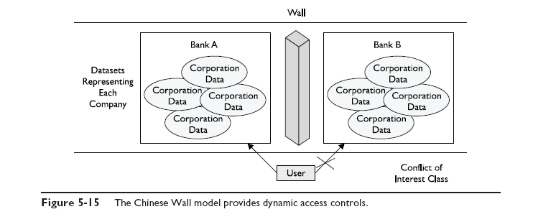
Chinese Wall model
The Brewer and Nash (or Chinese wall) model is used to eliminate conflicts of interest among classes of data/groups.

Slide 30
Uses of MAC
By themselves, we don’t often see pure MAC
Too rigid
Difficult to make usable
But more often, it is used in combination with DAC on modern operating systems
And is still seen in specialized systems, where data confidentiality is the key concern

Slide 31
RBAC
Role based access control defines role hierarchies and constraints.
Roles can be inherited, with junior/senior relationships.
Also can have hierarchies, so that anything above has rights of the class below
Often roles are constrained, so that users cannot have conflicts of interest.
Example: a grader shouldn’t also be a student in a class.
Can be dynamic or static in setup.
Example: Windows security levels

Slide 32
RBAC advantages and disadvantages
Advantage: no matter which access control framework you use to store rights, total number of rules tends to be reduced
Total number of roles is generally smaller than the number of users
Overhead is also smaller, since lookup tables are smaller
Disadvantage: new and not widely used!
Has been built into Windows 7 and on in a limited way, but DAC model is still dominant

