Slide 1
Some topics in application level security
Databases
Sendmail
DRM

Slide 2
More on databases
We’ve already seen the basics of SQL injections attacks
But there are other ways to “attack” databases (in SQL or other versions)
A few additional issues:
Updates and two phase commits
Access control
Information privacy

Slide 3
Updating databases
Large scale distributed databases come with issues relating to multiple updates
Two people can access/modify a record at the same time
Get many of the same issues that arise with parallel processors and shared resources.
Even if multiple alterations don’t conflict, still have to deal with network or computer failure mid-commit
Goal: avoid leaving the database in an inconsistent state

Slide 4
Two phase commit
The solution in most databases is a particular update protocol:
1. Request phase: all parts of the database that need to change are flagged
Result is either complete success or it aborts
If it aborts, all changes are reset
2. Commit phase: changes are performed on the database
If successful, all flags are released.
If it aborts, it again rolls back all changes to before phase 1.

Slide 5
Access control in databases
Access control sometimes comes from the OS level, but additional controls are built into many database systems
Example:
Separate ACL system
Often separate web-based side from back-end, to minimize vulnerabilities
First principles used: least privilege and separation of privilege

Slide 6
Access control in SQL
Discretionary based: owner/creator can grant privileges to others
Example command:
GRANT SELECT on (table) TO (user)
Also have a PUBLIC keyword
Also can create a virtual subset of the data, called a view, so that user can get full access to only a subset of the data
Think personnel records

Slide 7
Privilege delegation
Can also give other users permission to delegate, with the command WITH GRANT OPTION
This can later be revoked, which means the application needs to track who has been granted access and when
If Alice is granted access and gives it to Bob, but later loses her access, need to revoke Bob’s access also

Slide 8
Sensitive data
Databases can be encrypted, or (more commonly) certain entries can be encrypted
Obvious example: passwords
Can also store entire encrypted files but give decryption key only to users, so that the information cannot be compromised
However, more complex questions arise when we want aggregated data available, but not individual data

Slide 9
Privacy protection
If databases containing private information are released, certain fields can be sanitized
SSNs, names, addresses, etc.
However, inference attacks are still possible
Goal is to use database information as well as public information to learn more about underlying data
Example: employee records
Medical records, GIS data, and communication records are becoming particularly important here

Slide 10
Two examples
Netflix and IMDB both released databases of user habits
Netflix left off all user info, but in IMDB that information can be left on (at user’s discretion)
Researchers at UT Austin managed to determine a Netflix user based on the IMDB data
Medical encounter database:
Anonymized insurance database kept birthday, sex and zip code
Researcher from CMU linked this with voter registration records and found the medical record of the governor of Massachusetts

Slide 11
Protecting against inference attacks
Standard techniques:
Cell suppression: some cells are removed in the published version, to make inference attacks harder
Generalization: Instead of specific values, ranges are included in the released database
Example: Age range rather than specific age
Noise addition: Every value in the database has a small(ish) random number added to it
Goal: Average doesn’t change, but each individual entry does

Slide 12
Downside of obfuscation
For each of these, the data becomes less specific, so there is a trade-off.
In the extreme, data is so blurred that it is useless.
No widely accepted standard, and this is a hot area of research
Many are focused on what formal requirements we should have, as well as more and more sophisticated attacks.

Slide 13
K-anonymization
Database is secure if any possible SELECT query will return at least k records, where k is some threshold
Often accomplished by adding fake data to the database
But as little fake data as possible
One of the earliest notions of how privacy is “good enough” in a database
Heavily criticized but still used

Slide 14
Differential privacy
For any record R in the database and sensitive property P, the probability p that R is in the database and the probability p’ that R is not in the database differ by at most some ε
Essentially, given two very similar databases, the probability that a query will look the same from each is very high
Considerably more sophisticated, but also harder to work with

Slide 15
Email protocols
Various protocols are involved in email
SMTP: simple mail transfer protocol
Responsible for delivering message from client to recipient’s mail server
Text based, application layer protocol that uses TCP
POP and IMAP
Both responsible for delivering mail from server to recipient
POP is older, and designed for dial-up
IMAP better since it can coordinate both on and off-line, so it maintains a persistent connection when possible
IMAP also allows for client-side search of server records

Slide 16
Email security
None of these protocols have any security built in
So vulnerable to sniffing, etc.
Encryption is almost always incorporated
Usually at the transport layer and not just encryption of the messages
Most use SSL/TLS for TCP traffic
However, must then trust the server
So ISP employee can probably read everything on that ISP’s mail server
Additional implications for government access, etc.

Slide 17
PGP – end to end encryption
One system to address this is PGP encryption
Public key system to encrypt and/or digitally sign emails end to end
Relies on notion of web of trust to avoid man-in-the-middle attacks
Public keys can be digitally signed by other trusted users (called introducers)
After using the system for a while, the user will have a collection of trusted keys and can then introduce others

Slide 18
MIME
An extension of the original email protocol (SMTP) that allows exchange of more kinds of files
E.g. audio, images, applications
MIME header goes at the beginning of any message, and clients use that to render or display appropriately

Slide 19
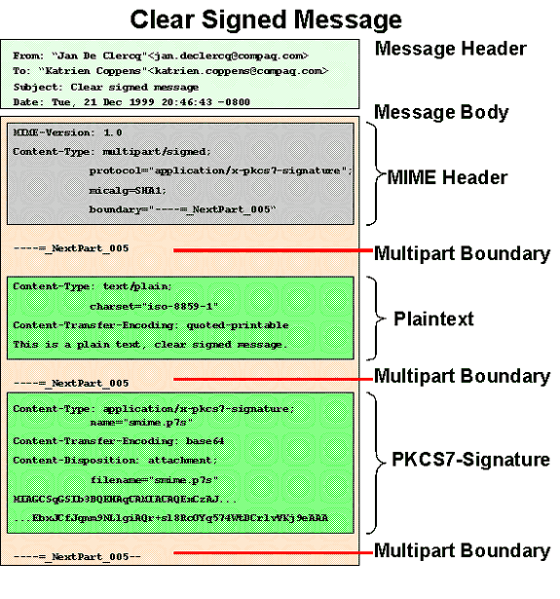
s/MIME – message authentication
Method to sign a message in order to authenticate the sender
Again relies upon public key cryptography
Key either transmitted securely or attested by an authority that is trusted
Email is structured according to MIME standard, and then signature given at end

Slide 20
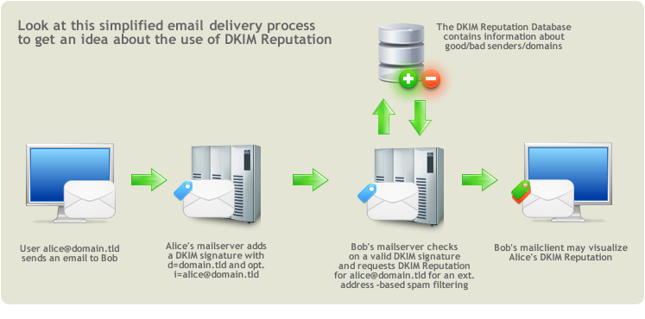
Domain Keys Identified Mail (DKM)
Method to authenticate a mail agent
A signing entity (usually server of the sender) adds a signature
DNS based for distribution of public keys of the signing entities
And hence
vulnerable to
DNS attacks

Slide 21
DKIM pros and cons
It is ridiculously easy to alter the FROM field on an email, and DKIM has been useful for stopping this
Example: Gmail now rejects any messages from eBay or PayPal that don’t have a valid DKIM signature to verify their origin
But not foolproof: can still have spammer make an ad at a reputable domain so that they get a signed copy of the message
Also not MIME-aware, which allows some potential for rewriting and breaking signatures

Slide 22
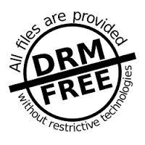
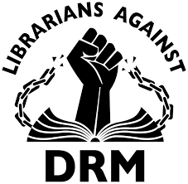
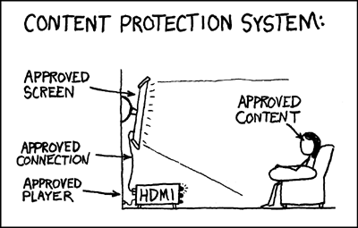
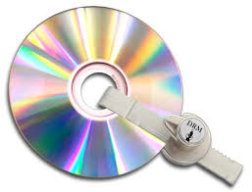
Digital rights management
DRM aims to protect copyrighted content
It is a general practice, and not a technical protocol
Implemented in many ways
Controversial!

Slide 23
Simple DRM
Can simply encrypt digital media, and then build the decryption key into authorized players
Generally, the file can only be played on the device that downloaded it, since player is the only one that can decrypt the decryption key
Minimizes vulnerability, since if that system is compromised, only gain access to the files that player has downloaded

Slide 24
CD DRM: history
In 2002, DRM on audio CDs became standard.
In 2005, Sony included DRM by default
Inserting a CD in Windows XP default configuration led to automatic installation
So DRM software installed itself silently, and “hid” itself (like a rootkit)
Later, researchers found that this code had a vulnerability, so that users were compromised without their knowledge
Led to lawsuits and eventual patching and halting of the technology

Slide 25
DVD DRM
DVDs use the Content Scrambling System (CSS), where licensed DVD players contained decryption key (and all communication was encrypted)
Based on secrecy of the protocol, and so of course was broken
Still the default, however
Blueray uses AACS, which is similar but is publicly available
Also uses stronger encryption and keys

Slide 26
Other DRM types
DRM also exists on iTunes content
Called FairPlay, and encrypts track so that only purchaser can play the content
Although music is currently DRM free
Netflix and Hulu use DRM to keep content restricted to up-to-date account holders
Ebooks incorporate similar versions of this technology

