Slide 1
Asymmetric Encryption

Slide 2
Announcements
Essay due
Next homework – crypto (on paper)
This week: more on encryption and authentication, then on to access control

Slide 3
Last time: symmetric key cryptography
Based on shared knowledge of a private key
BUT: protocol itself is not generally kept secret
Very secure:
For example, a 128-bit key in AES would take roughly 1 billion billion (est. 1.02 * 10¹⁸) years to crack on a 2012 supercomputer
Simple and easy to implement – XORs, etc

Slide 4
Asymmetric key cryptography
Also known as public key cryptography
Alice publishes something openly
Bob can then send messages to Alice using this public key
Huge and recent development
“New directions in cryptography”, by Diffie and Hellman, 1976
Daily conspiracy tidbit: Actually developed by UK government researchers in secret in 1973

Slide 5
Diffie-Hellman key exchange
Based on Z_{p} where p is either prime or a power of a prime (q^{k} with q prime)
We saw last time that Z_{p} is a finite field:
Nice + and * operations
Has multiplicative inverses, as well:
Take 2x = 1 mod 5
What is x?

Slide 6
The Diffie-Hellman protocol
Consider p prime, and s < p (both public)
Privately, Alice chooses a < p and Bob chooses b < p
Alice computes A = sª mod p and posts it
Bob computes B = s^{b} mod p and posts it
Alice computes the secret key Bª
Bob computes the secret key A^{b}
Claim: Bª = A^{b}, so they agree on a common secret key

Slide 7
Example:
Let s = 2, p = 29
Alice likes a = 3
Bob likes b = 7

Slide 8
Why does this work?
The common key is k = s^{ab} mod p
Recap: public info is p, s, A = sª, and B = s^{b}
a, b, and k are all private
What can an attacker do?

Slide 9
Hardness
At its base, the key to why this is hard is something called the discrete logarithm problem.
Remember logarithms?
Log₁₀ 1000 = ?
Log₂ 1024 = ?
Here, we want discrete logs:
given A, find log_{s} A = log_{s} sª = a, all modulo p

Slide 10
The discrete log problem
This is a problem that we “think” is hard
Similar to factoring
Note that there ARE ways to attack this – it is not NP-Hard, but there are no known fast algorithms
Stronger generalizations work in groups other than Z_{p}, like something called elliptic curves
A bit beyond this course, though

Slide 11
Beyond Diffie-Hellman
Shortly after this protocol first came out, RSA was first released
Stronger in many ways: it can be used to encrypt messages
However, it usually isn’t!
Slower than symmetric key encryption
Easier to attack
RSA is also built on hardness of factoring numbers
(Note: I’m going over RSA the algorithm, not RSA the company – they are different)

Slide 12
RSA: General overview
Alice looks up Bob’s public key, E_{B}, in a directory
Alice uses a known algorithm to encode a message m, resulting in E_{B}(m)
Bob then uses his private key D_{B} to decode, so that D_{B}(E_{B}(m)) = m
Idea: Alice can only give away m and E_{B}(m), but no one else can decode without D_{B}

Slide 13
How? Number theory!
Definition: The Euler phi function φ(n) is defined as the number of integers less than n that are relatively prime to n
Examples:
φ(7) = ?
φ(6) = ?

Slide 14
Phi function
Lemma: If p is prime, then φ(p) = p-1
Lemma: If p and q are both prime, then φ(p*q) = φ(p)*φ(q) = (p-1)(q-1)
Sketch of proof: What are p*q’s factors?

Slide 15
Euler’s Theorem
Theorem: If a and n positive integers with a relatively prime to n (so that gcd(a,n) = 1), then a^{φ(n)} = 1 mod n
Example: Let n = 7 and a = 3:
Another: Let n = 12 and a=5:

Slide 16
Euler’s Theorem
Why should we care? Inverses!
a and a^{φ(n)-1} will be inverses to each other modulo n
So if a is relatively prime to n, then there exists some b such that ab = 1 mod n
Just set b = a^{φ(n)-1}
A corollary: x^{y} mod n = x^{y mod φ(n)} mod n

Slide 17
RSA (Rivest Shamir Adelmann) 1978
Bob generates two primes p and q
Computes n = p*q and φ(n) = (p-1)(q-1)
Bob then picks e relatively prime to φ(n) and finds a d such that e*d = 1 mod φ(n)
He can do this, because he knows φ(n) – use Euclidean algorithm
d is now D_{B}, Bob’s private key
(e,n) are his public key
Essentially can forget about p,q, and φ(n)

Slide 18
RSA: encrypting
Now go to Alice, who has a message m, as well as e and n
To encrypt, Alice computes C = m^{e} mod n and sends C to Bob
Bob then takes C and computes C^{d} mod n
Claim: M = C^{d} mod n
Why?

Slide 19
RSA: double check
Well: C^{d} mod n = (Me)^{d} mod n = M^{ed} mod n
One way to see it:
Euler’s Theorem corollary – can take exponent mod φ(n): x^{y} mod n = x^{y mod φ(n)} mod n
So, here: M^{ed} mod n = M^{ed mod φ(n)} mod n = M¹ mod n = M.
Another way:
know ed = 1 mod φ(n), so (by definition) have ed = 1 + kφ(n) for some value k
Then M^{ed} = M^{1+kφ(n)} mod n = M¹ + M^{kφ(n)} mod n, and M^{φ(n)} = 1 mod n

Slide 20
RSA: double check
Catch – need M relatively prime to n.
Likely to be true, but we still want it to work
Luckily, still works if not relatively prime! We know it is still relatively prime to either p or q, since both are prime.
(Math is a bit more complex, but not hard to walk through the equations.)

Slide 21
The security of RSA
Public knowledge: (e,n)
How hard is it to get d?
Recall: d is the value that is d’s inverse mod φ(n)
This is easy if you know φ(n)
Use the extended Euclidean algorithm
How can you get φ(n) from (e,n)?
Answer: factoring!
Pretty good, though: no 512 bit number has yet been factored (I think…)

Slide 22
Cautions
There are a lot of attacks on RSA
Some examples:
Don’t choose “bad” values of n: easier to factor sometimes, especially if n isn’t big enough
Franklin-Reiter related message attack: If messages are related – for example, M₁ = f(M₂) for some polynomial f – then original messages can be recovered
Many more, depending on implementation.
In fact, “textbook” RSA, which we just went through, is considered insecure

Slide 23
Improvements: Elgamal
The Elgamel cryptosystem (named after its inventor) adds randomness to the basic structure of RSA
Result: encrypting the same message will give a different cipher text
Alice will need a different random number each time, though, or won’t be more secure
Nicely set up: encryptor (Alice) doesn’t need to know secret key, and decryptor (Bob) won’t need to know the random value
Alice does need to send two things instead of one, but result is much more secure

Slide 24
Hashing
Cryptographic hash functions are functions that take an input and return a fixed size alphanumeric string, call the hash value
Also message digest, digital fingerprint, digest, and checksum
Often used as signatures: provides reason to believe message has not been changed
Also passwords, etc.
Outside of security world also!

Slide 25
Goals of a hash
Some things are unchanged from data structures!
Goals of hash function:
Easy to calculate
Computationally difficult to calculate an input text that would generate any given hash output
Extremely unlikely that two different message would give the same hash
Essentially, these are deterministic functions that somehow behave randomly

Slide 26
Hashing standards
NIST also had a call to standardize modern hashes, in 2007
Results: 3 different algorithms SHA (with a number at the end)
SHA-256 employs a compression function with inputs of size 512 bits and outputs 256 bits
SHA-512 takes 1024 and outputs 512
MD5 is sometimes also used, but is widely considered to be insecure
Known attack where given two messages, one can compute two suffixes such that they collide
Result: can compute (for example) different PDF files with the same hash

Slide 27
Takeaway message
As a programmer or user of cryptography, you should know the major packages!
NSA Suite B is modern standard:
Encryption: AES
Signatures: Elliptic curves Diffie-Hellman: variant of Diffie-Hellman that uses those elliptic curve groups I briefly mentioned last week
Hashing: SHA

Slide 28

Note: no RSA!
Yet RSA is the most widely used in the transport layer
This is where website traffic lives, and we’ll talk more about it later in the course
Why??

Slide 29
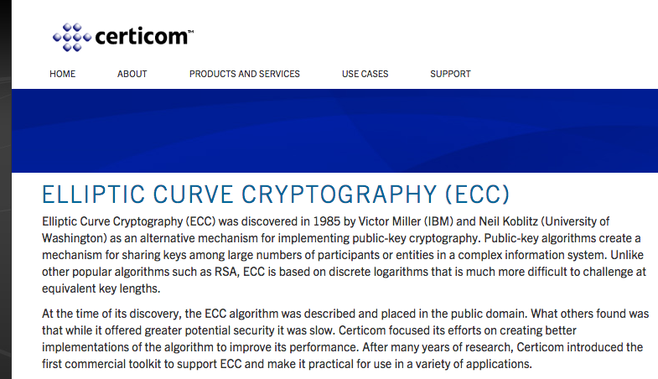
Why RSA?
RSA is used in websites, smart cards, at the OS level, and in many other places
Main reasons: speed, cost, legacy issues, etc.

