Slide 1
A historical overview
Sources:
Wikipedia
http://archives.cnn.com/2001/TECH/internet/11/19/hack.history.idg/index.html
http://www.sptimes.com/Hackers/history.hacking.html
http://www.centos.org/docs/4/4.5/Security_Guide/s2-sgs-ov-cs-how.html
Various other web sources, both for content and images

Slide 2
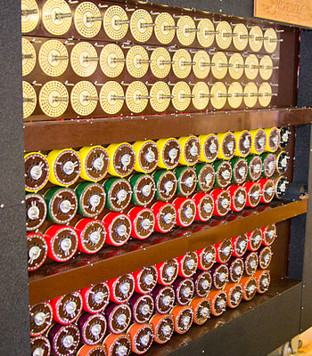
The 1930’s: Wartime efforts
One of the first relevant “computer” attacks was against the Enigma machine.
Based on the work of Polish cryptologists Rejewski, Zygalski, and Rozycki, researchers at Bletchley Park (including Turing, Welchman and Keen) develop the Bombe.
Based on a technique known as cribbing, where you assume the message contains some text analysts can guess. (Small key space didn’t help either.)

Slide 3
First computers
1946: ENIAC designed – the first all electronic computer
Following by many others, such as UNIVAC in 1951
At this point, computer security boils down to physical security, since there are only a few computers in the world, and there is no concept of networking or remote connection.

Slide 4
The 1960’s
The term “hacker” originates, based on a nickname for model train enthusiasts at MIT who hacked their trains to perform better.
Members of this group moved to the mainframe on campus and begin creating shortcuts and customizations.
One of the first reported vulnerabilities is here, on the Multics CTSS running on an IBM 7094. (When multiple instances of a test editor were invoked, the password file would display.)

Slide 5
More in the 1960’s
The DoD creates ARPANet, based on a paper in 1962.
It is used in research and academia as a way to exchange information. This is the initial carrier network which later became the internet.
Ken Thompson develops UNIX, widely thought of as the most hacker friendly OS because of is accessible tools and supportive user community.
Around the same time, Dennis Ritchie develops C. (Enough said.)

Slide 6
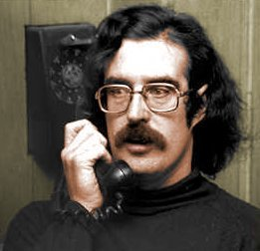
The 1960’s and 70’s
John Draper, aka “Captain Crunch”, finds a way to fool payphones into allowing free calls.
The article about him in Esquire magazine popularized the phreaking movement, which became closely tied to later hacking communities as phone networks because further digitized.

Slide 7
The 60’s and 70’s continued
Their success was based on realizing that certain frequencies (notably 2600Hz) would access AT&T’s long distance switching system.
They used a toy whistle from a cereal box.
Many clubs form and begin creating “blue boxes” based on the Esquire magazine instructions – including two kids in California who go by “Berkeley Blue” and “Oak Toebark”. (Hint: you’ve heard of these guys.)

Slide 8
More in 1970’s
On the technical side, the telnet protocol for ARPANet gave public access to ARPANet. (Also arguably the most insecure protocol out there!)
Jobs and Wozniak made the first personal computer and began marketing it for home users.
USENET is created, hosting bulletin-board-style (BBS) systems for communications between users. This quickly become the most popular forum for online communication.
Asymmetric encryption is developed (Diffie-Hellman).
1976: DES is approved.

Slide 9
Personal computers
The advent of the personal computer in 1975:
The Altair 8800, followed in 1976 by the Apple I and in 1877 by the Apple II
In 1982, the first 3 Apple computer viruses are found
In the same year, the first “worm” is created in Xerox for distributed computation; they get out of control and force shutdown of multiple systems.
(Side note: in the same year, TCP/IP is designed, and the internet truly launches.)

Slide 10
The 1980’s: a hacking “golden age”
The earliest hacking club is the Chaos Computer Club (in Germany).
In 1981, the Warelords form (in St. Louis), founded by Black Bark. They broke into many large systems, including the White House and Southwestern Bell.
In 1982, the 414’s broke into 60 computer systems such as Los Alamos to Memorial Sloan-Kettering Cancer Center; this attack led to a Newsweek front cover “Beware: Hackers at Play”, as well as emergency hearings and several new laws.
In 1983-4, Fred Cohen introduces the term “computer virus” for the first time.

Slide 11
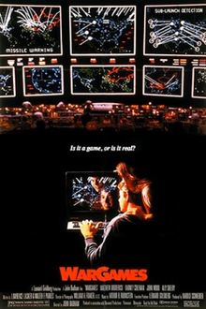
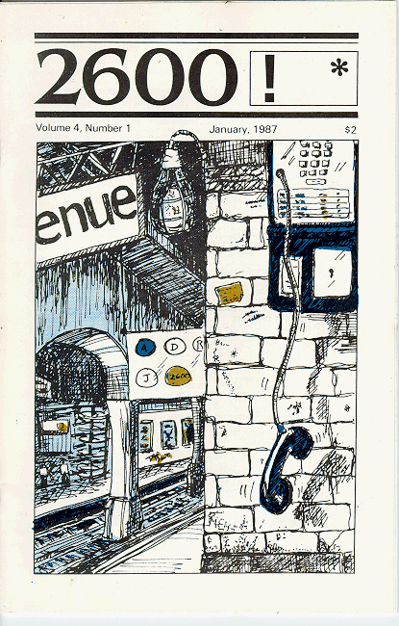
1983-1984: pop culture
The movie WarGames came out and introduced the hacker phenomenon; mass paranoia about computer vulnerabilities was the main result.
The magazine 2600 began in 1984, followed closely by the online ‘zine Phrack. Both allowed the dissemination of tips and instructions for would-be hackers, as well as address relevant issues and intensifying the subculture.
William Gibson popularized the term “cyberspace” through his science fiction novels.

Slide 12
Viruses and hacking
In 1984, British hackers are arrested for breaking into Prince Phillip’s email
Inspires the UK Computer Misuse Act directly afterwards
1985-6: First PC virus, named Brain
Intended to track a heart monitoring program for the IBM PC
Uses stealth techniques, and written by two brothers in Pakistan
Unintentional – it actually displayed a message that had the writers’ names and phone number
They’re still in business! www.brain.net.pk

Slide 13
1986-7: The Computer Fraud and Abuse Act
The Computer Fraud and Abuse Act finally makes it an outright crime to break into a computer system, punishable by jail time and fines.
However, does NOT cover juveniles.
It had been amended at least 6 times since then.
Really only covers “protected computers”
Used by the government or financial institution
Used in interstate or foreign commerce or communication

Slide 14
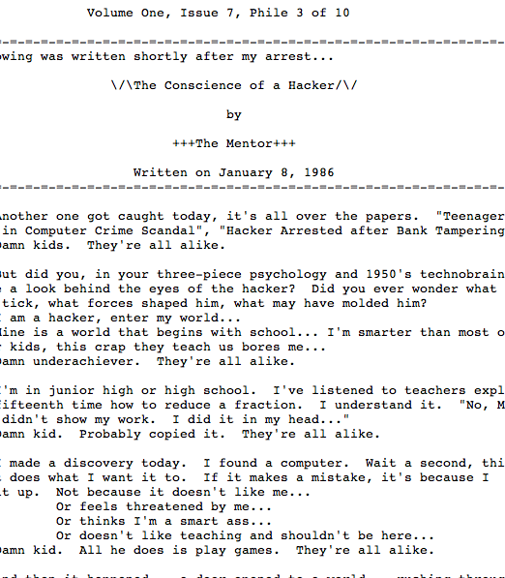
Also in 1986…
The Mentor was arrested, and subsequently wrote an article in Phrack which became famous:
“This is our world now... the world of the electron and the switch, the beauty of the baud. We make use of a service already existing without paying for what could be dirt-cheap if it wasn't run by profiteering gluttons, and you call us criminals. We explore... and you call us criminals. We seek after knowledge... and you call us criminals. We exist without skin color, without nationality, without religious bias... and you call us criminals. You build atomic bombs, you wage wars, you murder, cheat, and lie to us and try to make us believe it's for our own good, yet we're the criminals.”

Slide 15
1988
Robert Morris launched his worm on ARPAnet, providing the first prosecution under the Computer Fraud and Abuse Act. He is sentenced to 3 years probation and a $10,000 fine, and he is dismissed from Cornell.
The first significant computer crime against a bank occurred: $70,000,000 at First National Bank of Chicago.

Slide 16
1988
The Computer Emergency Response Team (CERT) is formed by U.S. defense agencies at Carnegie Mellon University; it is tasked with investigating the growing area of network-based attacks on computers.
Still located at Carnegie Mellon University.
Other worms follow, such as Father Christmas.

Slide 17
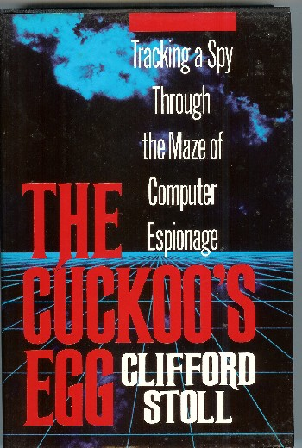
The Cuckoo’s egg
In 1989, Clifford Stoll published his book chronicling his efforts to track a hacker that acquired root access in Lawrence Berkeley National Laboratory.
Found a 75 cent accounting error.
Resulting in catching a German hacker who had compromised numerous military bases and was selling information to the KGB.
One of the first successful honeypots, and is perhaps the first documented computer break-in recorded.

Slide 18
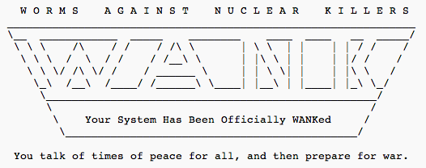
WANK worm: political hacking
The first politically motivated worm was the WANK worm, released in 1989 on the DECnet, primarily the component connecting NASA and DOE.
Never caught the authors, but they were believed to be Australians who went by Electron and Phoenix.

Slide 19
1990: Operation Sundevil
A special team operated by the Secret Service conducts raids in at 14 major cities. Targets include members of the Legion of Doom and other prominent hacking groups.
One target is also Steve Jackson Games. (Ever played Munchkin?) They actually seized a role playing book, GUPRS Cyperpunk, perhaps fearing it was hacking handbook.
This incident directly results in the formation of the Electronic Frontier Foundation (EFF).

Slide 20
1993
Sneakers is released – brings cryptography and penetration testing to the public eye
Hacker Kevin Poulsen (along with friends) rigs a phone system to let in only their calls, and “win” tons of stuff. Poulsen is convicted to 5 years in prison.
The hacking convention Defcon happens in Las Vegas for the first time. (Meant to be a one-time goodbye to BBSs, but it is so popular that it becomes annual.)

Slide 21
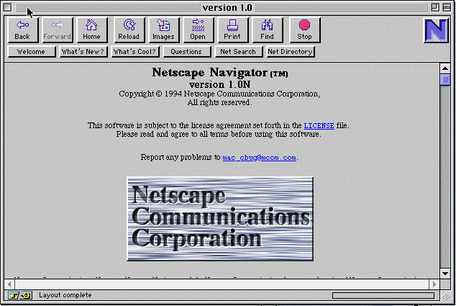
1994: The “web”
A new browser, Netscape Navigator, revolutionizes internet usage. Hackers adopt this new venue and migrate the BBSs over to webpages very quickly.

Slide 22
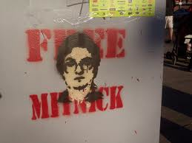
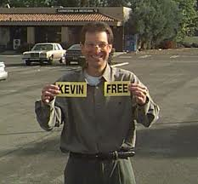
1995
Hackers is released! (A personal favorite)
Perhaps more vitally, the famous hacker Kevin Mitnick is captured and charged with stealing 20,000 credit card numbers. He is kept imprisoned for 4 years without a trial.
Finally sentenced in 1999 and released shortly after.

Slide 23
Cybercrime continues
In 1994-1995, Russian hackers steal over $10 million from Citibank and transfer it all over the world.
The ringleader, Vladimir Levin, used his work laptop after hours to manage the operation.
He is tried in the US and sentenced to 3 years in prison; in addition, authorities recover all but $400,000 of the stolen money.
In 1996, a group of hackers deface the DOJ, CIA, and Air Force websites.
The US General Accounting Office estimates there are 250,000 attempts to break into the Defense department, and estimate that 65% are successful.

Slide 24
More crime
Mp3’s are released and gain popularity in the mid-90’s. This leads to a slew of new filesharing, as well as crackdowns led by the RIAA.
In late 90’s, security goes more mainstream. (Superbowl ads even come out!) The release of Windows 98 leads to a host of publicly shared vulnerabilities.
AOHell, a suite of tools specifically targeting America Online, makes it easy for script kiddies to join the game on their favorite network.

Slide 25
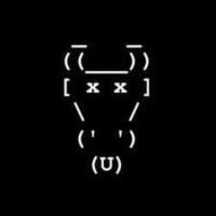
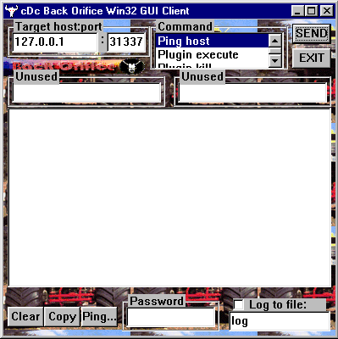
CDC and BackOrifice
In 1998, the Cult of the Dead Cow, a hacking group, released a “trojan horse” program. Once installed on Windows 95 or 98, the program allows unauthorized access (on port 31337, of course).
Humorously, would have made a great remote administration tool if they had only marketed it!

Slide 26
Late 90’s: the government
In May 1998, the members of the group LOpht testify to the US Congressional Government Affairs Committee, stating that they could take down the internet in less than 30 minutes.
A few months later, Janet Reno (the US Attorney General announces the creation of the National Infrastructure Protection Center, which is tasked with protecting the nation’s telecommunications, technology and transportation sectors.
In 1999, President Clinton launched a $1.46 billion initiative to improve computer security in the U.S.

Slide 27
Solar Sunrise in 1998
In Feb. 1998, a series of coordinated attacks against DoD targets began
Used well known OS vulnerability
At least 11 attacks following the same profile
Widespread, and appeared to come from around the world
Got hundreds of network passwords (on unclassified networks)
A 24 emergency watch involving multiple law enforcement agencies began
Occurred during preparation for military actions against Iraq, so serious concerns about origin
Finally caught 3 teenagers who did it all – 2 U.S. and 1 Israeli

Slide 28
Declaration of War
In 1999, the Legion of the Underground (LoU) declares “war” against Iraq and China because of civil rights violations in those countries.
Shortly after, 2600, the Chaos Computer Club, the CDC, Phrack, LOpht, and several other groups release a joint statement condemning this action:
"One cannot legitimately hope to improve a nation's free access to information by working to disable its data networks.”
The LoU responded by withdrawing their declaration.

Slide 29
More viruses and worms
In 1999, the Melissa virus became the most costly virus to date. (Ran inside Word 97 or 2000.)
Created by David Smith, and not originally intended to cause damage. However, the infected emails from the program overloaded the internet very quickly.
Closely followed by the ILOVEYOU worm, which used VBS in an email attachment to run a program that would propagate the program.
Estimated to cost billions in the US alone.
The two Filipino men who wrote it were released by the local government, since there were no laws against malware at the time. (That quickly changed.)

Slide 30
Developments in law
In 2000, Jonathan James became the first juvenile to be imprisoned for hacking. He served 6 months (followed by 6 months house arrest) after breaking into several government systems, including key NASA systems for the space station.
As an adult, he would have served 10 years, but this still set a precedent for future cases.
In 2001, Russian programmer Dmitry Sklyarov is arrested at the annual Def Con hacker convention. He is the first person criminally charged with violating the Digital Millennium Copyright Act (DMCA).

Slide 31
Microsoft and security
In 2001, Microsoft is the target of a new type of DNS attack. It is caught quickly, but destroys all access to Microsoft websites for several days.
Around the same time, Bill Gates declares that MS will begin securing all products and services, and invests in a large training and quality control campaign (discussed in a previous lecture).
Just a few months later, a paper is released on “shatter attacks”, exploiting a vulnerability in poorly installed applications on Windows. MS comes under fire (again).

Slide 32
Politics again
In 2001, political tensions between Chinese and the US resulted in “The Sixth Cyberware”, where groups from both countries tried to deface websites in the other country.
In 2003, the group Anonymous formed. Originally focused on entertainment, but later (around 2008) began to focus on international “hacktivism”, acting in protest to many different issues.

Slide 33
Export Law
In the U.S., export laws for technology become laughable. Originally set up in the 80’s, technology has far surpassed what is reasonable. (See commercials of the time.)
Encryption law is even further behind; cDc and their offshoot group Hacktivismo are not given permission by Dept. of Commerce to export strong encryption tools until 2003.
Even today, modern trends in development worldwide make enforcing laws quite difficult.

Slide 34
Famous US Government hacks
In Dec. 2006, NASA actually blocked all emails with attachments out of fear they’d hack the shuttle launches; Business week also announced the shuttle plans had been stolen by foreign intruders.
In 2007, the Secretary of Defense’s email account was hacked by foreign intruders as part of a larger hack on the Pentagon.
In summer 2008, the databases of both major presidential campaigns were hacked by unknown foreign intruders.
Many other countries report similar hacks.

Slide 35
Modern trends
Over the next few years (and into current time), a long list of worms, attacks, and legal battles continue.
Increasing focus is on credit card numbers and similar personal information, with high profile cases like those targeting Bank of America, Sony, and an Israeli sports web site.
Too many serious viruses and worms to list – all protocols, mainly web-based.

Slide 36
Target Breach
In 2013, hackers were able to lift “track data”, which enables attackers to create and sell counterfeit credit cards.
Worse than just card data!
Cost upwards of 8 billion for Target to cleanup.
CEO resigned in the aftermath.
Quite sophisticated compared to previous attacks:
Using code that targeted 3rd party heating and ventilation supplier.
The attack grabbed credit card numbers at the precise moment when they were present on the system and not encrypted.

Slide 37
Mobile security
The first mobile malware reported was Cabir, about 10 years ago.
A worm targeting the Symbion series 60 phones.
Spread using Bluetooth OBEX push protocol.
Currently, security lab Sophos reports more than 2000 pieces of mobile malware per day, targeting all mobile platforms.
Major issue: users are reluctant to run virus scanners, due to lack of awareness (and perhaps concerns for battery, etc.)
Plus, concerns over network threats and physical threats that are unique to phones.

Slide 38
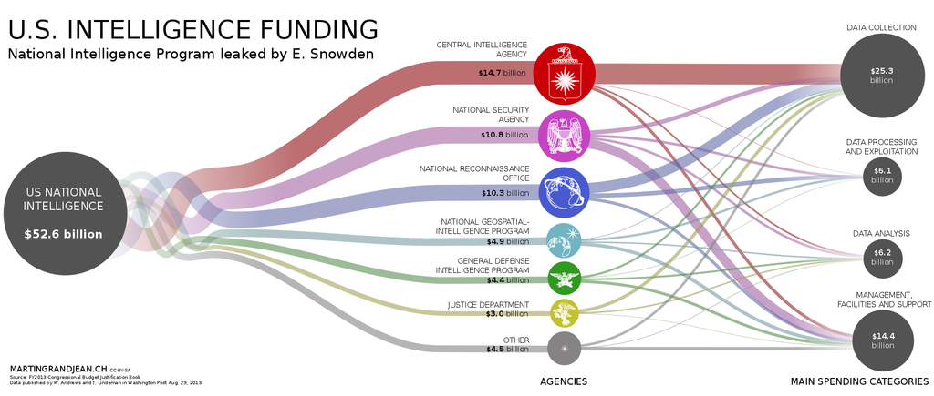
Privacy concerns
In 2013, Edward Snowden flew to Hong Kong in May, and in June revealed thousands of classified documents to 3 journalists.
Main reports were on the PRISM electronic data mining program and other programs funded by the US and its allies

Slide 39
The FBI and encryption
In 2015, a debate broke out about encryption on the Apple Iphone
A judge asked Apple to help the FBI to gain access to encrypted data during a criminal investigation
Apple refused, citing privacy concerns for its customers.
This is far from the first such case – every tech company gets such requests.
See https://www.eff.org/who-has-your-back-government-data-requests-2015

