Slide 1
Input testing SQL Injections

Slide 2
Recap
Code vulnerabilities:
Buffer overflows
String formatting
Overflow
Last time: runtime detection
Bounds checking
Stackguard (for some types of attacks)
Randomization and canaries

Slide 3
Challenge
A significant amount of testing is done, but in general, people care more about features then security
Until something breaks
How many lines of code do we really have to check? (“OMG PDF WTF”, Julia Wolf 2010)
Linux 2.6.32: 8-12 million
Windows NT 4: 11-12 million
Adobe Acrobat: 15 million

Slide 4
0-days
A hacker’s obsession:
A vulnerability that is not publically known
Often combine multiple attack vectors and vulnerabilities into one exploit
Can be open for months
These are actually sold
Much controversy here – see the zero day initiative
But aren’t always necessary!
Many security flaws are out there.

Slide 5
Finding bugs
A number of different tools and techniques
Static analysis is simply looking at the code and the system
Often called source code auditing
Dynamic evaluation looks at the system while it is running
Using a debugger or other tool
Often a combo is used, since neither is perfect

Slide 6
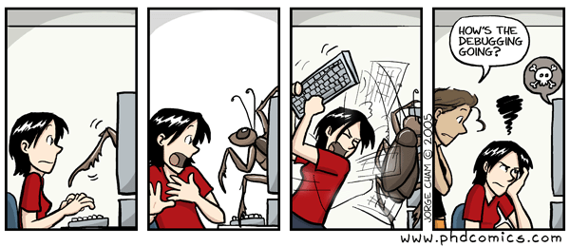
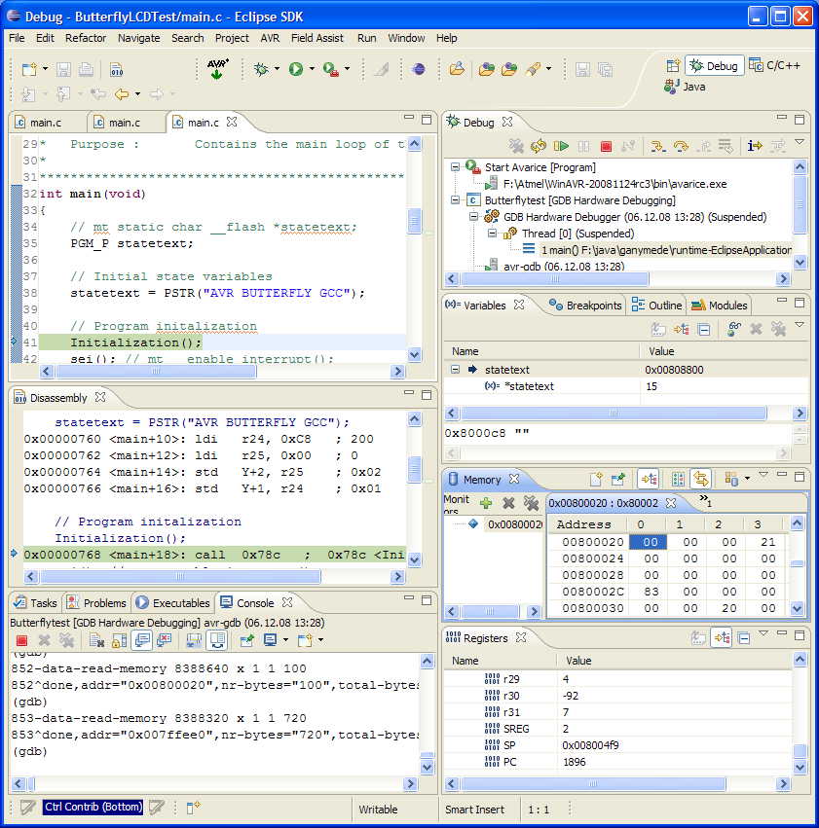
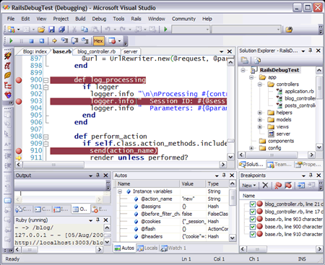
Debugging
Something we’re all (??) familiar with

Slide 7
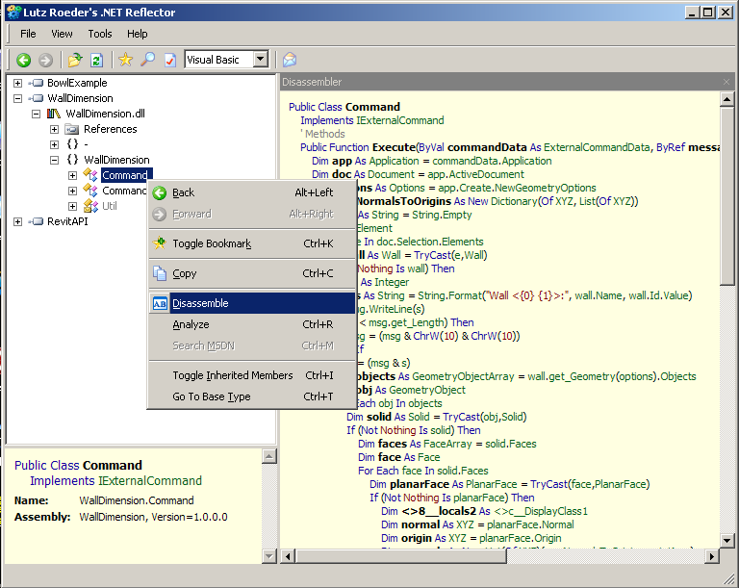
Reverse engineering
Decompilation: return code to programming-level language
(Not necessarily the one you began with)
Less successful in some cases

Slide 8
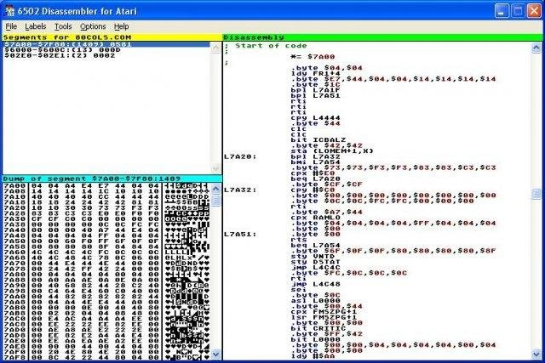
Reverse engineering
Disassembly: taking executable code back to assembler code
Many commercial ones – an older area
Protocol reverse engineering:
Big for secretive protocols, e.g. CSS

Slide 9
Regression testing
Goal is to run on as many normal inputs as possible, generally after a change or interface with other software
(Easier in engineering mentality)
This is a part of the design process everywhere
However, doesn’t always catch the odd errors or requests, since fundamentally we are checking that is it working, not how to break it.

Slide 10
Fuzzing
Whenever an application gets input, there is always a possibility of introducing malicious code
These points are called the attack surface.
Fuzzing is a means of automating the injection of unexpected input
Originated in 1988 with Miller at University of Wisconsin
Early work included random unstructured testing and a set of tools to evaluate software on many systems, along with analysis of the kinds of errors that were uncovered during the test

Slide 11
Fuzzing
Idea: Repeatedly run the program with many different inputs, recording crashes and error messages
Often developed for specific programs, protocols, or formats
i.e. web-based or file based
Two main types:
Mutation based
Generation-based

Slide 12
Trivial example
Standard HTTP GET request:
GET /index.html HTTP/1.1
Essentially, a “verb” that describes an action, plus optional arguments that modify that verb
Several possible methods:
GET, POST, PUT, DELETE, OPTIONS, CONNECT, HEAD, and TRACE
Other legal possibilities, because HTTP allows new ones to be added

Slide 13
Anomalous requests
Various options to detect different errors:
AA…AAA /index.html HTTP/1.1
GET ///////index.html HTTP/1.1
GET %n%n%n%n%n%n.html HTTP/1.1
GET /AAAAAAAAAA.html HTTP/1.1
GET /index.html HTTTTTTTTP/1.1
GET /index.html HTTP/1.1.1.1.1.1.1
Essentially, hunting for overflows or other errors

Slide 14
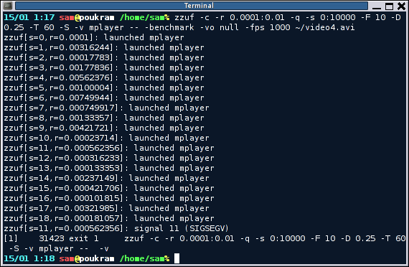

Mutation based fuzzing
Mutation based: take a well formed input, and randomly permute
Don’t need much knowledge of input structure
May fail some protocols that have challenge/response format
Tools: ZZUF

Slide 15
Example: pdf viewer
Google for pdf
Crawl results and build a set of samples
Use tool to:
Grab file
Mutate it
Feed to the program
Record if crashed

Slide 16
Generation based fuzzing
Test cases are made from description of the format, such as documentation, RFC, etc.
Anomalies then can be added into any possible spot in the input
More like my GET example earlier
In general, better results than random, since the knowledge of the protocol is built in
But requires user to have that knowledge

Slide 17
Tools for generation based fuzzing
Many popular ones
Example: Spike
Allows some automated tested of common fuzzing bugs
Basically a C API
Data structure is a SPIKE
SPIKE utility routines make dealing with binary data, network code, and common marshalling routines easy
SPIKE fuzzing framework automates iterating through all potential problem spots

Slide 18
Fuzzing Framework SPIKE calls
s_string_variable(“”);
s_string_repeat(“A”,5000);
Equivalent to s_push("perl -e 'print “A” x 5000’”)
While loop support
s_incrementfuzzstring();
s_incrementfuzzvariable();
Uses same set of fuzz strings to locate common web server overflows, format string bugs, etc

Slide 19
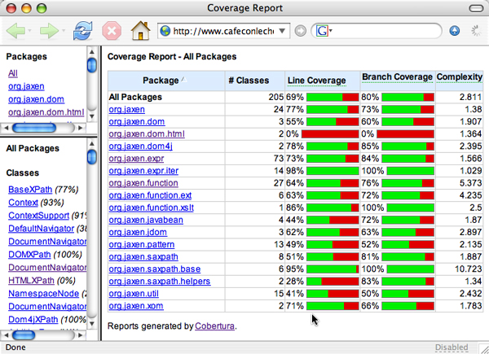
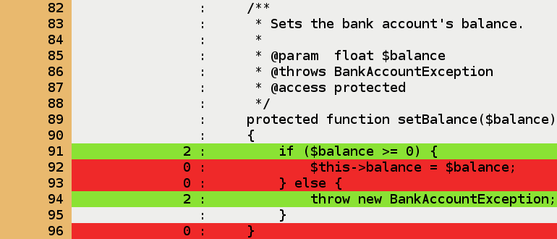
When is enough?
Code coverage is the question of how much code has been tested or executed.
Profiling tools exist for this in almost every language, with numerous metrics tested or examined.

Slide 20
Types of code coverage
Line/block coverage
Measures how many lines of source code have been run
Branch coverage
How many branches in code have been covered (conditional jumps)
Path coverage
How many different paths have been taken

Slide 21
Simple example
if (a > 2)
a = 2;
if (b > 2)
b = 2;
Requires:
1 test case for line coverage
2 test cases for branch coverage
4 test cases for path coverage

Slide 22
Code coverage tradeoffs
Benefits
Tells you if getting stuck somewhere
Might indicate benefits from different types of fuzzers, as well as comparisons
Problem:
Code can be covered but not reveal bugs!

Slide 23
Injection attacks
A family of bugs that generally arise from unsanitized inputs being accepted
Today: SQL injections
Related:
XSS: cross site scripting
HTTP response splitting

Slide 24
SQL Injection
One of the most common types, simply because databases running on webservers are one of the most common things out there!
Based on how SQL works as a language
Basic SQL:
Set of statements to interact with a database:
SELECT, DELETE, INSERT, etc.

Slide 25
Simple example
CREATE Table Cities
{
CityID INT,
CityName VARCHAR(200),
State VARCHAR(200)
}
Creates a simple table, which you can then interact with via SQL statements.

Slide 26
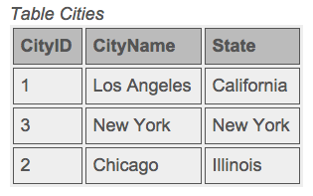
SQL Example
INSERT INTO Cities (CityID, CityName, State) VALUES (1, ‘Los Angeles’, ‘California’)
INSERT INTO Cities (CityID, CityName, State) VALUES (2, ‘New York’, ‘New York’)
INSERT INTO Cities (CityID, CityName, State) VALUES (3, ‘Chicago’, ‘Illinois’)
(You can then use select to display data, which can be fed back to web server)

Slide 27

So what can go wrong?
When inputs are accepted from the internet, these can actually affect your table if you aren’t careful!

Slide 28
Can be more sophisticated
Use of AND, OR, and other quantifiers allows fairly complex concatenations of commands
Not all of which you want to restrict away
Many “restricted” keywords are perfectly acceptable English inputs!
Simple example:
SELECT * FROM Users WHERE UserId = 105 or 1=1
Why is this a bug?

Slide 29
Other attacks
In SQL, WHERE “”=“” is always true
Server code:
uName = getRequestString("UserName");
uPass = getRequestString("UserPass");
sql = "SELECT * FROM Users WHERE Name ='" + uName + "' AND Pass ='" + uPass + "'”
Then simply insert “ or “”=“ into the box
Result:
SELECT * FROM Users WHERE Name ="" or ""="" AND Pass ="" or ""="”
Always true!

Slide 30
Real examples
In 2005, a company was put out of business because an SQL injection attack released over 200K credit cards (which were stored unencrypted…)
In 2007, the Microsoft UK page was defaced using an SQL injection
In 2008, Microsoft’s SQL server had an injection attack that took down thousands of PCs
Google SQL injection on any news site – these are all over.

Slide 31
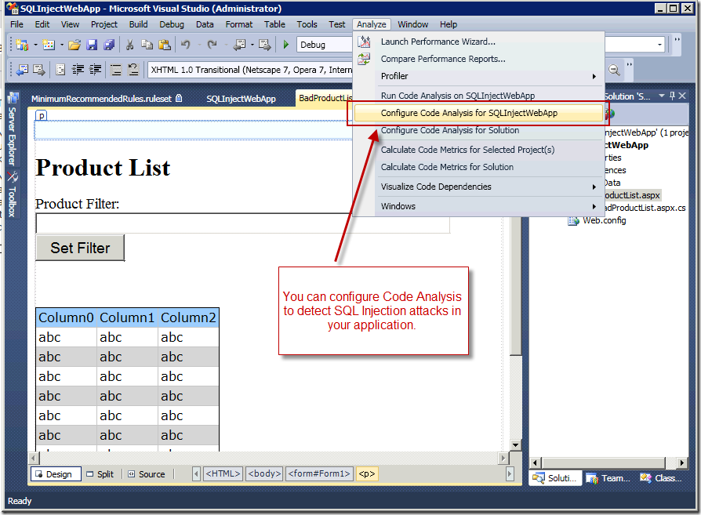
Ways to avoid these
Many vendor specific solutions to guard against these exist

Slide 32
Code level defenses
Can avoid “blacklisted” words
Serious downsides here, though.
Some words and characters that should be forbidden are pretty common in English!
Also, might be perfectly OK to allow SQL inputs from some fields.
Better way: SQL parameters

Slide 33
Protection parameters
SQL parameters are values added to queries at execution time.
SQL engine will check each parameter to be sure it is correct for its column and are treated literally, and not as part of the statement to execute
Example:
txtUserId = getRequestString("UserId");
txtSQL = "SELECT * FROM Users WHERE UserId = @0";
db.Execute(txtSQL,txtUserId);

Slide 34
Another example
txtNam = getRequestString("CustomerName");
txtAdd = getRequestString("Address");
txtCit = getRequestString("City");
txtSQL = "INSERT INTO Customers (CustomerName,Address,City) Values(@0,@1,@2)";
db.Execute(txtSQL,txtNam,txtAdd,txtCit);
Note that these add work, but are worth it!
Variations in most languages.
These are ASP .NET Razor examples.

Slide 35
Next time
Web vulnerabilities
Won’t be on midterm, but will be on the final exam!
Will pass out sample final and post review guide
Tuesday: review session in class – bring your questions
Next Thursday: Midterm

