Slide 1
Mobile OSes and security
Android
iOS
A bit more on Windows

Slide 2
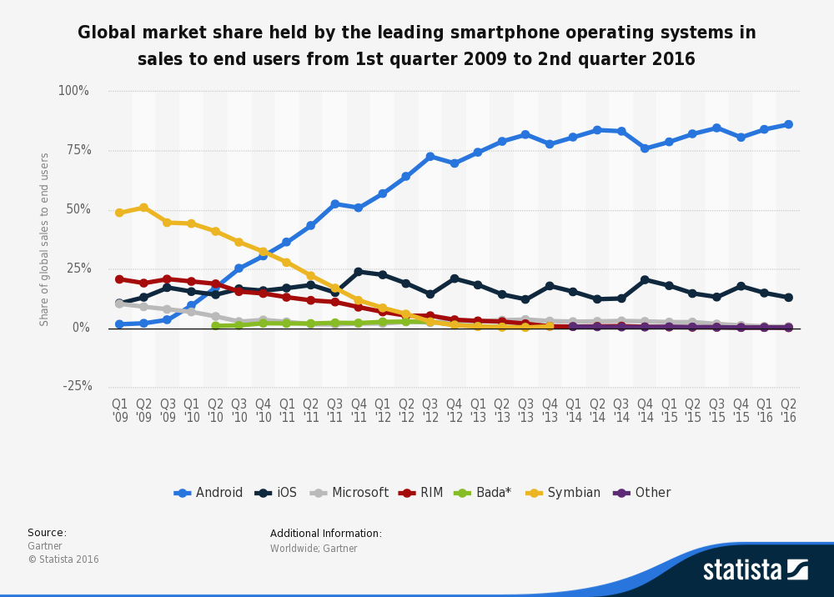
Mobile is now huge

Slide 3
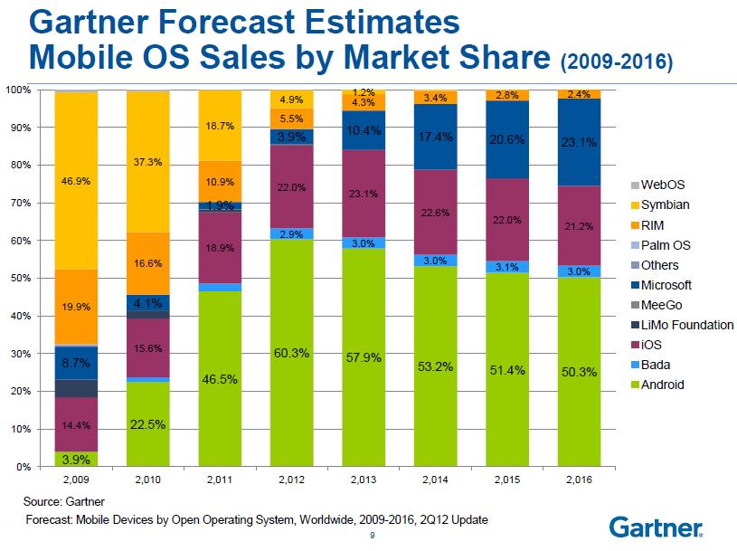

Slide 4
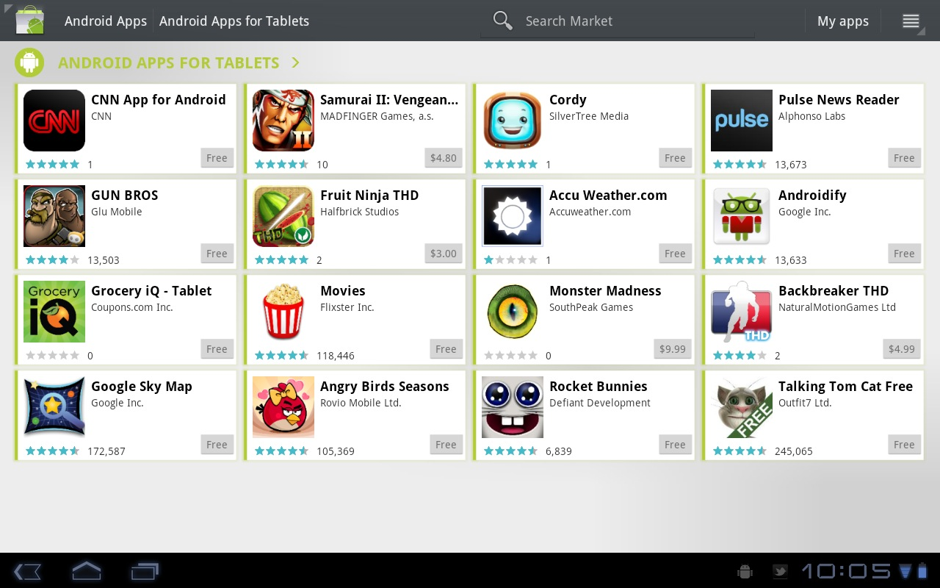
Tons of apps are available

Slide 5
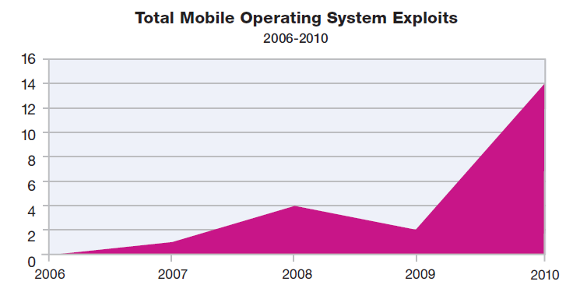
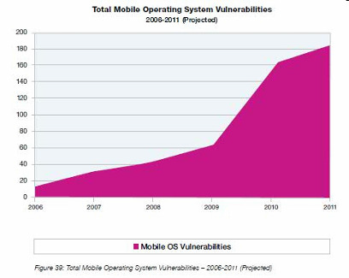
Attacks are increasing

Slide 6
Broad areas:
Insecure Storage
Applications store data, and need to share with other places, usually quickly
Information: Authentication credentials/tokens, financial info, profile and history, etc.
Insecure Network Communication
MITM attacks – these devices use many untrusted networks
SSL should be key for any mobile app

Slide 7
Broad areas (cont):
Unauthorized dialing/SMS:
User installs app, and it then sends premium rate messages
Used by malware and trojans such as FakePlayer, GGTracker (2010 on Android)
UI Impersonation
Essentially just Phishing or ClickJacking, but on mobile app
Example: NetFlix: gave error message and collected account information

Slide 8
Broad areas (cont):
Activity Monitoring
Copies and sends data (calls, messages, contact list) to attacker
Example: Pjapps (on Android, 2010)
System modification:
Application is essentially a rootkit, which hides itself and sends data back to attacker
Example: iKee Iphone worm changed root password and set wallpaper to Ricky Martin

Slide 9
Mobile malware attacks
Unique to phones:
Premium SMS messages
Identify location
Record phone calls
Log SMS
Similar to desktop/PCs:
Connects to botmasters
Steal data
Phishing
Malvertising

Slide 10
Comparison between platforms
Operating system
Unix
Windows
IOS
Approval process for applications
Market: Vendor controlled/Open
App signing: Vendor-issued/self-signed
User approval of permission
Programming language for applications
Managed execution: Java, .Net
Native execution: Objective C

Slide 11
The Android OS: Basics
Linux platform, programmed with Java but focused for a mobile environment
Includes support for SQL-lite databases
Includes software for secure network communication:
Open SLL, Bouncy Castel crypto API and Java library
Infrastructure in in C (since Linux)

Slide 12
The Android OS: Basics
Features:
Shared memory
Preemptive multitasking
Unix user identifiers and permissions
Process isolation between applications means limited need for complex policy configurations and sandboxing
More on this in a bit

Slide 13
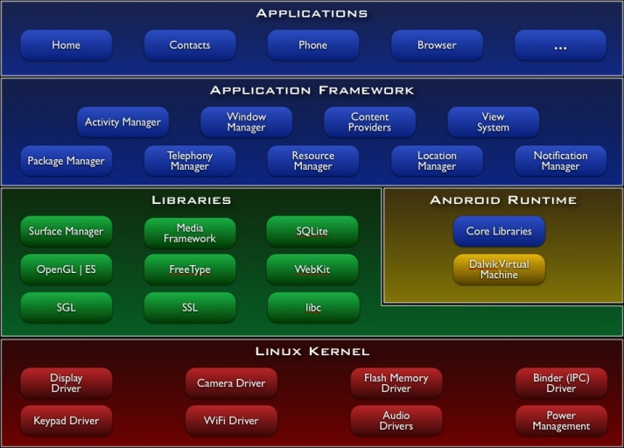

Slide 14
Applications
Applications run individually, under distinct UIDs with distinct permissions
NOT all with the user’s UID
Provides CPU and memory protection
Programs cannot read or write each other’s data or code
Sharing between them must be done explicitly
Heavily permissions based:
e.g. taking pictures, use GPS, make phone calls
All permissions given on install, to avoid repeated requests

Slide 15
Exploit prevention
100 libraries + 500 million lines new code
Open source -> public review, no obscurity
Overflow prevention
ProPolice stack protection
First on the ARM architecture
Some heap overflow protections
Chunk consolidation in DL malloc (from OpenBSD)
ASLR
Avoided in initial release
Many pre-linked images for performance
Developed and contributed by Bojinov, Boneh

Slide 16
Code signing
One (possible) long term guarantee is that android developers must sign their code
Usually self-signed certificates that can be generated without any external certification
Allows developers to update later without any complex permissions
Any applications run with the same key can ask to run with the same UID (so that updates and patches can use original code base)
Pretty unique – idea is that good code will lead to a good reputation

Slide 17
Obvious potential attacks
Even unprivileged malware can have unfortunate consequences:
Power or interruption issues
Noises or pop-ups
Permissions the user blindly agrees to can make this even worse
However, user permission is required for truly dangerous things:
Dialing calls
Disclosure of private data
Destruction of data

Slide 18
Developer responsibilities
Protect user data
Deal with constrained memory and batter power
Ensure programs are launched with correct permissions and UID parameters
Each program has manifest permissions to track what the application is allowed to do, expressed in AndroidManifest.xml
The user agrees to these upon install

Slide 19
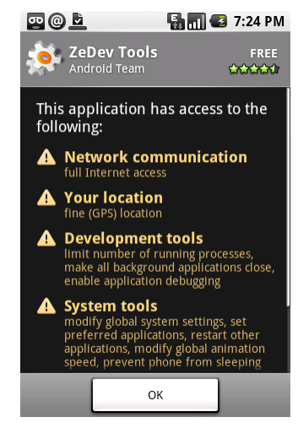
More on permissions
Once installed, permissions cannot be changed
Users often become uncomfortable with permissions they don’t understand
From developer side, permissions are just strings associated with a program and UID
Functionality allows lookups via checkPermission function

Slide 20
Levels for permissions
Each permission type has:
a short text label
a longer description (for use on install)
a protection level: normal, dangerous, signature, or signatureOrSystem
The protection level dangerous is designed to provide additional warnings for things like SEND_SMS, which could incur costs
The signature can only be granted to applications using the same key as the one running (allows coordination)

Slide 21
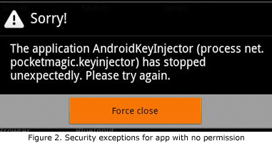
Permission failure
Using a feature which you don’t have permissions for causes a SecurityException
Often along with an error message of some type
Users are NOT informed when a permissions failure occurs, unless the app simply terminates

Slide 22
Intents
Intents are “a means by which an app can launch another app’s component using an abstract data structure describing what should be executed”
Essentially, a way to move data between Android processes
Don’t enforce security, but rather are how processes can pass messages across system boundaries
And hence a big target

Slide 23
What intents do
Start an Activity:
Such as opening a web page, using startActivity() method
To broadcast changes in events
To stop, start, or communicate with background services
Such as notifications
To access data (such as user’s contacts)

Slide 24
Intents
Lost of implementation details
But just think of them as blobs of data that can be moved between programs in order to get something done
Intents can be dispatched by the Activity Manager:
Eg Context.startActivity(Intent intent)
Can add categories to make the system more selective about what code the Intent can be handled by:
E.g. android.intent.category.BROWSABLE means that it is safe to be called from the web browser

Slide 25
Example
An intent with action Intent.ACTION_VIEW paired with data Uri.parse(“http:www.google.com”) indicates that an app wants to view the google webpage
If intent is sent out, the mobile OS decides what app is best to launch the browser
So a lot depends on how the OS matches intents to applications

Slide 26

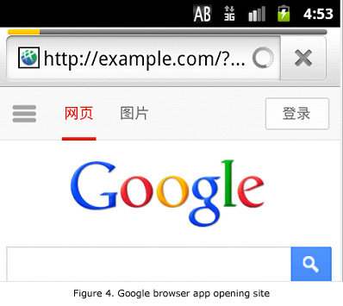
Sample attack
A shady developer might develop an app with an intent to open a browser and upload stolen data to the server
Since the browser opens the URL, the malicious app doesn’t need android.permission.INTERNET because this permissions has already been gotten by the browser app

Slide 27
Another example: logcat
Logcat is a logging system provide in Android
Used to collect, view and filter system and app debug output
An app needs to request android.permission.READ_LOG, which appears fairly harmless
Developers can write anything to logcat
Including sensitive debugging info, like logins, etc.
If careless, this debugging might not be removed
So another app can gain access to entire log! This usually at least includes things like browsing history and GPS data, even if nothing else.

Slide 28
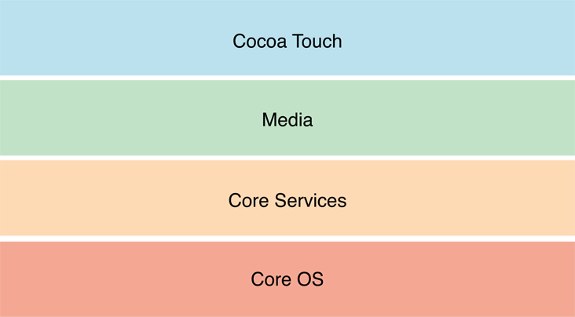
IOS overview
OS is based on Mach kernel like OSX
So essentially BSD based
Core services:
SQLite
UNIX sockets
POSIX threads
Usual APIs for network and file interfaces
Top layer is Cocoa Touch, which controls animation, multitasking, and gesture recognition for the OS
Generally implemented in C and Objective-C

Slide 29
Apple iOS Security
Device security
Prevent unauthorized use of the device
Data security
Protect data at rest; device may be lost or stolen
Network security
Networking protocols and encryption of data in transmission
App security
Secure platform foundation
Reference: http://images.apple.com/iphone/business/docs/iOS_Security.pdf

Slide 30
Device Security: passcodes
Strong passcodes
Passcode expiration
Passcode reuse history
Maximum failed attempts
Over-the-air passcode enforcement
Progressive passcode timeout

Slide 31
Data Security
Hardware encryption
Remote wipe
Local wipe
Encrypted Configuration Profiles
Encrypted iTunes backups

Slide 32
App Security
Runtime protection
System resources, kernel shielded from user apps
App “sandbox” prevents access to other app’s data
Inter-app communication only through iOS APIs
Code generation prevented
Mandatory code signing
All apps must be signed using an Apple-issued certificate
Application data protection
Apps can take advantage of built-in hardware encryption

Slide 33
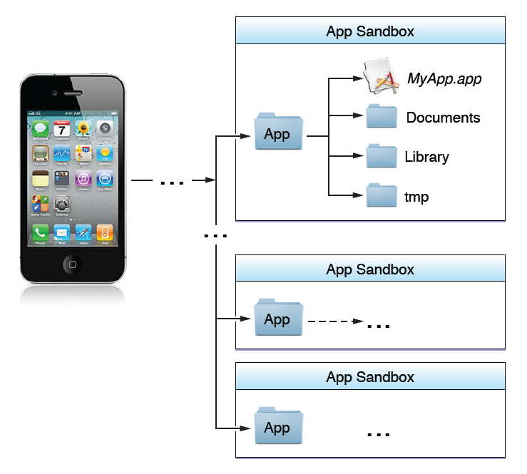
iOS Sandbox
Limit app’s access to files, preferences, network, other resources
Each app has own sandbox directory
Limits consequences of attacks
Same privileges for each app

Slide 34
A bit about Windows
We’ve already discussed some of the basics about Windows, since they have unified their desktop and mobile frameworks
But let’s discuss a bit about app management, since we didn’t focus on that in our desktop OS discussions

Slide 35

Windows Phone 7 security model
Policy system
Trusted Computing Base (TCB)
Central repository of rules
3-tuple {Principal, Right, Resource}
Fixed Permissions Chamber Types
Chamber Model
Least Privilege Chamber (LPC)
Elevated Rights
Chamber boundary is security boundary
Chambers defined using policy rules
4 chamber types, 3 fixed size, one can be expanded with capabilities (LPC)
Standard Rights
Capabilities
Dynamic Permissions (LPC)
Expressed in application manifest
Disclosed on Marketplace
Defines app’s security boundary on phone

Slide 36
Windows Phone 8 security model
Similar to WP7
Trusted Computing Base (TCB)
WP8 chambers are built on the Windows security infrastructure
Least Privilege Chamber (LPC)
Services and Application all in chambers
WP8 has a richer capabilities list
Dynamic Permissions (LPC)

Slide 37
Windows Phone OS 7.0 security model
Principles of isolation and least privilege
Each chamber
Provides a security and isolation boundary
Is defined and implemented using a policy system
The security policy of a chamber
Specifies the OS capabilities that processes in that chamber can access

Slide 38
Isolation
Every application runs in own isolated chamber
All apps have basic permissions, incl a storage file
Cannot access memory or data of other applications, including the keyboard cache.
No communication channels between applications, except through the cloud
Non-MS applications distributed via marketplace stopped in background
When user switches apps, previous app is shut down
Reason: application cannot use critical resources or communicate with Internet–based services while the user is not using the application

Slide 39
Four chamber types
Three types have fixed permission sets
Fourth chamber type is capabilities-driven
Applications that are designated to run in the fourth chamber type have capability requirements that are honored at installation and at run-time

Slide 40
Overview of four chambers
Trusted Computing Base (TCB) chamber
unrestricted access to most resources
can modify policy and enforce the security model.
kernel and kernel-mode drivers run in the TCB
Minimizing the amount of software that runs in the TCB is essential for minimizing the Windows Phone 7, 8 attack surface

Slide 41
Overview of four chambers
Elevated Rights Chamber (ERC)
Can access all resources except security policy
Intended for services and user-mode drivers
Standard Rights Chamber (SRC)
Default for pre-installed applications that do not provide device-wide services
Outlook Mobile is an example that runs in the SRC
Least Privileged Chamber (LPC)
Default chamber for all non-Microsoft applications
LPCs configured using capabilities (see next slide)

Slide 42
Granting privileges to applications
Goal: Least Privilege
Application gets capabilities needed to perform all its use cases, but no more
Developers
Use the capability detection tool to create the capability list
The capability list is included in the application manifest
Each application discloses its capabilities to the user,
Listed on Windows Phone Marketplace.
Explicit prompt upon application purchase
Disclosure within the application, when the user is about to use the location capability for the first time.

Slide 43
Recap: Comparison between platforms
Operating system
Unix
Windows
Approval process for applications
Market: Vendor controlled/Open
App signing: Vendor-issued/self-signed
User approval of permissions
Programming language for applications
Managed execution: Java, .Net
Native execution: Objective C

Slide 44
Comparison
 | iOS | Android | Windows
Unix | x | x
Windows |  |  | x
Open market |  | x
Closed market | x |  | x
Vendor signed | x
Self-signed |  | x | x
User approval of permissions |  | x | 7-> 8
Managed code |  | x | x
Native code | x

