Slide 1
Intro to Networks (part 1)

Slide 2
Networking basics
A huge part of modern security deals with networking, since a huge number of attacks come from something internet-based
Not to discount malware – we’ll talk about that later on.
So, the next few lectures will be a crash course on networking with an emphasis on security-related topics.

Slide 3
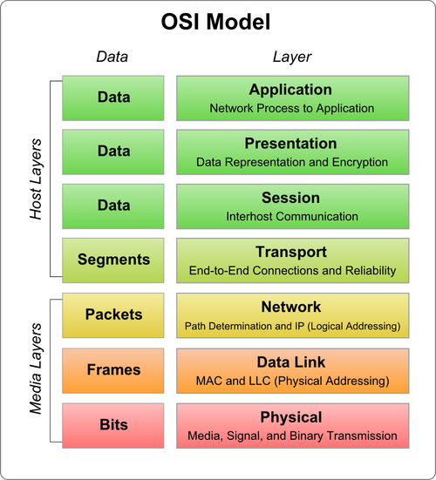
The OSI model
The Open Systems Interconnection (OSI) model is the standard way to model communication functions in computers
It divides the system into abstraction layers

Slide 4
The OSI model
Each layer concerns a different level of how computers communicate with each other
Security is important on multiple levels
Helpful to keep this in mind as we dive in starting at the lower levels

Slide 5
The data layer
We won’t worry too much about the link layer
Go take more ECE if you’re focused there
The data layer is concerned with actual physical addressing
Typically MAC addresses
Each machine must have a completely unique identifier, which is usually hardwired into it at the time of construction
Technically, hardwired into every piece of hardware that communicates, so a single machine may have several of these identifiers

Slide 6
MAC addresses
The MAC header contains the MAC address of the source and destination machine.
(MAC address and ethernet address are interchangeable here.)
They look like:
00-40-33-25-85-BB, or
00:40:33:25:85:BB

Slide 7
The OSI model
Moving up a layer, we need some way for computers to use the data layer MAC address to actually communicate
This is the first really interesting place we can dive in

Slide 8
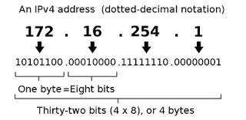
Network layer: IP addresses
Every computer has an address by which other computers can identify it
Two current standards in use: IPv4 is still the dominant one

Slide 9
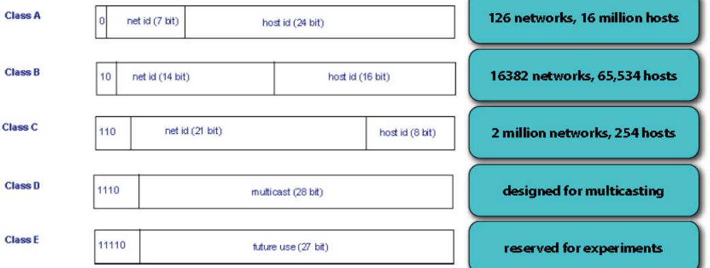
More on IPv4
There are different classes of networks, each of a different size:

Slide 10
Problem: space
IPv4 was designed in 1981.
Classes A-C allow for under 4.3 billion addresses total.
The reality is actually smaller, given restrictions and reserved windows.
Conclusion: Too many machines for IPv4 to stay feasible.
Solutions:
Subnetting
NAT
IPv6

Slide 11
Network Address Translation (NAT)
Simple early solution: instead of purchasing a class of addresses, just get one IP and address all of your traffic to it.
Then put a single machine visible the outside world
That machine then routes all internal traffic based on internal IPv4 addresses that are local
Can reuse addresses since no external machine sees them
But the router will need to do a lot of translation and keep records of all internal machines

Slide 12
NAT pros and Cons
Pros of NAT
Simple and secure
Combines well with firewalls on the network
Cheap and builds onto existing IPv4 framework
Cons of NAT
Single point of failure
Slower

Slide 13
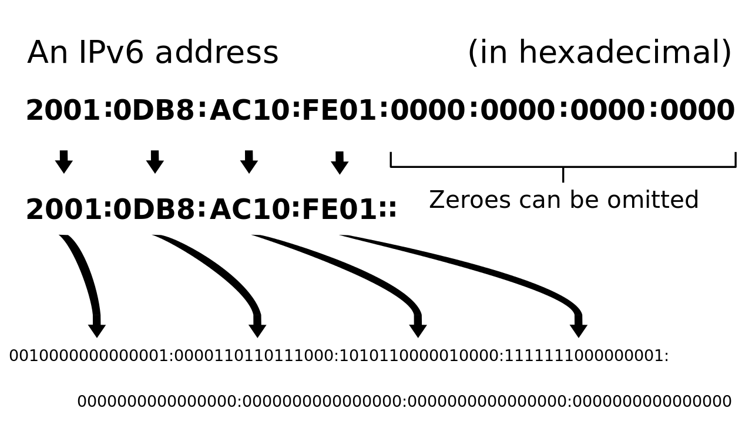
IPv6
Invented in 1998, and allows for 128-bit addresses
The transition has been slower than expected, but is growing:
Google estimates that about 13% of their current traffic load comes via IPv6
In 2012, that was under 1%, so it is increasing

Slide 14
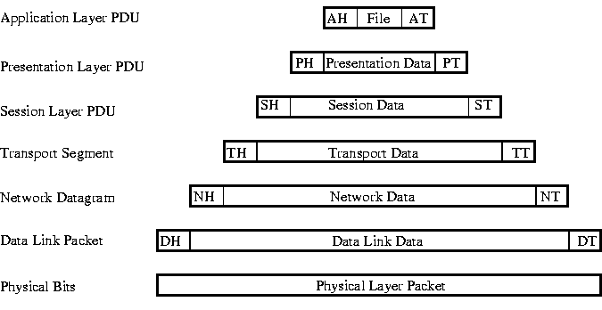
Sending Data
Messages are actually sent by dividing into packets, which encode bits of data
Each layer actually adds headers to the data, so the final packet contains different information

Slide 15
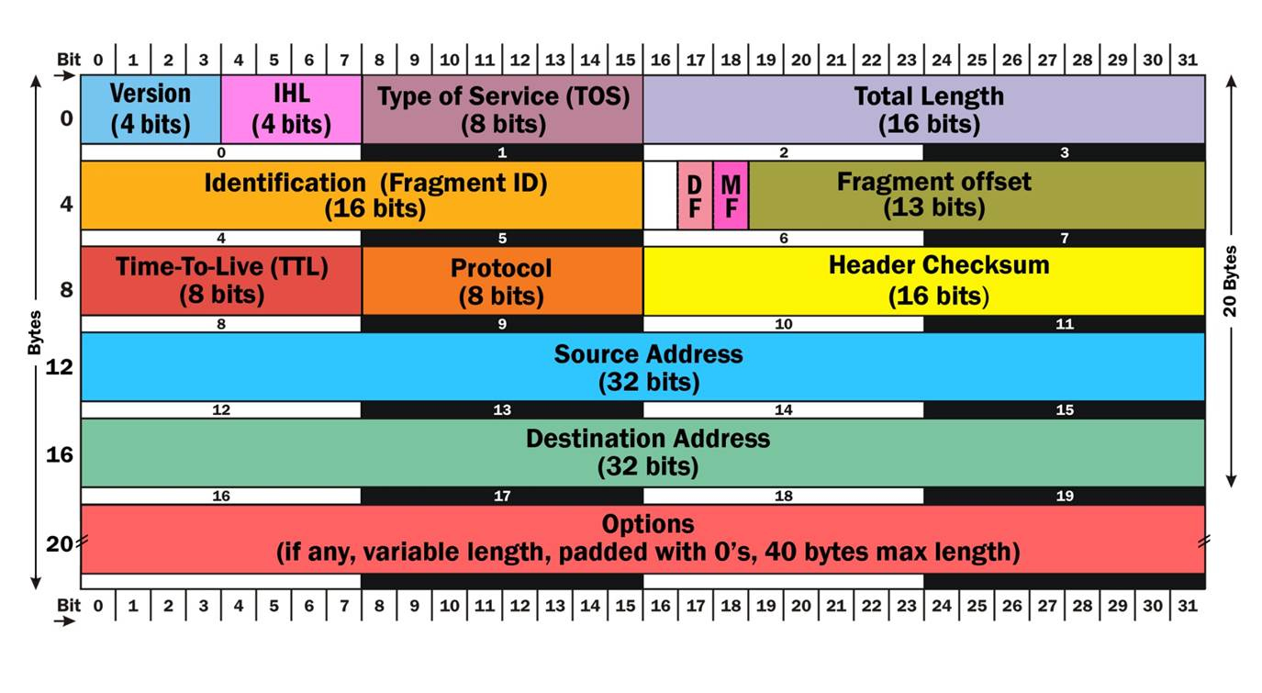
Security and packets
Certain areas of these headers and footers are very interesting from a security point view.
In particular, much information which details possible vulnerabilities can be available.
Also, impossible to hide it. (Why?)

Slide 16
Routing packets
Moving back a step – let’s consider routing in this situation
Each machine has a MAC address and an IP, but how do these message actually get passed around?

Slide 17
Network infrastructure
At the smallest scale, we have Local Area Networks (LANs): “a small interconnection infrastructure that typically uses a shared transmission medium” – Computer and communication networks by N. Mir
“Local” is relative – can be many or few computers – but generally all will connect to a single router or switch that serves traffic

Slide 18
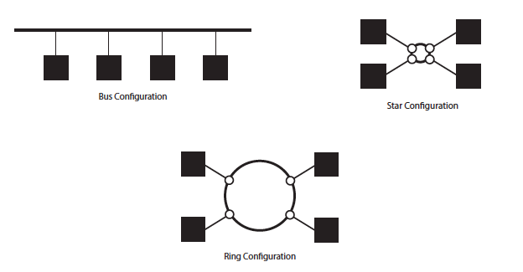
In simple LAN topologies (generally built with hubs), there is nothing preventing a host from sniffing traffic intending for someone else.

Slide 19
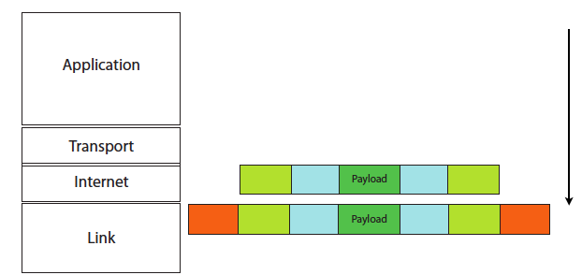
When a packet is translated from the internet (network) layer to the link layer, the machine must translate the destination IP address to a destination physical ethernet address.

Slide 20
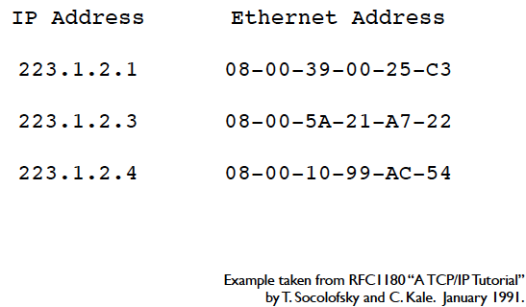
ARP: Address Resolution Protocol
This translation process is done via ARP.
Each node in memory has an ARP table, which looks something like this:

Slide 21
Viewing ARP data
On most systems (windows, linux, or mac), type “arp –a”:
Example (on my laptop):
Macintosh:~ echambe5$ arp -a
setup.ampedwireless.com;setup.ampedwireless.net (192.168.1.67) at f8:78:8c:0:1a:e6 on en0 ifscope [ethernet]
? (192.168.1.69) at 0:23:31:ee:37:56 on en0 ifscope [ethernet]
? (192.168.1.254) at 64:f:28:66:fc:c1 on en0 ifscope [ethernet]
? (192.168.1.255) at ff:ff:ff:ff:ff:ff on en0 ifscope [ethernet]

Slide 22
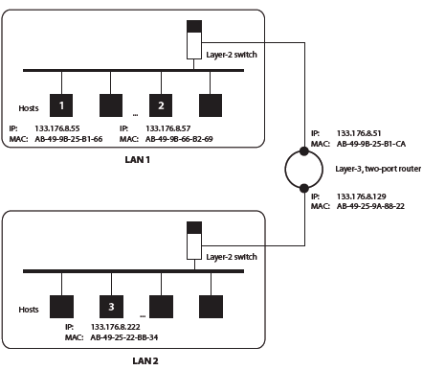
ARP Example
First example: Host 1 transmits to host 2
No entry in the table.
Host 1 broadcasts an ARP request on LAN 1.
Essentially:
“If your IP is 133.176.8.57, then reply with your MAC.”

Slide 23
ARP Example
First example:
Host 2 then replies with
AB-49-9B-66-B2-69.
The entry is added to ARP table, and transmission proceeds.

Slide 24
ARP Example
Second example:
Host 1 transmits to host 2 again.
Entry is in the ARP table, so we use it.
(If entry has changed, communication will fail and host 1 will try another ARP request.)

Slide 25
ARP Example
Third example: Host 1 transmits to host 3
No entry in ARP table.
Host 1 broadcasts an ARP request on LAN 1:
“if you IP is 133.176.8.222, then reply with your MAC address.”

Slide 26
ARP Example
Third example: Host 1 transmits to host 3
No reply is received.
Host 1 then transmits a frame with destination IP address 133.176.8.222 and a source MAC address of AB-49-9B-25-B1-CA

Slide 27
ARP Example
Third example: Host 1 transmits to host 3
The 2 port router gets the frame and sees the destination IP.
Either it is in its ARP table, or it sends an ARP request on all ports.

Slide 28
Network devices
Hubs, switches, and routers are all types of packet forwarding devices.
A hub is a layer-1 device. That means it only has knowledge of the physical layer, so it sends all frames to all hosts.
In essence, this means security is impossible.

Slide 29
Network devices
Switches are layer-2 devices, so they live on the link level.
This means they know about MAC addresses! So they can extract MAC addresses and only send the data to the target.
Inherently more secure, since harder to “sniff” for traffic on the local network.

Slide 30
Network devices
Routers live on layer 3, the actual network layer. They can:
Perform like switches
Forward frames across different kinds of networks
Utilize NAT to hide IP addresses
Forward frames across networks with different Net IDs. (Recall our IPv4 discussion last time.)

Slide 31
An attacker’s goal
Given that switchers and routers provide much more secure transmission, an attackers goal is essentially to get these to behave more like hubs.
We’ll talk about a few common types of network attacks that essentially do this.

Slide 32
ARP Poisoing
The goal is to convince the other computer that you are another IP (generally the default gateway), so that all traffic gets sent to you.
Step 1: Send unsolicited ARP replies to fill up another machine’s ARP table (so that it has to send ARP requests of its own)
Step 2: Reply to those ARP requests with your own MAC.

Slide 33
ARP Poisoning
There is no solid defense here, since ARP is inherently flexible. Possibilities:
Extra software to check for possible spoofs
Hard coded entries (but difficult to update)
OS level guards (timeouts, ignore unsolicited ARPS, etc.)
Note that there are legitimate uses! Page redirects, setting up redundancy, etc.

Slide 34
Implementing ARP Poisoning
ARP Poisoning sets the network up for a man-in-the-middle attack: once you have everyone talking to your computer, you can intercept and modify traffic at will
Tools: In a future lab, we will use tcpdump to monitor traffic and ettercap to sniff and filter content from the network
(We’ll dive into this in a week or two…)

