Slide 1
Network Security (part 2)

Slide 2
Protocols: recap
Last time, we saw:
MAC addresses
Internet Protocol: IP
ARP (to connect them)
These were designed before security was even an issue, and hence are fundamentally insecure.
Today, we’ll discuss more on how and move up the stack.

Slide 3
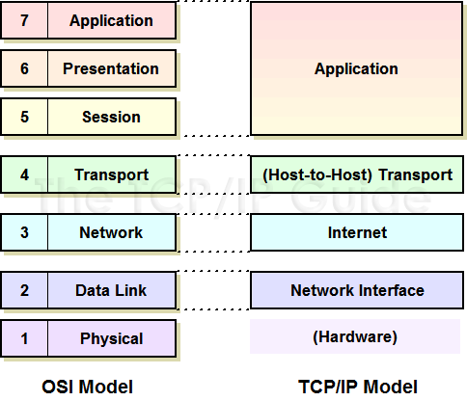
Last time:
Reminder: ARP is the interface between Network and Data
Or internet and network interface on the TCP/IP layers
This time, I’d like to:
Talk about securing the IP layer
Then move up the stack(s)

Slide 4
IP Spoofing
IP protocol doesn’t prevent anyone from lying about the source address.
Simple utilities exist to do this – it is also done for testing and other legitimate purposes.
Simple packet filtering is the best defense – outside attacker then can’t spoof an inside address.
But IP is just inherently insecure!

Slide 5
Ingress filtering
Proposal to have every router drop packets with “invalid” IPs
Would eliminate spoofing if everyone did it, and is commonly used
2012 report from MIT project studying this claims the latest software is running on 80% of the internet
However:
Source based
No incentives
Everyone must deploy
Can’t catch everything

Slide 6
IPSec
Protocol that authenticates and encrypts each IP packet in a communication
Host to host or network to network or host to network, depending on setups
Provides data integrity, authentication, data confidentiality, and replay protection by using cryptography and a number of other protocols

Slide 7
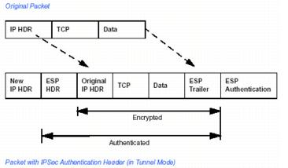
IPSec settings
Authentication Header (AH) versus Encapsulating Security Payload (ESP)
Either just authenticate source, or encrypt all communication
Tunnel versus Transport mode
Tunnel encapsulates entire packet and adds new headers, and is usually a key protocol for VPNs
Transport only encapsulates (encrypts) the payload, so IP headers stay the same

Slide 8
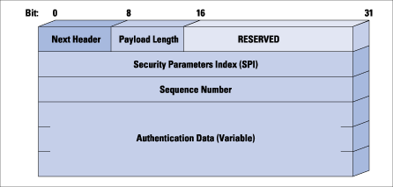
IPSec: AH mode
Authentication header:
Protects integrity and data origin authentication
Can also defend against replay attacks
Important note: incompatable with NAT!

Slide 9
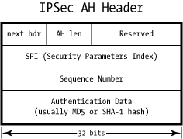
AH mode
The AH header identifies several key things:
Next hdr: identifies protocol type of payload
AH len: length of AH header
SPI is an identifier that helps associate a packet with relevant settings for the connection and details (encryption type, etc.)
Sequence number: protect against replay attacks
Authentication Data: usually a hash of the packet

Slide 10
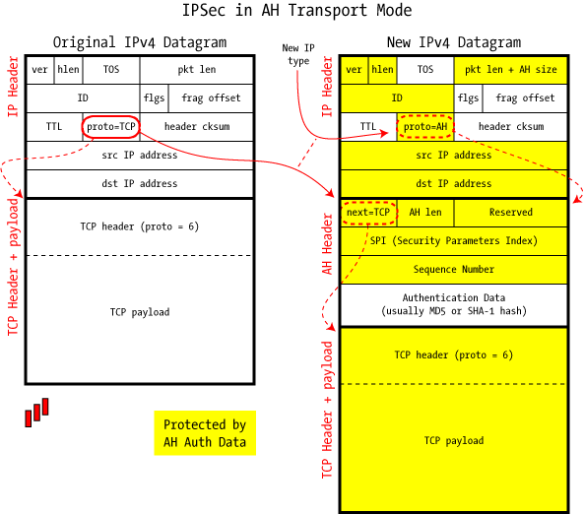
AH transport mode
Here, IP packet is modified only to include new header
At the destination, the AH header is simply removed after verification, and IP header gets the saved “proto” field put back in

Slide 11
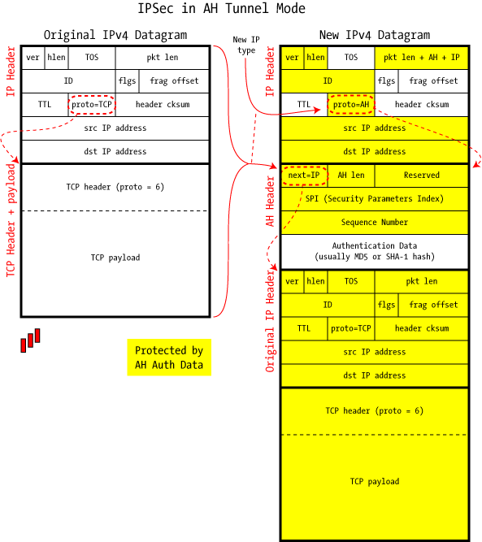
AH tunnel mode
In tunnel mode:
Entire packet is encapsulated (but not encrypted!)
Source and destination can be difference than those inside the packet
Hence, a “tunnel”
Most implementations treat tunnel mode as a virtual network interface
So data can be sent along or delivered locally

Slide 12
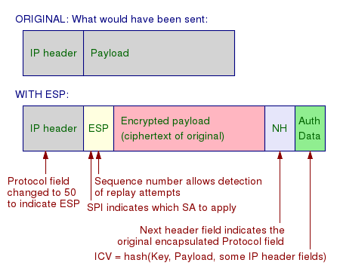
IPSec: ESP mode
Encapsulating security payload
Provides origin authenticity, integrity and confidentiality

Slide 13
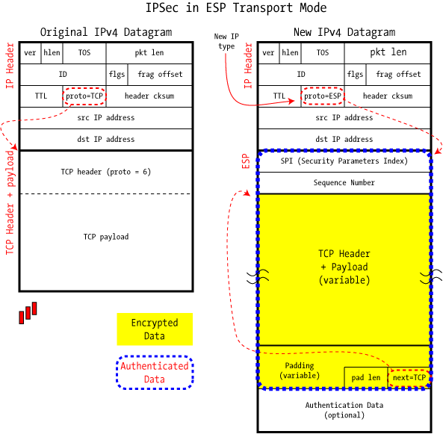
ESP in transport mode
Transport mode again just encapsulates the payload
So used for host to host communications
IP header is left in place (except for protocol), so source and destination stay the same

Slide 14
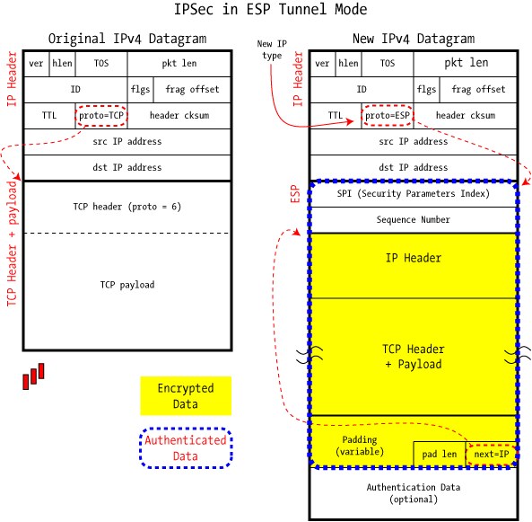
ESP in tunnel mode
In tunnel mode, we encrypt the entire original packet
Really close to a VPN (although no authentication in this setup)
Note: the fact that we’re in tunnel mode is actually encrypted here also – it’s in the payload (unlike in AH)

Slide 15
VPNs and security
It’s important to note that ESP in tunnel mode by itself is not up to security standards!
There are attacks on IPSec with encryption only (and no integrity protection)
Attack essentially calls for the attacker to inject some traffic onto the network and intercept responses, so nothing advanced here
Need integrity, so that you will ignore these other packets

Slide 16
Other protocols: ICMP
The Internet Control Message Protocol exists to provide error reporting and testing to IP.
Primarily used by network devices like routers to send error messages.
Example: When the TTL field reaches 0, a message is sent to source address.
Many common utilities are built on this – traceroute, ping, etc.
Often blocked except from certain trusted sources.

Slide 17
UDP: User Datagram Protocol
UDP builds on top of IP by supporting port routing:
Destination port number gets a UDP data field that adds application process
Source port number provides a return address
Minimal guarantees – no acknowledgements, flow control, or anything
In a sense, not easy to attack, but not reliable anyway!

Slide 18
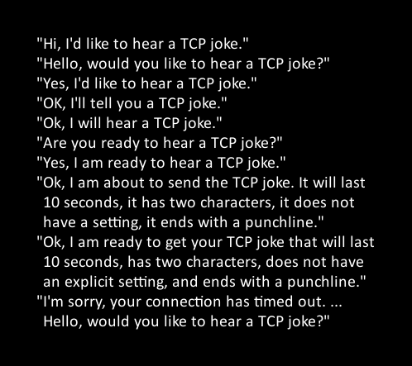
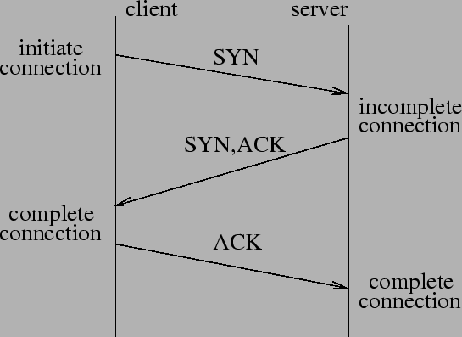
TCP: adding reliability
TCP preserves order and adds reliability:
Sender breaks data and attaches number
Receiver must acknowledge receipt, so lost packets are resent and packets are reassembled

Slide 19
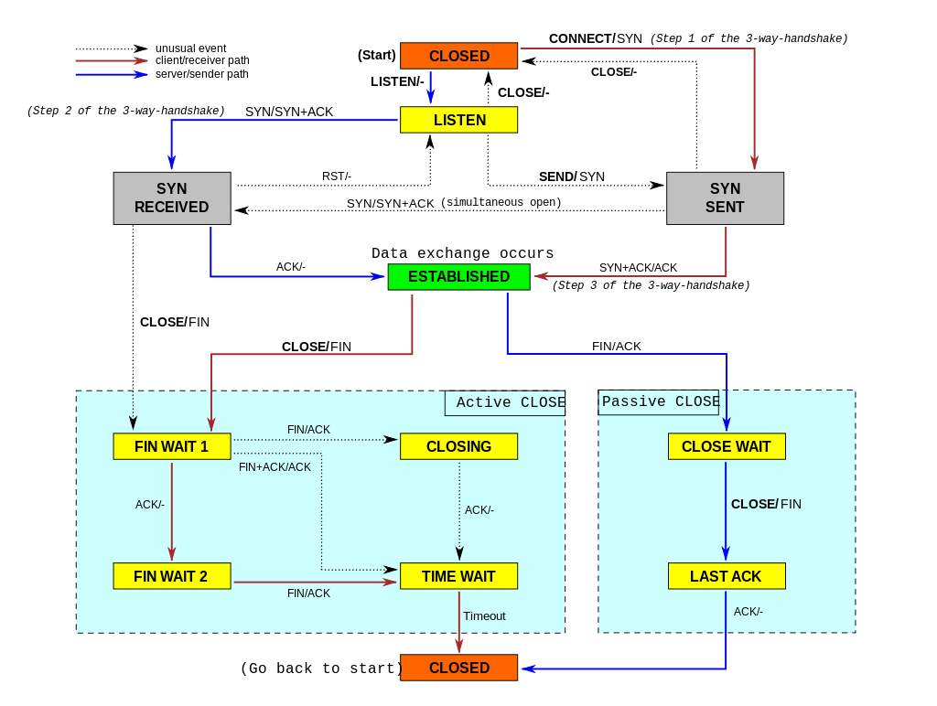
Actually, it’s a bit more complex:

Slide 20
Some attacks on TCP
TCP states can be easy to guess
And hence spoofed or fooled
TCP connection requires state, which means the server has to remember something
TCP Syn floods can then overrun memory
Denial of service is easy on this protocol!
More details…

Slide 21
Force TCP Session Closing
Suppose an attacker can guess the sequence number for an existing connection
Then send reset packet to close connection (so DOS)
Can naively guess (1/2³² chance)
Most systems allow for some window of sequences, however, so much easier
This is especially successful against long lived connections (like BGP, etc.), especially combined with packet sniffing, since this can help narrow the guessing range

Slide 22
TCP Spoofing
Each connection for TCP has some state associated
Client/server IP and port
Sequence numbers
Problem: easy to guess this state
Ports are standard
Sequence numbers stored in predictable way

Slide 23
Session Hijacking
Need a degree of unpredictability to avoid attacks.
If the attacker knows initial sequence number and rough amount of traffic, easier to guess, and can flood with likely numbers.
Some vulnerabilities are unavoidable, but simple randomization can make things harder.

Slide 24
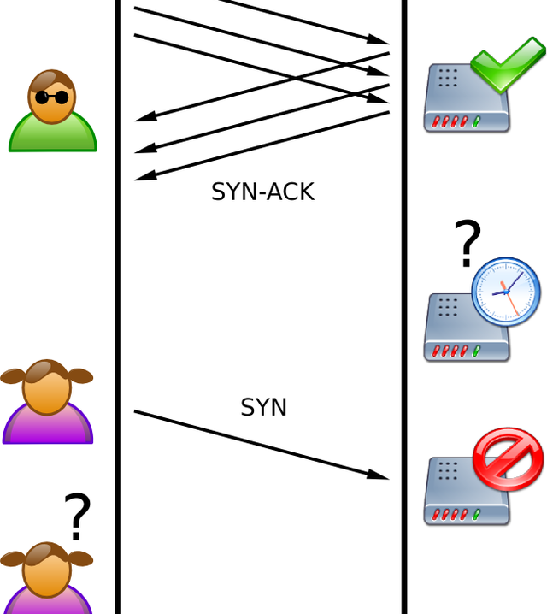
SYN flood
Attacker sends a ton of syn packets but no acks (or can use falsified IP so response will be ignored)
Server must remember all of these connections, so quickly runs out of space

Slide 25
SYN cookies
Invented by Dan Bernstein, the idea defeat SYN floods is to use “particular choices of initial TCP sequence numbers”.
Essentially, the server doesn’t have to remember the connection, but can instead reconstruct the query from the TCP sequence number.
Some restrictions – can’t accept some TCP options, and still some limits, but overall fairly successful.

Slide 26
Denial of service attacks
“Any attack that prevents or impairs the authorized use of networks, systems, or applications by exhausting resources such as CPU, memory, bandwidth, or disk space”
Can be local or network based
A Distributed DOS attack is a network based attack which uses multiple hosts

Slide 27
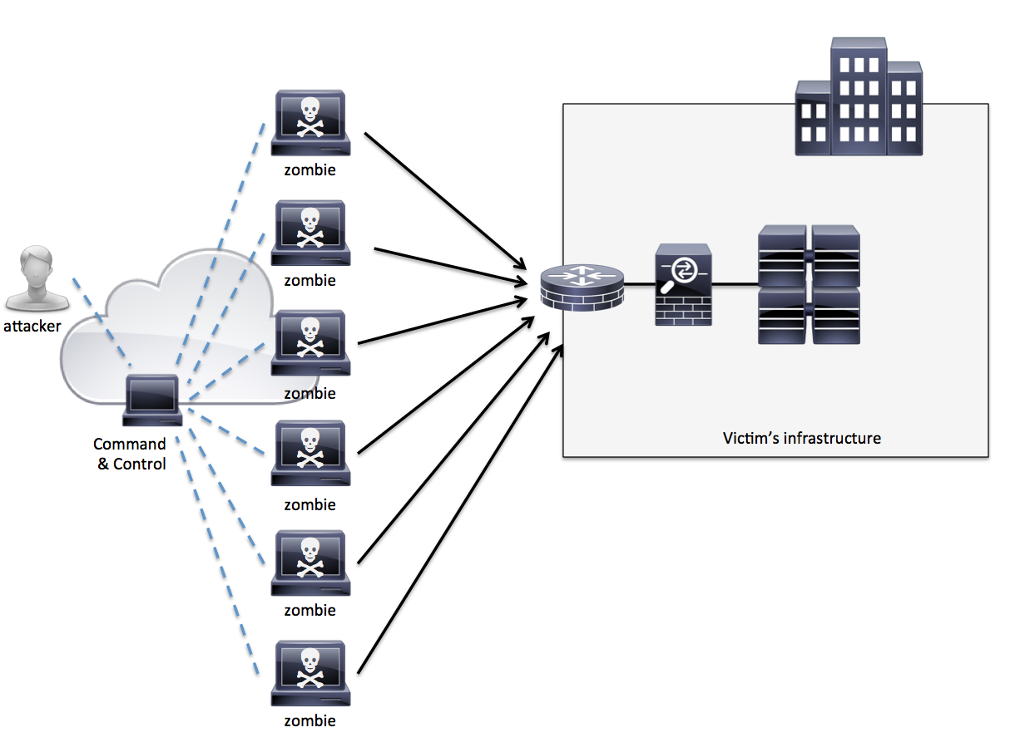
DDoS
Attacker compromises and uses other machines
Can spoof IPs to further complicate
Attack network or host resources
Long and active history…

Slide 28
DDoS reflector attack
Put victims IP as source address in many requests
The “reflector” machines then flood the victim
Advantages:
Hides source
Amplifies the attack
Successfully used many times

Slide 29
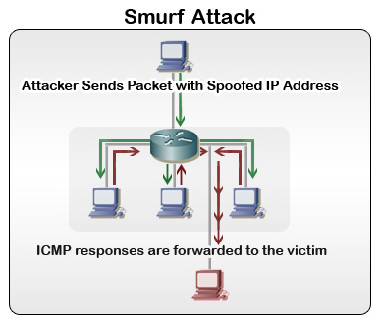
Smurf DoS attack
Attacker sends ICMP packets on broadcast mode with victim’s address as source.
On broadcast mode, everyone will then reply to that IP.

Slide 30
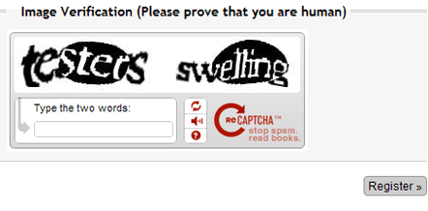
DDoS defenses
Packet filtering and monitoring
Change defaults – no ICMP broadcast anymore (mostly)
Incorporate SYN cookies
ISP filtering and traffic scrubbing
“Overprovision” servers
CAPTCHAs:

Slide 31
Intrusion detection/prevention
Deeper analysis and monitoring of network traffic, with content analysis
Network based
Host Based
Examples:
Snort
Verisys
Tripwire
Etc.

Slide 32
Detection methods
Misuse signature based detection
E.g. SNORT rules
Anomaly detection
Port scan detection
Combine well with firewalls, but usually more complex
Issues of resources and cost, allocation, separation of resources

Slide 33
Evasion techniques
Fragmentation: attack will go “under the radar” and bypass detection
Avoid defaults: IDS may expect trojans on particular ports, so configure to use different ports
Low bandwidth attacks – e.g. stealth port scanning
Address spoofing
Pattern change and evasion

Slide 34
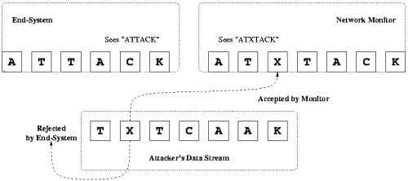
Attacks on NIDS
Insertion attacks:
NID systems actually keep “bad” packets that everyone else drops
This can actually be a vulnerability!

Slide 35
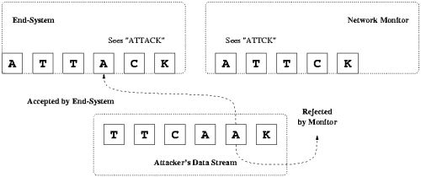
Attacks on NIDS
Evasion attacks:
End system can accept a packet that the NIDS rejects.

Slide 36
Not quite this simple…
In reality, it’s not quite this easy, but these simple ideas have been used in a multitude of ways on different systems.
Examples:
Bad headers
Unusual IP options
Even MAC addresses in the local network

Slide 37
Next time
Higher level protocols and their insecurities: DNS and BGP
Worms and Botnets
Onion routing and higher level (newish) constructions

