Slide 1
Intro to cryptography: Symmetric Encryption

Slide 2
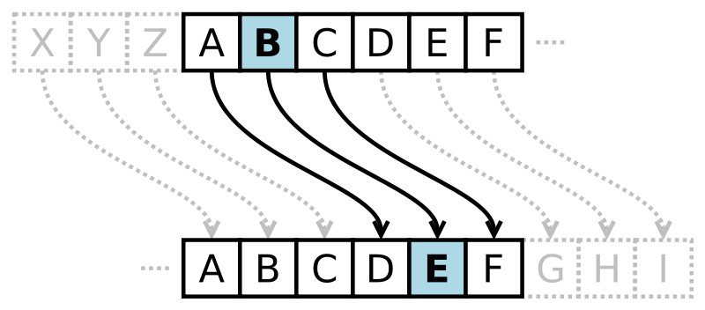
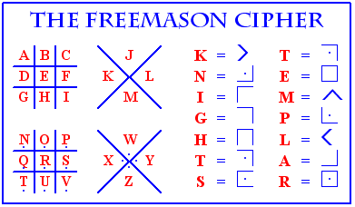
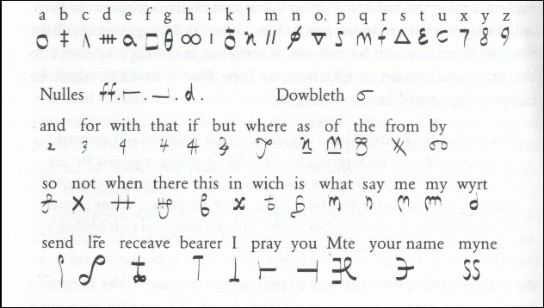
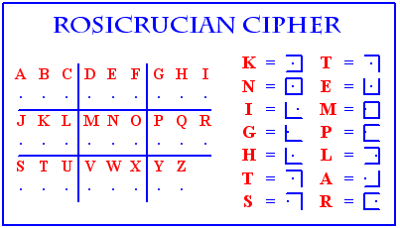
Cryptography
Cryptography is quite old

Slide 3
Code breaking
Common strategies for breaking codes:
Pattern analysis
Frequency analysis
Brute force
Spying or exploiting other human factors
However, the rise of automated encryption (even before the computer) changed the field of cryptography drastically

Slide 4
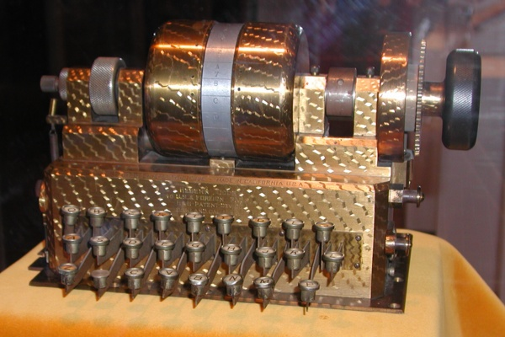
Some history
The rise of automated encryption began with the Herbern rotor in about 1912
First example of an electric system which automatically scrambled input
With every input, the rotor turned, and so the substitution alphabet changed
Not a new concept, but the first time it was automated
Herbern rotor:

Slide 5
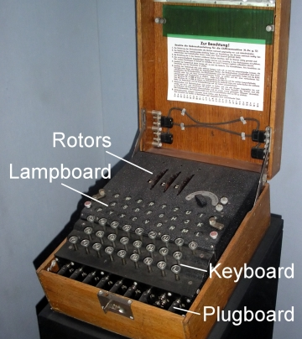
Enigma
Perhaps more famous is the enigma machine, used in WWII
Same basic principle, but had more rotors
Cryptoanalysis attacks become more sophisticated at this point

Slide 6
Modern landscape
Today, 2 main paradigms:
Symmetric encryption
Depends upon a secret, shared key
Examples: DES, AES
Asymmetric encryption
Also called public key cryptography
Examples: Diffie-Hellman key exchange, RSA

Slide 7
3 main goals in cryptographs
Confustion:
obfuscate the relationship between the plain text and the cipher text
Diffusion:
dissipate the redundancy in the plaintext by spreading it throughout the ciphertext
Secrecy:
ONLY in the key!

Slide 8
Case study: CSS
In 1996, DVDs began using the Content Scrambling System to protect from unauthorized copying
Secrecy depending on users not knowing the handshake protocol and where in memeory the keys were stored.
In 1999, a group in Norway reverse engineered it and made DeCSS, a tool to break this encryption

Slide 9
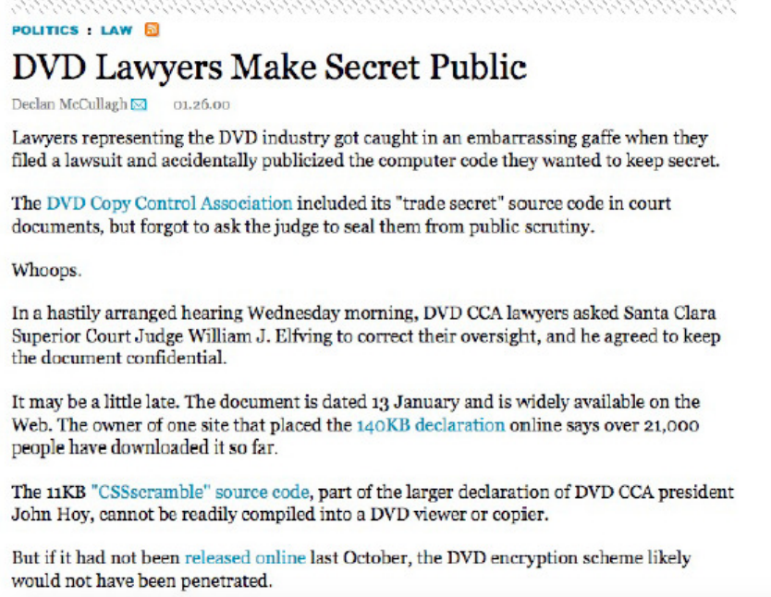
(Even funnier)

Slide 10
Case study: DES
In 1972, the NBS (now NIST – National Institute of Standards and Technology) issued a request for a standard cryptographic protocol
Criteria:
high level of security
completely specified
easy to understand
adaptable
economically implementable
efficient
able to be validated
exportable

Slide 11
Results
The first round resulted in complete failure.
The request was re-issued in 1974
IBM submitted a proposal for what would become DES
Based on Horst Feistel’s Lucifer cipher, developed in 1973-4
Final (modified) version was approved in 1976
The algorithm was slightly changed by the NSA (more on that later…)

Slide 12
Technique
DES encrypts 64 bits of plaintext using a 64 bit key
larger messages are just broken up into chunks of this size
Essential keys: XORs and permutation
Again, the key is the only secret – the algorithm is both simple and well understood

Slide 13
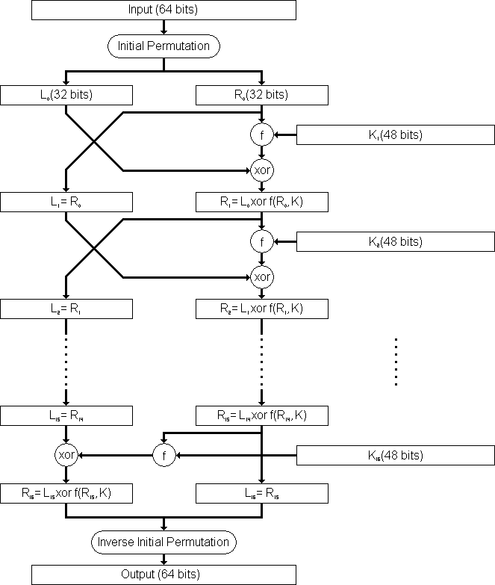
DES steps
Perform an initial permutation
Perform initial key transformation
Perform 16 identical rounds of key-dependent computation using a function f.
Perform inverse initial permutation
(Note: steps 1 and 4 are just necessitated by hardware constraints of the era.)

Slide 14
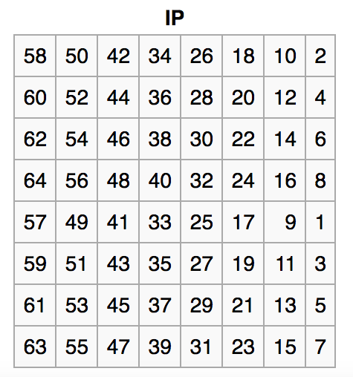
Step 1
The 64 input bits are permuted, using the fixed initial permutation (IP):

Slide 15
Step 2: Key transform
The 64 bit key is then reduced to a 56 bit key by ignoring every 8th bit.
These bits can be used as a parity check to ensure error correction.
After the 56 bit key is extracted, a different 48 bit subkey is generated for each round – called a compression permutation
First, divided into two 28 bit halves, which are shifted left by either two bits each, depending on the round
Then a subkey is chosen – each bit is used in approximately 14 out of the 16 rounds

Slide 16
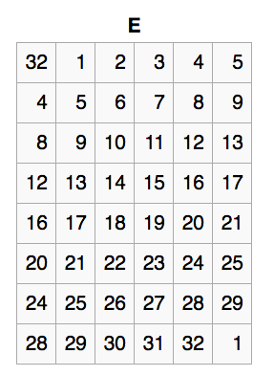
Step 3: Rounds
Given a 48 bit subkey for the round, the algorithm first takes the right half of the 64 bit data and expands it using a set expansion permutation.
makes the right half 48 bits for an XOR and provides a longer result that can be compressed during substitution
more importantly, it diffuses dependency of the output to many (ideally all) input bits

Slide 17
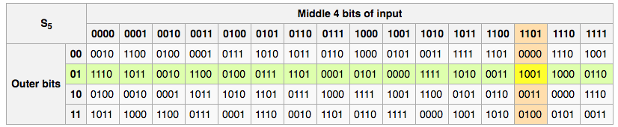
Step 3: Rounds (cont)
The compressed key is the XOR-ed with the expanded block.
Afterwards, the 48 bits move to the substitution boxes, or S-boxes
Each has a 6 bit input and a 4 bit output
8 different x-boxes – example (S5):

Slide 18
More on S-boxes
The S-boxes are the only non-linear portion of DES
In essence, they are the critical step that actually provides encryption and security, since otherwise the algorithm is trivial to break
However, they are fixed, and easy to implement (either in hardware or software) are a result, since they are always the same

Slide 19
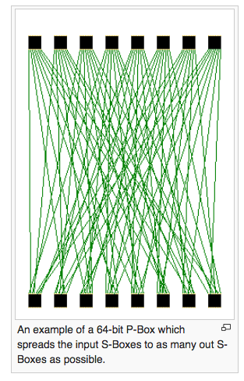
Step 3: Rounds (cont)
Then the output of the S-boxes in a round – a 32-bit result – is permuted according to the P-box.
This is a straight and fixed permutation: no additions or deletions or mixing at all

Slide 20
Step 3: Rounds (cont)
Finally, the output of that 32-bit permutation P-box is XOR-ed with the left half of the input of 64 bits.
remember, we were only working on the right half
The left and right halves then split, and the next round begins

Slide 21
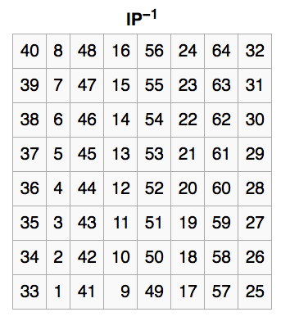
Step 4
Finally, the initial permutation is reversed
(not much to say here…)

Slide 22
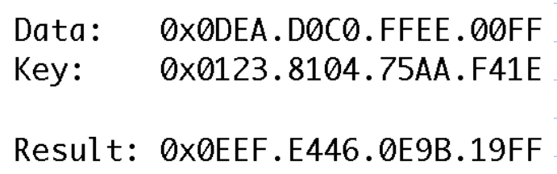
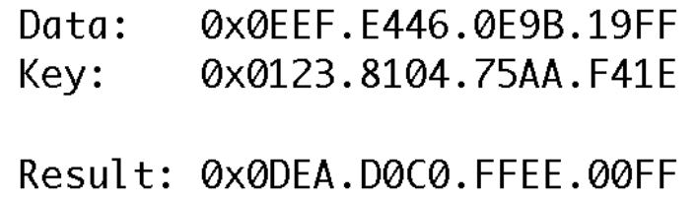
Looks pretty simple!
From the outside:

Slide 23
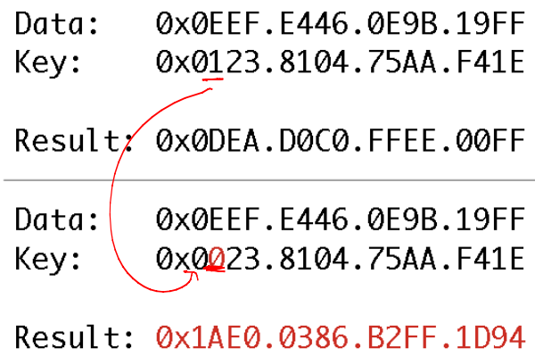
Why it works
Small changes can have big outcomes:

Slide 24
Daily conspiracy tidbit
The S-boxes actually make DES unusually resistant to an attack known as differential cryptanalysis, a technique which was discovered and published in 1990.
IBM later revealed that they knew of this technique, but were asked by the NSA to keep it quiet.
Also, many contend that the NSA changed the S-boxes so that they could break DES traffic more easily.
A senate committee investigated this in the late 70’s, but the details were never released to the public

Slide 25
Cracking DES
In 1990, Biham and Shamir developed (publically) differential cryptanalysis.
The technique considers ciphertext pairs: pairs of ciphertext where the plaintexts have particular differences
In 1992, they broke a ciphertext using 2^47 pairs
In 1994, Matsui used linear cryptanalysis to do better
Only 2^43 pairs needed, and later improved to 2^41
Took 50 days with 12 standard workstations

Slide 26
Final days of DES
In July 1998, the EFF (Electronic Frontier Foundation) built a machine for $250,000 that performed a brute force attack in 56 hours.
So, I some sense, the rise in computational power is what “broke” DES.
In 2002, DES was officially retired
Triple DES (3DES) is still in use, though
Repeat DES 3 times with different keyps
Still in use and pretty secure!
Drawback: very slow

Slide 27
Next: AES
In 1996, NIST issued a call to replace DES
In 1998, 15 algorithms were submitted
NIST then spent years testing these submissions
The winner was Rijndael, developed by 2 Belgian cryptographers.
Officially approved in 2001, and still used as a standard today.
Block length is 128 bits, and key lengths can vary – originally 128, 192, or 256 bits.

Slide 28
Math background
AES operates in a finite field, either Z₁₂₈ or Z₂₅₆.
Definition: Group
a group is a set equipped with an operation (such as addition or multiplication)
The operation must be:
associative, so that a(bc) = (ab)c
have an identity: a*1 = a, or b + 0 = b
and provide inverses: a * 1/a = 1, and b + (-b) = 0

Slide 29
Examples of groups
The real numbers are a group under addition:
Associative:
Identity:
Inverse:
Question: are the reals a group under multiplication?
Question: what about the integers under addition or multiplication?

Slide 30
Def: abelian group
A group where commutativity also holds is an abelian group: so a*b = b*a (and same for addition)
This isn’t always true – think about matrix multiplication, where you can’t swap the order.

Slide 31
Definition: Rings
A ring is a special type of set with two operations (which we’ll call + and *):
Must be an abelian group under +
Must be commutative and associative under * (but might not be a group if no inverse)
the * and + identity are not the same thing
one more rule: x * (y + x) = x*y + x* z
Examples: The reals and the integers are both rings over standard + and *.

Slide 32
Modular arithmetic
Most encryption algorithms work in a special ring – the integers modulo a number
Example: Z₆ is the set {0,1,2,3,4,5}
Can add and take result modulo 3
Can also multiply
Reminder: may not have multiplicative inverses
Can find one for some numbers but not others…

Slide 33
Finally - fields
A field is a ring where we also have multiplicative inverses
If p is a prime, then Z_{p} will be a field, but otherwise it will not
think back to Z₆ on the last slide
So: it turns out most cryptography is done in these finite fields, which is why they’re important to us.

Slide 34
Side not: WHY??
Why not use real numbers??
Why do we like finite fields?
Why are these good for cryptography?

Slide 35
Back to AES
So: AES works over Z₁₂₈, and has 10 rounds (for 128-bit keys) of 4 operations:
Substitute bytes: another S-box
Shift Rows – a permutation step
Mix columns: matrix multiplication
Add round key – an XOR with part of the secret key, which changes each round
Note: order of execution is different for encryption versus decryption

Slide 36
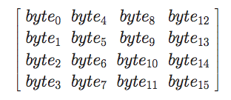
AES (cont)
Think of input as a matrix of bytes, which is called the state array:
in AES, a word is 4 bytes – so each column or row is called a word here
Note: 128 bits total

Slide 37
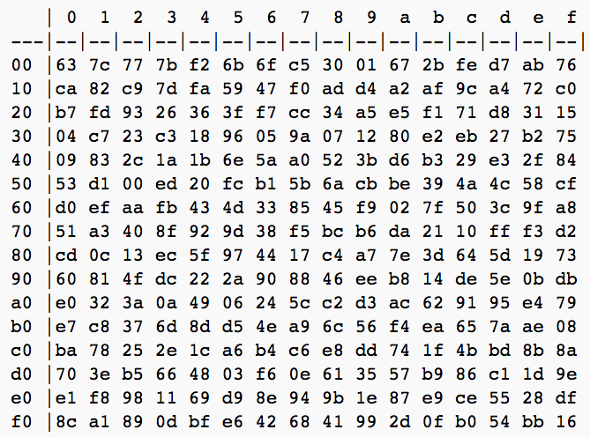
AES: Substitution step
The S-box in hexadecimal:
(Note: there’s some math behind this choice, but it’s easy to implement)

Slide 38
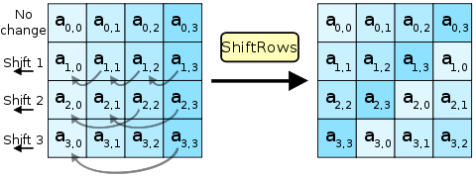
AES: Shiftrows step
Goal here is to mix the bytes in each row of the 4x4 matrix from step 1’s output.

Slide 39
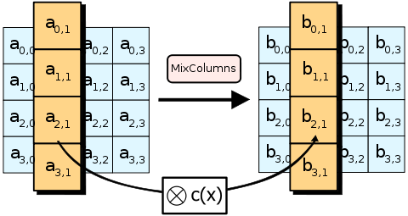
AES: Mix columns step
Goal is to move information in each column
Implemented by applying a particular matrix multiplication to the input
More precisely, each column is treated as a polynomial over a field GF(2⁸), and is then multiplied modulo x⁴+1 with a particular polynomial c(x) = 0x3*x³ + x² + x + 0x02.
(Beyond our scope - go take number theory to find out more!)

Slide 40
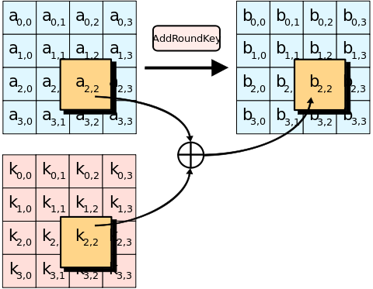
AES: add round key step
In each round, a particular subkey is chosen using Rijndael’s key schedule
The subkey is then XOR-ed with the matrix
(Again, easy to implement, but hard to justify how it was designed!)

Slide 41
AES:
More formally, AES is actually 3 of the Rijndael ciphers (developed by Daemen and Rijmen).
High speed and low RAM requirements were part of the selection process, and since it was made freely available, it is widely used today.
Remarkably secure
Only downside:
Requires a secret key!

Slide 42
Next time: public key encryption
When communicating, agreeing on a secret key is often the hard part
Everyone should use symmetric key encryption always!
But the internet is unsafe, and it’s hard to meet up in person with Amazon’s server so that we can send my credit card number securely
Hence, the rise of public key encryption, which is usually used to agree upon a secret key
However, it’s not generally used for communication beyond that, since it is much easier to crack.

