Slide 1
Botnets Wireless networking Buffer overflows continued

Slide 2
Botnet
Collection of compromised hosts
Spread like worms and viruses
Once installed, respond to remote commands
Platform for many network attacks
Spam forwarding
Click fraud
Keystroke logging
DDoS
Serious problems!
This is the top concern of many businesses like banks and online merchants

Slide 3
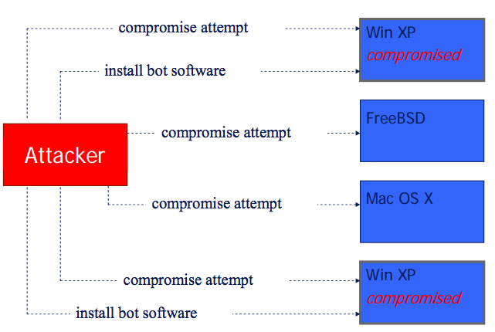
Building a botnet
Try different attacks:

Slide 4
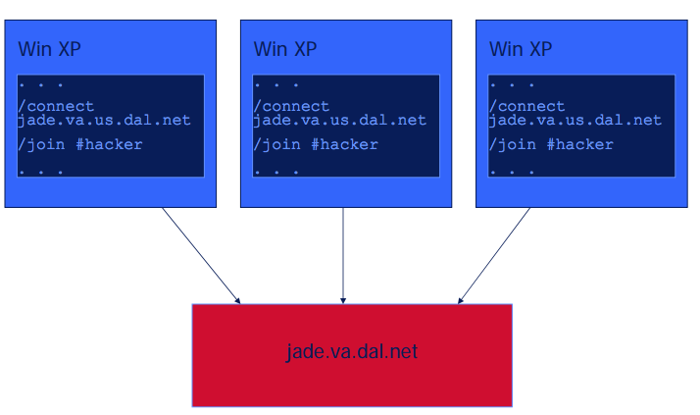
Building a botnet (cont)
Hosts then connect back:

Slide 5
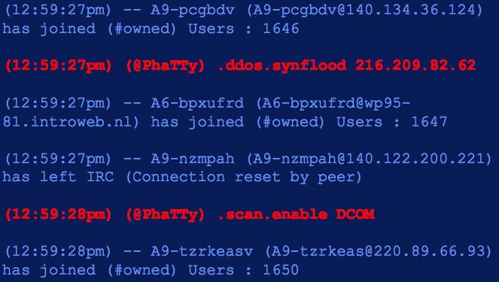
Building a botnet (cont)
And get instructions:

Slide 6
An example botnet: Storm email
Clicking on email or link caused malicious code to be installed
Fake news story on storm, ecard, links to malicious website
Incorporated a quick change to stay ahead of blocking: modified itself every 30 minutes to evade standard signature based monitoring
Infected 1.7 million bots by end of July
P2P architecture instead of centralized
For profit: it sent stock-picking spam, and ripped profits for the risen stocks

Slide 7
Bot detection methods
Signature based (and in most products)
Rule-based
Monitor outbound network connections (like ZoneAlarm) – generally annoying
Block certain ports
Hybrid approach: content based filtering
Match network packets to known command strings
Network monitoring
Bot hunter: correlate various NIDS alarms to identify infection sequence in progress
Recognize traffic patterns associated with infection

Slide 8
Wireless networking
New challenges in wireless:
Easier to sniff packets
Easier to hijack a session
Interloping: connecting through another person’s wifi connection
Authentication: physical presence can’t be assumed as a given in a LAN

Slide 9
Structure
Wifi doesn’t rely on Ethernet protocol at the link layer – instead, protocols defined by the IEEE 802.11 family of standards
Most TCP/IP implementations reframe packets depending on the recipient
So wireless traffic in 802.11 frames is converted to ethernet frames before being passed up the TCP/IP stack
And ethernet frames going to a wireless client are converted to 802.11 frames

Slide 10
Frames in 802.11
Management frames:
Authentication frames: client presents to an access point (AP) to identify itself, and AP replies
If client gets reply, then presents an association request frame, at which point the access point allocates resources
At each stage, the AP replies with an association response frame if successful
Finally, disassociation frames and reassociation frames are used to leave or move between APs.

Slide 11
Other frames
Beacon frame: AP announces its presence and gives necessary connection info to potential clients
Some other management ones, but less relevant for us
Data frames: set up and maintain communications, and actually send content between AP and client

Slide 12
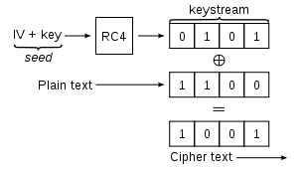
WEP
WEP protocol was built into the original 802.11 standard to address eavesdropping.
Data frames are encrypted using a stream cipher, where ciphertext is generated via an XOR of the plaintext M and a pseudo-random binary vector.
WEP uses RC4, a stream cipher which is simple and fairly efficient.
Seed is obtained by concatenating a 24-bit initialization vector (IV) with the WEP key, a secret key that both parties share.

Slide 13
Issues in WEP
Key started small – only 64 bits (so 40 past the IV), but is now increased to 256.
The same keystream should never be reused, since an attacker can do statistical attacks.
So IV values should never be reused, but this is actually not written into the standard – access points do not reject duplicate IVs,which is a vulnerability that has been used.
WEP also does a CRC-32 checksum, which is the output of a hash function of the message. This protects only against transmission errors, though – and this has also been exploited in attacks.

Slide 14
WEP authentication methods
Open system authentication: the client does not provide credentials and can immediately associate itself to the AP.
However, must have the correct encryption key, or else the AP ignores messages.
Shared Key authentication: the client must prove its possession of the WEP key before associating.
The AP sends a plaintext challenge, who encrypts it and resends.
If it decrypts correctly, then it is allowed to associate.
Open system is actually stronger!
In shared, the message and IV are sent in the clear, so can recover the keystream.

Slide 15
Attacks on WEP
However, even open system, WEP is not secure.
The first few bytes of the RC4 keystream are strongly “non-random”, so attacks can recover information about the key using many ciphertexts.
Not fast – need 40,000 data packets to get a 50% chance of cracking it, but possible in a busy system.
ARP reinjection: Attacker in an open system can assocate, capture a single ARP packet, and resend repeatedly, which generates the necessary amount of traffic quite quickly.

Slide 16
WEP Chop-chop attack
Another attack uses the CRC-32 checksum.
If checksum is incorrect, packet is silently dropped.
Attacker truncates data in the packet by one byte, then corrects checksum by guessing the byte = X.
If x was correct, it will respond.
Enough guesses and the entire keystream is recovered, at which point an ARP packet can be forged, ecrypted with this keystream, and sent in.

Slide 17
WEP caffe latte attack
Commonly used in coffee shops.
Attacker listens to wifi traffic and identifying APs that clients are trying to connect to, and then sets up a honeypot network with the same SSID.
The AP is never questioned in the protocol, so the honeypot takes some initial ARP packets from a client, and then flips bits referring to the sender MAC and IP and does a chop-chop attack.
This results in a valid encrypted ARP to the client, which can be repeatedly sent until enough information is gathered for the WEP key to be broken.
Note: This can be done to break an organization’s key while no where near the AP!

Slide 18
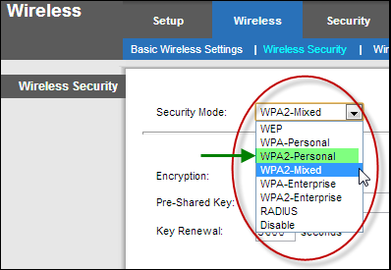
WPA: Wi-Fi Protected Access
More complex authentication scheme:
First generates a shared key for use in generating encryption keys
Then client is authenticated to the AP
Then shared key is used with encryption algorithm to generate keystreams
Two modes: PSK (or personal) and WPA Enterprise
Two protocols for encryption traffic: TKIP and WPA2

Slide 19
WPA PSK or personal
A shared secret key is manually entered into an AP and the client
Weak passwords can be a huge problem here: initial 4 way handshake can be captured and then broken via a dictionary attack
Not really a weakness of the protocol – just a reminder to be careful of passwords!

Slide 20
WPA 802.1x mode, or Enterprise
A third party authentication service is responsible for authenticating client and generating the key.
Several possibilities, governed by the Extensible Authentication Protocol, or EAP
Considered fairly secure

Slide 21
WPA: TKIP versus WPA2
TKIP, or Temporal Key Integrity Protocol, uses the same RC4 that is a problem in WEP
However, stronger implementation: increases the IV length and incorporates a “key-mixing” algorithm, so not simply concatenating
Still potentially vulnerable, but much more secure
WPA2 is based on AES, which (as of now) has not been broken.
Variations of the chop-chop attack have been performed on TKIP, but WPA has better safeguards, so again much more difficult.

Slide 22
Software security
Code can have perfect design and algorithm, but still have implementation vulnerabilities
We will examine common implementation flows
Special focus on language specific issues
C is a special target, but these can happen in various languages
Flaws can be because of libraries, OS, or various other external calls also
Goal: Pretend to be an attacker, and look at how to exploit program bugs

Slide 23
Buffer overflows: simple example
Char buf[80];
void vulnerable() {
gets(buf);
}
gets() reads all input bytes available on stdin, and stores them into buf[]
What if input has more than 80 bytes?
gets writes past the end of buf, overwriting other part of memory
This is a buffer overflow bug
Results:
Core dump (if we’re lucky)
Real vulnerability if not

Slide 24
More complex
Can take into account what other pieces of data are nearby:

Slide 25
Worse example
char buf[80];
int authenticated = 0;
void vulnerable() {
gets(buf);
}
… \\(other code)
A login routine sets authenticated flag only if the user gets the password correct.
Risk?
Where will C store the int authenticated?
So if attacker supplies 81 bytes, and the 81st is set to not be zero, then authenticated is now true!

Slide 26
Even worse!
char buf[80];
int (*fnptr) ();
void vulnerable() {
gets(buf);
}
… \\(other code)
Function pointer fnptr is involved – invoked somewhere else.
What can the attacker do?
Overwrite fnptr with any address, to redirect program execution!
Crafty attacker:
Input contains malicious machine instructions, followed by pointer to overwrite fnptr
When fnptr is next called, flow of control will be redirected to malicious code.
Called a malicious code injection attack.

Slide 27
Buffer overflows
Buffer overflows are by far the most common implementation flaw (or at least used to be)
Web applications arguably have taken over…
C does not guarantee type of length safety
This is deliberate! Very low level language
No bounds checking for array or pointer accesses
Buffer overflow vulnerabilities are the result of this, so that memory accesses can corrupt flow of execution

Slide 28
Exploits
Consider how this could be used:
If a webserver accepts requests from clients and processes them, a buffer overflow in the code can let malicious client gain control
If server is running as root (BAD!), attacker can compromise system and leave a backdoor.
These are especially common in worms, as we saw with the Morris worm last time
That one used such an exploit in finger.

Slide 29
Even supposedly secure code:
What can happen here?
Notes:
Check if buf is NULL, which is good.
But if len is long, then len+2 might overflow – would allocate only a 1 bit array, and memcopy would overflow.

Slide 30
Can these really happen?

