Slide 1

Chapter 13 :: Scripting Languages
Programming Language Pragmatics
Michael L. Scott
Copyright © 2009 Elsevier

Slide 2
What Is A Scripting Language
Modern scripting languages have two principal sets of ancestors.
  command interpreters or “shells” of traditional batch and “terminal” (command-line) computing
    IBM’s JCL, MS-DOS command interpreter, Unix sh and csh
  various tools for text processing and report generation
    IBM’s RPG, and Unix’s sed and awk.
From these evolved
  Rexx, IBM’s “Restructured Extended Executor,” which dates from 1979
  Perl, originally devised by Larry Wall in the late 1980s, and now the most widelyused general purpose scripting language.
  Other general purpose scripting languages include Tcl (“tickle”), Python, Ruby, VBScript (for Windows) and AppleScript (for the Mac)
Copyright © 2009 Elsevier

Slide 3
What Is A Scripting Language
Scripting on Microsoft platforms
  As in several other aspects of computing, Microsoft tends to rely on internally developed technology in the area of scripting languages
  Most scripting applications are based on VBScript - dialect of Visual Basic
  Microsoft has also developed a very general scripting interface (Windows Script) that is implemented uniformly by the operating system, the web server, and the Internet Explorer browser
  A Windows Script implementation of JScript, the company’s version of JavaScript, comes pre-installed on Windows machines, but languages like Perl and Python can be installed as well, and used to drive the same interface.
  Many other Microsoft applications use VBScript as an extension language, but for these the implementation framework (Visual Basic for Applications [VBA]) does not make it easy to use other languages instead
Copyright © 2009 Elsevier

Slide 4
What Is A Scripting Language
Scripting on Microsoft platforms
  Given Microsoft’s share of the desktop computing market, VBScript is one of the most widely used scripting languages
    It is almost never used on other platforms
  Perl, Tcl, Python, PHP, and others see significant use on Windows
    For server-side web scripting, PHP currently predominates: as of February 2005, some 69% of the 59 million Internet web sites surveyed by Netcraft LTD were running the open source Apache web server, and of them most of the ones with active content were using PHP
    Microsoft’s Internet Information Server (IIS) was second to Apache, with 21% of the sites, and many of those had PHP installed as well.
    For client-side scripting, where Internet Explorer controls about 70% of the browser market, most web site administrators need their content to be visible to the other 30%
    Explorer supports JavaScript (JScript), but other browsers do not support VBScript
Copyright © 2009 Elsevier

Slide 5
Common Characteristics:
Both batch and interactive use
  While a few languages (e.g. Perl) have a compiler that requires the entire source program, almost all scripting languages either compile or interpret line by line
  Many “compiled” versions are actually completely equivalent to the interpreter running behind the scenes (like in Python).
Copyright © 2009 Elsevier

Slide 6
Common Characteristics:
Economy of expression
  Two variants: some make heavy use of punctuation and short identifiers (like Perl), while others emphasize “English-like” functionality
Either way, things get shorter. Java versus Python (or Ruby or Perl):
  class Hello {
  public static void main(String[] args) {
  System.out.println(“Hello, world!”);
  }
  print “Hello, world!\n”
Copyright © 2009 Elsevier

Slide 7
Common Characteristics:
Lack of declarations; simple scoping rules.
  While the rules vary, they are generally fairly simple and additional syntax is necessary to alter them.
    In Perl, everything is of global scope by default, but optional parameters can limit the scope to local
    In PHP, everything is local by default, and any global variables must be explicitly imported.
    In Python, everything is local to the block in which the assignment appears, and special syntax is required to assign a variable in a surrounding scope.
Copyright © 2009 Elsevier

Slide 8
Common Characteristics:
Flexible dynamic typing
  In PHP, Python and Ruby, the type of a variable is only checked right before use
  In Perl, Rexx, or Tcl, things are even more dynamic:
  $a = “4”
  print $a . 3 . “\n”
  print $a + 3 . “\n”
  Outputs the following:
  43
  7
Copyright © 2009 Elsevier

Slide 9
Common Characteristics:
Easy access to other programs
  While all languages provide support for OS functionality, scripting languages generally provide amazing and much more fundamental built-in support.
  Examples include directory and file manipulation, I/O modules, sockets, database access, password and authentication support, and network commmunications.
Copyright © 2009 Elsevier

Slide 10
Common Characteristics:
Sophisticated pattern matching and string manipulation
  Perl is perhaps the master of this, but it traces back to the text processing sed/awk ancestry.
  These are generally based on extended regular expression (which we already saw a bit of when using lex at the beginning).
Copyright © 2009 Elsevier

Slide 11
Common Characteristics:
High level data types
  In general, scripting languages provide support for sets, dictionaries, lists and tuples (at a minimum).
  While languages like C++ and Java have these, they usually need to be imported separately.
  Behind the scenes, optimizations like arrays indexed using hash tables are quite common.
  Garbage collection is always automatic, so user never has to deal with heap/stack issues.
Copyright © 2009 Elsevier

Slide 12
Problem Domains
Some general purpose languages—Scheme and Visual Basic in particular—are widely used for scripting
Conversely, some scripting languages, including Perl, Python, and Ruby, are intended by their designers for general purpose use, with features intended to support “programming in the large”
  modules, separate compilation, reflection, program development environments
For the most part, however, scripting languages tend to see their principal use in well defined problem domains
Copyright © 2009 Elsevier

Slide 13
Problem Domains: Scripts
Shell Languages
  They have features designed for interactive use
  Provide a wealth of mechanisms to manipulate file names, arguments, and commands, and to glue together other programs
    Most of these features are retained by more general scripting languages
  We consider a few of them - full details can be found in the bash man page, or in various on-line tutorials:
    Filename and Variable Expansion
    Tests, Queries, and Conditions
    Pipes and Redirection
    Quoting and Expansion
    Functions
    The #! Convention
Copyright © 2009 Elsevier

Slide 14
Scripts
History
  These began as the simple command languages which allowed a user to process punch-cards.
  For example, the control card at the front could indicate that the coming cards were:
    a program to be compiled
    input for a program that had already been compiled
    machine language for the compiler itself
  Control cards later in the deck could be used to:
    check exit status of the program, and decide what to do next
  Lasting effects: In general, no way to backup! Many of these scripting languages have little-to-no iteration.
Copyright © 2009 Elsevier

Slide 15
Scripts
History (cont.)
  Scripting languages gradually become more sophisticated as computers began to time-share.
  In 1964, Pouzin gave a design for a more complex command language, which he called a “shell”.
  This design was the inspiration for Thompson in the design of the Unix shell in 1973.
  In the mid-1970’s, Bourne and Mashey separately added control flow and variables; Bourne’s eventually became the standard in Unix, called sh.
  Most common today is bash, the “Bourne-again” shell, but others still exist: csh, tcsh, ksh, sh…
Copyright © 2009 Elsevier

Slide 16
Scripts: Filename and variable expansion
Wilcard expansion, or “globbing” (after original unix command glob) allow us to get any files matching input constrants.
Examples:
  ls *.pdf
  ls fig?.pdf
  ls fig[0-9].pdf
  ls fig3.{eps,pdf}
More complex:
  for fig in *eps; do ps2pdf $fig; done
  for fig in *.eps
  do
  ps2pdf $fig
  done
Copyright © 2009 Elsevier

Slide 17
Scripts: Tests and Queries
Can modify the previous to only call ps2pdf on missing pdf files.
Example: (-nt checks if left file is newer than right, and % removes the trailing .eps from variable $fig)
  for fig in *.eps
  do
  target = ${fig%.eps}.pdf
  if [$fig -nt $target]
  then
  ps2pdf $fig
  fi
  done
Copyright © 2009 Elsevier

Slide 18
Scripts: Pipes and redirection
Perhaps most significant feature of Unix shell was the ability to chain commands together, “piping” the output of one as the input of another
Example (run in your homework directory): echambe5@turing:~/…/homework$ ls *.pdf | grep hw
hw10.pdf
hw2.pdf
hw4.pdf
hw5.pdf
hw7.pdf
hw8.pdf
Copyright © 2009 Elsevier

Slide 19
Scripts: Pipes and redirection
These can get even more complex:
for fig in *; do echo ${fig%.*}; done | sort -u | wc -l
Explanation:
  The for loop prints the names of all files with extensions removed
  The sort -u removes duplicates
  The wc -l counts the number of lines
Final output: the number of files in our current directory with fig in the title, not distinguishing between files with different extensions but the same line (like file1.eps, file1.pdf, and file1.jpeg).
Copyright © 2009 Elsevier

Slide 20
Scripts: Pipes and redirection
You can also redirect output to a file with > (output to file) or >> (append to a file).
Example: Put a list of figures in a file:
for fig in *; do echo ${fig%.*}; done
| sort -u > all_figs
I often grade homework with <, which reads input from a file (so that I don’t have to type in the same sequence of commands repeatedly).
Copyright © 2009 Elsevier

Slide 21
Scripts: Quotes
Single quotes inhibit expansion and treat interior as a single word, and double quotes treat it as a single word but don’t inhibit expansion.
Example:
foo = bar
single = ‘$foo’
double = “$foo”
echo $single $double
(Prints out: “$foo bar”)
Copyright © 2009 Elsevier

Slide 22
Scripts: Expansion
Commands in {} are treated by bash as a single unit, and are executed in the current shell:
{ date; ls; } >> file_list
Commands in () are passed to subshell for evaluation - using nested dynamic scope - and if they have a $ before, are passed back into context:
for fig in $(cat my_figs)
do
ps2pdf ${fig}.eps
done
Copyright © 2009 Elsevier

Slide 23
Scripts: Expansion
In this example, the spaces are important!
{ date; ls; } >> file_list
Without spaces, this is pattern-based list generation (and again, spaces are important):
prompt$ echo abc{12,34,56} xyz
abc12 abc34 abc56 xyz
prompt$ echo abc{12,34,56} xyz
abc12xyz abc34xyz abc56xyz
Copyright © 2009 Elsevier

Slide 24
Scripts: Functions
Can define your own fuctions, as well.
Example:
function ll () {
ls -l “$@”
}
This allows you to type ll instead of ls -l at the prompt.
In this, $1 would be first parameter, $2 the second, etc, so $@ represents the entire parameter list.
What do the double quotes do again?
Copyright © 2009 Elsevier

Slide 25
Scripts: The !# syntax
To run a script in a file:
. my_script
This reads the input line by line - but it’s not an executable.
Most version of UNIX can make it a script:
  Mark it as executable: i.e. chmod +x my_script
  Begin the script with a control sequence telling it how to run it: #!/bin/bash
This syntax is not just for bash - used also for Perl, Python, etc.
Copyright © 2009 Elsevier

Slide 26
A Python example
#!/usr/bin/python
import sys
import smtplib
import os
import time
# configurations
instructor = 'Erin Chambers'
instructorEmail = 'echambe5@slu.edu'
subject = "CS 344: Grade for Assignment 3"
testonly = False # for testing script
Copyright © 2009 Elsevier

Slide 27
A Python example
# send email to student with copy of the file
def send(email, contents):
# Format the email itself
emailBody = """From: %s <%s>
To: %s
Subject: %s
%s
""" % (instructor, instructorEmail, email, subject, contents)
# send it
message = '\r\n'.join(emailBody.split('\n'))
if testonly:
lines = message.split('\r\n')
for i in range(8):
print lines[i]
return
smtp = smtplib.SMTP('slumailrelay.slu.edu')
smtp.sendmail(instructorEmail, [email], message)
print 'Email has been sent to', email
time.sleep(1) # avoid sending email to quickly
Copyright © 2009 Elsevier

Slide 28
A Python example
if len(sys.argv) != 2:
print 'Usage: sendSLUmail addrbook directory'
exit(1)
# read address book
addressbook = {}
abf = file(sys.argv[1])
for a in abf:
student, address = tuple(a.split())
addressbook[student] = address
# Augment the subject
#subject += sys.argv[2]
Copyright © 2009 Elsevier

Slide 29
A Python example
# get the directory
#directory = "Assignment" + sys.argv[2]
directory = "."
for ent in os.listdir(directory):
cur = ent
if os.path.isdir(cur):
email = addressbook[ent]
resp = cur + '/midsemester.txt'
if os.access(resp, os.R_OK):
# get contents of file
contents = file(resp).read()
send(email, contents)
else:
print ent, "has no Response"
Copyright © 2009 Elsevier

Slide 30
A second domain: text processing
Shell languages are heavily string dominated.
  For example, raw_input in Python defaults to strings, and string manipulation is quite extensive.
However, they are also quite a poor choice for text editing, since common tasks that an editor like vi or emacs can do are not easy to implement.
Examples:
  Insertion
  Deletion
  Search and replace
  Bracket matching
  Forward and backward motion over text
Copyright © 2009 Elsevier

Slide 31
Text processing
Example: Suppose we want to extract all headers from an html page.
Can use an editor to search for each tag, find the matching tag, and delete both of them - but it is tedious.
In sed, this is easy:
  Use pattern matching to find a tag like <h1>
  Delete it in the current line
  Print any lines that don’t have the matching closing tag (like </h1> or </H1>)
  Finally, delete the line minus the closing tag
Copyright © 2009 Elsevier

Slide 32
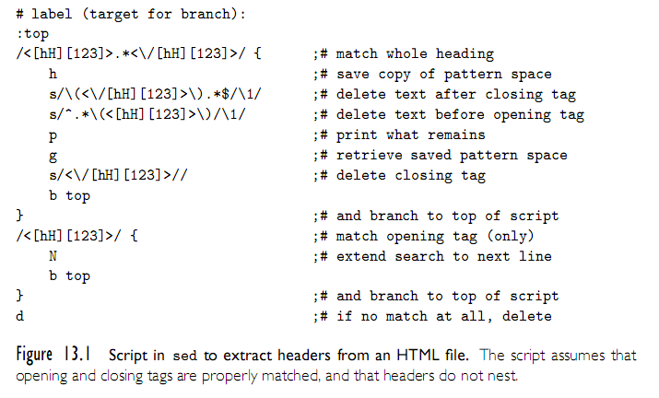
Text processing with Sed
Text Processing and Report Generation
  Sed
Copyright © 2009 Elsevier

Slide 33
Text processing with Sed
Can clearly see the editor heritage here:
  Commands are generally very simple - usually only a single character.
  No real variables beyond the current line being matched.
As a result, sed is quite limited. Generally, used most for simple, 1-line programs.
Example: The following reads from standard input and removes any blank lines:
sed -e’/^[[:space:]]*$d’
Copyright © 2009 Elsevier

Slide 34
Text processing with Awk
Awk was designed in 1977 by Aho, Weinberger and Kernighan to address Sed’s limitations.
This language is the “link” between Sed and the more full-featured scripting languages; still reads one line at a time, but gives better syntax and functionality.
Each program consists of a set of patterns, each of which has an associated action.
Current input line is always $0, and it has functions such as getline and substr(s, a, b).
Also has loops and other basic constructs, and supports regular expressions.
Copyright © 2009 Elsevier

Slide 35
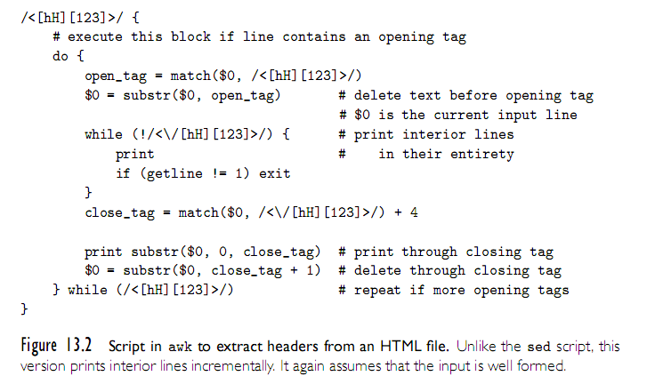
Awk
Text Processing and Report Generation
  Awk
Copyright © 2009 Elsevier

Slide 36
More Awk
Awk’s coolest features are fields and associative arrays.
By default, awk parses each input line into words (called fields), delineated by white space (although you can change this) - a bit like split() in Python.
These fields are pseudovariables available as $1, $2, etc.
Example: awk ‘{print $2}’
  Prints the second word of every line in standard input
Associative arrays are essentially like Python’s dictionaries - you have an array, but no numeric indices.
Copyright © 2009 Elsevier

Slide 37
Awk Example:
BEGIN { #noise words
nw[“a”] = 1; nw[“an”] = 1; nw[“and”] = 1; nw[“but”] = 1; nw[“by”] = 1; nw[“for”] = 1; nw[“from”] = 1; nw[“in”] = 1; nw[“into”] = 1; nw[“of”] = 1; nw[“or”] = 1; nw[“the”] = 1; nw[“to”] = 1;
}
{
for (i=1; i<= NF; i++) {
if (!nw[$i] || i==0 || $(i-1)~/[:-]$/) {
#capitolize the word
$i = toupper(substr($i, 1, 1)) substr($i,2)
}
printf $i “ “;
}
printf “\n”;
}
Copyright © 2009 Elsevier

Slide 38
Text processing: Perl
Perl
  Perl was originally developed by Larry Wall in 1987, while he was working at the NSA
  The original version was an attempt to combine sed, awk, and sh
  It was a Unix-only tool, meant primarily for text processing (the name stands for “practical extraction and report language”)
    over the years Perl has grown into a large and complex language
  Perl is almost certainly the most popular and widely used scripting language
  It is also fast enough for much general purpose use, and includes
    separate compilation, modularization, and dynamic library mechanisms appropriate for large-scale projects
  It has been ported to almost every known operating system
Copyright © 2009 Elsevier

Slide 39
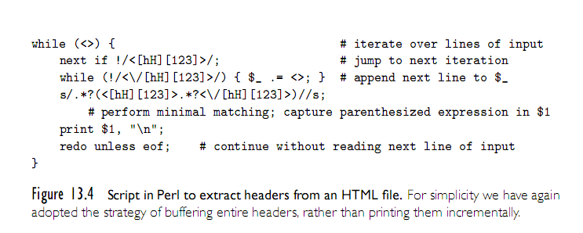
Perl Example
Copyright © 2009 Elsevier

Slide 40
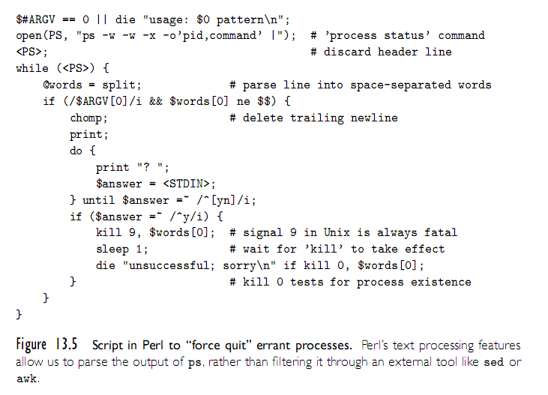
Another Perl Example
Copyright © 2009 Elsevier

Slide 41
Mathematical Languages
While a slightly different setup, it’s worth mentioning the languages that have evolved to serve mathematics and statistics.
Originated in APL, which was designed in the 1960’s to emphasize concise, elegant expressions for mathematical algorithms.
Modern successors: Maple, Matlab, and Mathematica.
  Each of these has its own strengths, but all support numerical methods, symbolic mathematics, mathematical modeling, and real arithmetic.
Copyright © 2009 Elsevier

Slide 42
Statistical Languages
Similarly, S and R evolved to serve the statistics community.
S was designed in the late 1970’s at Bell Labs, and is the dominant commercial language.
R is the (mostly) compatable open-source alternative.
Features:
  Multidimensional array and list types
  Array slices
  Call-by-need parameters
  First-class functions
  Unlimited extent
Copyright © 2009 Elsevier

Slide 43
“Glue” languages
“Glue” Languages and General Purpose Scripting
  Rexx is generally considered the first of the general purpose scripting languages (predating Perl and Tcl by almost a decade, and Ruby and Python by even longer).
  Beyond text processing and shell features, these offer more full-featured scripting languages provide extensive libraries of OS control.
  Examples: File IO, process management, security, network/socket access, timing, synchronization.
  In a sense, just as text-processing mechanisms minimize the need to use external tools like sed, awk, and grep, operating system features built into the language minimize the need for other external interface tools.
  Many also provide higher-level types, such as hashes, tuples, strings, lists, etc., as well as better real-arithmetic support.
  Many even offer threads, first-class or higher-order functions, iterators, and more complex structures.
Copyright © 2009 Elsevier

Slide 44
“Glue” languages: Tcl
Tcl
  Tcl was developed in the late 1980s at UC, Berkeley (Prof. John Ousterhout)
  Over the previous several years his group had developed a suite of VLSI design automation tools, each of which had its own idiosyncratic command language
  The initial motivation for Tcl (“tool command language”) was the desire for an extension language that could be embedded in all the tools, providing them with uniform command syntax and reducing the complexity of development and maintenance
Tcl quickly evolved beyond its emphasis on command extension to encompass “glue” applications as well
  Ousterhout joined Sun Microsystems in 1994, where for three years he led a multiperson team devoted to Tcl development
In comparison to Perl, Tcl is somewhat more verbose
  It makes less use of punctuation, and has fewer special cases
Copyright © 2009 Elsevier

Slide 45
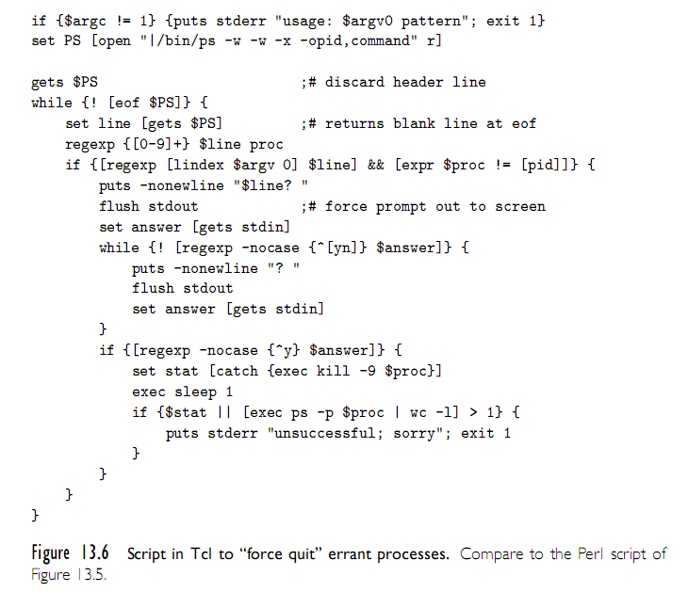
Tcl example
Copyright © 2009 Elsevier

Slide 46
“Glue” languages: Python and Ruby
“Glue” Languages and General Purpose Scripting
  Perl and Tcl are roughly contemporaneous: both were initially developed in the late 1980s
    Perl was originally intended for glue and text processing applications
    Tcl was originally an extension language, but soon grew into glue applications
  Python and Ruby came later, and that extra time is reflected in their design.
  Both really came out of a motivation by their users to “do it the right way”, not because there was no available tool.
Copyright © 2009 Elsevier

Slide 47
“Glue” languages: Python
Python was originally developed by Guido van Rossum at CWI in Amsterdam, the Netherlands, in the early 1990s
  He continued his work at CNRI in Reston, Virginia, beginning in 1995
  In 2000 the Python team moved to BeOpen.com, and to Digital Creations
  Recent versions of the language are owned by the Python Software
    All releases are Open Source.
Python features:
  First fully object-oriented scripting language.
  Standard library is just as rich as Perl, but partitioned into namespaces more like C++ (so that those modules must be imported).
  Perhaps most distinctively (and controversial), cares about indentation.
Copyright © 2009 Elsevier

Slide 48
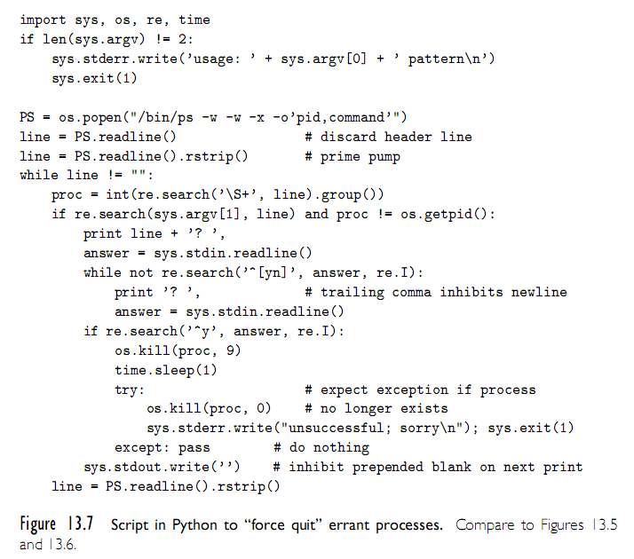
Python Example
Copyright © 2009 Elsevier

Slide 49
“Glue” languages: Ruby
Ruby
  As the popularity of scripting grew in the 1990s, users were motivated to develop additional languages, to provide additional features, address the needs of specific application domains or support a style of programming.
  Developed in 1990 by Matsumoto: “I wanted a language more powerful than Perl, and more object-oriented than Python.”
  Spread rapidly after 2001, partially due to the popular Ruby On Rails web-development framework.
  Notable features:
    Everything is an object (like in Smalltalk).
    Powerful use of blocks and iterators.
    Classes can inherit code from modules (not just other classes).
  See Fig. 13.8 for our same script in Ruby.
Copyright © 2009 Elsevier

Slide 50
Problem Domains
Extension Languages
  Most applications accept some sort of commands
    these commands are entered textually or triggered by user interface events such as mouse clicks, menu selections, and keystrokes
    Commands in a grapical drawing program might save or load a drawing; select, insert, delete, or modify its parts; choose a line style, weight, or color; zoom or rotate the display; or modify user preferences.
  An extension language serves to increase the usefulness of an application by allowing the user to create new commands, generally using the existing commands as primitives.
  Extension languages are increasingly seen as an essential feature of sophisticated tools
    Adobe’s graphics suite (Illustrator, Photoshop, InDesign, etc.) can be extended (scripted) using JavaScript, Visual Basic (on Windows), or AppleScript
    AOLserver, an open-source web server from America On-Line, can be scripted using Tcl. Disney and Industrial Light and Magic use Python to extend their internal (proprietary) tools
Copyright © 2009 Elsevier

Slide 51
Problem Domains
Extension Languages
  To admit extension, a tool must
    incorporate, or communicate with, an interpreter for a scripting language
    provide hooks that allow scripts to call the tool’s existing commands
    allow the user to tie newly de.ned commands to user interface events
  With care, these mechanisms can be made independent of any particular scripting language
  One of the oldest existing extension mechanisms is that of the emacs text editor, used to write this book
    An enormous number of extension packages have been created for emacs; many of them are installed by default in the standard distribution.
    The extension language for emacs is a dialect of Lisp called Emacs Lisp.
    An example script appears in Figure 13.9
      It assumes that the user has used the standard marking mechanism to select a region of text
Copyright © 2009 Elsevier

Slide 52
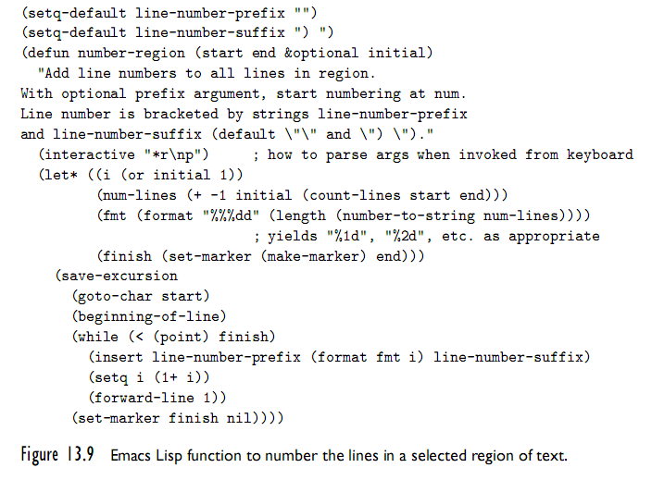
Problem Domains
Copyright © 2009 Elsevier

Slide 53
Scripting the World Wide Web
CGI Scripts
  The original mechanism for server-side web scripting is the Common Gateway Interface (CGI)
  A CGI script is an executable program residing in a special directory known to the web server program
  When a client requests the URI corresponding to such a program, the server executes the program and sends its output back to the client
    this output needs to be something that the browser will understand: typically HTML.
  CGI scripts may be written in any language available
    Perl is particularly popular:
      its string-handling and “glue” mechanisms are suited to generating HTML
      it was already widely available during the early years of the web
Copyright © 2009 Elsevier

Slide 54
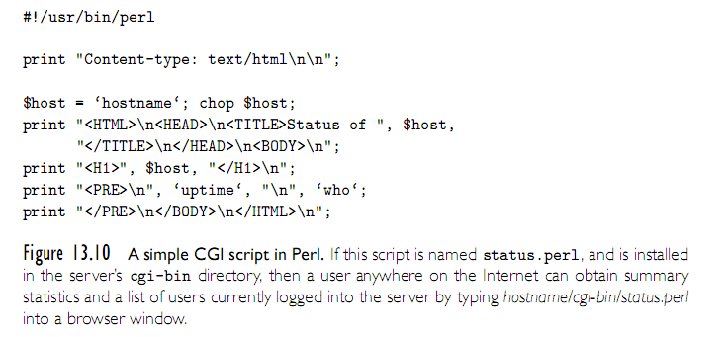
Scripting the World Wide Web
Copyright © 2009 Elsevier

Slide 55
Scripting the World Wide Web
Embedded Server-Side Scripts
  Though widely used, CGI scripts have several disadvantages:
    The web server must launch each script as a separate program, with potentially significant overhead
      Though, CGI script compiled to native code can be very fast once running
    Scripts must generally be installed in a trusted directory by trusted system administrators
      they cannot reside in arbitrary locations as ordinary pages do
    The name of the script appears in the URI, typically prefixed with the name of the trusted directory, so static and dynamic pages look different to end users
    Each script must generate not only dynamic content, but also the HTML tags that are needed to format and display it
      This extra “boilerplate” makes scripts more difficult to write
  Most web servers now provide a “module loading” mechanism that allows interpreters for one or more scripting languages
Copyright © 2009 Elsevier

Slide 56
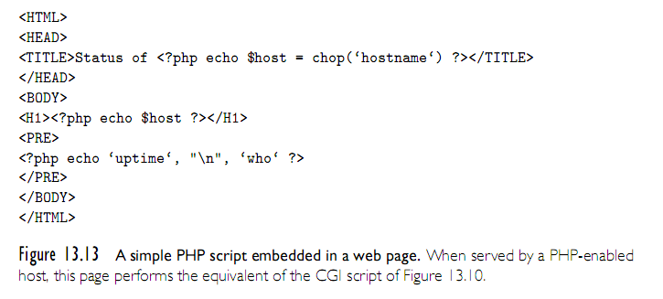
Scripting the World Wide Web
Copyright © 2009 Elsevier

Slide 57
Scripting the World Wide Web
Client-Side Scripts
  embedded server-side scripts are generally faster than CGI script, at least when startup cost predominates
    communication across the Internet is still too slow for interactive pages
  Because they run on the web designer’s site, CGI scripts and, to a lesser extent, embeddable server-side scripts can be written in many different languages
    All the client ever sees is standard HTML.
  Client-side scripts, by contrast, require an interpreter on the client’s machine
    there is a powerful incentive for convergence in client-side scripting languages: most designers want their pages to be viewable by as wide an audience as possible
Copyright © 2009 Elsevier

Slide 58
Scripting the World Wide Web
Client-Side Scripts
  While Visual Basic is widely used within specific organizations, where all the clients of interest are known to run Internet Explorer, pages intended for the general public almost always use JavaScript for interactive features.
Java Applets
  An applet is a program designed to run inside some other program
  The term is most often used for Java programs that display their output in (a portion of) a web page.
  To support execution of applets, most modern browsers contain a Java virtual machine.
Copyright © 2009 Elsevier

Slide 59
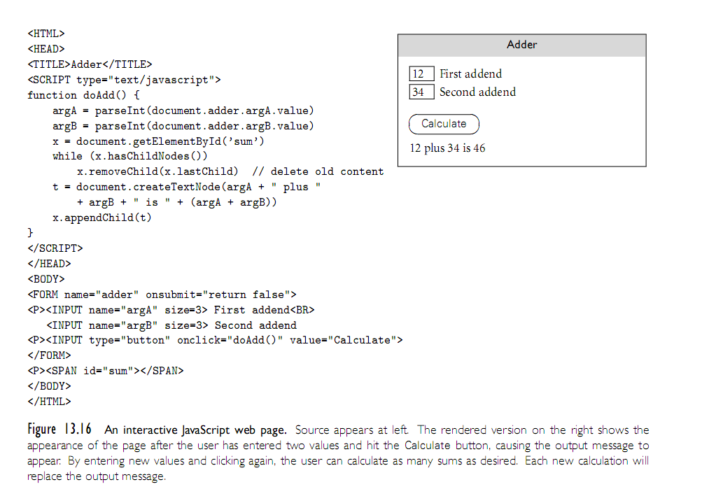
Scripting the World Wide Web
Copyright © 2009 Elsevier

Slide 60
Innovative Features
Earlier we listed several common characteristics of scripting languages:
  both batch and interactive use
  economy of expression
  lack of declarations; simple scoping rules
  flexible dynamic typing
  easy access to other programs
  sophisticated pattern matching and string manipulation
  high level data types
Copyright © 2009 Elsevier

Slide 61
Innovative Features: Scope and Names
Most scripting languages (Scheme is the obvious exception) do not require variables to be declared
  Perl and JavaScript permit optional declarations - sort of compiler-checked documentation
  Perl can be run in a mode (use strict ’vars’) that requires declarations
With or without declarations, most scripting languages use dynamic typing
  The interpreter can perform type checking at run time, or coerce values when appropriate
  Tcl is unusual in that all values—even lists—are represented internally as strings
Copyright © 2009 Elsevier

Slide 62
Innovative Features: nesting and scope
Nesting and scoping conventions vary quite a bit
  Scheme, Python, JavaScript provide the classic combination of nested subroutines and static (lexical) scope
  Tcl allows subroutines to nest, but uses dynamic scope
  Named subroutines (methods) do not nest in PHP or Ruby
    Perl and Ruby join Scheme, Python, and JavaScript in providing firstclass anonymous local subroutines
  Nested blocks are statically scoped in Perl
  In Ruby, they are part of the named scope in which they appear
  Scheme, Perl, Python provide for variables captured in closures
  PHP and the major glue languages (Perl, Tcl, Python, Ruby) all have sophisticated namespace rules
    mechanisms for information hiding and the selective import of names from separate modules
Copyright © 2009 Elsevier

Slide 63
Innovative Features: scope
Undeclared variables with static scope present an interesting issue: how do we know if x is local, global, or in-between (if scopes can nest)?
  In Perl, all variables are global unless otherwise specified.
  In PHP, local unless explicitly imported.
  Ruby has only two levels: $foo is global, foo is local; @foo is instance of current object, and @@foo is instance variable of current object’s class
  In Python, all variables are local by default, unless explicitly imported:
  i=1; j=3
  def outer()
Copyright © 2009 Elsevier

Slide 64
Innovative Features: scope
Scope in Python
  In Python, all variables are local by default, unless explicitly imported:
  i=1; j=3
  def outer():
  def middle(k):
  def inner():
  global i #from main program, not outer
  i = 4
  inner()
  return i,j,k #3 element tuple
  i=2
  return middle(j) #old (global) j
  print outer()
  print i,j
  This prints: (2,3,3)
  4 3
Copyright © 2009 Elsevier

Slide 65
Innovative Features: scope
Scope in Python
  By default, there is no way for a nested scope to write to a non-local or non-global scope - so in previous example, inner could not modify outer’s i variable.
R has an interesting convention:
  Normal assignment puts value into the local variable:
  i <- 4
  Superassignment puts value into whatever variable would be found under normal (static) scoping rules:
  i <<- 4
Tcl uses dynamic scoping, but in an odd way - the programmer must request other scopes explicitly:
upvar i j ;#j is the local name for caller’s I
uplevel 2 {puts [expr $a + $b] }
#executes ‘puts’ two scopes up on dynamic chain
Copyright © 2009 Elsevier

Slide 66
Innovative Features: Pattern matching
Regular expressions are present in many scripting languages and related tools employ extended versions of the notation
  extended regular expressions (which we already saw) in sed and awk, Perl, Tcl, Python, and Ruby
  grep, the stand-alone Unix is a pattern-matching tool, is another useful program that you might be familiair with
In general, two main groups.
  The first group includes awk, egrep (the most widely used of several different versions of grep), the regex routines of the C standard library, and older versions of Tcl
    These implement REs as defined in the POSIX standard
  Languages in the second group follow the lead of Perl, which provides a large set of extensions, sometimes referred to as “advanced REs”
Copyright © 2009 Elsevier

Slide 67
Pattern matching: POSIX REs
Basic operations are familiar:
/ab(cd|ef)g*/ - Matches abcd, abcdg, abefg, abefgg, etc.
Other quantifiers:
  ?: 0 or 1 repetitions
  +: 1 or more repetitions
  {n}: exactly n repetitions
  {n,}: at least n repetitions
  {n,m}: between n and m repetitions
  ^ and $ force the match to be at the beinning or end of the line
  Brackets can indicate a character class: [aeiou] - any vowel
  Ranges: [0-9]
  A dot . matches any single character
  ^ before a character class is negation
Copyright © 2009 Elsevier

Slide 68
Pattern matching: extended REs
Perl adds on to this extensively.
Example:
$_ = “albatross”;
if (/ba.*s+/) … #true
if (/^ba.*s+/) … #false - no match at start
=~ tests if it matches, !~ tests if it does not (or defaults to checking against $_, if not specified)
Substitution is done by s///:
$foo = “albatross”;
$foo =~ s/lbat/c; #now across
Copyright © 2009 Elsevier

Slide 69
Pattern matching: extended REs
Variations on normal REs:
  Trailing i makes the match case insensitive.
  $foo = “Albatross”;
  if ($foo =~ /^al/i) … #true
  Trailing g will replace all occurances.
  $foo = “albatross”;
  $foo =~ s/[aeiou]/-/g … # “-lb-tr-ss”
  Trailing x has Perl ignore all comments and embedded white space in the pattern, so that you can break up long patterns into multiple lines.
Copyright © 2009 Elsevier

Slide 70
Pattern matching: greedy matches
If multiple matches are possible, it will take the “left-most longest” possible one. For example, in the string abcbcbcde, the pattern /(bc)+/ will match abcbcbcde.
This is knows as the “greedy” match.
Other options:
  *? matches the smallest number of instances of the preceeding subexpression that will allow it to succeed.
  +? matches at least one instance, but no more than necessary
  ?? matches either 0 or 1 instance, with a preference for 0
Copyright © 2009 Elsevier

Slide 71
Innovative Features: Data Types
As we have seen, scripting languages don’t generally require (or even permit) the declaration of types for variables
Most perform extensive run-time checks to make sure that values are never used in inappropriate ways
Some languages (e.g., Scheme, Python, and Ruby) are relatively strict about this checking
  When the programmer wants to convert from one type to another, it must say so explicitly
Perl (and likewise Rexx and Tcl) takes the position that programmers should check for the errors they care about
  in the absence of such checks the program should do something reasonable
Copyright © 2009 Elsevier

Slide 72
Innovative Features: Data Types
Numeric types have a bit more variation across languages, but emphasis is universally that the programmer shouldn’t worry about the issue unless necessary.
Won’t say too much here, except be cautious about arithmetic if it matters to your program.
Some of these even store numbers as strings, so calculations may not always be what you expect, although most do a good job of auto-converting if needed.
Copyright © 2009 Elsevier

Slide 73
Innovative Features: Data Types
For composite types, a heavy emphasis is on mappings (also called dictionaries, hashes, or associated arrays).
  Generally these are similar to arrays, but access time depends upon a hash funtion.
  Example:
  director = {}
  director[‘Star Wars’] = ‘George Lucas’
  director[‘The Princess Bride’] = ‘Rob Reiner’
  print director[‘Star Wars’]
  print ‘Buffy’ in director
Behind the scenes, this is actually using a hash function. Still O(1) access time (mostly), but the constant is not nearly as fast as normal array access.
Copyright © 2009 Elsevier

Slide 74
Innovative Features
Object Orientation
  Perl 5 has features that allow one to program in an object-oriented style
  PHP and JavaScript have cleaner, more conventional-looking object-oriented features
    both allow the programmer to use a more traditional imperative style
  Python and Ruby are explicitly and uniformly object-oriented
  Perl uses a value model for variables; objects are always accessed via pointers
  In PHP and JavaScript, a variable can hold either a value of a primitive type or a reference to an object of composite type.
    In contrast to Perl, however, these languages provide no way to speak of the reference itself, only the object to which it refers
Copyright © 2009 Elsevier

Slide 75
Innovative Features
Object Orientation (2)
  Python and Ruby use a uniform reference model
  Classes are themselves objects in Python and Ruby, much as they are in Smalltalk
  They are types in PHP, much as they are in C++, Java, or C#
  Classes in Perl are simply an alternative way of looking at packages (namespaces)
  JavaScript, remarkably, has objects but no classes
    its inheritance is based on a concept known as prototypes
  While Perl’s mechanisms su.ce to create object-oriented programs, dynamic lookup makes
  Both PHP and JavaScript are more explicitly object oriented
Copyright © 2009 Elsevier

