Slide 1
Some History and Perspective

Slide 2
An overview
Throughout the semester, we’ve seen several different languages and paradigms.
However, it is useful to take a step back and look over the history of programming languages, including which features were introduced when (and why).
Take away message: a good programmer should be unfaithful.

Slide 3
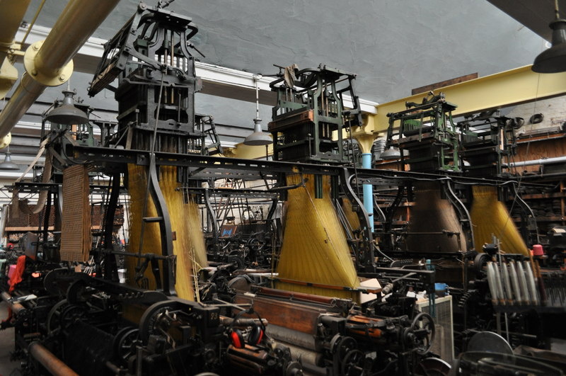
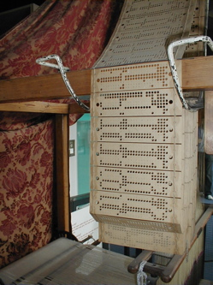
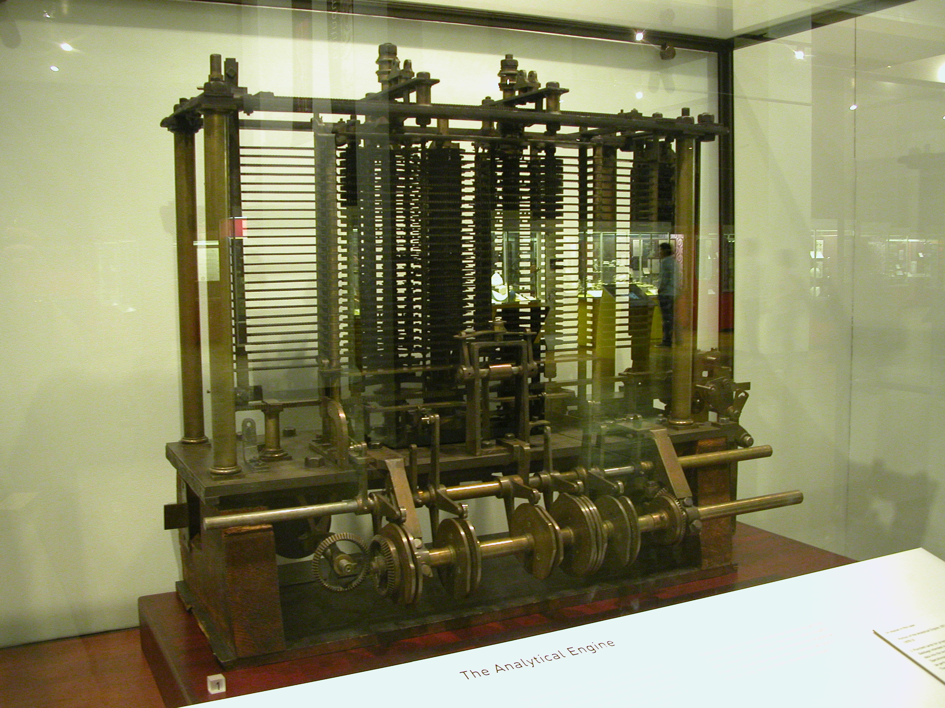
The beginning: before the 1940’s
Early example of what we know think of as “programming” include:
Jaquard’s loom, which used
punch cards to assemble textiles
The Analytical Engine, which was
designed by Charles Babbage and
programmed by Ada Lovelace
_x0016_

Slide 4
Early theoretical modeling
In addition, mathematicians were designing the theoretical concepts necessary to model a computer.
The Turing machine: set the basis for von Neumann architecture, as well as the formal analysis of algorithms
Church’s lambda calculus was the precursor of functional programming
Church-Turing thesis: "It was stated ... that 'a function is effectively calculable if its values can be found by some purely mechanical process.' We may take this literally, understanding that by a purely mechanical process one which could be carried out by a machine. The development ... leads to ... an identification of computability with effective calculability"
_x0016_

Slide 5
The 1940’s
In the 1940’s, machine and assembly languages were designed for the massive computers like ENIAC.
  Each was specific to a single machine.
It quickly became clear that these were quite error-prone.
At this point, the focus remained on the problem being solved - the programming languages were not themselves a focus of study at all.
_x0016_

Slide 6
The 1950’s
In the 1950’s, the firsrt programming languages were designed. The major ones:
Fortran: FORmula TRANslator, designed by Backus et al in 1955.
  Introduced variables, loops, procedures, and much more.
  Also has many awkward features, which unfortunately have stuck around for backward compatibility.
  Still widely used in engineering applications which do lots of array manipulations.
_x0016_

Slide 7
The 1950’s
LISP: LISt Processor, designed by McCarthy et all in 1958
  Based on the concept of computing by evaluating functions. Very good for symbolic computing.
  For years, the only language for Artificial Intelligence work. (Prolog is 12 years younger.)
  Many dialects, two standards (Scheme, Common Lisp). Nice programming environments.
Cobol: COmmon Business Oriented Language, by the Short Range Committee (headed by Grace Hopper), in 1958
  Oriented towards business applications.
  Strict organization with elaborate data structures, and introduced record types for the first time.
  Very poor control structures.
  Most common in government (for a very long time).
_x0016_

Slide 8
1960: Algol
The ALGOL60 report was developed in the late 50’s and published in 1960.
This document (and the resulting languages) introduced two innovations:
  Nested block structure, as well as recursion.
  Lecical scoping (as opposed to a global scope)
In addition, BNF was codified as the primary way to parse expressions.
This report was heavily influential on all later programming languages.
_x0016_

Slide 9
The 1960’s
In 1968, ALGOL 68 was released, which officially implemented the features outlined in the 1960 document.
  In addition, added higher order functions, concurrent and parallel blocks, and automatic type coercion.
  Arguably the most elegant language design.
  Extremely difficult to learn and implement in effectively.
  Comletely unused today.
_x0016_

Slide 10
The 1960’s: others
1964: BASIC
  an easy-to-use language, designed to be the first language for a programmer to learn.
  Somewhat limited, which has been addressed in later versions (which are now much more difficult to use).
1964: PLI
  Combination of Fortran, Algol 60, and Cobol, designed for general purpose use.
  Introduced the concept of event handling.
1967: Simula 67
  An extension of Algol 60 designed for simulation of concurrent processes.
  Introduced the central concepts of object orientation: classes and encapsulation.
  Predecessor of Smalltalk and C++.
_x0016_

Slide 11
C
Developed by Dennis and Ritchie between 1969 and 1973.
The implementation language of Unix.
A great tool for systems programming and a software development language on personal computers.
Once fashionable, still in use, but usually superseded by C++.
Dangerous if not used properly:
not recommended to novice programmers.
Relatively low-level.
_x0016_

Slide 12
Pascal (in 1970)
Originated when Wirth actually walked out of the Algol 68 design committee.
A conceptually simplified and cleaned-up successor of Algol 60.
A great language for teaching structured programming.
An excellent first language to learn: teaches good programming habits.
Its later extensions (for example, Delphi) are full-fledged systems programming packages, as powerful as any Java kit.
_x0016_

Slide 13
Smalltalk: 1972
Designed in Xerox PARC, inspired (due to a bet) by the idea that message passing introduced in Simula could be implemented in “a page of code”.
The purest object-oriented language ever designed - arguably cleaner than Java and much cleaner than C++.
Comes complete with a graphical interface and an integrated programming environment.
In skilled hands, a powerful tool.
_x0016_

Slide 14
Prolog: 1972
The first logical programming language.
Initially aimed at natural language processing, but has grown since then.
Very powerful:
  Non-deterministic (built-in backtracking).
  Elaborate, flexible pattern matching.
  Associative memory.
  Pattern-directed procedure invocation.
In skilled hands, a very strong tool.
_x0016_

Slide 15
ML: 1973
Stands for Meta-Language
Built a polymorphic type system on top of Lisp
The first statically typed functional programming language (and also uses static scoping).
Not purely function - a greater use of side-effects than Haskell or others.
Does not use lazy evaluation.
_x0016_

Slide 16
C++: 1980
First language to combine object orientation with systems programming.
This is a hybrid design, with object orientation added to a completely different base language.
Complicated syntax, difficult semantics.
Very fashionable, very much in demand.
_x0016_

Slide 17
C++: 1980
First language to combine object orientation with systems programming.
This is a hybrid design, with object orientation added to a completely different base language.
Complicated syntax, difficult semantics.
Very fashionable, very much in demand.
_x0016_

Slide 18
1980’s overall trends
One notable development (present in modula, Ada, and ML) is the use of modules.
Allowed more focus on large-scale systems.
Also connected well to general programming constructs.
_x0016_

Slide 19
1980’s overall trends
The concept of RISC architecture also came into being here.
  Main idea: hardware should be designed for compilers, and not for human assembly programmers
This movement brought significant focus on (and funding to) the design of aggressive compilation techniques that utilized better and better processor speeds.
_x0016_

Slide 20
1980’s: other languages
1983: Ada
1984: MATLAB
1987: Perl
1988: Mathematica
This is also when the design for Haskell took place (actually released in 1990).
_x0016_

Slide 21
1990’s: overall trends
Most of the design in the 90’s focused on internet development.
RAD (rapid application development) became a catchphrase.
  In general, object-oriented with IDE’s and garbage collection.
  Also the beginning of scripting languages.
_x0016_

Slide 22
1990’s: languages
1990: Haskell
1991: Python
1991: HTML
1993: Ruby
1995: Java and Javascript
1995: PHP
_x0016_

Slide 23
Java
A neat, cleaned up, sized-down reworking of C++.
Full object orientation (though not as consistent as Smalltalk)
Designed for Internet programming, but general-purpose.
It is said (not quite correctly) to be slow.
The real reason it took off was its early integration with the Netscape Navigator web browser.
_x0016_

Slide 24
Current trends
Concurrent and distributed programming support.
Adding security and reliable verification to older languages.
Integration with databases, including XML.
Open source design philosophy.
Educational initiatives: Squeak and Scratch stand out.
  These even tie in with issues of recruitment and retention, since many complain that the “standard” CS curriculum is designed to help students fail.
_x0016_

