Slide 1
A historical overview
Sources:
Wikipedia
http://archives.cnn.com/2001/TECH/internet/11/19/hack.history.idg/index.html
http://www.sptimes.com/Hackers/history.hacking.html
http://www.centos.org/docs/4/4.5/Security_Guide/s2-sgs-ov-cs-how.html
Various other web sources, both for content and images

Slide 2
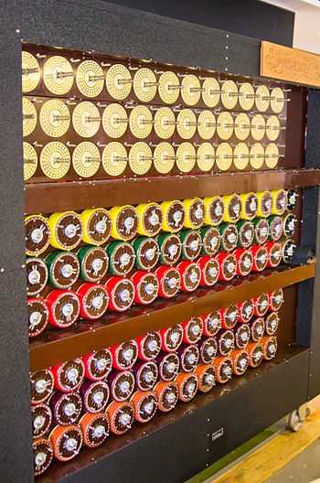
The 1930’s
One of the first relevant “computer” attacks was against the Enigma machine.
Based on the work of Polish cryptologists Rejewski, Zygalski, and Rozycki, researchers at Bletchley Park (including Turing, Welchman and Keen) develop the Bombe.
This was essentially possible because Enigma used a small key space, and they could use brute force.

Slide 3
The 1960’s
The term “hacker” originates, based on a nickname for model train enthusiasts at MIT who hacked their trains to perform better.
Members of this group moved to the mainframe on campus and begin creating shortcuts and customizations.
One of the first reported vulnerabilities is here, on the Multics CTSS running on an IBM 7094. (When multiple instances of a test editor were invoked, the password file would display.)

Slide 4
More in the 1960’s
The DoD creates ARPANet, which is used in research and academia as a way to exchange information. This is the initial carrier network which later became the internet.
Ken Thompson develops UNIX, widely thought of as the most hacker friendly OS because of is accessible tools and supportive user community.
Around the same time, Dennis Ritchie develops C. (Enough said.)

Slide 5
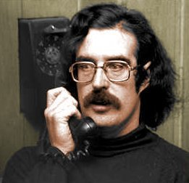
The 1970’s
John Draper, aka “Captain Crunch”, finds a way to fool payphones into allowing free calls.
The article about him in Esquire magazine popularized the “phreaking” movement, which became closely tied to later hacking communities as phone networks because further digitized.

Slide 6
The 1970’s continued
Their success was based on realizing that certain frequencies (notably 2600Hz) would access AT&T’s long distance switching system.
Many clubs form and begin creating “blue boxes” based on the Esquire magazine instructions – including two kids in California who go by “Berkeley Blue” and “Oak Toebark”. (Hint: you’ve heard of these guys.)

Slide 7
More in 1970’s
On the technical side, the telnet protocol for ARPANet gave public access to ARPANet. (Also arguably the most insecure protocol out there!)
Jobs and Wozniak made the first personal computer and began marketing it for home users.
USENET is created, hosting bulletin-board-style (BBS) systems for communications between users. This quickly become the most popular forum for online communication.
Asymmetric encryption is developed (Diffie-Hellman).

Slide 8
The 1980’s: a “golden age”
The advent of the personal computer (closely followed by the modem) in the 1980’s led to a rise in computer hacking groups; the earliest is the Chaos Computer Club (in Germany).
In 1981, the Warelords form (in St. Louis), founded by Black Bark. They broke into many large systems, including the White House and Southwestern Bell.
In 1982, the 414’s broke into 60 computer systems such as Los Alamos to Memorial Sloan-Kettering Cancer Center; this attack led to a Newsweek front cover “Beware: Hackers at Play”, as well as emergency hearings and several new laws.

Slide 9
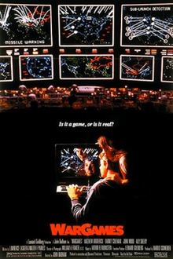
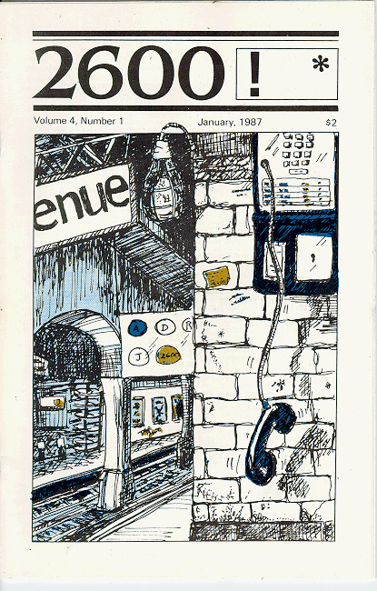
1983-1984
The movie WarGames came out and introduced the hacker phenomenon; mass paranoia about computer vulnerabilities was the main result.
The magazine 2600 began in 1984, followed closely by the online ‘zine Phrack. Both allowed the dissemination of tips and instructions for would-be hackers, as well as address relevant issues and intensifying the subculture.
William Gibson popularized the term “cyberspace” through his science fiction novels.

Slide 10
1986: The Computer Fraud and Abuse Act
The Computer Fraud and Abuse Act finally makes it an outright crime to break into a computer system, punishable by jail time and fines.
However, does NOT cover juveniles.
In the UK, the first conviction occurs for a computer break-in. (It was overrun when appealed, since it was prosecuted under a forgery and counterfeiting act.)

Slide 11
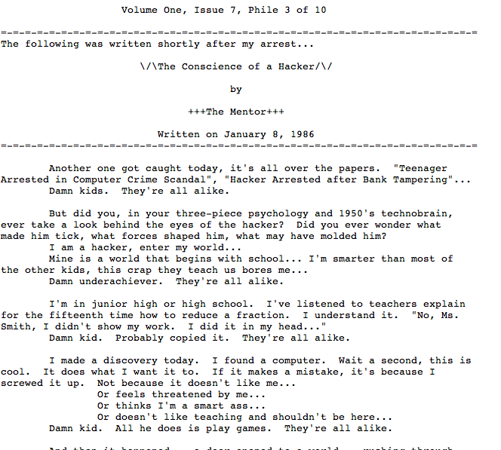
Also in 1986…
The Mentor was arrested, and subsequently wrote an article in Phrack which became famous:
“This is our world now... the world of the electron and the switch, the beauty of the baud. We make use of a service already existing without paying for what could be dirt-cheap if it wasn't run by profiteering gluttons, and you call us criminals. We explore... and you call us criminals. We seek after knowledge... and you call us criminals. We exist without skin color, without nationality, without religious bias... and you call us criminals. You build atomic bombs, you wage wars, you murder, cheat, and lie to us and try to make us believe it's for our own good, yet we're the criminals.”

Slide 12
1988
Robert Morris launched his worm on ARPAnet, providing the first prosecution under the Computer Fraud and Abuse Act. He is sentenced to 3 years probation and a $10,000 fine, and he is dismissed from Cornell.
The Computer Emergency Response Team (CERT) is formed by U.S. defense agencies at Carnegie Mellon University; it is tasked with investigating the growing area of network-based attacks on computers.
Other worms follow, such as Father Christmas.

Slide 13
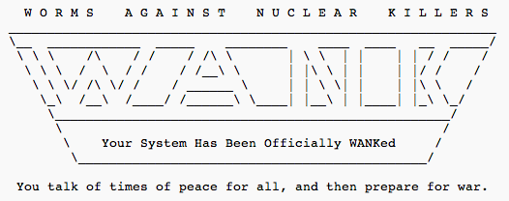
WANK worm: political hacking
The first politically motivated worm was the WANK worm, released in 1989 on the DECnet, primarily the component connecting NASA and DOE.
Never caught the authors, but they were believed to be Australians who went by Electron and Phoenix.

Slide 14
1990: Operation Sundevil
A special team operated by the Secret Service conducts raids in at 14 major cities. Targets include members of the Legion of Doom and other prominent hacking groups.
One target is also Steve Jackson Games. (Ever played Munchkin?) They actually seized a role playing book, GUPRS Cyperpunk, perhaps fearing it was hacking handbook.
This incident directly results in the formation of the Electronic Frontier Foundation (EFF).

Slide 15
1993
Sneakers is released – brings cryptography to the public eye
Hacker Kevin Poulsen (along with friends) rigs a phone system to let in only their calls, and “win” tons of stuff. Poulsen is convicted to 5 years in prison.
The hacking convention Defcon happens in Las Vegas for the first time. (Meant to be a one-time goodbye to BBSs, but it is so popular that it becomes annual.)

Slide 16
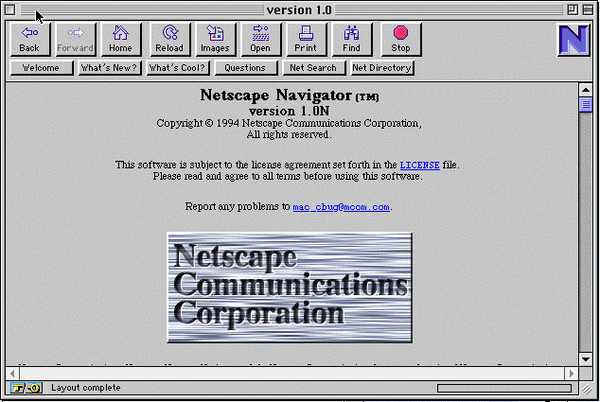
1994: The “web”
A new browser, Netscape Navigator, revolutionizes internet usage. Hackers adopt this new venue and migrate the BBSs over to webpages very quickly.

Slide 17
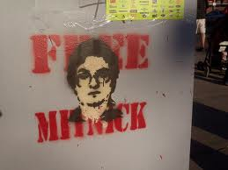
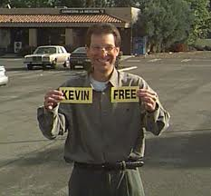
1995
Hackers is released! (A personal favorite)
Perhaps more vitally, the famous hacker Kevin Mitnick is captured and charged with stealing 20,000 credit card numbers. He is kept imprisoned for 4 years without a trial.
Finally sentenced in 1999 and released shorter after.

Slide 18
Cybercrime continues
In 1994-1995, Russian hackers steal over $10 million from Citibank and transfer it all over the world.
The ringleader, Vladimir Levin, used his work laptop after hours to manage the operation.
He is tried in the US and sentenced to 3 years in prison; in addition, authorities recover all but $400,000 of the stolen money.
In 1996, a group of hackers deface the DOJ, CIA, and Air Force websites.
The US General Accounting Office estimates there are 250,000 attempts to break into the Defense department, and estimate that 65% are successful.

Slide 19
More crime
Mp3’s are released and gain popularity in the mid-90’s. This leads to a slew of new filesharing, as well as crackdowns led by the RIAA.
In late 90’s, security goes more mainstream. (Superbowl ads even come out!) The release of Windows 98 leads to a host of publicly shared vulnerabilities.
AOHell, a suite of tools specifically targeting America Online, makes it easy for script kiddies to join the game on their favorite network.

Slide 20
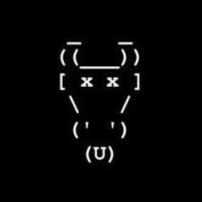
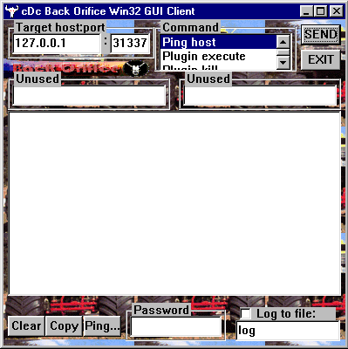
CDC and BackOrifice
In 1998, the Cult of the Dead Cow, a hacking group, released a “trojan horse” program. Once installed on Windows 95 or 98, the program allows unauthorized access (on port 31337, of course).
Humorously, would have made a great remote administration tool if they had only marketed it!

Slide 21
Late 90’s: the government
In May 1998, the members of the group LOpht testify to the US Congressional Government Affairs Committee, stating that they could take down the internet in less than 30 minutes.
A few months later, Janet Reno (the US Attorney General announces the creation of the National Infrastructure Protection Center, which is tasked with protecting the nation’s telecommunications, technology and transportation sectors.
In 1999, President Clinton launched a $1.46 billion initiative to improve computer security in the U.S.

Slide 22
Declaration of War
In 1999, the Legion of the Underground (LoU) declares “war” against Iraq and China because of civil rights violations in those countries.
Shortly after, 2600, the Chaos Computer Club, the CDC, Phrack, LOpht, and several other groups release a joint statement condemning this action:
"One cannot legitimately hope to improve a nation's free access to information by working to disable its data networks.”
The LoU responded by withdrawing their declaration.

Slide 23
More viruses and worms
In 1999, the Melissa virus became the most costly virus to date. (Ran inside Word 97 or 2000.)
Created by David Smith, and not originally intended to cause damage. However, the infected emails from the program overloaded the internet very quickly.
Closely followed by the ILOVEYOU worm, which used VBS in an email attachment to run a program that would propagate the program.
Estimated to cost billions in the US alone.
The two Filipino men who wrote it were released by the local government, since there were no laws against malware at the time. (That quickly changed.)

Slide 24
Developments in law
In 2000, Jonathan James became the first juvenile to be imprisoned for hacking. He served 6 months (followed by 6 months house arrest) after breaking into several government systems, including key NASA systems for the space station.
As an adult, he would have served 10 years, but this still set a precedent for future cases.
In 2001, Russian programmer Dmitry SklyarovDmitry Sklyarov is arrested at the annual Def Con hacker convention. He is the first person criminally charged with violating the Digital Millennium Copyright Act (DMCA).

Slide 25
Microsoft and security
In 2001, Microsoft is the target of a new type of DNS attack. It is caught quickly, but destroys all access to Microsoft websites for several days.
Around the same time, Bill Gates declares that MS will begin securing all products and services, and invests in a large training and quality control campaign (discussed in a previous lecture).
Just a few months later, a paper is released on “shatter attacks”, exploiting a vulnerability in poorly installed applications on Windows. MS comes under fire (again).

Slide 26
Politics again
In 2001, political tensions between Chinese and the US resulted in “The Sixth Cyberware”, where groups from both countries tried to deface websites in the other country.
In 2003, the group Anonymous formed. Originally focused on entertainment, but later (around 2008) began to focus on international “hacktivism”, acting in protest to many different issues.

Slide 27
Export Law
In the U.S., export laws for technology become laughable. Originally set up in the 80’s, technology has far surpassed what is reasonable. (See commercials of the time.)
Encryption law is even further behind; cDc and their offshoot group Hacktivismo are not given permission by Dept. of Commerce to export strong encryption tools until 2003.
Even today, modern trends in development worldwide make enforcing laws quite difficult.

Slide 28
Modern trends
Over the next few years, a long list of worms, attacks, and legal battles continue.
Increasing focus is on credit card numbers and similar personal information, with high profile cases like those targeting Bank of America, Sony, and an Israeli sports web site.
Important trends: mobile devices? Quantum computing?

