Slide 1

Issues in Internet Security

Slide 2
Securing the Internet
How does the internet hold up security-wise?
Not well:
Not very secure
Very prone to failure
Not well regulated
In general, all users should assume things might stop working at any given moment!

Slide 3
The problem
The internet forms a key infrastructure for our society.
Basic unit for multiple systems:
Banking
Electricity, power companies, and other utilities
Water and sewage
Hospitals and medical systems
All of these mean that the internet is a powerful point of failure.

Slide 4
What to do?
In some ways, addressing this question is too broad.
Some steps:
Better awareness of risks
Form better infrastructure
Better government understanding (and yes, even monitoring)
More concretely, identify main points of failure and try to address these issues.

Slide 5
Core Weaknesses
DNS and routing
Privacy
Optional security mechanisms do add security and privacy (such as IPSec).
We’ll look at two more options today.
Physical infrastructure (largely up to companies)
Weaknesses in individual providers (again out of our control)

Slide 6
DNS
The Domain Name System (DNS) is the distributed system for mapping user friendly domain names (such as google.com or mathcs.slu.edu) to the correct IP addresses.
It is hierarchical:
Authoritative name servers “own” a domain
These govern which servers “own” subdomains
Invented in 1983 by Paul Mockapetris; prior to this every computer simply had a file called hosts.txt that stored all computers on the ARPANET.

Slide 7
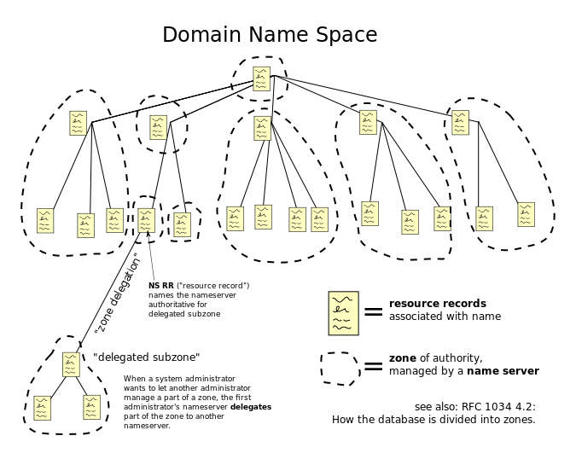
How DNS is managed

Slide 8
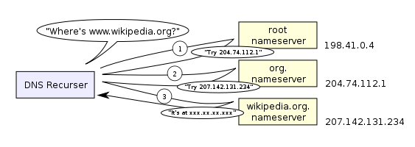
How DNS works

Slide 9
More DNS details
DNS is generally udp based (so not terribly reliable).
To reduce the load on the system, records are cached for some period of time; this is generally a small amount of time, but the protocol supports up to 68 years.
The OS of any computer runs a DNS resolvers that applications hand requests to.
In addition, home users are relying on ISPs setting up a DNS server to track their current IP.
Things can be even more complex; some applications (such as web browsers) even keep their own DNS cache.

Slide 10
DNS details (cont.)
Hostnames and IPs don’t necessarily match 1-1.
For example, often set up a domain name with multiple IPs in order to distribute traffic load.
Also used for email delivery.
Multiple servers are generally provided for each domain to deal with any failures in the system.
Variants such as dynamic DNS (DDNS) allow for rapid update by the hosts (such as for mobile systems).

Slide 11
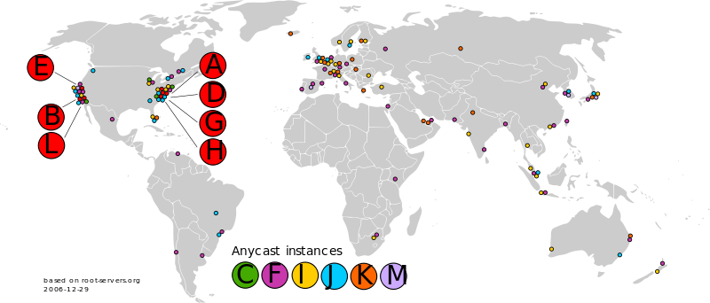
Root servers
At the top level, there are 13 root servers (A-M) somewhere in the world, with additional scattered backups.

Slide 12
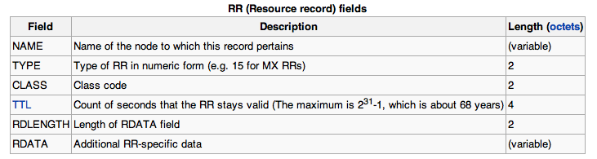
DNS resource records
The data structure that holds the information is called a resource record (often abbreviated RR).
Contains:

Slide 13
Security and DNS
DNS lookups are inherently not secret or secure.
Nothing guarantees information integrity in this system.
This is a problem – the internet depends on this process working correctly!
Obvious availability issues, since these servers going down would disrupt service worldwide.
The server or client could be a threat, since nothing is authenticated in this system.

Slide 14
DNS lookup problems
What can really go wrong?
A DNS answer (coming from a server) could be spoofed by a malicious user.
Relatively easy – it’s UDP, remember?
A DNS server could actually send false data.
DNS databases could be corrupted.

Slide 15
DNSSEC: a solution
The basic concept of DNSSEC is simple – all transactions are “signed” so that you know the correct source is giving you the data.
Two options:
The server responding can “sign”
Or the server that owns the namespace can “sign”
DNSSEC has the server that owns the namespace sign the authenticity of any RR’s giving an address.
Note: not a privacy solution!

Slide 16
Practical implications
Each DNS database must store signatures for RR’s.
Essentially adds several portions to the RR’s, including DNSKEY, RRSIG, etc.
The records have gotten much longer as a result.
ICANN (which manages DNS) signs for itself and top level domains.
Each top level domain signs for domains under it.
And so on down.

Slide 17
An example
Consider mathcs.slu.edu (or 165.134.234.6). Who signs this translation?
The SLU DNS server
And how can we be sure that that is the correct server to sign?
Because the EDU server verifies the SLU server’s signature
Each level leads one step closer to top level ICANN server, and this information lives in DNS databases.
Ideally, every query will begin at the top, so entire chain is authenticated.

Slide 18
Some problems
To use DNSSEC, it must be supported by the DNS server above you (as well as all the others above that).
If no RRSIG comes back in the RR, it could be an error. Or a man-in-the-middle attack. Or a configuration problem along the way.
To be secure, need to check all signatures yourself, but also can have trusted authority check them (and to have secure communication between yourself and authority).

Slide 19
Non-existent records
How can we get a signed record for EVERY possible non-existent name out there, to be sure they actually don’t exist?
Solution: Names are alphabetically ordered. Between any two names, a bunch don’t exist, so we can sign this range of names.
When someone looks up one of these names, we give them a range signature.

Slide 20
For Example
lasr.cs.ucla.edu
131.179.192.136
You get authoritative information that the name isn’t assigned
pelican.cs.ucla.edu
lbsr.cs.ucla.edu –
pd.cs.ucla.edu
131.179.128.17
NOT ASSIGNED
toucan.cs.ucla.edu
131.179.128.16
pelican.cs.ucla.edu
131.179.128.17
toucan.cs.ucla.edu
131.179.128.16
Foils spoofing attacks
> host last.cs.ucla.edu

Slide 21
DNSSEC status
Implementations of DNSSEC are in use, and are heavily promoted (first by DARPA and now by DHS).
ICANN has signed the root, and all the major nodes are done (.com, .gov, .edu, .org, .net)
NOT all signed below, however, and many “island of security” exist in DNS.
These sign for themselves and anyone below.
The utility of DNSSEC ultimately depends on the clients actually checking signatures.

Slide 22
Using DNSSEC
Unfortunately, installing and managing DNSSEC is also fairly difficult.
Particularly hard for domains with lots of things to support, since every new name required lots of new things to sign.
In practice, many things sign certificates for lengthy amounts of time (days or months), which makes hijacking after an update much easier, also.

Slide 23
Privacy
Obviously, DNSSEC does nothing to keep communication secret. DNS is inherently public!
Encryption is the core of how we keep communication secret. So what else should we worry about?
Traffic analysis:
Sometimes, the goal is to hide that we are even talking to each other.
This can be deduced even if our data is encrypted, since routing is a public process.

Slide 24
Location privacy
In addition to knowledge of communication, location information is given away by packet data.
IP addresses often give away a lot of information about where you are.
Mobile devices communicate while you are on the move!
Can be used to get information on our movement and actions, often without our knowledge.
What types of solutions are possible today, given our internet infrastructure?

Slide 25
Anonymizers
Network sites that accept requests from outsiders.
They submit these requests under their own or a fake identity.
Responses are returned to the original requester.
In fact, a NAT box is a simple version of this!
Problem:
The anonymizer knows your identity.
Generally, should not assume this is a reliable source of anonymity, since can be tricked, hacked, or compelled into giving up information.

Slide 26
Onion Routing
Meant to conceal sources and destinations in all traffic.
A group of nodes agree to be onion routers.
The users obtain cryptographic keys for those nodes.
Each packet goes through many hops.
Many users send many packets through the routers, which conceals who is really talking to whom.
Setup for a packet:
Encrypt the packet with the destination’s key.
Wrap that with another packet to another router, encrypted with that router’s key.
Iterate this many times.

Slide 27
A picture:
Source
Destination
Onion routers

Slide 28
What’s Really in the Packet

Slide 29
Delivering the Message

Slide 30
What does this get us?
Assuming it all went right:
Nobody could read our data.
Nobody is sure who sent it (except the receiver).
Nobody is sure who received it (except the sender).

Slide 31
Onion routing issues
Using keys properly
Traffic analysis is still possible
Overhead is a problem
Multiple hops
Multiple encryptions
Limited anti-government possibilities. (In particular, China has a history of disabling these.)
Ethical implications, also.
This makes running botnets much easier.

