Slide 1

Intrusion Detection
Notes:
A significant security problem for networked systems is hostile, or at least unwanted,
trespass by users or software. User trespass can take the form of unauthorized logon
to a machine or, in the case of an authorized user, acquisition of privileges or performance
of actions beyond those that have been authorized. Software trespass can
take the form of a virus, worm, or Trojan horse.
This chapter covers the subject of intruders. We discuss other forms of attack
in subsequent chapters. First, we examine the nature of the intrusion attack and
then look at strategies detecting intrusions.

Slide 2
Intruders
two most publicized threats to security are malware and intruders
generally referred to as a hacker or cracker
Classes (from [ANDE80]:
masquerader
likely to be an outsider
an unauthorized individual who penetrates a system to exploit a legitimate user account
misfeasor
generally an insider
legitimate user who misuses privileges
clandestine user
can be either insider or outsider
individual who seizes supervisory control to evade auditing and access controls or to suppress audit collection
Notes:
One of the two most publicized threats to security is the intruder (the other is
malware), generally referred to as a hacker or cracker. In an important early study
of intrusion, Anderson [ANDE80] identified three classes of intruders:
• Masquerader: An individual who is not authorized to use the computer
and who penetrates a system’s access controls to exploit a legitimate user’s
account
• Misfeasor: A legitimate user who accesses data, programs, or resources for
which such access is not authorized, or who is authorized for such access but
misuses his or her privileges
• Clandestine user: An individual who seizes supervisory control of the system
and uses this control to evade auditing and access controls or to suppress audit
collection
The masquerader is likely to be an outsider; the misfeasor generally is an insider;
and the clandestine user can be either an outsider or an insider.
Intruder attacks range from the benign to the serious. At the benign end of the
scale, there are many people who simply wish to explore internets and see what is
out there. At the serious end are individuals who are attempting to read privileged
data, perform unauthorized modifications to data, or disrupt the system.

Slide 3
Examples of Intrusion
remote root compromise
web server defacement
guessing / cracking passwords
copying databases containing credit card numbers
viewing sensitive data without authorization
running a packet sniffer
distributing pirated software
using an unsecured modem to access internal network
impersonating an executive to get information
using an unattended workstation
Notes:
[GRAN04] lists the following examples of intrusion:
• Performing a remote root compromise of an e-mail server
• Defacing a Web server
• Guessing and cracking passwords
• Copying a database containing credit card numbers
• Viewing sensitive data, including payroll records and medical information,
without authorization
• Running a packet sniffer on a workstation to capture usernames and passwords
• Using a permission error on an anonymous FTP server to distribute pirated
software and music files
• Dialing into an unsecured modem and gaining internal network access
• Posing as an executive, calling the help desk, resetting the executive’s e-mail
password, and learning the new password
• Using an unattended, logged-in workstation without permission

Slide 4
Hackers
motivated by thrill of access and/or status
hacking community is a strong meritocracy
status is determined by level of competence
benign intruders consume resources and slow performance for legitimate users
intrusion detection systems (IDSs) and intrusion prevention systems (IPSs) are designed to help counter hacker threats
intruder problem led to establishment of computer emergency response teams (CERTs)
Notes:
Traditionally, those who hack into computers do so for the thrill of
it or for status. The hacking community is a strong meritocracy in which status
is determined by level of competence. Thus, attackers often look for targets of
opportunity and then share the information with others. A typical example is a
break-in at a large financial institution reported in [RADC04]. The intruder took
advantage of the fact that the corporate network was running unprotected services,
some of which were not even needed. In this case, the key to the break-in was the
pcAnywhere application. The manufacturer, Symantec, advertises this program as
a remote control solution that enables secure connection to remote devices. But the
attacker had an easy time gaining access to pcAnywhere; the administrator used the
same three-letter username and password for the program. In this case, there was
no intrusion detection system on the 700-node corporate network. The intruder was
only discovered when a vice president walked into her office and saw the cursor
moving files around on her Windows workstation.
Benign intruders might be tolerable, although they do consume resources and
may slow performance for legitimate users. However, there is no way in advance to
know whether an intruder will be benign or malign. Consequently, even for systems
with no particularly sensitive resources, there is a motivation to control this problem.
Intrusion detection systems (IDSs) and intrusion prevention systems (IPSs),
of the type described in this chapter and Chapter 9 , respectively, are designed to
counter this type of hacker threat. In addition to using such systems, organizations
can consider restricting remote logons to specific IP addresses and/or use virtual
private network technology.
One of the results of the growing awareness of the intruder problem has been
the establishment of a number of computer emergency response teams (CERTs).
These cooperative ventures collect information about system vulnerabilities and disseminate
it to systems managers. Hackers also routinely read CERT reports. Thus,
it is important for system administrators to quickly install all software patches to
discovered vulnerabilities. Unfortunately, given the complexity of many IT systems,
and the rate at which patches are released, this is increasingly difficult to achieve
without automated updating. Even then, there are problems caused by incompatibilities
resulting from the updated software. Hence the need for multiple layers of
defense in managing security threats to IT systems.

Slide 5
Hacker Patterns of Behavior
1
select the target using IP lookup tools such as NSLookup, Dig, and others
2
map network for accessible services using tools such as NMAP
3
use that password to access remainder of network
4
5
6
7
identify potentially vulnerable services (in this case, pcAnywhere)
brute force (guess) pcAnywhere password
install remote administration tool called DameWare
wait for administrator to log on and capture his password
Notes:
Table 8.1(a)
Hacker Patterns of Behavior

Slide 6
Criminals
organized groups of hackers now a threat
corporation / government / loosely affiliated gangs
typically young
meet in underground forums
common target is credit card files on e-commerce servers
criminal hackers usually have specific targets
once penetrated act quickly and get out
IDS / IPS can be used but less effective
sensitive data should be encrypted
Notes:
Organized groups of hackers have become a widespread and common
threat to Internet-based systems. These groups can be in the employ of a corporation
or government but often are loosely affiliated gangs of hackers. Typically, these
gangs are young, often Eastern European, Russian, or southeast Asian hackers who
do business on the Web [ANTE06]. They meet in underground forums with names
like DarkMarket.org and theftservices.com to trade tips and data and coordinate
attacks. A common target is a credit card file at an e-commerce server. Attackers
attempt to gain root access. The card numbers are used by organized crime gangs
to purchase expensive items and are then posted to carder sites, where others can
access and use the account numbers; this obscures usage patterns and complicates
investigation.
Whereas traditional hackers look for targets of opportunity, criminal hackers
usually have specific targets, or at least classes of targets in mind. Once a site is
penetrated, the attacker acts quickly, scooping up as much valuable information as
possible and exiting.
IDSs and IPSs can also be used for these types of attackers but may be less
effective because of the quick in-and-out nature of the attack. For e-commerce sites,
database encryption should be used for sensitive customer information, especially
credit cards. For hosted e-commerce sites (provided by an outsider service), the
e-commerce organization should make use of a dedicated server (not used to support
multiple customers) and closely monitor the provider’s security services.

Slide 7
Criminal Enterprise Patterns of Behavior
act quickly and precisely to make their activities harder to detect
exploit perimeter via vulnerable ports
use Trojan horses (hidden software) to leave back doors for re-entry
use sniffers to capture passwords
do not stick around until noticed
Notes:
Table 8.1(b)
Criminal Enterprise Patterns of Behavior

Slide 8
Insider Attacks
among most difficult to detect and prevent
employees have access and systems knowledge
may be motivated by revenge/entitlement
employment was terminated
taking customer data when moving to a competitor
IDS / IPS can be useful but also need:
enforcement of least privilege, monitor logs, strong authentication, termination process
Notes:
Insider attacks are among the most difficult to detect and
prevent. Employees already have access and knowledge about the structure and
content of corporate databases. Insider attacks can be motivated by revenge of
simply a feeling of entitlement. An example of the former is the case of Kenneth
Patterson, fired from his position as data communications manager for American
Eagle Outfitters. Patterson disabled the company’s ability to process credit
card purchases during five days of the holiday season of 2002. As for a sense of
entitlement, there have always been many employees who felt entitled to take
extra office supplies for home use, but this now extends to corporate data. An
example is that of a vice president of sales for a stock analysis firm who quit to go
to a competitor. Before she left, she copied the customer database to take with her.
The offender reported feeling no animus toward her former employee; she simply
wanted the data because it would be useful to her.
Although IDS and IPS facilities can be useful in countering insider attacks, other
more direct approaches are of higher priority. Examples include the following:
• Enforce least privilege, only allowing access to the resources employees need
to do their job.
• Set logs to see what users access and what commands they are entering.
• Protect sensitive resources with strong authentication.
• Upon termination, delete employee’s computer and network access.
• Upon termination, make a mirror image of employee’s hard drive before
reissuing it. That evidence might be needed if your company information turns
up at a competitor.

Slide 9
Internal Threat Patterns of Behavior
create network accounts for themselves and their friends
access accounts and applications they wouldn't normally use for their daily jobs
e-mail former and prospective employers
conduct furtive instant-messaging chats
visit web sites that cater to disgruntled employees, such as f'dcompany.com
perform large downloads and file copying
access the network during off hours
Notes:
Table 8.1(c)
Insider Attack Patterns of Behavior

Slide 10
The following definitions from RFC 2828
(Internet Security Glossary)
are relevant to our discussion:
Security Intrusion: A security event, or a combination of multiple security events, that constitutes a security incident in which an intruder gains, or attempts to gain, access to a system (or system resource) without having authorization to do so.
Intrusion Detection : A security service that monitors and analyzes system events for the purpose of finding, and providing real-time or near real-time warning of, attempts to access system resources in an unauthorized manner.
Notes:
The objective of the intruder is to gain access to a system or to increase the range
of privileges accessible on a system. Most initial attacks use system or software
vulnerabilities that allow a user to execute code that opens a back door into the
system. Intruders can get access to a system by exploiting attacks such as buffer
overflows on a program that runs with certain privileges. We examine such software
vulnerabilities in Part Two.
Alternatively, the intruder attempts to acquire information that should have
been protected. In some cases, this information is in the form of a user password.
With knowledge of some other user’s password, an intruder can log in to a system
and exercise all the privileges accorded to the legitimate user. Password guessing
and password acquisition techniques are discussed in Chapter 3 .
The following definitions from RFC 2828 (Internet Security Glossary) are relevant
to our discussion:
Security Intrusion: A security event, or a combination of multiple security
events, that constitutes a security incident in which an intruder gains, or attempts
to gain, access to a system (or system resource) without having authorization
to do so.
Intrusion Detection : A security service that monitors and analyzes
system events for the purpose of finding, and providing real-time or near
real-time warning of, attempts to access system resources in an unauthorized
manner.

Slide 11
Intrusion Detection Systems (IDSs)
host-based IDS
monitors the characteristics of a single host for suspicious activity
network-based IDS
monitors network traffic and analyzes network, transport, and application protocols to identify suspicious activity
comprises three logical components:
sensors - collect data
analyzers - determine if intrusion has occurred
user interface - view output or control system behavior
Notes:
IDSs can be classified as follows:
• Host-based IDS : Monitors the characteristics of a single host and the events
occurring within that host for suspicious activity
• Network-based IDS : Monitors network traffic for particular network segments
or devices and analyzes network, transport, and application protocols
to identify suspicious activity
An IDS comprises three logical components:
• Sensors: Sensors are responsible for collecting data. The input for a sensor
may be any part of a system that could contain evidence of an intrusion. Types
of input to a sensor includes network packets, log files, and system call traces.
Sensors collect and forward this information to the analyzer.
• Analyzers: Analyzers receive input from one or more sensors or from other
analyzers. The analyzer is responsible for determining if an intrusion has
occurred. The output of this component is an indication that an intrusion has
occurred. The output may include evidence supporting the conclusion that an
intrusion occurred. The analyzer may provide guidance about what actions to
take as a result of the intrusion.
• User interface: The user interface to an IDS enables a user to view output
from the system or control the behavior of the system. In some systems, the
user interface may equate to a manager, director, or console component.

Slide 12
IDS Principles
assume intruder behavior differs from legitimate users
overlap in behaviors causes problems
false positives
false negatives
Notes:
Authentication facilities, access control facilities, and firewalls all play a role in
countering intrusions. Another line of defense is intrusion detection, and this has
been the focus of much research in recent years. This interest is motivated by a
number of considerations, including the following:
1. If an intrusion is detected quickly enough, the intruder can be identified and
ejected from the system before any damage is done or any data are compromised.
Even if the detection is not sufficiently timely to preempt the intruder,
the sooner that the intrusion is detected, the less the amount of damage and
the more quickly that recovery can be achieved.
2. An effective IDS can serve as a deterrent, thus acting to prevent intrusions.
3. Intrusion detection enables the collection of information about intrusion techniques
that can be used to strengthen intrusion prevention measures.
Intrusion detection is based on the assumption that the behavior of the intruder
differs from that of a legitimate user in ways that can be quantified. Of course, we
cannot expect that there will be a crisp, exact distinction between an attack by an
intruder and the normal use of resources by an authorized user. Rather, we must
expect that there will be some overlap.
Figure 8.1 suggests, in abstract terms, the nature of the task confronting the
designer of an IDS. Although the typical behavior of an intruder differs from the
typical behavior of an authorized user, there is an overlap in these behaviors. Thus,
a loose interpretation of intruder behavior, which will catch more intruders, will
also lead to a number of false positives , or authorized users identified as intruders.
On the other hand, an attempt to limit false positives by a tight interpretation of
intruder behavior will lead to an increase in false negatives , or intruders not identified
as intruders. Thus, there is an element of compromise and art in the practice of
intrusion detection.
In Anderson’s study [ANDE80], it was postulated that one could, with reasonable
confidence, distinguish between a masquerader and a legitimate user. Patterns
of legitimate user behavior can be established by observing past history, and significant
deviation from such patterns can be detected. Anderson suggests that the task
of detecting a misfeasor (legitimate user performing in an unauthorized fashion) is
more difficult, in that the distinction between abnormal and normal behavior may
be small. Anderson concluded that such violations would be undetectable solely
through the search for anomalous behavior. However, misfeasor behavior might
nevertheless be detectable by intelligent definition of the class of conditions that
suggest unauthorized use. Finally, the detection of the clandestine user was felt to
be beyond the scope of purely automated techniques. These observations, which
were made in 1980, remain true today.

Slide 13
IDS Requirements
run continually
be fault tolerant
resist subversion
impose a minimal overhead on system
configured according to system security policies
adapt to changes in systems and users
scale to monitor large numbers of systems
provide graceful degradation of service
allow dynamic reconfiguration
Notes:
[BALA98] lists the following as desirable for an IDS. It must
• Run continually with minimal human supervision.
• Be fault tolerant in the sense that it must be able to recover from system
crashes and reinitializations.
• Resist subversion. The IDS must be able to monitor itself and detect if it has
been modified by an attacker.
• Impose a minimal overhead on the system where it is running.
• Be able to be configured according to the security policies of the system that is
being monitored.
• Be able to adapt to changes in system and user behavior over time.
• Be able to scale to monitor a large number of hosts.
• Provide graceful degradation of service in the sense that if some components
of the IDS stop working for any reason, the rest of them should be affected as
little as possible.
• Allow dynamic reconfiguration; that is, the ability to reconfigure the IDS
without having to restart it.

Slide 14
Host-Based IDS
adds a specialized layer of security software to vulnerable or sensitive systems
monitors activity to detect suspicious behavior
primary purpose is to detect intrusions, log suspicious events, and send alerts
can detect both external and internal intrusions
Notes:
Host-based IDSs add a specialized layer of security software to vulnerable or
sensitive systems; examples include database servers and administrative systems.
The host-based IDS monitors activity on the system in a variety of ways to detect
suspicious behavior. In some cases, an IDS can halt an attack before any damage
is done, but its primary purpose is to detect intrusions, log suspicious events, and
send alerts.
The primary benefit of a host-based IDS is that it can detect both external and
internal intrusions, something that is not possible either with network-based IDSs
or firewalls.

Slide 15
Host-Based IDS Approaches to Intrusion Detection
anomaly detection
signature detection
threshold detection
involves counting the number of occurrences of a specific event type over an interval of time
profile based
profile of the activity of each user is developed and used to detect changes in the behavior of individual accounts
involves an attempt to define a set of rules or attack patterns that can be used to decide that a given behavior is that of an intruder
Notes:
Host-based IDSs follow one of two general approaches to intrusion detection:
1. Anomaly detection : Involves the collection of data relating to the behavior
of legitimate users over a period of time. Then statistical tests are applied to
observed behavior to determine with a high level of confidence whether that
behavior is not legitimate user behavior. The following are two approaches to
statistical anomaly detection:
a. Threshold detection: This approach involves defining thresholds, independent
of user, for the frequency of occurrence of various events.
b. Profile based: A profile of the activity of each user is developed and used
to detect changes in the behavior of individual accounts.
2. Signature detection : Involves an attempt to define a set of rules or attack patterns
that can be used to decide that a given behavior is that of an intruder.
In essence, anomaly approaches attempt to define normal, or expected, behavior,
whereas signature-based approaches attempt to define proper behavior.
In terms of the types of attackers listed earlier, anomaly detection is effective
against masqueraders, who are unlikely to mimic the behavior patterns of the
accounts they appropriate. On the other hand, such techniques may be unable to
deal with misfeasors. For such attacks, signature-based approaches may be able
to recognize events and sequences that, in context, reveal penetration. In practice,
a system may employ a combination of both approaches to be effective against a
broad range of attacks.

Slide 16
Audit Records
native audit records
multiuser operating systems include accounting software that collects information on user activity
advantage is that no additional collection software is needed
disadvantage is that records may not contain the needed information or in a convenient form
detection-specific audit record
collection facility that generates records containing only information required by the IDS
advantage is that it could be made vendor independent and ported to a variety of systems
disadvantage is the extra overhead of having, in effect, two accounting packages running on a machine
Notes:
A fundamental tool for intrusion detection is the audit record. Some record of
ongoing activity by users must be maintained as input to an IDS. Basically, two
plans are used:
• Native audit records: Virtually all multiuser operating systems include
accounting software that collects information on user activity. The advantage
of using this information is that no additional collection software is needed.
The disadvantage is that the native audit records may not contain the needed
information or may not contain it in a convenient form.
• Detection-specific audit records: A collection facility can be implemented that
generates audit records containing only that information required by the IDS.
One advantage of such an approach is that it could be made vendor independent
and ported to a variety of systems. The disadvantage is the extra overhead
involved in having, in effect, two accounting packages running on a machine.

Slide 17
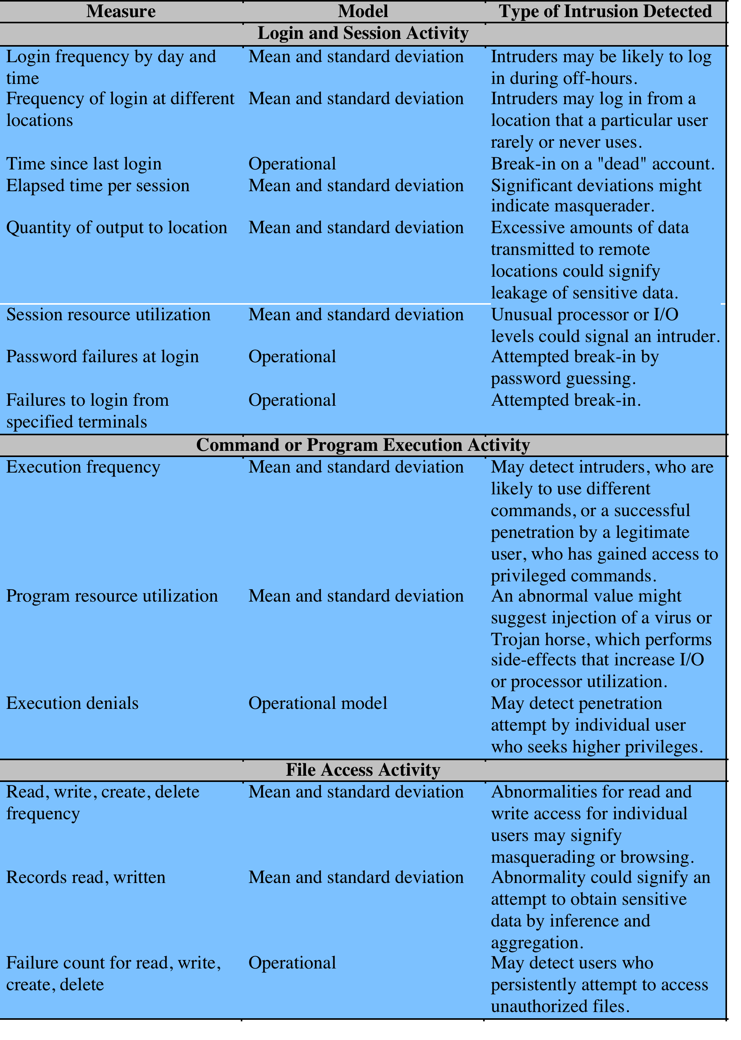
Table 8.2
Measures
That May
Be Used For Intrusion
Detection
Notes:
As an example of the use of these various metrics and models, Table 8.2
shows various measures used for the Stanford Research Institute (SRI) IDS (IDES)
[ANDE95, JAVI91] and the follow-on program Emerald [NEUM99].

Slide 18
Signature Detection
rule-based anomaly detection
historical audit records are analyzed to identify usage patterns
rules are generated that describe those patterns
current behavior is matched against the set of rules
does not require knowledge of security vulnerabilities within the system
a large database of rules is needed
rule-based penetration identification
key feature is the use of rules for identifying known penetrations or penetrations that would exploit known weaknesses
rules can also be defined that identify suspicious behavior
typically rules are specific to the machine and operating system
Notes:
Signature techniques detect intrusion by observing events in the system and applying
a set of rules that lead to a decision regarding whether a given pattern of activity
is or is not suspicious. In very general terms, we can characterize all approaches as
focusing on either anomaly detection or penetration identification, although there is
some overlap in these approaches.
Rule-based anomaly detection is similar in terms of its approach and strengths
to statistical anomaly detection. With the rule-based approach, historical audit
records are analyzed to identify usage patterns and to generate automatically rules
that describe those patterns. Rules may represent past behavior patterns of users,
programs, privileges, time slots, terminals, and so on. Current behavior is then
observed, and each transaction is matched against the set of rules to determine if it
conforms to any historically observed pattern of behavior.
As with statistical anomaly detection, rule-based anomaly detection does not require
knowledge of security vulnerabilities within the system. Rather, the scheme is based on
observing past behavior and, in effect, assuming that the future will be like the past. In
order for this approach to be effective, a rather large database of rules will be needed. For
example, a scheme described in [VACC89] contains anywhere from 10 4 to 10 6 rules.
Rule-based penetration identification takes a very different approach to intrusion
detection. The key feature of such systems is the use of rules for identifying
known penetrations or penetrations that would exploit known weaknesses. Rules
can also be defined that identify suspicious behavior, even when the behavior is
within the bounds of established patterns of usage. Typically, the rules used in
these systems are specific to the machine and operating system. The most fruitful
approach to developing such rules is to analyze attack tools and scripts collected on
the Internet. These rules can be supplemented with rules generated by knowledgeable
security personnel. In this latter case, the normal procedure is to interview
system administrators and security analysts to collect a suite of known penetration
scenarios and key events that threaten the security of the target system.
A simple example of the type of rules that can be used is found in NIDX, an
early system that used heuristic rules that can be used to assign degrees of suspicion
to activities [BAUE88]. Example heuristics are the following:
1. Users should not read files in other users’ personal directories.
2. Users must not write other users’ files.
3. Users who log in after hours often access the same files they used earlier.
4. Users do not generally open disk devices directly but rely on higher-level
operating system utilities.
5. Users should not be logged in more than once to the same system.
6. Users do not make copies of system programs.

Slide 19
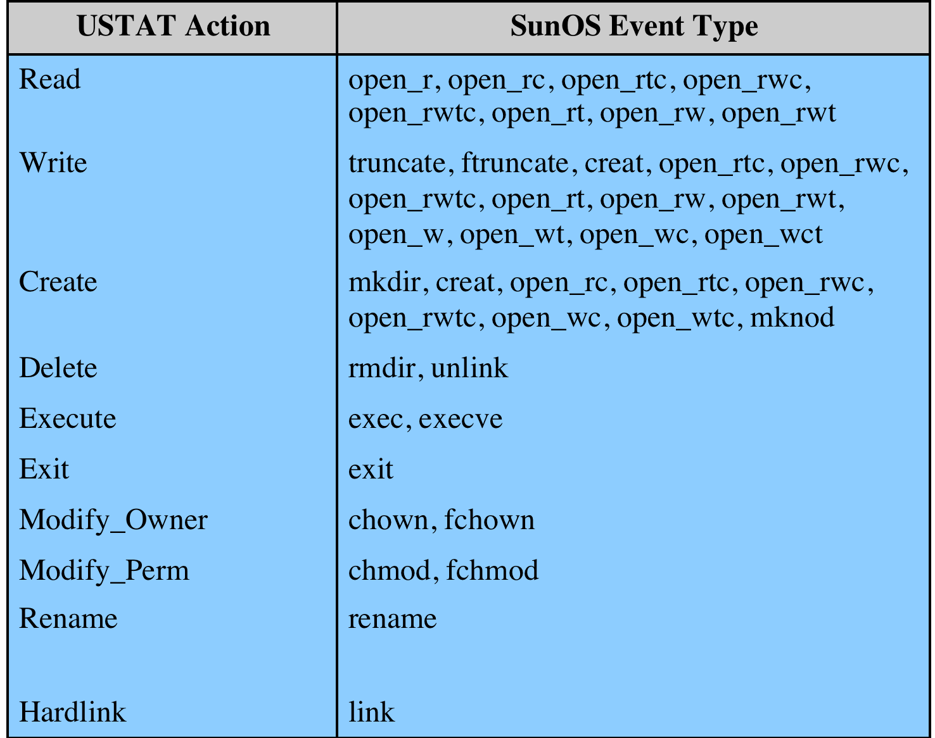
Table 8.3 USTAT Actions vs. SunOS Event Types
Notes:
The penetration identification scheme used in IDES is representative of the
strategy followed. Audit records are examined as they are generated, and they are
matched against the rule base. If a match is found, then the user’s suspicion rating
is increased. If enough rules are matched, then the rating will pass a threshold that
results in the reporting of an anomaly.
The IDES approach is based on an examination of audit records. A weakness
of this plan is its lack of flexibility. For a given penetration scenario, there may
be a number of alternative audit record sequences that could be produced, each
varying from the others slightly or in subtle ways. It may be difficult to pin down
all these variations in explicit rules. Another method is to develop a higher-level
model independent of specific audit records. An example of this is a state transition
model known as USTAT [VIGN02, ILGU95]. USTAT deals in general actions
rather than the detailed specific actions recorded by the UNIX auditing mechanism.
USTAT is implemented on a SunOS system that provides audit records on
239 events. Of these, only 28 are used by a preprocessor, which maps these onto
10 general actions ( Table 8.3 ). Using just these actions and the parameters that are
invoked with each action, a state transition diagram is developed that characterizes
suspicious activity. Because a number of different auditable events map into
a smaller number of actions, the rule-creation process is simpler. Furthermore, the
state transition diagram model is easily modified to accommodate newly learned
intrusion behaviors.

Slide 20
Distributed Host-Based IDS
Notes:
Traditionally, work on host-based IDSs focused on single-system stand-alone facilities.
The typical organization, however, needs to defend a distributed collection
of hosts supported by a LAN or internetwork. Although it is possible to mount a
defense by using stand-alone IDSs on each host, a more effective defense can be
achieved by coordination and cooperation among IDSs across the network.
Porras points out the following major issues in the design of a distributed IDS
[PORR92]:
• A distributed IDS may need to deal with different audit record formats. In a
heterogeneous environment, different systems will employ different native audit
collection systems and, if using intrusion detection, may employ different
formats for security-related audit records.
• One or more nodes in the network will serve as collection and analysis points
for the data from the systems on the network. Thus, either raw audit data or
summary data must be transmitted across the network. Therefore, there is a
requirement to assure the integrity and confidentiality of these data. Integrity
is required to prevent an intruder from masking his or her activities by altering
the transmitted audit information. Confidentiality is required because the
transmitted audit information could be valuable.
• Either a centralized or decentralized architecture can be used. With a centralized
architecture, there is a single central point of collection and analysis of
all audit data. This eases the task of correlating incoming reports but creates
a potential bottleneck and single point of failure. With a decentralized architecture,
there is more than one analysis center, but these must coordinate their
activities and exchange information.
A good example of a distributed IDS is one developed at the University of
California at Davis [HEBE92, SNAP91]; a similar approach has been taken for a
project at Purdue [SPAF00, BALA98]. Figure 8.2 shows the overall architecture,
which consists of three main components:
• Host agent module: An audit collection module operating as a background
process on a monitored system. Its purpose is to collect data on security related
events on the host and transmit these to the central manager.
LAN monitor agent module: Operates in the same fashion as a host agent
module except that it analyzes LAN traffic and reports the results to the central
manager.
• Central manager module: Receives reports from LAN monitor and host
agents and processes and correlates these reports to detect intrusion.

Slide 21
Distributed Host-Based IDS
Notes:
The scheme is designed to be independent of any operating system or system
auditing implementation. Figure 8.3 shows the general approach that is taken. The
agent captures each audit record produced by the native audit collection system. A
filter is applied that retains only those records that are of security interest. These
records are then reformatted into a standardized format referred to as the host
audit record (HAR). Next, a template-driven logic module analyzes the records for
suspicious activity. At the lowest level, the agent scans for notable events that are
of interest independent of any past events. Examples include failed files, accessing
system files, and changing a file’s access control. At the next higher level, the agent
looks for sequences of events, such as known attack patterns (signatures). Finally,
the agent looks for anomalous behavior of an individual user based on a historical
profile of that user, such as number of programs executed, number of files accessed,
and the like.
When suspicious activity is detected, an alert is sent to the central manager.
The central manager includes an expert system that can draw inferences from
received data. The manager may also query individual systems for copies of HARs
to correlate with those from other agents.
The LAN monitor agent also supplies information to the central manager.
The LAN monitor agent audits host-host connections, services used, and volume of
traffic. It searches for significant events, such as sudden changes in network load,
the use of security-related services, and network activities such as rlogin .
The architecture depicted in Figures 8.2 and 8.3 is quite general and flexible.
It offers a foundation for a machine-independent approach that can expand from
stand-alone intrusion detection to a system that is able to correlate activity from
a number of sites and networks to detect suspicious activity that would otherwise
remain undetected.

Slide 22
Network-Based IDS (NIDS)
monitors traffic at selected points on a network
examines traffic packet by packet in real or close to real time
may examine network, transport, and/or application-level protocol activity
comprised of a number of sensors, one or more servers for NIDS management functions, and one or more management consoles for the human interface
analysis of traffic patterns may be done at the sensor, the management server or a combination of the two
Notes:
A network-based IDS (NIDS) monitors traffic at selected points on a network or
interconnected set of networks. The NIDS examines the traffic packet by packet in
real time, or close to real time, to attempt to detect intrusion patterns. The NIDS
may examine network-, transport-, and/or application-level protocol activity. Note
the contrast with a host-based IDS; a NIDS examines packet traffic directed toward
potentially vulnerable computer systems on a network. A host-based system examines
user and software activity on a host.
A typical NIDS facility includes a number of sensors to monitor packet traffic, one
or more servers for NIDS management functions, and one or more management consoles
for the human interface. The analysis of traffic patterns to detect intrusions may
be done at the sensor, at the management server, or some combination of the two.

Slide 23
NIDS Sensor Deployment
inline sensor
inserted into a network segment so that the traffic that it is monitoring must pass through the sensor
passive sensors
monitors a copy of network traffic
Notes:
Sensors can be deployed in one of two modes: inline and passive. An inline
sensor is inserted into a network segment so that the traffic that it is monitoring
must pass through the sensor. One way to achieve an inline sensor is to combine
NIDS sensor logic with another network device, such as a firewall or a LAN
switch. This approach has the advantage that no additional separate hardware
devices are needed; all that is required is NIDS sensor software. An alternative
is a stand-alone inline NIDS sensor. The primary motivation for the use of
inline sensors is to enable them to block an attack when one is detected. In this
case the device is performing both intrusion detection and intrusion prevention
functions.
More commonly, passive sensors are used. A passive sensor monitors a
copy of network traffic; the actual traffic does not pass through the device. From
the point of view of traffic flow, the passive sensor is more efficient than the
inline sensor, because it does not add an extra handling step that contributes to
packet delay.
Figure 8.4 illustrates a typical passive sensor configuration. The sensor connects
to the network transmission medium, such as a fiber optic cable, by a direct
physical tap. The tap provides the sensor with a copy of all network traffic being
carried by the medium. The network interface card (NIC) for this tap usually does
not have an IP address configured for it. All traffic into this NIC is simply collected
with no protocol interaction with the network. The sensor has a second NIC that
connects to the network with an IP address and enables the sensor to communicate
with a NIDS management server.

Slide 24
Notes:
Consider an organization with multiple sites, each of which has one or more LANs,
with all of the networks interconnected via the Internet or some other WAN
technology. For a comprehensive NIDS strategy, one or more sensors are needed
at each site. Within a single site, a key decision for the security administrator is the
placement of the sensors.
Figure 8.5 illustrates a number of possibilities. In general terms, this configuration
is typical of larger organizations. All Internet traffic passes through an external firewall
that protects the entire facility. Traffic from the outside world, such as customers and
vendors that need access to public services, such as Web and mail, is monitored. The
external firewall also provides a degree of protection for those parts of the network
that should only be accessible by users from other corporate sites. Internal firewalls
may also be used to provide more specific protection to certain parts of the network.
A common location for a NIDS sensor is just inside the external firewall
( location 1 in the figure). This position has a number of advantages:
• Sees attacks, originating from the outside world, that penetrate the network’s
perimeter defenses (external firewall).
• Highlights problems with the network firewall policy or performance.
• Sees attacks that might target the Web server or ftp server.
• Even if the incoming attack is not recognized, the IDS can sometimes recognize
the outgoing traffic that results from the compromised server.
Instead of placing a NIDS sensor inside the external firewall, the security
administrator may choose to place a NIDS sensor between the external firewall and
the Internet or WAN ( location 2 ). In this position, the sensor can monitor all network
traffic, unfiltered. The advantages of this approach are as follows:
• Documents number of attacks originating on the Internet that target the network
• Documents types of attacks originating on the Internet that target the network
A sensor at location 2 has a higher processing burden than any sensor located
elsewhere on the site network.
In addition to a sensor at the boundary of the network, on either side of the
external firewall, the administrator may configure a firewall and one or more sensors
to protect major backbone networks, such as those that support internal servers
and database resources ( location 3 ). The benefits of this placement include the
following:
• Monitors a large amount of a network’s traffic, thus increasing the possibility
of spotting attacks
• Detects unauthorized activity by authorized users within the organization’s
security perimeter
Thus, a sensor at location 3 is able to monitor for both internal and external
attacks. Because the sensor monitors traffic to only a subset of devices at the site, it can
be tuned to specific protocols and attack types, thus reducing the processing burden.
Finally, the network facilities at a site may include separate LANs that support
user workstations and servers specific to a single department. The administrator
could configure a firewall and NIDS sensor to provide additional protection for
all of these networks or target the protection to critical subsystems, such as personnel
and financial networks ( location 4 ). A sensor used in this latter fashion provides
the following benefits:
• Detects attacks targeting critical systems and resources
• Allows focusing of limited resources to the network assets considered of
greatest value
As with a sensor at location 3, a sensor at location 4 can be tuned to specific
protocols and attack types, thus reducing the processing burden.

Slide 25
Intrusion Detection Techniques
signature detection
at application, transport, network layers; unexpected application services, policy violations
anomaly detection
denial of service attacks, scanning, worms
when a sensor detects a potential violation it sends an alert and logs information related to the event
used by analysis module to refine intrusion detection parameters and algorithms
security administration can use this information to design prevention techniques
Notes:
As with host-based intrusion detection, network-based intrusion detection makes
use of signature detection and anomaly detection.
SIGNATURE DETECTION [SCAR07] lists the following as examples of that types of
attacks that are suitable for signature detection:
• Application layer reconnaissance and attacks: Most NIDS technologies
analyze several dozen application protocols. Commonly analyzed ones include
Dynamic Host Configuration Protocol (DHCP), DNS, Finger, FTP, HTTP,
Internet Message Access Protocol (IMAP), Internet Relay Chat (IRC),
Network File System (NFS), Post Office Protocol (POP), rlogin/rsh, Remote
Procedure Call (RPC), Session Initiation Protocol (SIP), Server Message
Block (SMB), SMTP, SNMP, Telnet, and Trivial File Transfer Protocol
(TFTP), as well as database protocols, instant messaging applications, and
peer-to-peer file sharing software. The NIDS is looking for attack patterns
that have been identified as targeting these protocols. Examples of attack include
buffer overflows, password guessing, and malware transmission.
• Transport layer reconnaissance and attacks: NIDSs analyze TCP and UDP
traffic and perhaps other transport layer protocols. Examples of attacks are
unusual packet fragmentation, scans for vulnerable ports, and TCP-specific
attacks such as SYN floods.
• Network layer reconnaissance and attacks: NIDSs typically analyze IPv4,
ICMP, and IGMP at this level. Examples of attacks are spoofed IP addresses
and illegal IP header values.
• Unexpected application services: The NIDS attempts to determine if the
activity on a transport connection is consistent with the expected application
protocol. An example is a host running an unauthorized application service.
• Policy violations: Examples include use of inappropriate Web sites and use of
forbidden application protocols.
ANOMALY DETECTION TECHNIQUES [SCAR07] lists the following as examples of
that types of attacks that are suitable for anomaly detection:
• Denial-of-service (DoS) attacks: Such attacks involve either significantly
increased packet traffic or significantly increase connection attempts, in an
attempt to overwhelm the target system. These attacks are analyzed in Chapter 7 .
Anomaly detection is well suited to such attacks.
• Scanning : A scanning attack occurs when an attacker probes a target network
or system by sending different kinds of packets. Using the responses received
from the target, the attacker can learn many of the system’s characteristics and
vulnerabilities. Thus, a scanning attack acts as a target identification tool for
an attacker. Scanning can be detected by atypical flow patterns at the application
layer (e.g., banner grabbing ), transport layer (e.g., TCP and UDP port
scanning), and network layer (e.g., ICMP scanning).
• Worms: Worms spreading among hosts can be detected in more than one way.
Some worms propagate quickly and use large amounts of bandwidth. Worms can
also be detected because they can cause hosts to communicate with each other that
typically do not, and they can also cause hosts to use ports that they normally do
not use. Many worms also perform scanning. Chapter 6 discusses worms in detail.
When a sensor detects a potential violation, it sends an alert and logs information
related to the event. The NIDS analysis module can use this information to refine
intrusion detection parameters and algorithms. The security administrator can use
this information to design prevention techniques. Typical information logged by a
NIDS sensor includes the following:
• Timestamp (usually date and time)
• Connection or session ID (typically a consecutive or unique number assigned to
each TCP connection or to like groups of packets for connectionless protocols)
• Event or alert type
• Rating (e.g., priority, severity, impact, confidence)
• Network, transport, and application layer protocols
• Source and destination IP addresses
• Source and destination TCP or UDP ports, or ICMP types and codes
• Number of bytes transmitted over the connection
• Decoded payload data, such as application requests and responses
• State-related information (e.g., authenticated username)

Slide 26
Notes:
So far, we have looked at three overlapping and complementary architectures
for intrusion detection: host-based, distributed host-based, and network intrusion
detection. A distributed host-based IDS makes use of host-based IDSs that can
communicate with one another. A NIDS focuses on network events and network
devices. Both host-based distributed IDSs and NIDSs may involve the use of a central
IDS to manage and coordinate intrusion detection and response.
In recent years, the concept of communicating IDSs has evolved to schemes
that involve distributed systems that cooperate to identify intrusions and to adapt
to changing attack profiles. Two key problems have always confronted systems such
as IDSs, firewalls, virus and worm detectors, and so on. First, these tools may not
recognize new threats or radical modifications of existing threats. And second, it is
difficult to update schemes rapidly enough to deal with rapidly spreading attacks.
A separate problem for perimeter defenses, such as firewalls, is that the modern
enterprise has loosely defined boundaries, and hosts are generally able to move
in and out. Examples are hosts that communicate using wireless technology and
employee laptops that can be plugged into network ports.
Attackers have exploited these problems in several ways. The more traditional
attack approach is to develop worms and other malicious software that spreads ever more
rapidly and to develop other attacks (such as DoS attacks) that strike with overwhelming
force before a defense can be mounted. This style of attack is still prevalent. But more
recently, attackers have added a quite different approach: Slow the spread of the attack so
that it will be more difficult to detect by conventional algorithms [ANTH07].
A way to counter such attacks is to develop cooperated systems that can recognize
attacks based on more subtle clues and then adapt quickly. In this approach,
anomaly detectors at local nodes look for evidence of unusual activity. For example,
a machine that normally makes just a few network connections might suspect that an
attack is under way if it is suddenly instructed to make connections at a higher rate.
With only this evidence, the local system risks a false positive if it reacts to the suspected
attack (say by disconnecting from the network and issuing an alert) but it risks
a false negative if it ignores the attack or waits for further evidence. In an adaptive,
cooperative system, the local node instead uses a peer-to-peer “gossip” protocol to
inform other machines of its suspicion, in the form of a probability that the network
is under attack. If a machine receives enough of these messages so that a threshold is
exceeded, the machine assumes an attack is under way and responds. The machine
may respond locally to defend itself and also send an alert to a central system.
An example of this approach is a scheme developed by Intel and referred to
as autonomic enterprise security [AGOS06]. Figure 8.6 illustrates the approach.
This approach does not rely solely on perimeter defense mechanisms, such as
firewalls, or on individual host-based defenses. Instead, each end host and each
network device (e.g., routers) is considered to be a potential sensor and may have
the sensor software module installed. The sensors in this distributed configuration
can exchange information to corroborate the state of the network (i.e., whether an
attack is under way).
The Intel designers provide the following motivation for this approach:
1. IDSs deployed selectively may miss a network-based attack or may be slow
to recognize that an attack is under way. The use of multiple IDSs that
share information has been shown to provide greater coverage and more
rapid response to attacks, especially slowly growing attacks (e.g., [BAIL05],
[RAJA05]).
2. Analysis of network traffic at the host level provides an environment in which
there is much less network traffic than found at a network device such as a
router. Thus, attack patterns will stand out more, providing in effect a higher
signal-to-noise ratio.
3. Host-based detectors can make use of a richer set of data, possibly using
application data from the host as input into the local classifier.
An analogy may help clarify the advantage of this distributed approach.
Suppose that a single host is subject to a prolonged attack and that the host is configured
to minimize false positives. Early on in the attack, no alert is sounded because
the risk of false positive is high. If the attack persists, the evidence that an attack
is under way becomes stronger and the risk of false positive decreases. However,
much time has passed. Now consider many local sensors, each of which suspect the
onset of an attack and all of which collaborate. Because numerous systems see the
same evidence, an alert can be issued with a low false positive risk. Thus, instead of
a long period of time, we use a large number of sensors to reduce false positives and
still detect attacks.
We now summarize the principal elements of this approach, illustrated in
Figure 8.6 . A central system is configured with a default set of security policies.
Based on input from distributed sensors, these policies are adapted and specific
actions are communicated to the various platforms in the distributed system. The
device-specific policies may include immediate actions to take or parameter settings
to be adjusted. The central system also communicates collaborative policies to all
platforms that adjust the timing and content of collaborative gossip messages. Three
types of input guide the actions of the central system:
• Summary events: Events from various sources are collected by intermediate
collection points such as firewalls, IDSs, or servers that serve a specific segment
of the enterprise network. These events are summarized for delivery to
the central policy system.
• DDI events: Distributed detection and inference (DDI) events are alerts that
are generated when the gossip traffic enables a platform to conclude that an
attack is under way.
• PEP events: Policy enforcement points (PEPs) reside on trusted, selfdefending
platforms and intelligent IDSs. These systems correlate distributed
information, local decisions, and individual device actions to detect intrusions
that may not be evident at the host level.

Slide 27
Honeypot
decoy systems designed to:
lure a potential attacker away from critical systems
collect information about the attacker’s activity
encourage the attacker to stay on the system long enough for administrators to respond
filled with fabricated information that a legitimate user of the system wouldn’t access
resource that has no production value
incoming communication is most likely a probe, scan, or attack
outbound communication suggests that the system has probably been compromised
once hackers are within the network, administrators can observe their behavior to figure out defenses
Notes:
A relatively recent innovation in intrusion detection technology is the honeypot.
Honeypots are decoy systems that are designed to lure a potential attacker away
from critical systems. Honeypots are designed to
• Divert an attacker from accessing critical systems.
• Collect information about the attacker’s activity.
• Encourage the attacker to stay on the system long enough for administrators
to respond.
These systems are filled with fabricated information designed to appear valuable
but that a legitimate user of the system wouldn’t access. Thus, any access to the
honeypot is suspect. The system is instrumented with sensitive monitors and event
loggers that detect these accesses and collect information about the attacker’s activities.
Because any attack against the honeypot is made to seem successful, administrators
have time to mobilize and log and track the attacker without ever exposing
productive systems.
The honeypot is a resource that has no production value. There is no legitimate
reason for anyone outside the network to interact with a honeypot. Thus, any
attempt to communicate with the system is most likely a probe, scan, or attack.
Conversely, if a honeypot initiates outbound communication, the system has probably
been compromised.
Initial efforts involved a single honeypot computer with IP addresses designed
to attract hackers. More recent research has focused on building entire honeypot
networks that emulate an enterprise, possibly with actual or simulated traffic and
data. Once hackers are within the network, administrators can observe their behavior
in detail and figure out defenses.

Slide 28
Honeypot Deployment
Notes:
Honeypots can be deployed in a variety of locations. Figure 8.8 illustrates
some possibilities. The location depends on a number of factors, such as the type
of information the organization is interested in gathering and the level of risk that
organizations can tolerate to obtain the maximum amount of data.
A honeypot outside the external firewall ( location 1 ) is useful for tracking
attempts to connect to unused IP addresses within the scope of the network. A honeypot
at this location does not increase the risk for the internal network. The danger
of having a compromised system behind the firewall is avoided. Further, because
the honeypot attracts many potential attacks, it reduces the alerts issued by the firewall
and by internal IDS sensors, easing the management burden. The disadvantage
of an external honeypot is that it has little or no ability to trap internal attackers,
especially if the external firewall filters traffic in both directions.
The network of externally available services, such as Web and mail, often
called the DMZ (demilitarized zone), is another candidate for locating a honeypot
( location 2 ). The security administrator must assure that the other systems in the
DMZ are secure against any activity generated by the honeypot. A disadvantage of
this location is that a typical DMZ is not fully accessible, and the firewall typically
blocks traffic to the DMZ the attempts to access unneeded services. Thus, the firewall
either has to open up the traffic beyond what is permissible, which is risky, or
limit the effectiveness of the honeypot.
A fully internal honeypot ( location 3 ) has several advantages. Its most important
advantage is that it can catch internal attacks. A honeypot at this location can
also detect a misconfigured firewall that forwards impermissible traffic from the
Internet to the internal network. There are several disadvantages. The most serious
of these is if the honeypot is compromised so that it can attack other internal
systems. Any further traffic from the Internet to the attacker is not blocked by the
firewall because it is regarded as traffic to the honeypot only. Another difficulty for
this honeypot location is that, as with location 2, the firewall must adjust its filtering
to allow traffic to the honeypot, thus complicating firewall configuration and potentially
compromising the internal network.

Slide 29
SNORT
lightweight IDS
real-time packet capture and rule analysis
easily deployed on nodes
uses small amount of memory and processor time
easily configured
Notes:
Snort is an open source, highly configurable and portable host-based or network-based
IDS. Snort is referred to as a lightweight IDS, which has the following characteristics:
• Easily deployed on most nodes (host, server, router) of a network
• Efficient operation that uses small amount of memory and processor time
• Easily configured by system administrators who need to implement a specific
security solution in a short amount of time
Snort can perform real-time packet capture, protocol analysis, and content searching
and matching. Snort can detect a variety of attacks and probes, based on a set of
rules configured by a system administrator.
A Snort installation consists of four logical components ( Figure 8.9 ):
• Packet decoder: The packet decoder processes each captured packet to
identify and isolate protocol headers at the data link, network, transport, and
application layers. The decoder is designed to be as efficient as possible and its
primary work consists of setting pointers so that the various protocol headers
can be easily extracted.
• Detection engine: The detection engine does the actual work of intrusion
detection. This module analyzes each packet based on a set of rules defined
for this configuration of Snort by the security administrator. In essence, each
packet is checked against all the rules to determine if the packet matches
the characteristics defined by a rule. The first rule that matches the decoded
packet triggers the action specified by the rule. If no rule matches the packet,
the detection engine discards the packet.
• Logger: For each packet that matches a rule, the rule specifies what logging
and alerting options are to be taken. When a logger option is selected, the logger
stores the detected packet in human readable format or in a more compact
binary format in a designated log file. The security administrator can then use
the log file for later analysis.
• Alerter: For each detected packet, an alert can be sent. The alert option in the
matching rule determines what information is included in the event notification.
The event notification can be sent to a file, to a UNIX socket, or to a
database. Alerting may also be turned off during testing or penetration studies.
Using the UNIX socket, the alert can be sent to a management machine
elsewhere on the network.
A Snort implementation can be configured as a passive sensor, which monitors
traffic but is not in the main transmission path of the traffic, or an inline sensor,
through which all packet traffic must pass. In the latter case, Snort can perform
intrusion prevention as well as intrusion detection. We defer a discussion of intrusion
prevention to Chapter 9 .

Slide 30
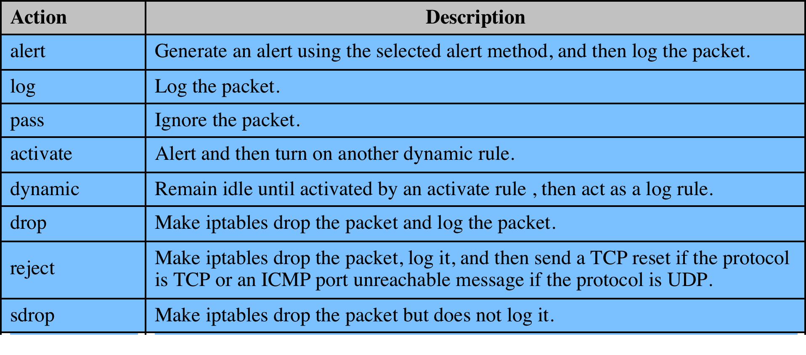
SNORT Rules
use a simple, flexible rule definition language
each rule consists of a fixed header and zero or more options
Notes:
Snort uses a simple, flexible rule definition language that generates the rules used
by the detection engine. Although the rules are simple and straightforward to write,
they are powerful enough to detect a wide variety of hostile or suspicious traffic.
Each rule consists of a fixed header and zero or more options ( Figure 8.10 ).
The header has the following elements:
• Action: The rule action tells Snort what to do when it finds a packet that
matches the rule criteria. Table 8.4 lists the available actions. The last three
actions in the list (drop, reject, sdrop) are only available in inline mode.
• Protocol: Snort proceeds in the analysis if the packet protocol matches this field.
The current version of Snort (2.6) recognizes four protocols: TCP, UDP, ICMP,
and IP. Future releases of Snort will support a greater range of protocols.
Source IP address: Designates the source of the packet. The rule may specify a
specific IP address, any IP address, a list of specific IP addresses, or the negation
of a specific IP address or list. The negation indicates that any IP address
other than those listed is a match.
• Source port: This field designates the source port for the specified protocol
(e.g., a TCP port). Port numbers may be specified in a number of ways, including
specific port number, any ports, static port definitions, ranges, and by
negation.
• Direction: This field takes on one of two values: unidirectional (- ≥) or bidirectional
(< - >). The bidirectional option tells Snort to consider the address/
port pairs in the rule as either source followed by destination or destination
followed by source. The bidirectional option enables Snort to monitor both
sides of a conversation.
• Destination IP address: Designates the destination of the packet.
• Destination port: Designates the destination port.
Following the rule header may be one or more rule options. Each option
consists of an option keyword, which defines the option; followed by arguments,
which specify the details of the option. In the written form, the set of rule options is
separated from the header by being enclosed in parentheses. Snort rule options are
separated from each other using the semicolon (;) character. Rule option keywords
are separated from their arguments with a colon (:) character.

Slide 31
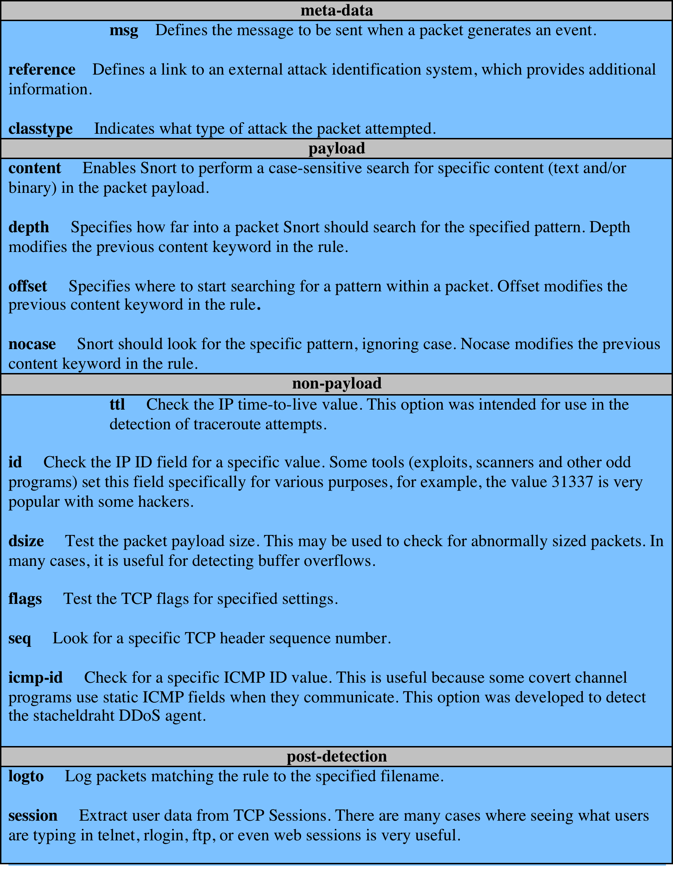
Examples
of
SNORT Rule Options
Notes:
There are four major categories of rule options:
• meta-data: Provide information about the rule but do not have any affect during
detection
• payload: Look for data inside the packet payload and can be interrelated
• non-payload: Look for non-payload data
• post-detection: Rule-specific triggers that happen after a rule has matched a
packet
Table 8.5 provides examples of options in each category.

