Slide 1
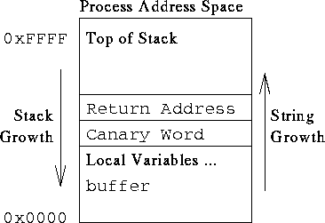
More on Buffer Overflows

Slide 2

Buffer Overflow
Recap: very simply, a buffer overflow is when a program overruns the boundary of a buffer’s allocated space and overwrites adjacent memory.
char A[8];
unsigned short B;
strcpy(A, “excessive”);

Slide 3
A simple vulnerability
Simple code vulnerabilities use functions that don’t check whether a buffer’s bounds are overwritten.

Slide 4
More complex
More complex attacks take into account what other pieces of data are nearby on the stack:

Slide 5
And another
Even without code being called inside the program, can still mess with the intent of the program.
Note that non-execute bits won’t help stop this one!

Slide 6
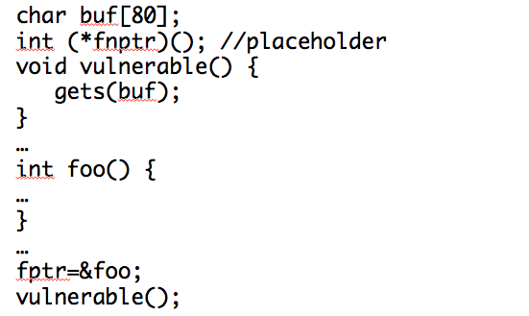
Even worse
It’s not hard to get function pointers overwritten, even with no execution allowed:

Slide 7
Fixing these issues
Fixing is largely a matter of not using unsafe functions.

Slide 8
Caution:
Care is still needed, however – check this next one, which appears secure.
What is the bug here?

Slide 9
But could this really happen?

Slide 10
And now a few HW hints…
Sorry, had to come in person!
Aren’t you glad you came today? =)

