Slide 1
Network Security (part 3)

Slide 2
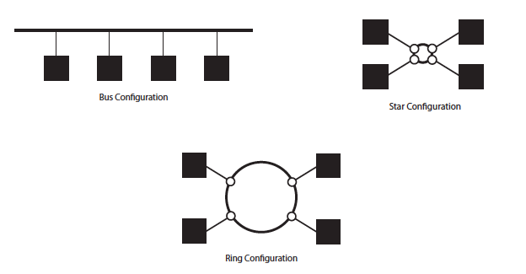
In our simple topologies from yesterday (generally built with hubs), there is nothing preventing a host from sniffing traffic intending for someone else.

Slide 3
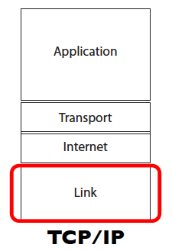
We need to examine the link layer in order to better understand how to prevent eavesdropping.
At the top end of the link layer, we can examine how machines address each other physically.

Slide 4
MAC addresses
The MAC header contains the MAC address of the source and destination machine.
(MAC address and ethernet address are interchangeable here.)
They look like:
00-40-33-25-85-BB, or
00:40:33:25:85:BB

Slide 5
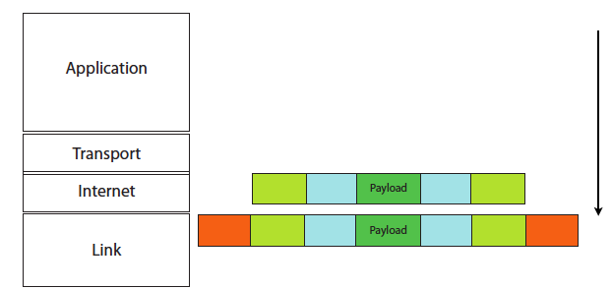
So, when a packet is translated from the internet (network) layer to the link layer, the machine must translate the destination IP address to a destination physical ethernet address.

Slide 6
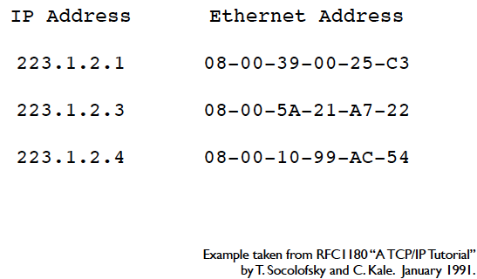
ARP: Address Resolution Protocol
This translation process is done via ARP.
Each node in memory has an ARP table, which looks something like this:

Slide 7
Viewing ARP data
On most systems (windows, linux, or mac), type “arp –a”:
Example (on my laptop):
Macintosh:~ echambe5$ arp -a
setup.ampedwireless.com;setup.ampedwireless.net (192.168.1.67) at f8:78:8c:0:1a:e6 on en0 ifscope [ethernet]
? (192.168.1.69) at 0:23:31:ee:37:56 on en0 ifscope [ethernet]
? (192.168.1.254) at 64:f:28:66:fc:c1 on en0 ifscope [ethernet]
? (192.168.1.255) at ff:ff:ff:ff:ff:ff on en0 ifscope [ethernet]

Slide 8
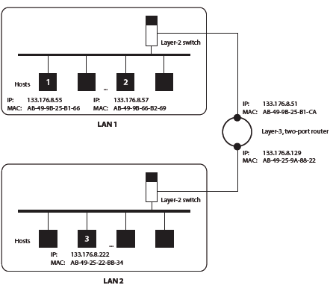
ARP Example
First example: Host 1 transmits to host 2
No entry in the table.
Host 1 broadcasts an ARP request on LAN 1.
Essentially:
“If your IP is 133.176.8.57, then reply with your IP.”

Slide 9
ARP Example
First example:
Host 2 then replies with
AB-49-9B-66-B2-69.
The entry is added to ARP table, and transmission proceeds.

Slide 10
ARP Example
Second example:
Host 1 transmits to host 2 again.
Entry is in the ARP table, so we use it.
(If entry has changed, communication will fail and host 1 will try another ARP request.)

Slide 11
ARP Example
Third example: Host 1 transmits to host 3
No entry in ARP table.
Host 1 broadcasts an ARP request on LAN 1:
“if you IP is 133.176.8.222, then reply with your MAC address.”

Slide 12
ARP Example
Third example: Host 1 transmits to host 3
No reply is received.
Host 1 then transmits a frame with destination IP address 133.176.8.222 and a destination MAC address of AB-49-9B-25-B1-CA

Slide 13
ARP Example
Third example: Host 1 transmits to host 3
The 2 port router gets the frame and sees the destination IP.
Either it is in its ARP table, or it sends an ARP request on all ports.

Slide 14
Network devices
Hubs, switches, and routers are all types of packet forwarding devices.
A hub is a layer-1 device. That means it only has knowledge of the physical layer, so it sends all frames to all hosts.
In essence, this means security is impossible.

Slide 15
Network devices
Switches are layer-2 devices, so they live on the link level.
This means they know about MAC addresses! So they can extract MAC addresses and only send the data to the target.
Inherently more secure, since harder to “sniff” for traffic on the local network.

Slide 16
Network devices
Routers live on layer 3, the actual network layer. They can:
Perform like switches
Forward frames across different kinds of networks
Utilize NAT to hide IP addresses
Forward frames across networks with different Net IDs. (Recall our IPv4 discussion last time.)

Slide 17
An attacker’s goal
Given that switchers and routers provide much more secure transmission, an attackers goal is essentially to get these to behave more like hubs.
We’ll talk about a few common types of network attacks that essentially do this.

Slide 18
ARP Poisoing
The goal is to convince the other computer that you are another IP (generally the default gateway), so that all traffic gets sent to you.
Step 1: Send unsolicited ARP replies to fill up another machine’s ARP table (so that it has to send ARP requests of its own)
Step 2: Reply to those ARP requests with your own MAC.

Slide 19
ARP Poisoning
There is no solid defense here, since ARP is inherently flexible. Possibilities:
Extra software to check for possible spoofs
Hard coded entries (but difficult to update)
OS level guards (timeouts, ignore unsolicited ARPS, etc.)
Note that there are legitimate uses! Page redirects, setting up redundancy, etc.

Slide 20
Implementing ARP Poisoning
ARP Poisoning sets the network up for a man-in-the-middle attack: once you have everyone talking to your computer, you can intercept and modify traffic at will
This will be the basis of the next lab
Tools: Here, we will use tcpdump to monitor traffic and ettercap to sniff and filter content from the network

Slide 21
Tcpdump
Free linux command line tool that dumps all traffic from a network interface.
Other tools do exist. Wireshark, for example, is a free graphics based client much like tcpdump.
Must be run as root (or admin privileges).
With a hub (or wireless network), will see all traffic; on a switched network, will see all traffic routed to your machine
Good tutorial: http://danielmiessler.com/study/tcpdump

Slide 22
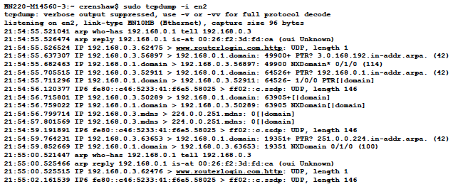
Tcpdump example

Slide 23
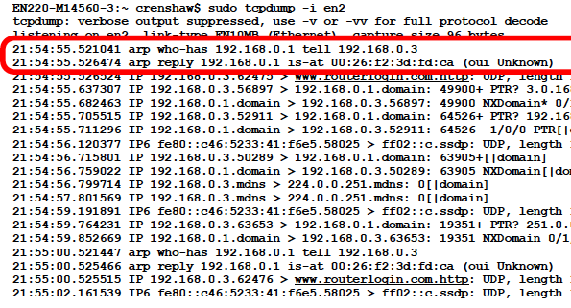
Huh? (Look closer)

Slide 24
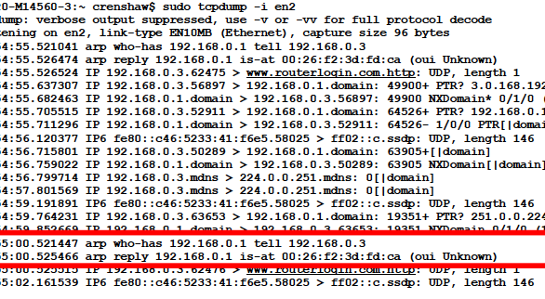
And here:

Slide 25
Ettercap
Multipurpose sniffer and content filter for “network management” (i.e. man-in-the-middle attacks).
See http://linux.die.net/man/8/ettercap
You can use ettercap simply to sniff, but also to automatically apply filters to content being sent.

Slide 26
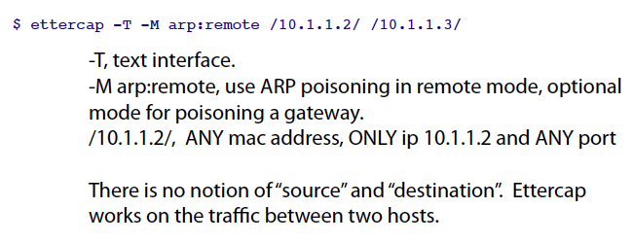
Ettercap example 1: Observe traffic between two machines

Slide 27
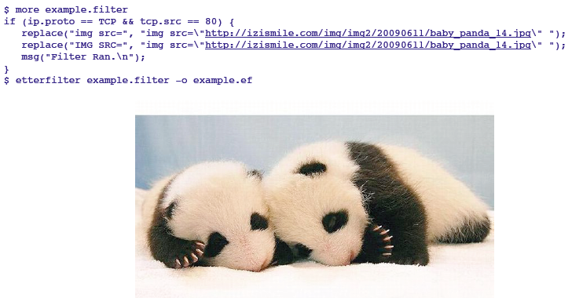
Ettercap example 2: Alter web traffic
Step 1: write a filter and compile it.

Slide 28
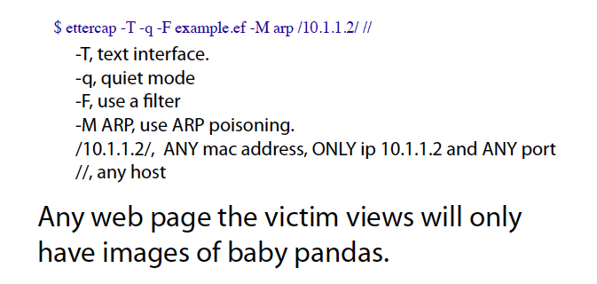
Ettercap example 2: Alter web traffic
Step 2: run ettercap

Slide 29
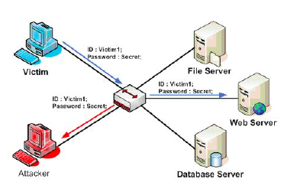
Beyond ARP poisoning
Once you have the basic setup, still need to conduct man-in-the-middle attack
ARP poisoning lets you eavesdrop, but what if the traffic is encrypted?

Slide 30
Recall: Key exchanges
Simple protocol:
Alice sends her public key to Bob.
Bob sends his public key to Alice.
Alice encrypts message with Bob’s public key, so Bob can decrypt with his private key.
Bob encrypts with Alice’s public key, and she can then decrypt with her own private key.

Slide 31
Recall: Key exchanges
Exploiting the simple protocol:
When Alice sends her public key to Bob, Eve intercepts and sends along her own public instead.
(Likewise for Bob’s public key.)
When Alice sends a message to Bob, Eve is able to decrypt it. She can then send it along to Bob (encrypted with her own key, which Bob thinks is Alice’s), or can replace it with a new one.
(Likewise for a message from Bob to Alice.)

Slide 32
Avoiding this attack
Simple key exchange: “A common cryptographic technique is to encrypt each individual conversation with a session key.” --Applied Cryptography by Schneier
Alice gets Bob’s public key from a distribution center
Alice generates a random session key, encrypts it with Bob’s public key, and sends it.
Bob decrypts Alice’s message using his private key
Both can then use the session key to encrypt.

Slide 33
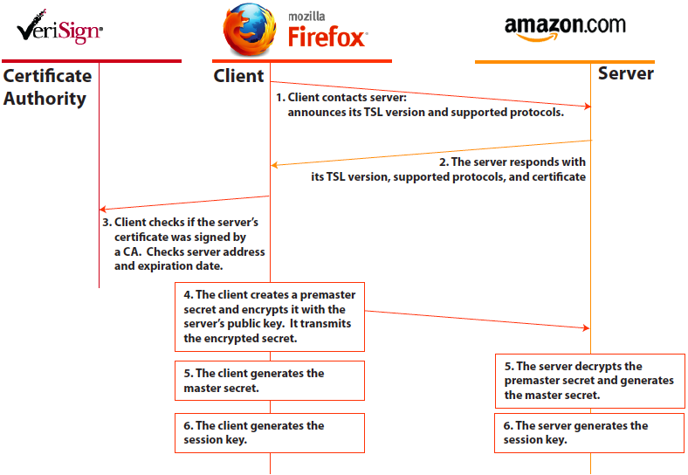
Example: TSL (in web apps)

Slide 34
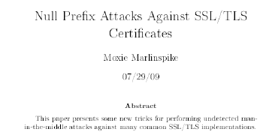

Note: still not foolproof!
At Black Hat DC 2009, for example, Moxie Marlinspike announced a security hold in one kind of certificate used I the SSL and TSL protocols.
His attack adds a null string character to a certificate field, which tricks the programs into recognizing a domain (incorrectly).

Slide 35
SSLstrip
He developed and now distributes a tool called SSL strip – essentially a simple python script to install the tool.
See the download page for details: http://www.thoughtcrime.org/software/sslstrip/
Given this (and other known issues), many think SSL has deep flaws in its structure, although it continues to be the industry leader.

Slide 36
Network Design: A Case Study
Independent of all these low level (and important issues), it may still be up to you to design a network for a corporation.
Infrastructure requirements and goals are a key point of the design:
Data should be confidential, and internal plans kept secret.
Releasing sensitive data should require approval.

Slide 37
Policy Design and Development
Goal is to develop security policies
Examine:
Internal organizations
Data classes
User classes
Infrastructure options or limitations

Slide 38
First principles:
Principle of Least Privilege: A subject should be given only those privileges that it needs to complete its task.
Principle of Open Design: The security of a mechanism should not depend on the secrecy of its design or implementation.

Slide 39
First principles:
Principle of Separation of Priviledge; The system should not grant permission based on a single condition.
Principle of Fail-Safe Defaults: Unless a subject is given explicit access to an object, it should be denied access.

Slide 40
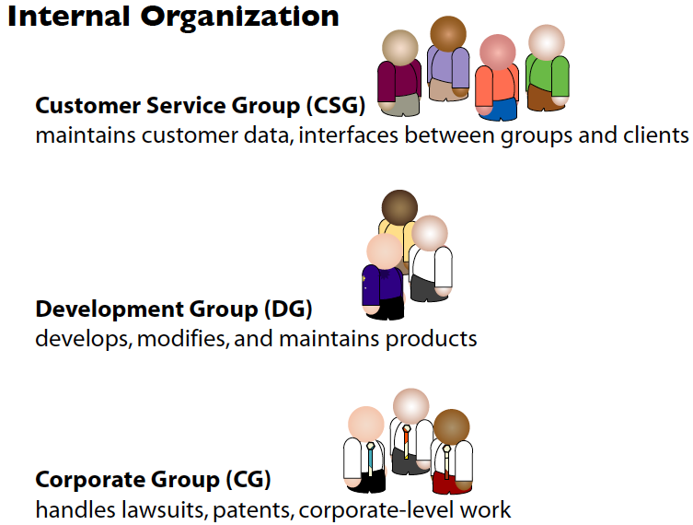
Example : a (fake) company

Slide 41
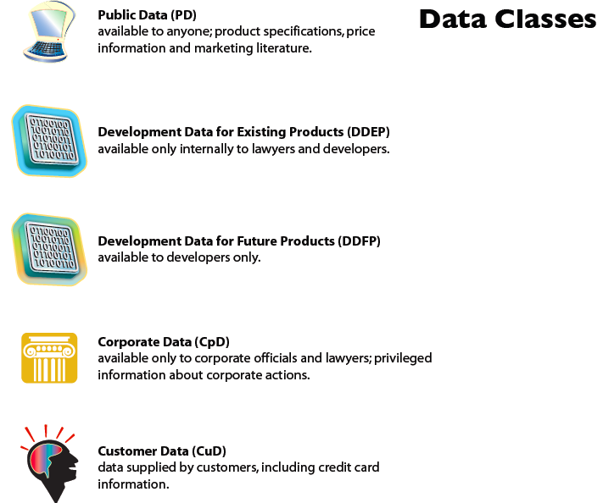
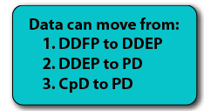
Example : a (fake) company

Slide 42
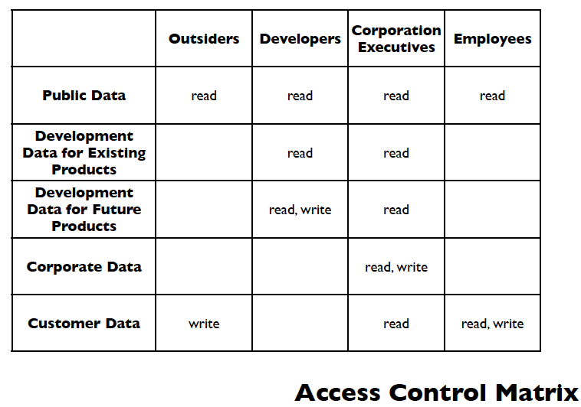
Fake Company (cont.)

Slide 43
Network Design Fundamentals
Most large scale networks have a “Demilitarized Zone” (DMZ):
A separate network between the purely internal network and the actual external internet
Two firewalls (one on each end), each with different sets of rules
Very few machines present; this is a place for services that need external access regularly, but actual workstations don’t fall into this category

Slide 44
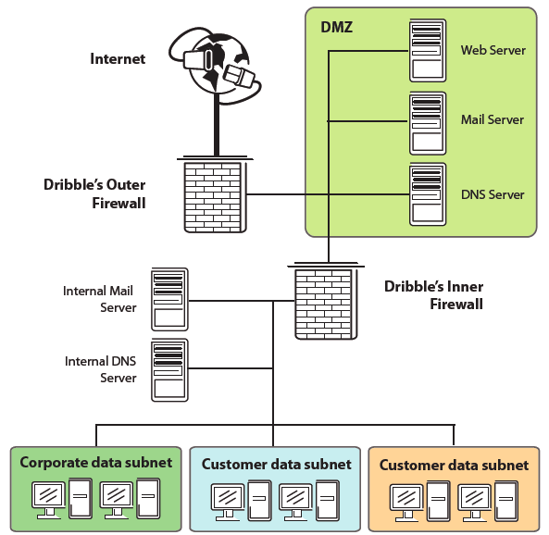
Possible design for our company

Slide 45
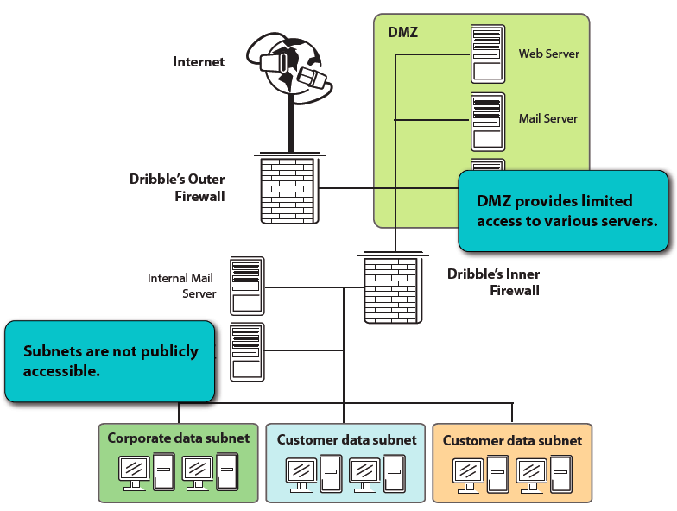
A few things to note:

Slide 46
The outer firewall
Goals of the outer firewall:
“No read up”: restrict public access to the corporate network, which has sensitive data they do not have rights to access.
“No write down”: Restrict Dribble employee’s access to the internet, so that they cannot share sensitive data outside the company.

Slide 47
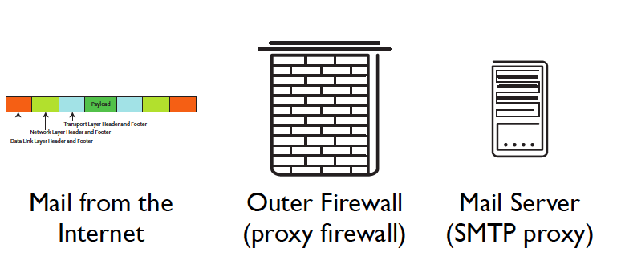
The outer firewall
Here, the company has decided that the outside network only needs access to the web server and the mail server.

Slide 48
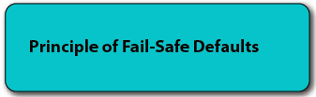
The inner firewall
This firewall will block ALL traffic except:
SMTP connections (although all electronic mail goes through DMZ server)
System admins may access the DMZ computers from a trusted server only

Slide 49
Administrator connection
Uses SSH protocol
Inner firewall ensures that SSH can only go to the DMZ servers
SSH is set up at a trusted machine, so that we can ensure strong cryptographic authentication at both endpoints

Slide 51
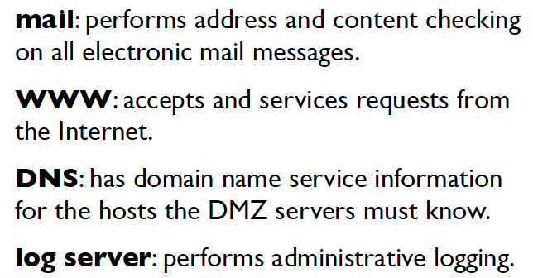
DMZ Servers

Slide 52
DMZ Mail Server
Performs all checks and sanitization of email, and so removes burden for this from the firewall.
Reassembles messages
Scans letters and attachments
Destination addresses are rewritten to route mail to the internal mail server.
Also runs SSH server for admin access.

Slide 53
DMZ Web Server
Accepts and services requests and orders from the internet
When consumer data is entered, it is checked and then encoded immediately, and the original file is deleted.
Only the public key is on the web server.
No customer data is stored in clear text.
Also runs SSH server for admin connection.

Slide 54
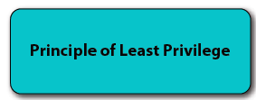
DMZ DNS Server
Has domain name service information for any hosts that the DMZ computers must know
DMZ mail, web, and log server
Internal trusted admin host
Outer firewall
Inner firewall
Does NOT know others (e.g. internal mail server)

Slide 55
DMZ log server
Performs administrative logging of network traffic or server info
Logs help to track data in case of attacks (although logs can be deleted)
Placed in the DMZ to limit its access
Accepts SSH connections from trusted admin host

Slide 56
Server Summary
In a nutshell, each server will have the minimum knowledge of the network necessary to perform its task
Operating systems for servers are kept very small, with only necessary services running

Slide 58
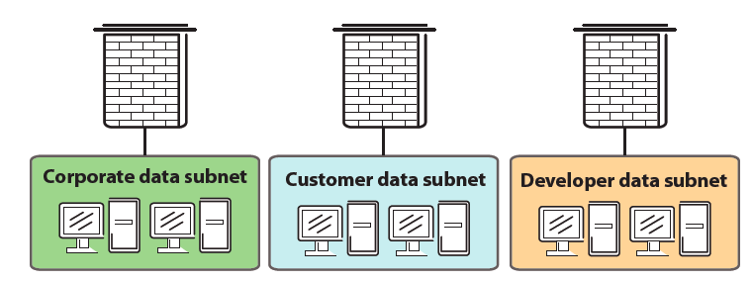
Internal networks
Each internal network has its own firewall

Slide 59
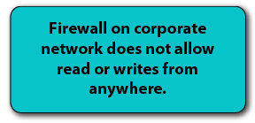
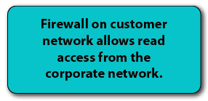
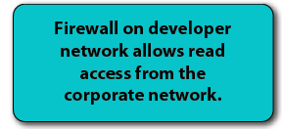
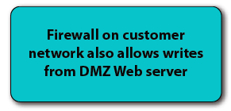

Slide 60
A few notes
This network is highly restrictive: note that NO internet connections other than email and customer web traffic is allowed to the internal network.
Note also that internal networks may have their own intranet services, such as chat servers, internal webpages, etc.

Slide 61
Additional DMZ services
Most DMZs incorporate intrusion detection systems to track connections
In addition, most companies have a web proxy server with caching in the DMZ to monitor, block, and speed up web browsing.
VPNs often also require a connection to the outside world, so support for these connections would reside in a DMZ

