Slide 1
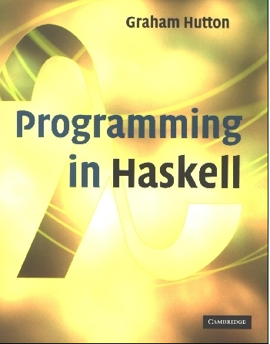
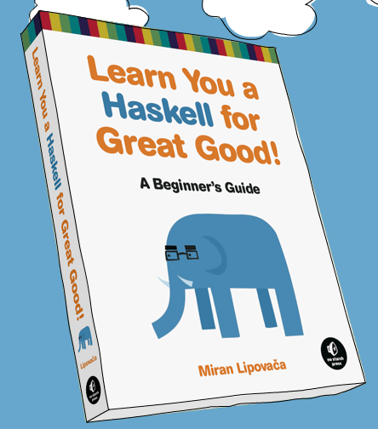
PROGRAMMING IN HASKELL
Typeclasses and higher order functions
Based on lecture notes by Graham Hutton
The book “Learn You a Haskell for Great Good”
(and a few other sources)

Slide 2
Ranges in Haskell
As already discussed, Haskell has extraordinary range capability on lists:
ghci> [1..15]
[1,2,3,4,5,6,7,8,9,10,11,12,13,14,15]
ghci> ['a'..'z']
"abcdefghijklmnopqrstuvwxyz"
ghci> ['K'..'Z']
"KLMNOPQRSTUVWXYZ”
ghci> [2,4..20]
[2,4,6,8,10,12,14,16,18,20]
ghci> [3,6..20]
[3,6,9,12,15,18]

Slide 3
Ranges in Haskell
But be careful:
ghci> [0.1, 0.3 .. 1]
[0.1,0.3,0.5,0.7,0.8999999999999999,1.0999999999999999]
(I’d recommend just avoiding floating point in any range expression in a list – imprecision is just too hard to predict.)

Slide 4
Infinite Lists
Can be very handy – these are equivalent:
[13,26..24*13]
take 24 [13,26..]
A few useful infinite list functions:
ghci> take 10 (cycle [1,2,3])
[1,2,3,1,2,3,1,2,3,1]
ghci> take 12 (cycle "LOL ")
"LOL LOL LOL "
ghci> take 10 (repeat 5)
[5,5,5,5,5,5,5,5,5,5]

Slide 5
List Comprehensions
Very similar to standard set theory list notation:
ghci> [x*2 | x <- [1..10]]
[2,4,6,8,10,12,14,16,18,20]
Can even add predicates to the comprehension:
ghci> [x*2 | x <- [1..10], x*2 >= 12]
[12,14,16,18,20]
ghci> [ x | x <- [50..100], x `mod` 7 == 3]
[52,59,66,73,80,87,94]

Slide 6
List Comprehensions
Can even combine lists:
ghci> let nouns = ["hobo","frog","pope"]
ghci> let adjectives =
["lazy","grouchy","scheming"]
ghci> [adjective ++ " " ++ noun | adjective
<- adjectives, noun <- nouns]
["lazy hobo","lazy frog","lazy pope","grouchy hobo","grouchy frog",
"grouchy pope","scheming hobo","scheming frog","scheming pope"]

Slide 7
Exercise
Write a function called myodds that takes a list and filters out just the odds using a list comprehension.
Then test it by giving it an infinite list, but then only “taking” the first 12 elements.
Note: Your code will start with something like:
myodds xs = [ put your code here ]

Slide 8
Type Classes
We’ve seen types already:
ghci> :t 'a'
'a' :: Char
ghci> :t True
True :: Bool
ghci> :t "HELLO!"
"HELLO!" :: [Char]
ghci> :t (True, 'a')
(True, 'a') :: (Bool, Char)
ghci> :t 4 == 5
4 == 5 :: Bool

Slide 9
Type of functions
It’s good practice (and REQUIRED in this class) to also give functions types in your definitions.
removeNonUppercase :: [Char] -> [Char]
removeNonUppercase st =
[ c | c <- st, c `elem` ['A'..'Z']]
addThree :: Int -> Int -> Int -> Int
addThree x y z = x + y + z

Slide 10
Type Classes
In a typeclass, we group types by what behaviors are supported. (These are NOT object oriented classes – closer to Java interfaces.)
Example:
ghci> :t (==)
(==) :: (Eq a) => a -> a -> Bool
Everything before the => is called a type constraint, so the two inputs must be of a type that is a member of the Eq class.

Slide 11
Type Classes
Other useful typeclasses:
Ord is anything that has an ordering.
Show are things that can be presented as strings.
Enum is anything that can be sequentially ordered.
Bounded means has a lower and upper bound.
Num is a numeric typeclass – so things have to “act” like numbers.
Integral and Floating what they seem.

Slide 12
Curried Functions
In Haskell, every function officially only takes 1 parameter (which means we’ve been doing something funny so far).
ghci> max 4 5
5
ghci> (max 4) 5
5
ghci> :type max
max :: Ord a => a -> a -> a
Note: same as max :: (Ord a) => a -> (a -> a)

Slide 13
Currying Conventions
To avoid excess parentheses when using curried functions, two simple conventions are adopted:
The arrow → associates to the right.
Int → Int → Int → Int
Means Int → (Int → (Int → Int)).

Slide 14
As a consequence, it is then natural for function application to associate to the left.
mult x y z
Means ((mult x) y) z.
Unless tupling is explicitly required, all functions in Haskell are normally defined in curried form.

Slide 15
Polymorphic Functions
A function is called polymorphic (“of many forms”) if its type contains one or more type variables.
length :: [a] → Int
for any type a, length takes a list of values of type a and returns an integer.

Slide 16
Note:
Type variables can be instantiated to different types in different circumstances:
> length [False,True]
2
> length [1,2,3,4]
4
a = Bool
a = Int
Type variables must begin with a lower-case letter, and are usually named a, b, c, etc.

Slide 17
Many of the functions defined in the standard prelude are polymorphic. For example:
fst :: (a,b) → a
head :: [a] → a
take :: Int → [a] → [a]
zip :: [a] → [b] → [(a,b)]
id :: a → a

Slide 18
Overloaded Functions
A polymorphic function is called overloaded if its type contains one or more class constraints.
sum :: Num a ⇒ [a] → a
for any numeric type a, sum takes a list of values of type a and returns a value of type a.

Slide 19
Note:
Constrained type variables can be instantiated to any types that satisfy the constraints:
> sum [1,2,3]
6
> sum [1.1,2.2,3.3]
6.6
> sum [’a’,’b’,’c’]
ERROR
a = Int
a = Float
Char is not a numeric type

Slide 20
Hints and Tips
When defining a new function in Haskell, it is useful to begin by writing down its type;
Within a script, it is good practice to state the type of every new function defined;
When stating the types of polymorphic functions that use numbers, equality or orderings, take care to include the necessary class constraints.

Slide 21
Exercise
What are the types of the following functions?
second xs = head (tail xs)
swap (x,y) = (y,x)
pair x y = (x,y)
double x = x*2
palindrome xs = reverse xs == xs
twice f x = f (f x)

Slide 22
Higher order functions
Remember that functions can also be inputs:
applyTwice :: (a -> a) -> a -> a
applyTwice f x = f (f x)
After loading, we can use this with any function:
ghci> applyTwice (+3) 10
16
ghci> applyTwice (++ " HAHA") "HEY"
"HEY HAHA HAHA"
ghci> applyTwice ("HAHA " ++) "HEY"
"HAHA HAHA HEY"
ghci> applyTwice (3:) [1]
[3,3,1]

Slide 23
Useful functions: zipwith
zipWith is a default in the prelude, but if we were coding it, it would look like this:
zipWith :: (a -> b -> c) -> [a] -> [b] -> [c]
zipWith _ [] _ = []
zipWith _ _ [] = []
zipWith f (x:xs) (y:ys) =
f x y : zipWith' f xs ys
Look at declaration for a bit…

Slide 24
Useful functions: zipwith
Using zipWith:
ghci> zipWith (+) [4,2,5,6] [2,6,2,3]
[6,8,7,9]
ghci> zipWith max [6,3,2,1] [7,3,1,5]
[7,3,2,5]
ghci> zipWith (++) ["foo ", "bar ", "baz "]
["fighters", "hoppers", "aldrin"]
["foo fighters","bar hoppers","baz aldrin"]
ghci> zipWith' (*) (replicate 5 2) [1..]
[2,4,6,8,10]
ghci> zipWith' (zipWith' (*))
[[1,2,3],[3,5,6],[2,3,4]]
[[3,2,2],[3,4,5],[5,4,3]]
[[3,4,6],[9,20,30],[10,12,12]]

Slide 25
Useful functions: flip
The function “flip” just flips order of inputs to a function:
flip :: (a -> b -> c) -> (b -> a -> c)
flip f = g
where g x y = f y x
ghci> flip' zip [1,2,3,4,5] "hello"
[('h',1),('e',2),('l',3),('l',4),('o',5)]
ghci> zipWith (flip' div) [2,2..] [10,8,6,4,2]
[5,4,3,2,1]

Slide 26
Useful functions: map
The function map applies a function across a list:
map :: (a -> b) -> [a] -> [b]
map _ [] = []
map f (x:xs) = f x : map f xs
ghci> map (+3) [1,5,3,1,6]
[4,8,6,4,9]
ghci> map (++ "!") ["BIFF", "BANG", "POW"]
["BIFF!","BANG!","POW!"]
ghci> map (replicate 3) [3..6]
[[3,3,3],[4,4,4],[5,5,5],[6,6,6]]
ghci> map (map (^2)) [[1,2],[3,4,5,6],[7,8]]
[[1,4],[9,16,25,36],[49,64]]

Slide 27
Useful functions: filter
The function fliter:
filter :: (a -> Bool) -> [a] -> [a]
filter _ [] = []
filter p (x:xs)
| p x = x : filter p xs
| otherwise = filter p xs
ghci> filter (>3) [1,5,3,2,1,6,4,3,2,1]
[5,6,4]
ghci> filter (==3) [1,2,3,4,5]
[3]
ghci> filter even [1..10]
[2,4,6,8,10]

Slide 28
Using filter: quicksort!
quicksort :: (Ord a) => [a] -> [a]
quicksort [] = []
quicksort (x:xs) =
let smallerSorted = quicksort (filter (<=x) xs)
biggerSorted = quicksort (filter (>x) xs)
in smallerSorted ++ [x] ++ biggerSorted
(Also using let clause, which temporarily binds a function in the local context. The function actually evaluates to whatever “in” is.)

