Slide 1
Detecting attacks
Based on material by Prof. Vern Paxson, UC Berkeley

Slide 2
Detecting Attacks
Given a choice, we’d like our systems to be airtight-secure
But often we don’t have that choice
#1 reason why not: cost (in different dimensions)
A (messy) alternative: detect misuse rather than build a system that can’t be misused
Upon detection: clean up damage, maybe block incipient “intrusion”
Note: can be prudent for us to do this even if we think system is solid - defense in depth
Note: “misuse” might be about policy rather than security
E.g. your own employees shouldn’t be using file-sharing apps
Problem space:
Lacks principles
Has many dimensions (where to monitor, how to look for problems, how much accuracy required, what can attackers due to elude us)
Is messy and in practice also very useful

Slide 3
Example scenario
Suppose you’ve been hired to provide computer security for some company which we’ll call FooCorp.
They offer web-based services via backend programs invoked via URLs:
http://foocorp.com/amazeme.exe?profile=info/luser.txt
Script makes sure that “profile” arg. is a relative filename

Slide 4
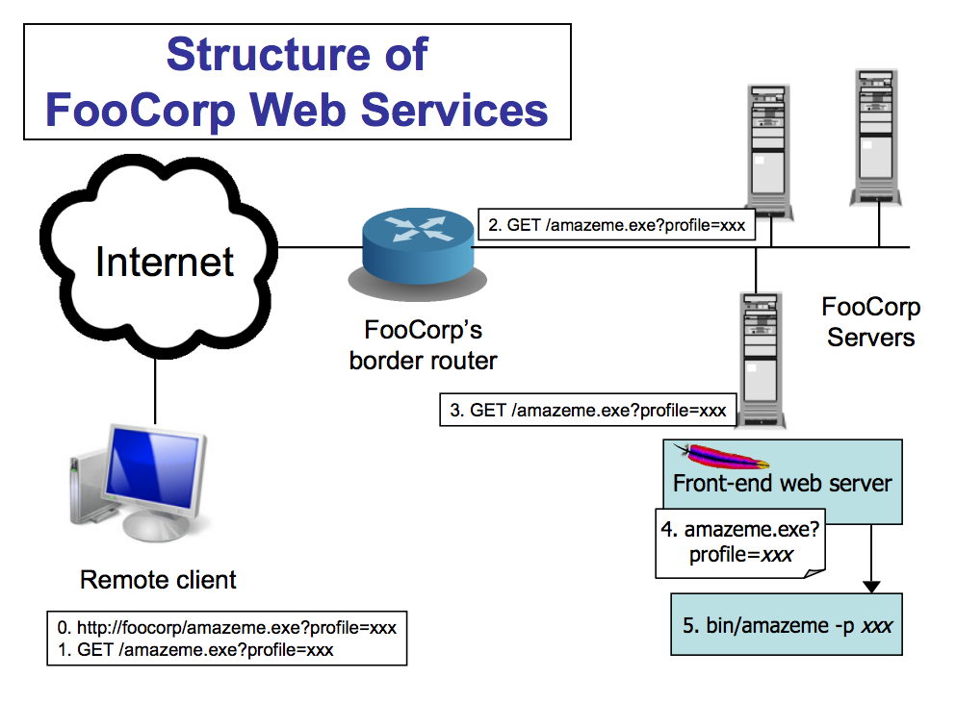

Slide 5
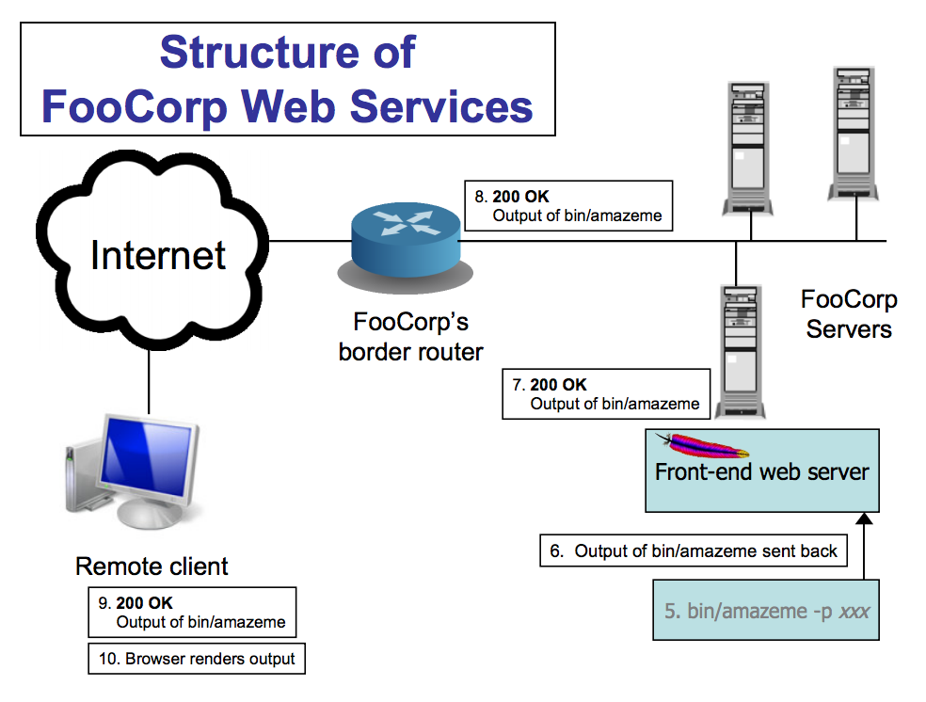

Slide 6
Example scenario
Suppose you’ve been hired to provide computer security for some company which we’ll call FooCorp.
They offer web-based services via backend programs invoked via URLs:
http://foocorp.com/amazeme.exe?profile=info/luser.txt
Script makes sure that “profile” arg. is a relative filename
Due to installed base issues, you can’t alter backend components like amazeme.exe
One of the zillion of attacks you’re worried about is information leakage via directory traversal:
E.g. GET /amazeme.exe?profile=../../../../../etc/passwd

Slide 7
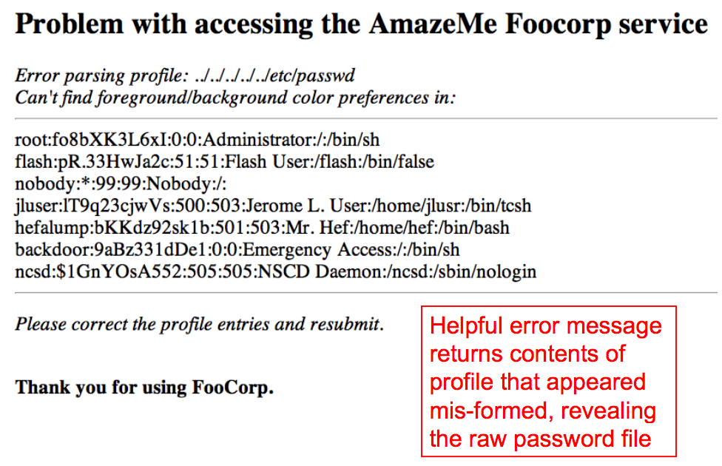

Slide 8
How can we detect this type of attack?
Approach #1: look at the network traffic
Design a “NIDS”
Scan HTTP requests
Look for “/etc/passwd” and/or “../../”
Think about our structure for a minute – where would this be located?

Slide 9
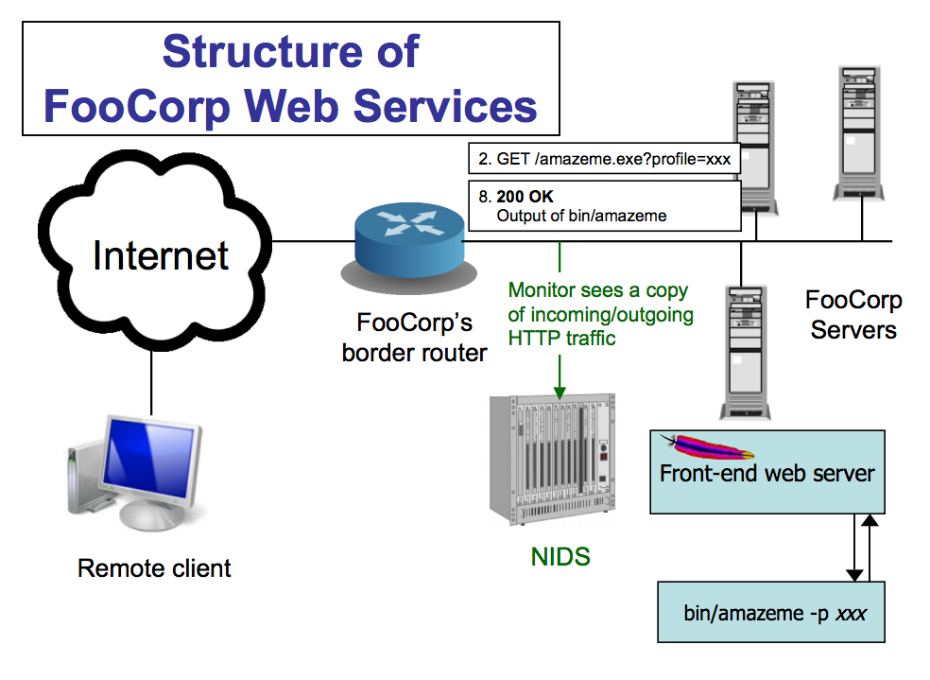

Slide 10
Pros and Cons
Pros:
No need to touch or trust end systems
Can “bolt on” security
Cheap: cover many systems w/ single monitor
Cheap: centralized management
Possible cons:
Scan for “/etc/passwd”? What about other sensitive files?
Scan for “../../”?
Sometimes seen in legit. requests (= false positive)
What about “%2e%2e%2f%2e%2e%2f”? (= evasion)
Okay, need to do full HTTP parsing
What about “..///.///..////”?
Okay, need to understand Unix filename semantics too!
What if it’s HTTPS and not HTTP?
Need access to decrypted text / session key - yuck!

Slide 11
Detecting the attack
Approach #2: instrument the web server
Host-based IDS (sometimes called “HIDS”)
Scan ?arguments sent to back-end programs, and look for “/etc/passwd” and/or “../../”
Big picture again: what does this one look like?

Slide 12
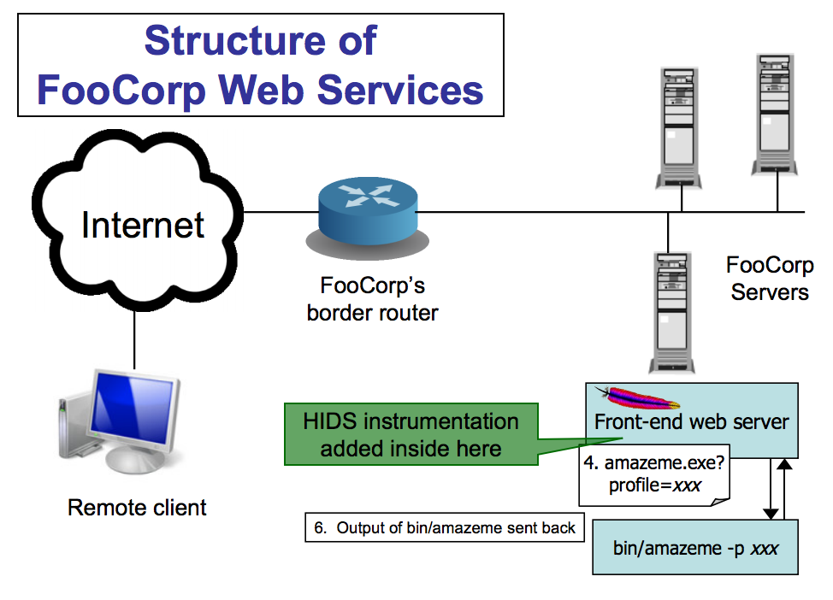

Slide 13
Approach 2 pros and cons
Pros:
No problems with HTTP complexities like %-escapes
Works for encrypted HTTPS!
Issues?
Have to add code to each (possibly different) web server
And that effort only helps with detecting web server attacks
Still have to consider Unix filename semantics (“..////.//”)
Still have to consider other sensitive files

Slide 14
(Still) detecting the attack
Approach #3: each night, script runs to analyze log files generated by web servers
Again scan ?arguments sent to back-end programs
Big picture…

Slide 15
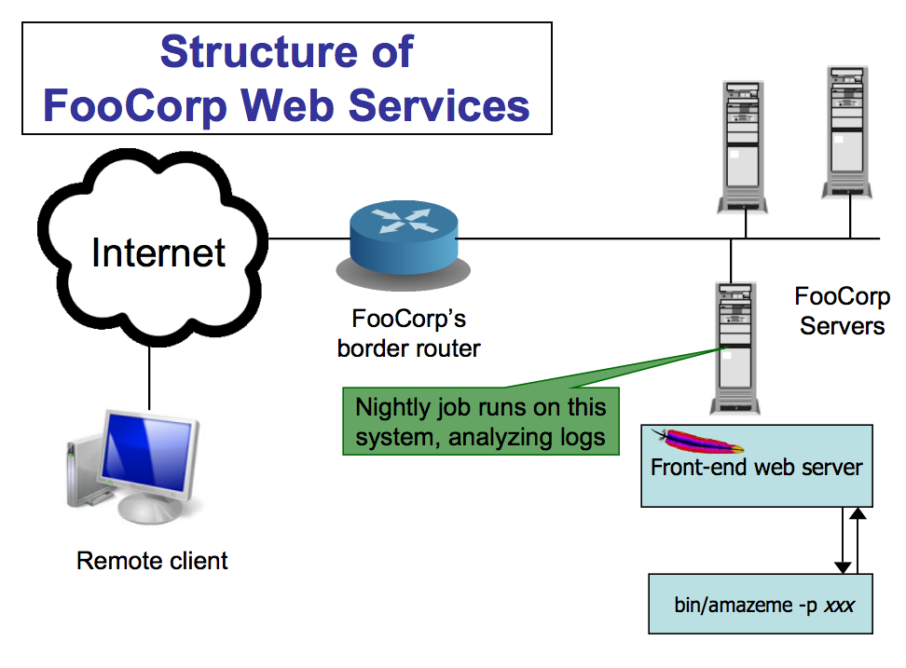

Slide 16
Approach 3 pros and cons
Pros:
Cheap: web servers generally already have such logging facilities built into them
No problems like %-escapes, encrypted HTTPS
Issues?
Again must consider filename tricks, other sensitive files
Can’t block attacks & prevent from happening
Detection delayed, so attack damage may compound
If the attack is a compromise, then malware might be able to alter the logs before they’re analyzed
(Not really a problem for directory traversal information leak example)

Slide 17
More ways to detect the attack
Approach #4: monitor system call activity of backend processes
Look for access to /etc/passwd
Picture is similar to the last approach, but timing differs

Slide 18
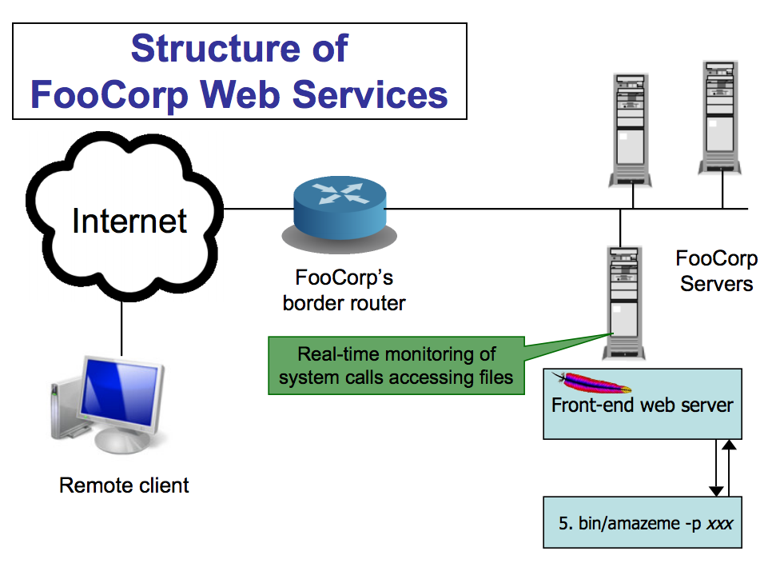

Slide 19
Approach 4 pros and cons
Pros:
No issues with any HTTP complexities
May avoid issues with filename tricks
Attack only leads to an “alert” if attack succeeded
Issues?
Might have to analyze a huge amount of data
Maybe other processes make legit accesses to the sensitive files (false positives)
Maybe we’d like to detect attempts even if they fail?
“situational awareness”

Slide 20
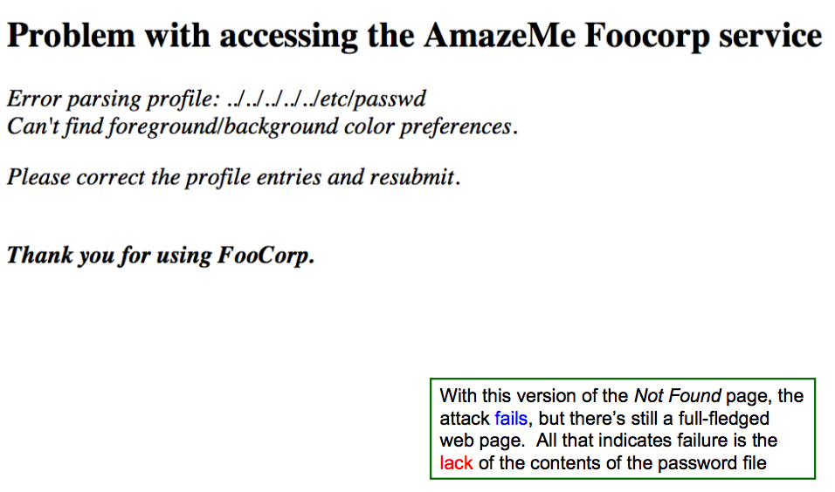
How do we know if an attack succeeded?
Instrumenting web server:
Need to inspect bin/amazeme ’s output
What do we look for?
Can’t just assume failure = empty output from bin/amazeme …

Slide 21
Back to penetration testing
Idea: rather than detect attacks, launch them yourself!
Vulnerability scanning: use a tool to probe your own systems with a wide range of attacks, fix any that succeed
Pros:
Accurate: if your scanning tool is good, it finds real problems
Proactive: can prevent future misuse
Intelligence: can ignore IDS alarms that you know can’t succeed
Issues?
Can take a lot of work
Not so helpful for systems you can’t modify
Dangerous for disruptive attacks, and you might not know which these are!
In practice, this approach is prudent and widely used today

Slide 22
Detection Accuracy
Two types of detector errors:
False positive (FP): alerting about a problem when in fact there was no problem
False negative (FN): failing to alert about a problem when in fact there was a problem
Detector accuracy is often assessed in terms of rates at which these occur:
Define Ι to be the event of an instance of intrusive behavior occurring (something we want to detect)
Define Α to be the event of detector generating alarm
Define:
False positive rate = P[Α|¬ Ι]
False negative rate = P[¬Α| Ι]

Slide 23
Detection Tradeoffs
Perfect detection is impossible!
The art of a good detector is achieving an effective balance between FPs and FNs
Suppose our detector has an FP rate of 0.1% and an FN rate of 2%. Is it good enough? Which is better, a very low FP rate or a very low FN rate?
Well, this depends on the cost of each type of error
E.g., FP might lead to paging a duty officer and consuming hour of their time; FN might lead to $10K cleaning up compromised system that was missed
but also critically depends on the rate at which actual attacks occur in your environment

Slide 24
Base rate and what it means
Suppose our detector has a FP rate of 0.1% (!) and a FN rate of 2% (not bad!)
Scenario #1: our server receives 1,000 URLs/day, and 5 of them are attacks
Expected # FPs each day = 0.1% * 995 ≈ 1
Expected # FNs each day = 2% * 5 = 0.1 (< 1/week)
Pretty good!
Scenario #2: our server receives 10,000,000 URLs/day, and 5 of them are attacks
Expected # FPs each day ≈ 10,000 :-(
Nothing changed about the detector; only our environment changed
Accurate detection very challenging when base rate of activity we want to detect is quite low

Slide 25
IDS versus IPS
If we can detect attacks, how about blocking them?
Issues:
Not a possibility for retrospective analysis (e.g., nightly job that looks at logs)
Quite hard for detector that’s not in the data path - how can NIDS that passively monitors traffic block attacks?
Change firewall rules dynamically; forge RST packets
And still there’s a race regarding what attacker does before block
False positives get more expensive
You don’t just bug an operator, you damage production activity
Today’s technology/products pretty much all offer blocking
– Intrusion prevention systems (IPS - “eye-pee-ess”)

Slide 26
Examples of detection
Signature-based: look for activity that matches the structure of a known attack
Example (from the freeware Snort NIDS):
alert tcp $EXTERNAL_NET any -> $HOME_NET
139 flow:to_server,established
content:"|eb2f 5feb 4a5e 89fb 893e 89f2|"
msg:"EXPLOIT x86 linux samba overflow"
reference:bugtraq,1816
reference:cve,CVE-1999-0811
classtype:attempted-admin

Slide 27
Signature-based detection, cont
What’s nice about this approach?
Conceptually simple
Takes care of known attacks (of which there are zillions)
Easy to share signatures, build up libraries
What’s problematic about this approach?
Blind to novel attacks
Might even miss variants of known attacks (“..///.//../”)
Of which there are zillions
Simpler versions look at low-level syntax, not semantics
Can lead to weak power (either misses variants, or generates lots of false positives)

Slide 28
Vulnerability signatures
Idea: don’t match on known attacks, match on known problems
Example (also from Snort):
alert tcp $EXTERNAL_NET any -> $HTTP_SERVERS 80
uricontent: ".ida?"; nocase; dsize: > 239; flags:A+
msg:"Web-IIS ISAPI .ida attempt”
reference:bugtraq,1816
reference:cve,CAN-2000-0071
classtype:attempted-admin
That is, match URIs that invoke *.ida?*, have more than 239 bytes of payload, and have ACK set (maybe others too)
This example detects any* attempt to exploit a particular buffer overflow in IIS web servers
Used by the “Code Red” worm

Slide 29
Vulnerability signatures, cont
What’s nice about this approach?
Conceptually fairly simple
Takes care of known attacks
Easy to share signatures, build up libraries
Can detect variants of known attacks
Much more concise than per-attack signatures
What’s problematic?
Can’t detect novel attacks (new vulnerabilities)
Signatures can be hard to write / express
Can’t just observe an attack that works, need to delve into how it works

Slide 30
Anomaly based detection
Idea: attacks look peculiar.
High-level approach: develop a model of normal behavior (say based on analyzing historical logs). Flag activity that deviates from it.
FooCorp example: maybe look at distribution of characters in URL parameters, learn that some are rare and/or don’t occur repeatedly
If we happen to learn that ‘.’s have this property, then could detect the attack even without knowing it exists
Big benefit: potential detection of a wide range of attacks, including novel ones

Slide 31
Anomaly detection: drawbacks
What’s problematic about this approach?
Can fail to detect known attacks
Can fail to detect novel attacks, if don’t happen to look peculiar along measured dimension
What happens if the historical data you train on includes attacks?
Base Rate Fallacy particularly acute: if prevalence of attacks is low, then you’re more often going to see benign outliers
High FP rate
OR: require such a stringent deviation from “normal” that most attacks are missed (high FN rate)

Slide 32
Specification based detection
Idea: don’t learn what’s normal; specify what’s allowed
FooCorp example: decide that all URL parameters sent to foocorp.com servers must have at most one ‘/’ in them
Flag any arriving param with > 1 slash as an attack
What’s nice about this approach?
Can detect novel attacks
Can have low false positives
If FooCorp audits its web pages to make sure they comply
What’s problematic about this approach?
Expensive: lots of labor to derive specifications and keep them up to date as things change (“churn”)

Slide 33
Behavioral detection
Idea: don’t look for attacks, look for evidence of compromise
FooCorp example: inspect all output web traffic for any lines that match a passwd file
Example for monitoring user shell keystrokes: unset HISTFILE
Example for catching code injection: look at sequences of system calls, flag any that prior analysis of a given program shows it can’t generate
E.g., observe process executing read(), open(), write(), fork(), exec() …
… but there’s no code path in the (original) program that calls those in exactly that order!

Slide 34
Behavioral based: pro/con
What’s nice about this approach?
Can detect a wide range of novel attacks
Can have low false positives
Depending on degree to which behavior is distinctive
E.g., for system call profiling: no false positives!
Can be cheap to implement
E.g., system call profiling can be mechanized
What’s problematic about this approach?
Post facto detection: discovers that you definitely have a problem, w/ no opportunity to prevent it
Brittle: for some behaviors, attacker can maybe avoid it
Easy enough to not type “unset HISTFILE”
How could they evade system call profiling?
Mimicry: adapt injected code to comply w/ allowed call sequences

Slide 35
Next lab: intrusion detection
You’ll be asked to analyze logs to describe what things are attacks versus false positives
Hint: most aren’t attacks, but the important thing is to describe and justify your answer
Also analyze TCPdump a bit more and write some snort rules
Due next Friday

