Slide 1
A few final issues
Legal obligations
Malware
Spam

Slide 2
Announcements
Grades for lab 3 emailed yesterday.
Test is Thursday, May 7, at noon.
No one is taking a conflict. (Right??)
Review guide will be posted tomorrow and handed out with a final sample exam on Tuesday.
Review session in class next Thursday.
Extra office hours next Tuesday and Wednesday. TBD – email me and keep an eye on the website.
Don’t forget final homework – should be up now, due next Thursday.

Slide 3
Profit driven cybercrime
Worth looking at some unsavory social/criminal aspects of security
In particular, cybercrime at various levels is now worth a lot of money
Who is responsible for regulating?
What incentives do people have?

Slide 4
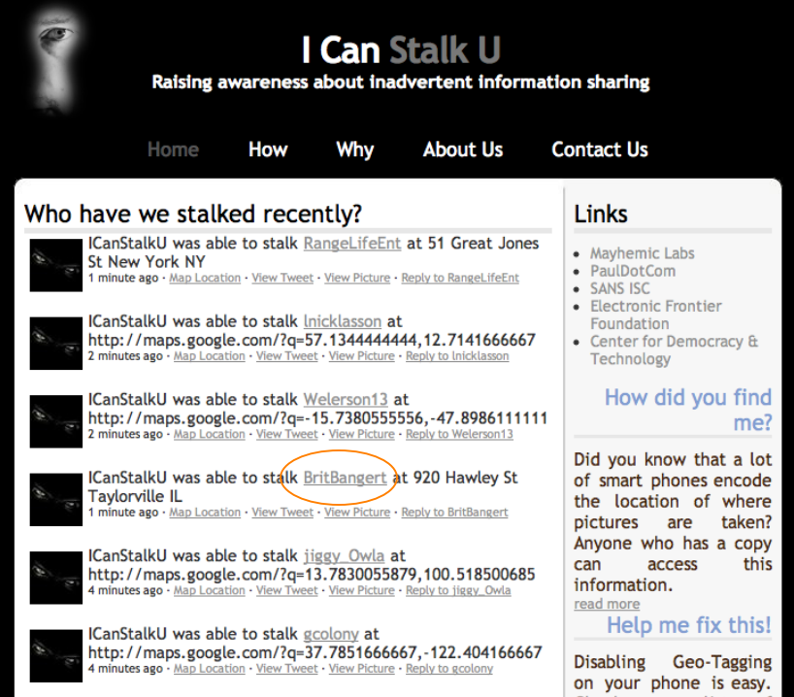
Information sharing
Can be inadvertent, but hard to raise awareness.
Project from
2010:

Slide 5
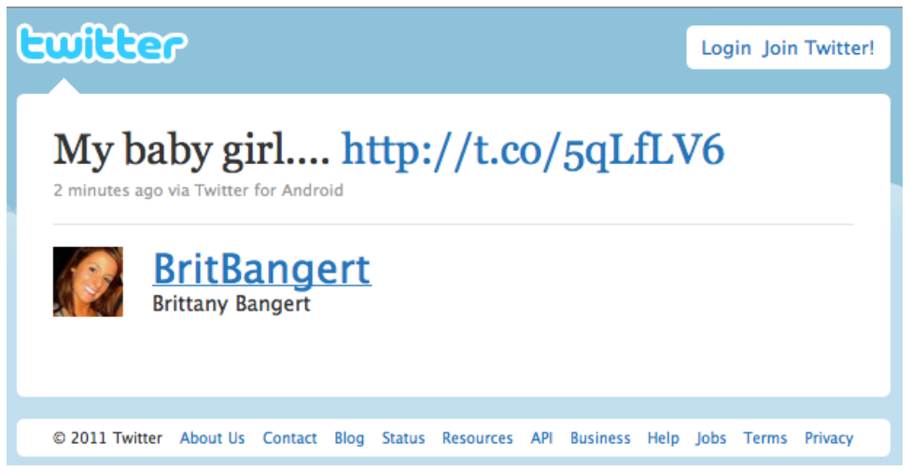
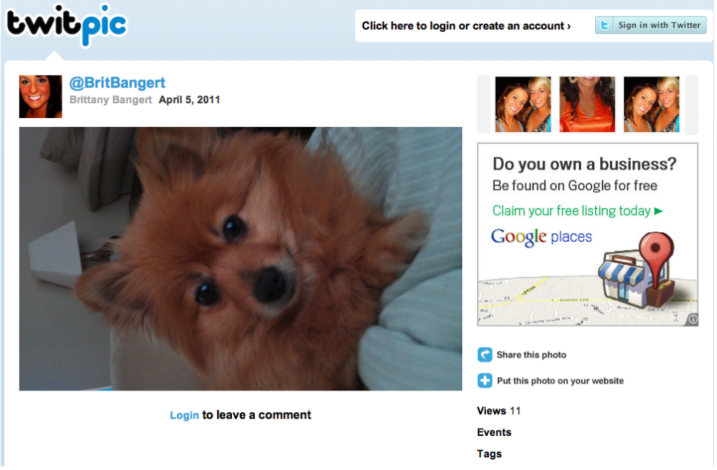

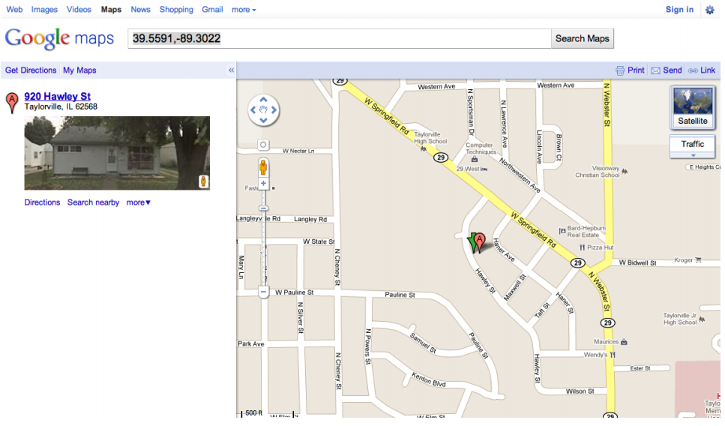
What it did:

Slide 6
An example: privacy policies
Website privacy policies:
Some protection: US sites can be convicted of false advertising if they violate them
But policies can be anything
Most people answer: “Well, but if they’re that bad, people will notice and not use the site! You can always opt out.”
How plausible?

Slide 7
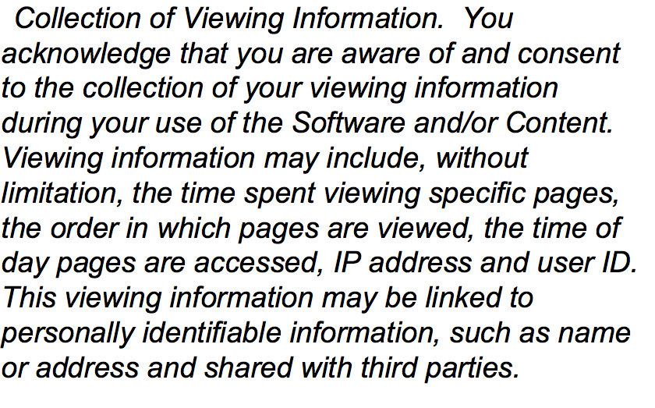
The New Yorker
Privacy policy as of a year ago (slightly different now, but close):

Slide 8
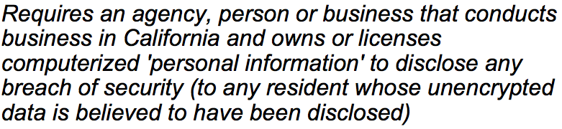
A good example
SB 1386 (California law passed in 2003):
Quite effective! Sites began to pay more attention, since this law applied to out of state companies also.

Slide 9
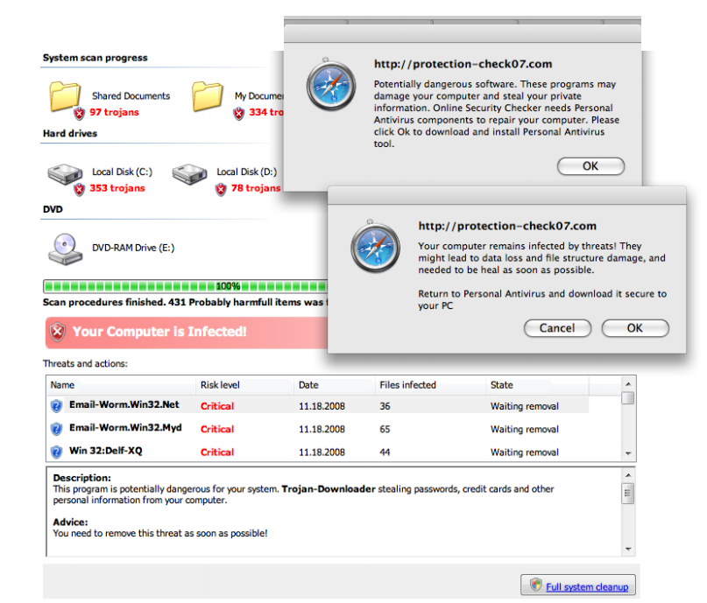
Malware Monetization
Malware can be used to generate money:
Keylogging
Ransomware
Scareware
Not exciting,
but a real issue
for most users!

Slide 10
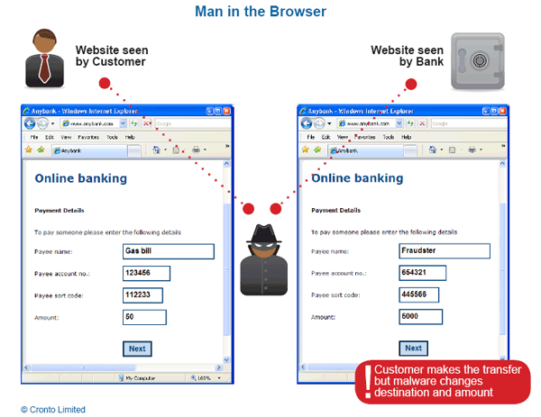
New variant: transaction generators
“Man-in-the-browser” attack:

Slide 11
Man-in-the-browser (cont)
Malware installed in your browser that ensures the customer always sees what they expect, but the actual values are changed when sent to destination
Classic example: bank attacks
Not really defeated by strong authentication! This falls under transaction verification.
Best defense is those annoying text messages your bank wants you to sign up for

Slide 12
Large scale malware: botnets
Large scale attacks generally require an “army”.
Interesting point – the infected user is actually impacted very little! Cost is external.
Used for:
DDoS (extortion)
Spam
Click fraud
Scam infrastructure, such as posting a webpage, DNS takedowns, or proxy traffic

Slide 13
More on Spam
Spam, at its heart, is an effort to get customers.
Think of snail mail analog, which is not illegal.
However, main difference is the burden of cost – on the receiver rather than the sender.
Not trivial: estimated at around $100 billion a year to store and send spam.
What ways can spammers make money, and what incentive is there to stop it?

Slide 14
Monetizing spam
Examples:
Emails asking for money or offering profit scheme
Phishing for passwords and private information
Advertising goods and services
Recruiting crooks, bots, etc.
Pump-and-dump stocks
Primary cost to sender is maintaining the list
Either automated web crawler or purchasing lists from others
(Remember that New Yorker policy that so bothered me?)

Slide 15
Economics of Spam
Recent experiment: After infiltrating a botnet, researchers wanted to find out how much people actually click on spam emails.
Result: 350 million messages sent, and 28 people responded
Success rate is .000008%
Estimated average across all types is only .0001% or less
But, given low costs, still raises a profit.

Slide 16
Life as a spammer
Storm infiltration study found:
Modern spam campaigns can send 10s of billions of spams using mailing lists of 100s of millions of addresses
3/4 to 5/6 of all spam delivery attempts fail before the message is even sent to the receiver’s server
due to heavy & effective use of black-listing
It takes around 20,000 “postcard” spams to get one person to visit the postcard site
1 in 10 of the visitors will click to download the postcard
It takes around 12,000,000 Viagra spams to get one person to visit the site and make a purchase (~$100)

Slide 17
Spam defenses
On the user end:
Give out email only to trusted websites!
Never list email directly on the web – use “– at –” notation or an image
Industry side:
MTA authentication via DKM, so that “from” field can’t be spoofed
Sender Policy Framework (SPF) – checks if the message comes from the correct IP network
not using crypto, so susceptible to IP spoofing
CAPTCHAs: Completely Automated Public Turing test to tell Computers and Humans Apart

Slide 18
Blacklisting and Greylisting
Several centralized hubs exist that track sources of spam, which many ISPs use to block these messages
Published in DNS blacklists: DNSBLs
Considered fairly controversial, since many are fairly aggressive in their classification
Greylisting: SMTP supports “temporary rejection”
Idea is that legitimate sender will log and resend after a certain amount of time
Spammers typically can’t handle this volume of response

Slide 19
Content filtering
Spam defense we are all familiar with, where software analyzes the text and decides if it is spam
Used in almost all commercial products now
Behind the scenes:
Bayesian filtering (machine learning)
ALPACAS (A Large-scale, Privacy-Aware Collaborative Antispam System)

Slide 20
Another angle:
One study looking at purchases of spam-advertised pharmaceuticals found that 3 banks actually hosted 95% or more of all the sales
Let to a novel idea: go against the credit card companies that process these transactions
Forces them to restrict activity, which shuts down many websites (and reduces the spam ads from them)

Slide 21
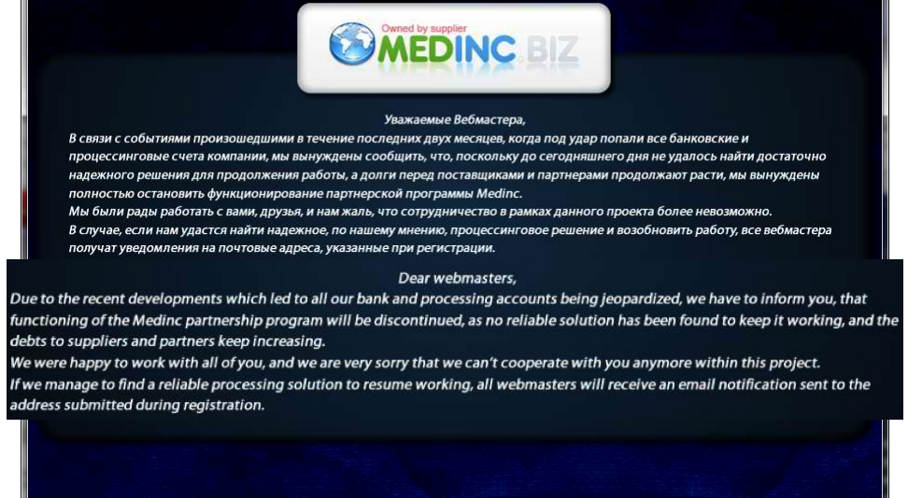
Results:

Slide 22
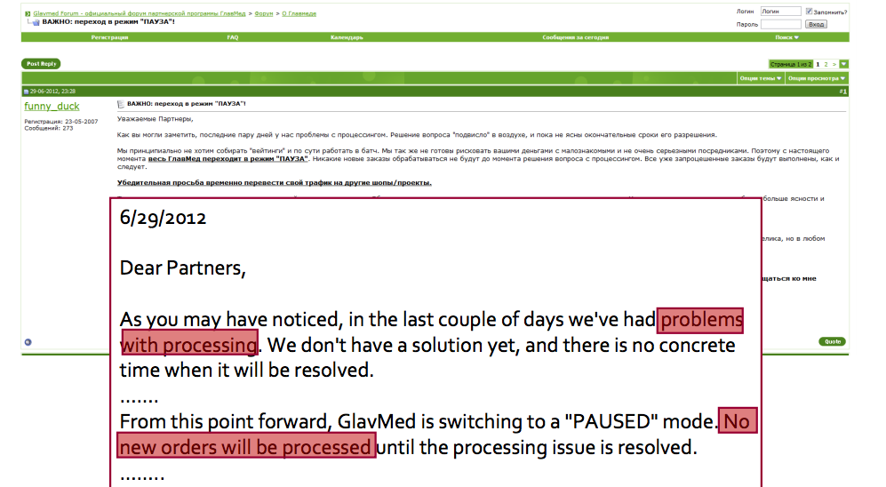
Results:

Slide 23
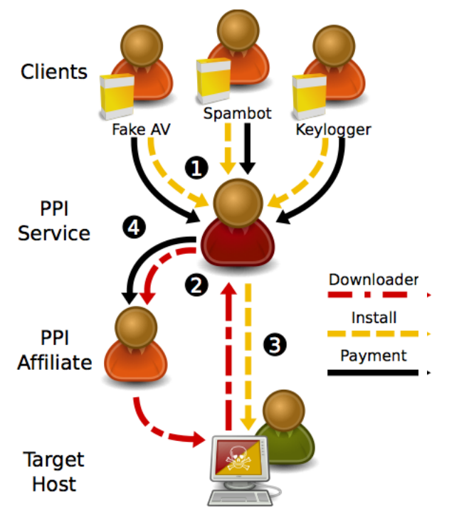
Pay per install
Idea: Affiliates sign up for building a network or earning money, and get a file from the PPI site
These files are bound with another program that they host on their site
Downloader then gets both files
Originally based on advertisements
Now used to spread spyware and malware

Slide 24
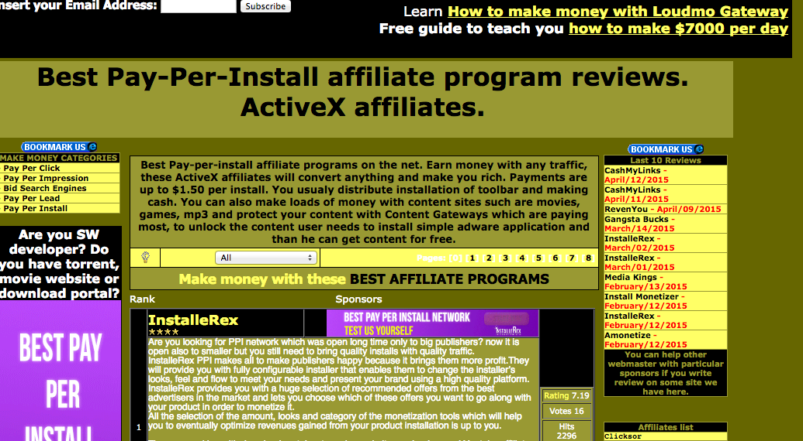
PPI

Slide 25
Why is this significant:
Markets enable efficiencies
Specialization: individuals rewarded for doing a single thing particularly well
Lowers barrier-to-entry
Only need a single skill
Some underground market activities are legal
Competition spurs innovation
Accelerates arms race
Defenders must assume a more pessimistic threat model
Facilitates non-$ Internet attacks (political, nation-state)
Provides actors with cheap attack components
Provides stealthy actors with plausible cover

Slide 26
Good news for the good guys:
Depending on marketplace architecture, can present a target / single point of failure
Remember that pharmaceutical example a few slides ago?
By definition, deals are between crooks
Major issue of betrayal by “rippers”
Markets only provide major efficiencies if they facilitate deals between strangers
Susceptible to infiltration

Slide 27
One final topic I didn’t do much with….
Programming language security:
Usually the focus of a final essay
Discussion:
What security features do you think should be in a language?
Which languages are the “most” secure?

