Slide 1
Network security
Further protocols and issues

Slide 2
Protocols: recap
There are a few main protocols that govern the internet:
Internet Protocol: IP
Transmission Control Protocol: TCP
ICMP
UDP
Most of these were designed before security was even an issue, and hence are fundamentally insecure.

Slide 3
IP Spoofing
IP protocol doesn’t prevent anyone from lying about the source address.
Simple utilities exist to do this – it is also done for testing and other legitimate purposes.
Simple packet filtering is the best defense – outside attacker then can’t spoof an inside address.
But IP is just inherently insecure!

Slide 4
Ingress filtering
Proposal to have every router drop packets with “invalid” IPs
Would eliminate spoofing if everyone did it, and is commonly used
However:
Source based
No incentives
Everyone must deploy

Slide 5
IPSec
Protocol that authenticates and encrypts each IP packet in a communication
Host to host or network to network or host to network, depending on setups
Provides data integrity, authentication, data confidentiality, and replay protection by using cryptography and a number of other protocols

Slide 6
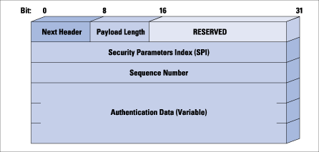
IPSec workings
Authentication header:
Protects integrity and data origin authentication
Can also defend against replay attacks

Slide 7
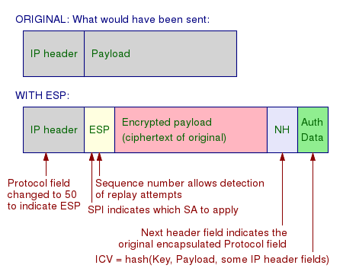
IPSec workings
Encapsulating security payload
Provides origin authenticity, integrity and confidentiality

Slide 8
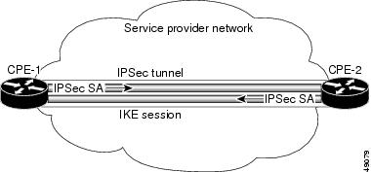
IPSec workings
Security association
The bundle of algorithms and parameters (such as keys) that is being used to encrypt and authenticate in one direction.
(So usually 2 per session.)

Slide 9
ICMP
The Internet Control Message Protocol exists to provide error reporting and testing to IP.
Primarily used by network devices like routers to send error messages.
Example: When the TTL field reaches 0, a message is sent to source address.
Many common utilities are built on this – traceroute, ping, etc.
Often blocked except from certain trusted sources.

Slide 10
UDP: User Datagram Protocol
UDP builds on top of IP by supporting port routing:
Destination port number gets a UDP data field that adds application process
Source port number provides a return address
Minimal guarantees – no acknowledgements, flow control, or anything
In a sense, not easy to attack, but not reliable anyway!

Slide 11
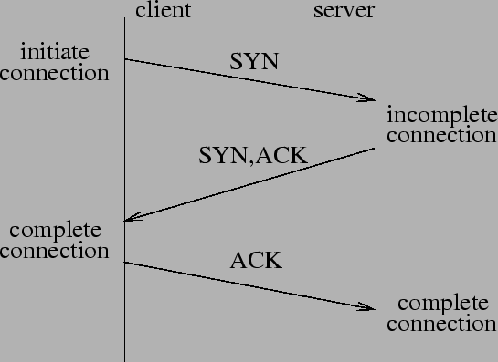
TCP: adding reliability
TCP preserves order and adds reliability:
Sender breaks data and attaches number
Receiver must acknowledge receipt, so lost packets are resent and packets are reassembled

Slide 12
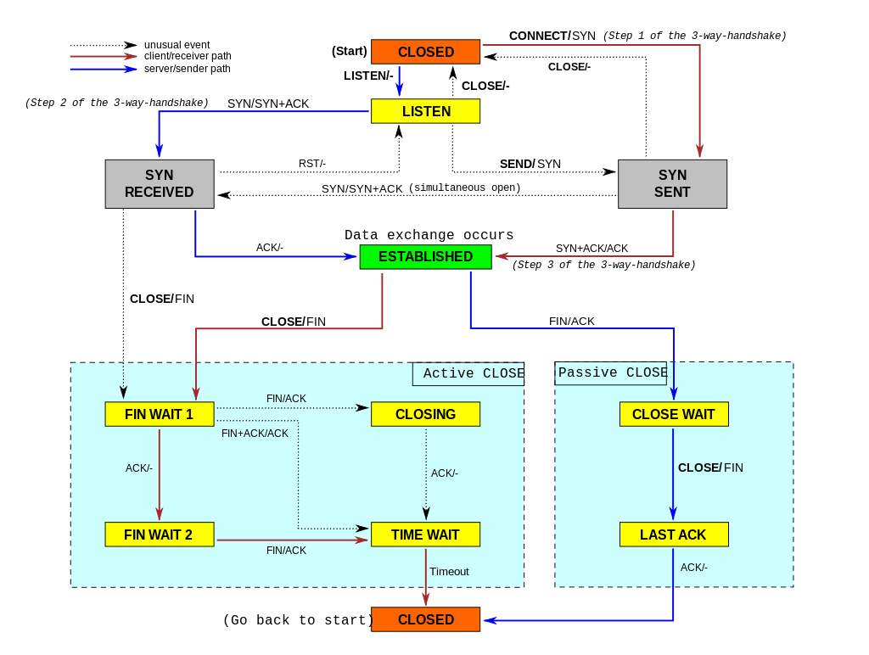
A bit more complex:

Slide 13
Some attacks on TCP
TCP states can be easy to guess
And hence spoofed or fooled
TCP connection requires state, which means the server has to remember something
TCP Syn floods can then overrun memory
Denial of service is easy on this protocol!
More details…

Slide 14
Force TCP Session Closing
Suppose an attacker can guess the sequence number for an existing connection
Then send reset packet to close connection (so DOS)
Can naively guess (1/2³² chance)
Most systems allow for some window of sequences, however, so much easier
This is especially successful against long lived connections (like BGP, etc.), especially combined with packet sniffing

Slide 15
TCP Spoofing
Each connection for TCP has some state associated
Client/server IP and port
Sequence numbers
Problem: easy to guess this state
Ports are standard
Sequence numbers stored in predictable way

Slide 16
Session Hijacking
Need a degree of unpredictability to avoid attacks.
If the attacker knows initial sequence number and rough amount of traffic, easier to guess, and can flood with likely numbers.
Some vulnerabilities are unavoidable, but simple randomization can make things harder.

Slide 17
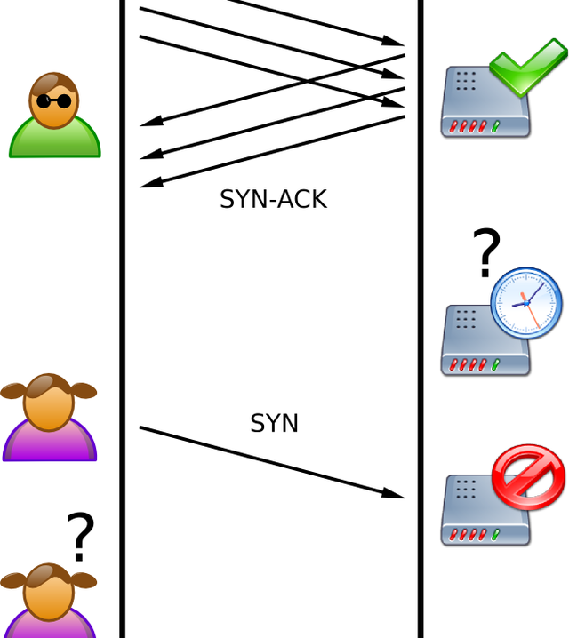
SYN flood
Attacker sends a ton of syn packets but no acks (or can use falsified IP so response will be ignored)
Server must remember all of these connections, so quickly runs out of space

Slide 18
SYN cookies
Invented by Dan Bernstein, the idea defeat SYN floods is to use “particular choices of initial TCP sequence numbers”.
Essentially, the server doesn’t have to remember the connection, but can instead reconstruct the query from the TCP sequence number.
Some restrictions – can’t accept some TCP options, and still some limits, but overall fairly successful.

Slide 19
Denial of service attacks
“Any attack that prevents or impairs the authorized use of networks, systems, or applications by exhausting resources such as CPU, memory, bandwidth, or disk space”
Can be local or network based
A Distributed DOS attack is a network based attack which uses multiple hosts

Slide 20
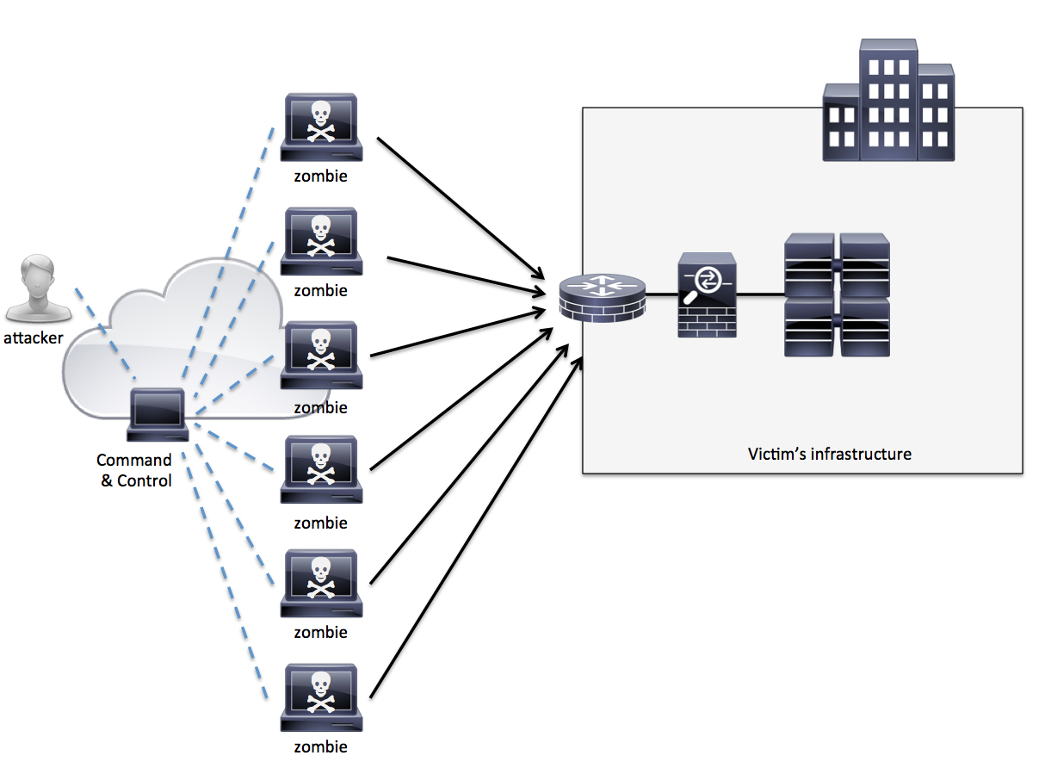
DDoS
Attacker compromises and uses other machines
Can spoof IPs to further complicate
Attack network or host resources
Long and active history…

Slide 21
DDoS reflector attack
Put victims IP as source address in many requests
The “reflector” machines then flood the victim
Advantages:
Hides source
Amplifies the attack
Successfully used many times

Slide 22
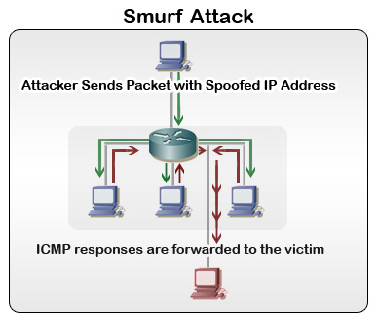
Smurf DoS attack
Attacker sends ICMP packets on broadcast mode with victim’s address as source.
On broadcast mode, everyone will then reply to that IP.

Slide 23
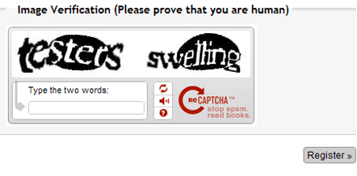
DDoS defenses
Packet filtering and monitoring
Change defaults – no ICMP broadcast anymore (mostly)
Incorporate SYN cookies
ISP filtering and traffic scrubbing
“Overprovision” servers
CAPTCHAs:

Slide 24
Intrusion detection/prevention
Deeper analysis and monitoring of network traffic, with content analysis
Network based
Host Based
Examples:
Snort
Verisys
Tripwire
Etc.

Slide 25
Detection methods
Misuse signature based detection
E.g. SNORT rules
Anomaly detection
Port scan detection
Combine well with firewalls, but usually more complex
Issues of resources and cost, allocation, separation of resources

Slide 26
Evasion techniques
Fragmentation: attack will go “under the radar” and bypass detection
Avoid defaults: IDS may expect trojans on particular ports, so configure to use different ports
Low bandwidth attacks – e.g. stealth port scanning
Address spoofing
Pattern change and evasion

Slide 27
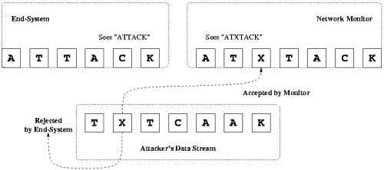
Attacks on NIDS
Insertion attacks:
NID systems actually keep “bad” packets that everyone else drops
This can actually be a vulnerability!

Slide 28
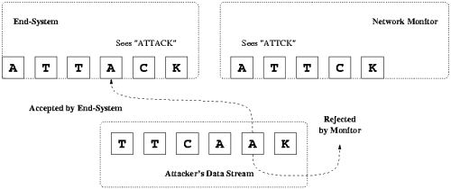
Attacks on NIDS
Evasion attacks:
End system can accept a packet that the NIDS rejects.

Slide 29
Not quite this simple…
In reality, it’s not quite this easy, but these simple ideas have been used in a multitude of ways on different systems.
Examples:
Bad headers
Unusual IP options
Even MAC addresses in the local network

Slide 30
Next time
Higher level protocols and their insecurities: DNS and BGP
Worms and Botnets
Onion routing and higher level (newish) constructions
Homework: read “required reading” section of lab by Thursday!

