Slide 1

Chapter 12 :: Concurrency
Programming Language Pragmatics
Michael L. Scott
Copyright © 2009 Elsevier

Slide 2
Background and Motivation
So far, we have focused on sequential programming:
  Necessary for traditional imperative programming
  Habitual in declarative or functional as well
However, some things can not be sequential!
  Some programs must track independent tasks
  Considerable speed can be gained
  Sometimes we have separate physical devices
Copyright © 2009 Elsevier

Slide 3
Background and Motivation
A process (or thread) is a potentially-active execution context
Classic von Neumann (stored program) model of computing has single thread of control
A concurrent system is one where two or more tasks are in process at the same time at any point
A system is parallel if more than one task can be physically active at once
  Requires more than 1 processor
(There is a difference between the two!)
Copyright © 2009 Elsevier

Slide 4
Background and Motivation
Processes/Threads can come from
  multiple CPUs
  kernel-level multiplexing of single physical machine
  language or library level multiplexing of kernel-level abstraction
They can run
  in true parallel
  unpredictably interleaved
  run-until-block
Most work focuses on the first two cases, which are equally difficult to deal with
Copyright © 2009 Elsevier

Slide 5
Background and Motivation
Historically, this work has come from two sources:
  Scientific computing, where (even on early supercomputers) parallelizing computations was important.
  Web development, which introduced the need for parallel servers and concurrent client programs.
    Go re-read the networking chapter of the 1300 textbook; even there, for our simple servers, we need to introduce threads so that the server can somehow make multiple communications coherent.
Copyright © 2009 Elsevier

Slide 6
Background and Motivation
Two main classes of programming notation
  synchronized access to shared memory
  message passing between processes that don't share memory
Both approaches can be implemented on hardware designed for the other, though shared memory on message-passing hardware tends to be slow
Principle difference: the message passing type requires active participation of 2 processors at either end - one to send and one to receive - while on a multiprocessor, reading or writing only needs one processor to control
Copyright © 2009 Elsevier

Slide 7
Coherence
Even on a multiprocessor, there is usually a local cache and a shared main memory, so issues can arise.
If two processors page in a common bit of memory, they may be operating under old or invalid data at the same time.
  This is known as the cache coherence problem.
On a bus-based system, things aren’t too bad, since processors can eavesdrop; when it needs to change its copy, it requests an exclusive copy and waits for the other processors to invalidate their copies
Without the bus, this is still an open question.
Copyright © 2009 Elsevier

Slide 8
Background and Motivation
Race conditions
  A race condition occurs when actions in two processes are not synchronized and program behavior depends on the order in which the actions happen
  Race conditions are not all bad; sometimes any of the possible program outcomes are ok (e.g. workers taking things off a task queue)
Copyright © 2009 Elsevier

Slide 9
Background and Motivation
Race conditions (which we want to avoid):
  Suppose processors A and B share memory, and both try to increment variable X at more or less the same time
  Very few processors support arithmetic operations on memory, so each processor executes
      LOAD X
      INC
      STORE X
  Suppose X is initialized to 0. If both processors execute these instructions simultaneously, what are the possible outcomes?
    could go up by one or by two
Copyright © 2009 Elsevier

Slide 10
Background and Motivation
Synchronization
  SYNCHRONIZATION is the act of ensuring that events in different processes happen in a desired order
  Synchronization can be used to eliminate race conditions
  In our example we need to synchronize the increment operations to enforce MUTUAL EXCLUSION on access to X
  Most synchronization can be regarded as either:
    Mutual exclusion (making sure that only one process is executing a critical section [touching a variable, for example] at a time),
    or as
    CONDITION SYNCHRONIZATION, which means making sure that a given process does not proceed until some condition holds (e.g. that a variable contains a given value)
Copyright © 2009 Elsevier

Slide 11
Background and Motivation
One might be tempted to think of mutual exclusion as a form of condition synchronization (the condition being that nobody else is in the critical section), but it isn't.
  The distinction is basically existential v. universal quantification
    Mutual exclusion requires multi-process consensus
We do not in general want to over-synchronize
  That eliminates parallelism, which we generally want to encourage for performance
Basically, we want to eliminate "bad" race conditions, i.e., the ones that cause the program to give incorrect results
Copyright © 2009 Elsevier

Slide 12
Background and Motivation
Historical development of shared memory ideas
  To implement synchronization you have to have something that is ATOMIC
    that means it happens all at once, as an indivisible action
    In most machines, reads and writes of individual memory locations are atomic (note that this is not trivial; memory and/or busses must be designed to arbitrate and serialize concurrent accesses)
    In early machines, reads and writes of individual memory locations were all that was atomic
  To simplify the implementation of mutual exclusion, hardware designers began in the late 60's to build so-called read-modify-write, or fetch-and-phi, instructions into their machines
Copyright © 2009 Elsevier

Slide 13
Synchronization
Synchronization is generally implicit in memory passing models, since a message must be send before it can be received.
However, in shared-memory, unless we do something special, a new “receiving thread” will not necessarily wait, and could read an “old” value of a variable before it has been written by the “sending” thread.
Usually implement (in either model) by spinning or blocking.
Copyright © 2009 Elsevier

Slide 14
Concurrent Programming Fundamentals
SCHEDULERS give us the ability to "put a thread/process to sleep" and run something else on its process/processor
Six principle options in most systems:
  Co-begin
  Parallel loops
  Launch-at-elaboration
  Fork (with optional join)
  Implicit receipt
  Early reply
Copyright © 2009 Elsevier

Slide 15
Co-begin
This allows a set of operations to be performed at the same time:
co-begin
stmt_1
stmt_2
…
stmt_n
end
Each statement is usually a subroutine call, but can be any sequential or parallel compound itself.
Copyright © 2009 Elsevier

Slide 16
Parallel Loops
Specifies a loop whose iterations happen concurrently. For example, in OpenMP for C:
for (int i = 0; i < 3; i++) {
printf(“thread %d here\n”, i);
}
In C#:
Parallel.For(0,3, i=> {
Console.WriteLine(“Thread “ + I + “here”);
});
Copyright © 2009 Elsevier

Slide 17
Launch-at-elaboration
In some languages, code for a thread looks like that of a subroutine with no parameters. When the declaration is elaborated, a thread is created to execute the code.
In Ada (where threads are tasks):
procedure P is
task T is
…
end T;
begin -- P
…
end P;
}
  Task T has its own block, which begins to execute as soon as P is entered. If P is recursive, there may be many copies of T operating concurrently. When end of P is reached, it waits for “its” copy of T to end before leaving.
Copyright © 2009 Elsevier

Slide 18
Fork/join
Fork is more general than the last 3 examples: makes the creation of threads an explicit executable task.
Join is the reverse operation, which allows a thread to wait for the completion of a previously forked thread.
Java syntax, where we need inheritance:
class ImageRenderer extends Thread {
…
ImageRenderer(args) {
//constructor
}
public void run() {
//code to be run by the thread
}
}
  The thread is started not at creation, but when the method start is called. Note that this requires run to be defined.
Copyright © 2009 Elsevier

Slide 19
Fork/join
Other variants:
  In C#, thread classes don’t need to inherit. Instead, one can be created from an arbitrary ThreadStart delegate:
  class ImageRenderer {
…
public ImageRenderer(args) {
//constructor
}
public void Foo() {
//code to be run by the thread
}
}
…
ImageRenderer rendObj = new ImageRenderer(args);
Thread rend = new Thread(new
ThreadStart(rendObj.Foo));
Copyright © 2009 Elsevier

Slide 20
Fork/join
Other variants:
  In the new language Clik (recently developed at MIT and licensed to a private company), threads are simply created by the call spawn:
spawn any_function(args);
Later, the built in operation sync will join any threads. The language includes built-in (very efficient) support.
Copyright © 2009 Elsevier

Slide 21
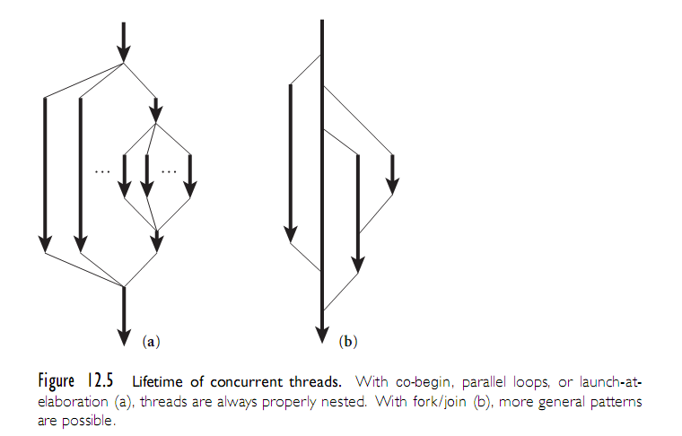
Concurrent Programming Fundamentals
Copyright © 2009 Elsevier

Slide 22
Concurrent Programming Fundamentals
Implementations of threads
  Threads must be implemented on top of the OS processes.
  Could put each thread on a separate OS process - but this is expensive.
    Processes are implemented in the kernel, and need procedure calls.
    These are general purpose, which means extra features we don’t need but must pay for anyway.
  At the other end, could put all threads onto one process.
    Means there is no real parallel programming!
    If current thread blocks, then none of the other threads can run if the process is suspended by the OS.
  Generally, some in-between.
Copyright © 2009 Elsevier

Slide 23
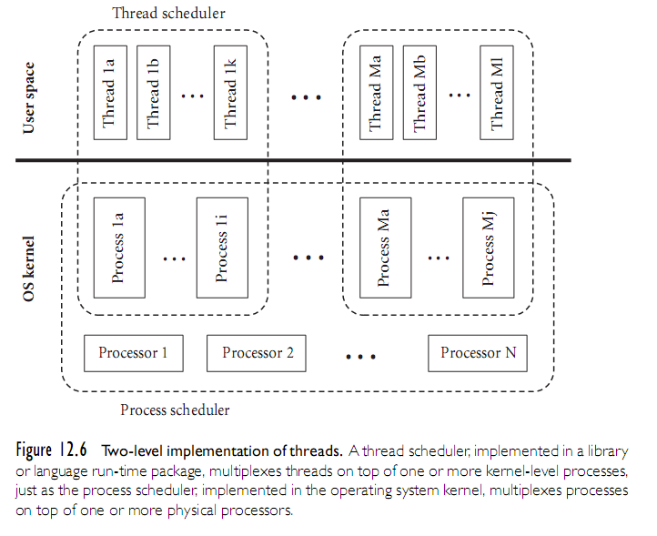
Concurrent Programming Fundamentals
Copyright © 2009 Elsevier

Slide 24
Concurrent Programming Fundamentals
Need to implement threads running on top of processes.
Coroutines: a sequential control-flow mechanism
  The programmer can suspend the current coroutine and resume a specific other routine by calling transfer command.
  Input to transfer is typically a pointer.
  Saw these in chapter 8: they are useful because they save the old program counter in an entirely separate space on the stack, and when we resume, it starts right where the last call left off.
Copyright © 2009 Elsevier

Slide 25
Concurrent Programming Fundamentals
Coroutines
  Multiple execution contexts, only one of which is active
  Other and current are pointers to context blocks
    Contains sp; may contain other stuff as well (priority, I/O status, etc.)
  Store these context blocks on a queue, and a thread can:
    Yield the processor and add itself to the queue if it is waiting for something else to complete
    Yield voluntarily for fairness (or be forced to by the scheduler)
  In any case, a new thread is removed from the queue and given the process once the current thread yields
Copyright © 2009 Elsevier

Slide 26
Concurrent Programming Fundamentals
Run-until block threads on a single process
  Need to get rid of explicit argument to transfer
  Ready list data structure: threads that are runnable but not running
      procedure reschedule:
        t : cb := dequeue(ready_list)
        transfer(t)
  To do this safely, we need to save 'current' somewhere - two ways to do this:
    Suppose we're just relinquishing the processor for the sake of fairness (as in MacOS or Windows 3.1):
      procedure yield:
        enqueue (ready_list, current)
        reschedule
    Now suppose we're implementing synchronization:
      sleep_on(q)
        enqueue(q, current)
        reschedule
  Some other thread/process will move us to the ready list when
  we can continue
Copyright © 2009 Elsevier

Slide 27
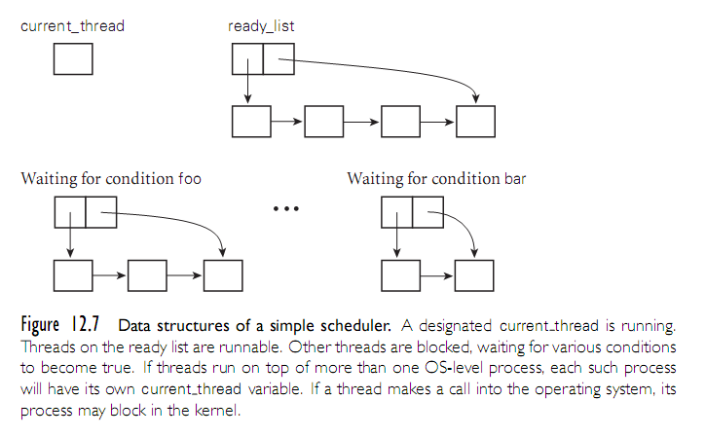
Concurrent Programming Fundamentals
Copyright © 2009 Elsevier

Slide 28
Implementing Synchronization
Condition synchronization with atomic reads and writes is easy
  You just cast each condition in the form of "location X contains value Y" and you keep reading X in a loop until you see what you want
Mutual exclusion is harder – for example, busy-wait synchronization
  Much early research was devoted to figuring out how to build it from simple atomic reads and writes
  Dekker is generally credited with finding the first correct solution for two processes in the early 1960s
  Dijkstra published a version that works for N processes in 1965
  Peterson published a much simpler two-process solution in 1981
In practice, we need a constant time and space solution, and for this, we need atomic instructions that can do more.
Copyright © 2009 Elsevier

Slide 29
Implementing Synchronization
Repeatedly reading a shared location until it reaches a certain value is known as spinning or busy-waiting.
A busy-wait mutual exclusion mechanism is known as a spin lock.
Simple example: test_and_set, which sets a variable to true and returns boolean indicating if it was false.
type lock = boolean := false;
procedure aquire_lock(ref L : lock)
while not test_and_set(L)
while L
--nothing - spin
procdure release_lock(ref L : lock)
L := false
Copyright © 2009 Elsevier

Slide 30
Implementing Synchronization
Barriers are provided to make sure every thread completes a particular section of code before proceeding.
Implemented as a number, initialized to the number of threads, and a boolean, done = FALSE.
When a thread finishes, it subtracts 1 from the number and waits until done is set to true.
The last thread that sets the counter to 0 will set done equal to false, freeing all the threads to continue.
Note that the counter means that we need O(n) time for n processors to synchronize and continue, which is too long in some machines.
  Best known is O(log n), although some specially designed hardware can get this closer to O(1) in practice.
Copyright © 2009 Elsevier

Slide 31
Implementing Synchronization
The problem with spin locks is that they waste processor cycles.
Sychronization mechanisms are needed that interact with a thread/process scheduler to put a process to sleep and run something else instead of spinning.
Note, however, that spin locks are still valuable for certain things, and are widely used.
  In particular, it is better to spin than to sleep when the expected
  spin time is less than the rescheduling overhead
Copyright © 2009 Elsevier

Slide 32
Implementing Synchronization
Semaphors were the first proposed scheduler-based synchronization mechanism, and remain widely used.
  Described by Dijkstra in 1960’s, and are in Algol 68.
Conditional critical regions and monitors came later
Monitors have the highest-level semantics, but a few sticky semantic problem - they are also widely used
Synchronization in Java is sort of a hybrid of monitors and CCRs (Java 3 will have true monitors.)
Shared-memory synch in Ada 95 is yet another hybrid
Copyright © 2009 Elsevier

Slide 33
Implementing Synchronization
A semaphore is a basically just a counter.
It has an initial value and two operations, P and V, for changing that value.
  A thread that calls P atomically decrements the counter and waits until it is nonnegative.
  A thread that calls V atomically increments the counter and wakes up any waiting threads.
Binary semaphore will be initialized to 1, and any P/V operations occur in paris.
This is basically a mutual exclusion lock - P aquires the lock, and V releases it.
Copyright © 2009 Elsevier

Slide 34
Implementing Synchronization
More generally, if initialized to some k, it will allocate k copies of some resource.
A semaphore in essence keeps track of the difference between the number of P and V operations that have occurred.
A P operation is delayed (the process is de-scheduled) until #P-#V <= k, the initial value of the semaphore.
Copyright © 2009 Elsevier

Slide 35
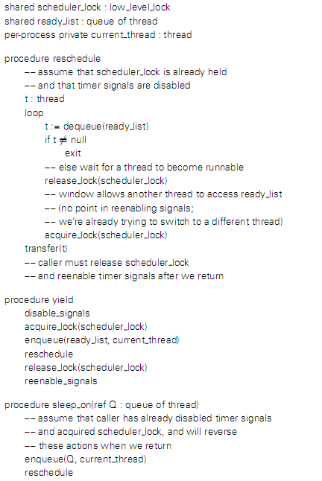
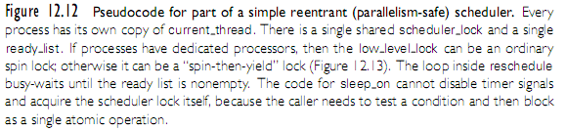
Implementing Synchronization
Note: a possible implementation is shown on the next slide
Copyright © 2009 Elsevier

Slide 36
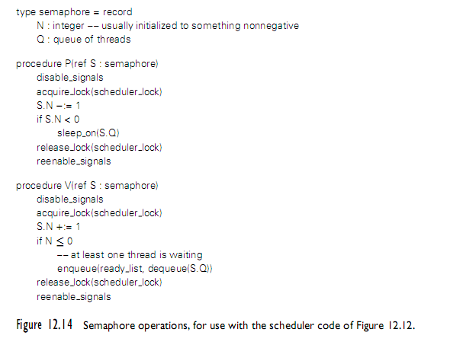
Implementing Synchronization
Copyright © 2009 Elsevier

Slide 37
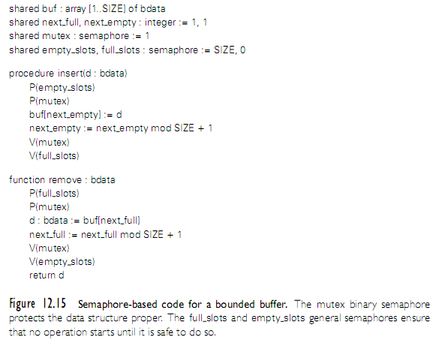
Implementing Synchronization
Copyright © 2009 Elsevier

Slide 38
Implementing Synchronization
It is generally assumed that semaphores are fair, in the sense that processes complete P operations in the same order they start them
Problems with semaphores
  They're pretty low-level.
    When using them for mutual exclusion, for example (the most common usage), it's easy to forget a P or a V, especially when they don't occur in strictly matched pairs (because you do a V inside an if statement, for example, as in the use of the spin lock in the implementation of P)
  Their use is scattered all over the place.
    If you want to change how processes synchronize access to a data structure, you have to find all the places in the code where they touch that structure, which is difficult and error-prone
Copyright © 2009 Elsevier

Slide 39
Language-Level Mechanisms
Monitors were an attempt to address the two weaknesses of semaphores listed above
They were suggested by Dijkstra, developed more thoroughly by Brinch Hansen, and formalized nicely by Hoare in the early 1970s
Several parallel programming languages have incorporated monitors as their fundamental synchronization mechanism
  none incorporates the precise semantics of Hoare's formalization
Copyright © 2009 Elsevier

Slide 40
Language-Level Mechanisms
A monitor is a shared object with operations, internal state, and a number of condition queues. Only one operation of a given monitor may be active at a given point in time
A process that calls a busy monitor is delayed until the monitor is free
  On behalf of its calling process, any operation may suspend itself by waiting on a condition
  An operation may also signal a condition, in which case one of the waiting processes is resumed, usually the one that waited first
Copyright © 2009 Elsevier

Slide 41
Language-Level Mechanisms
The precise semantics of mutual exclusion in monitors are the subject of considerable dispute. Hoare's original proposal remains the clearest and most carefully described
  It specifies two bookkeeping queues for each monitor: an entry queue, and an urgent queue
  When a process executes a signal operation from within a monitor, it waits in the monitor's urgent queue and the first process on the appropriate condition queue obtains control of the monitor
  When a process leaves a monitor it unblocks the first process on the urgent queue or, if the urgent queue is empty, it unblocks the first process on the entry queue instead
Copyright © 2009 Elsevier

Slide 42
Language-Level Mechanisms
Building a correct monitor requires that one think about the "monitor invariant“. The monitor invariant is a predicate that captures the notion "the state of the monitor is consistent."
  It needs to be true initially, and at monitor exit
  It also needs to be true at every wait statement
  In Hoare's formulation, needs to be true at every signal operation as well, since some other process may immediately run
Hoare's definition of monitors in terms of semaphores makes clear that semaphores can do anything monitors can
The inverse is also true; it is trivial to build a semaphores from monitors (Exercise in book, actually)
Copyright © 2009 Elsevier

Slide 43
Language-Level Mechanisms
Condition critical regions, like monitors, are an easier to use alternative to semaphors.
Example:
  region protected_variable, when bool_cond do:
  code that can modify protected_variable
  end region
No thread can access a protected variable expect within the region statement for that variable.
Boolean is a lock to be sure only 1 thread is in there at a time.
Avoids the user having to check everything themselves.
Built in to Edison, and seems to have influenced Java/C#.
Copyright © 2009 Elsevier

Slide 44
Language-Level Mechanisms
In Java, every object accessible to more than 1 thread has an implicit mutual exclusion lock built in.
Java example:
  synchronized (my_shared_object) {
  \\ critical section of code
  }
A thread can suspend or voluntarily release itself using wait. It can even wait until some condition is met:
  while (!condition) {
  wait();
  }
C# has a lock statement that is essentially the same.
Copyright © 2009 Elsevier

Slide 45
Language-Level Mechanisms
C/C++ has pthreads and mutex locks, but nothing like the extent of support in Java (and somewhat non-standard between versions).
  Large scale projects use MPI library package.
One advantage of Haskell (and other pure functional languages) is that they can be parallelized very easily. Why?
Prolog can also be easily parallelized, with two different strategies:
  Parallel searches for things on the right of a predicate
  Parallel searches to satisfy two different predicates
Copyright © 2009 Elsevier

