Slide 1

Chapter 13 :: Scripting Languages
Programming Language Pragmatics
Michael L. Scott
Copyright © 2009 Elsevier

Slide 2
What Is A Scripting Language
Modern scripting languages have two principal sets of ancestors.
  command interpreters or “shells” of traditional batch and “terminal” (command-line) computing
    IBM’s JCL, MS-DOS command interpreter, Unix sh and csh
  various tools for text processing and report generation
    IBM’s RPG, and Unix’s sed and awk.
From these evolved
  Rexx, IBM’s “Restructured Extended Executor,” which dates from 1979
  Perl, originally devised by Larry Wall in the late 1980s, and now (still?) the most widely used general purpose scripting language.
  Other general purpose scripting languages include Tcl (“tickle”), Python, Ruby, VBScript or Powershell (for Windows) and AppleScript (for the Mac)
Copyright © 2009 Elsevier

Slide 3
Common Characteristics:
Last time, we discussed a few commonalities:
  Batch/interactive use
  Economy of expression
  Simple scoping combined with no declarations
  Flexible, dynamic typing
  Easy access to OS functionality
  Sophisticated string matching
  High level data types often included (in more modern ones)
Copyright © 2009 Elsevier

Slide 4
Shell scrips
We also went over some of the basics of shell scripting
Completely useful, although very easy to forget if you don’t use it regularly
My goal here is to familiarize you with the basics, so that this is something you can come back to easily later on
  Again, this is something you’ve already done a bit of, since the command line IS a shell script – you will probably just need to adapt to using for loops, piping things together, etc.
Copyright © 2009 Elsevier

Slide 5
More on Sed/Awk
We saw a few examples of Sed and Awk programs, but I’d like to consider the syntax a bit more carefully today
This are very simple programs, but powerful in their own right, especially for doing simple pattern maching/replacement on a UNIX system
Copyright © 2009 Elsevier

Slide 6
Sed commands
The key to Sed for most people is the substitute command, S
  Simple example: change “day” in the “old” file to “night” in the “new” file:
  sed s/day/night/ <old >new
And if you want to test this, can use a shell script!
  Pipe the output of sed command so that it will print:
  echo day | sed s/day/night/
Some quirks:
  The following will print out “Sunnight”:
  echo Sunday | sed 's/day/night/'
Copyright © 2009 Elsevier

Slide 7
Sed commands
By default, things are only changed once:
  sed ‘s/one/ONE/’ < file
  File:
  one two three, one two three
  four three two one
  one hundred
  Output:
  ONE two three, one two three
  four three two ONE
  ONE hundred
Copyright © 2009 Elsevier

Slide 8
A tiny bit of AWK
AWK’s basic structure:
  pattern { action }
  $n indicates the n-th field of the input line
  Example: FileOwner:
  BEGIN { print “File\tOwner” }
  { print $9, “\t”, $3 }
  END { print “ – DONE – “ }
  Using it: ls –l | FileOwner
  Output: File Owner
  a.file barnett
  another.file barnett
  - DONE -
Copyright © 2009 Elsevier

Slide 9
Newer text processing: Perl
Perl was originally developed by Larry Wall in 1987, while he was working at the NSA
The original version was an attempt to combine sed, awk, and sh
It was a Unix-only tool, meant primarily for text processing (the name stands for “practical extraction and report language”)
  over the years Perl has grown into a large and complex language
Perl is almost certainly the most popular and widely used scripting language
It is also fast enough for general purpose use, and includes separate compilation, modularization, and dynamic library mechanisms appropriate for large-scale projects
It has been ported to almost every known operating system
Copyright © 2009 Elsevier

Slide 10
Simple intro to Perl
Your first script:
#!/usr/local/bin/perl
print ”Hello world!\n";
Variables start with a $:
$apple_count = 5;
$count_report = "There are $apple_count apples.";
print "The report is: $count_report\n";
Output from the above is: “The report is: There are 5 apples.”
Copyright © 2009 Elsevier

Slide 11
Perl: string details
Regular expressions are in slashes, and matching is with the =~
$sentence =~ /the/
  The above is true if the string “the” appears in variable $
Simple pattern replacement: The following prints “Hello mom!”
$mystring = "Hello world!";
$mystring =~ s/world/mom/;
print $mystring;
Does a string contain a digit: the following prints “Yes”
$mystring = "[2004/04/13] The date of this article.";
if($mystring =~ m/\d/) { print "Yes"; }
Copyright © 2009 Elsevier

Slide 12
Perl: string details
These can get more complex: the following prints “The first number is 2004”:
$mystring = "[2004/04/13] The date of this article.";
if($mystring =~ m/(\d+)/) {
print "The first number is $1.”;}
Also simple repetition: g does a global search – the entire string from left to right.
$mystring = "[2004/04/13] The date of this article.";
while($mystring =~ m/(\d+)/g) {
print "Found number $1.”;}
Copyright © 2009 Elsevier

Slide 13
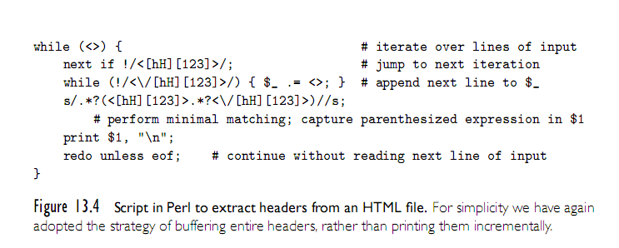
Perl Example
Copyright © 2009 Elsevier

Slide 14
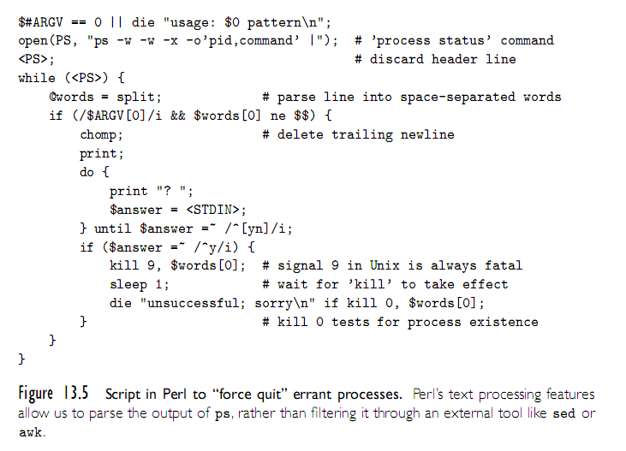
Another Perl Example
Copyright © 2009 Elsevier

Slide 15
Mathematical Languages
While a slightly different setup, it’s worth mentioning the languages that have evolved to serve mathematics and statistics.
Originated in APL (or “A Programming Language”), which was designed in the 1960’s by Kenneth Iverson to emphasize concise, elegant expressions for mathematical algorithms.
Modern successors: Maple, Matlab, and Mathematica.
  Each of these has its own strengths, but all support numerical methods, symbolic mathematics, mathematical modeling, and real arithmetic.
Copyright © 2009 Elsevier

Slide 16
Mathematical Languages: Maple
Maple focuses on doing computer algebra well. (NOT college algebra – group theory and symbolic computation).
Dynamically typed, imperative, with lexical scoping.
Goal was a powerful symbolic language that could run on low cost computers (in the 1980’s). Coded it with a small C kernal, and released in 1982.
Can do all the basics – integration, series expansion, plotting, Laplace transforms, etc.
Copyright © 2009 Elsevier

Slide 17
Mathematical Languages: Matlab
Designed in the late 1970’s by a professor who wanted to give students access to certain functionality without having to learn FORTRAN.
Specialty and strength is really numerical computing – less symbolic and more handling operations on large matrices.
  Optional packages add symbolic computing, but not really as strong in this area.
Dynamic and weakly typed, with support for object oriented programming.
Copyright © 2009 Elsevier

Slide 18
Mathematical Languages: Mathematica
Designed by Stephen Wolfram while at U of I
Supports procedural, functional, and object oriented paradigms (although really functional at heart).
Strength is the sheer amount of supported libraries and tools – data and image visualization and processing, symbolic computations, and numerical operations, as well as more traditional mathematical tools.
Underneath, two parts: kernal and front end.
Copyright © 2009 Elsevier

Slide 19
Statistical Languages
Similarly, S and R evolved to serve the statistics community.
S was designed in the late 1970’s at Bell Labs, and is the dominant commercial language.
R is the (mostly) compatable open-source alternative, which seems to be taking over.
Features:
  Multidimensional array and list types
  Array slices
  Call-by-need parameters
  First-class functions
  Unlimited extent
Copyright © 2009 Elsevier

Slide 20
Statistical Languages: R example
library(caTools) #external package providing write.gif function
jet.colors <- colorRampPalette(c("#00007F", "blue", "#007FFF", "cyan", "#7FFF7F”,"yellow", "#FF7F00", "red", "#7F0000"))
m <- 1200 # define size
C <- complex( real=rep(seq(-1.8,0.6, length.out=m), each=m ),
imag=rep(seq(-1.2,1.2, length.out=m), m ) )
C <- matrix(C,m,m) #reshape as square matrix of complex numbers
Z <- 0 # initialize Z to zero
X <- array(0, c(m,m,20)) # initialize output 3D array
for (k in 1:20) { # loop with 20 iterations
Z <- Z^2+C # the central difference equation
X[,,k] <- exp(-abs(Z)) # capture results
}
write.gif(X, "Mandelbrot.gif", col=jet.colors, delay=1000)
Copyright © 2009 Elsevier

Slide 21

Statistical Languages: R example
Copyright © 2009 Elsevier

Slide 22
“Glue” languages
“Glue” Languages and General Purpose Scripting
  Rexx is generally considered the first of the general purpose scripting languages (predating Perl and Tcl by almost a decade, and Ruby and Python by even longer).
  Beyond text processing and shell features, these offer more full-featured scripting languages provide extensive libraries of OS control.
  Examples: File IO, process management, security, network/socket access, timing, synchronization.
  In a sense, just as text-processing mechanisms minimize the need to use external tools like sed, awk, and grep, operating system features built into the language minimize the need for other external interface tools.
  Many also provide higher-level types, such as hashes, tuples, strings, lists, etc., as well as better real-arithmetic support.
  Many even offer threads, first-class or higher-order functions, iterators, and more complex structures.
Copyright © 2009 Elsevier

Slide 23
“Glue” languages: Tcl
Tcl
  Tcl was developed in the late 1980s at UC, Berkeley (Prof. John Ousterhout)
  Over the previous several years his group had developed a suite of VLSI design automation tools, each of which had its own idiosyncratic command language
  The initial motivation for Tcl (“tool command language”) was the desire for an extension language that could be embedded in all the tools, providing them with uniform command syntax and reducing the complexity of development and maintenance
Tcl quickly evolved beyond its emphasis on command extension to encompass “glue” applications as well
  Ousterhout joined Sun Microsystems in 1994, where for three years he led a multiperson team devoted to Tcl development
In comparison to Perl, Tcl is somewhat more verbose
  It makes less use of punctuation, and has fewer special cases
Copyright © 2009 Elsevier

Slide 24
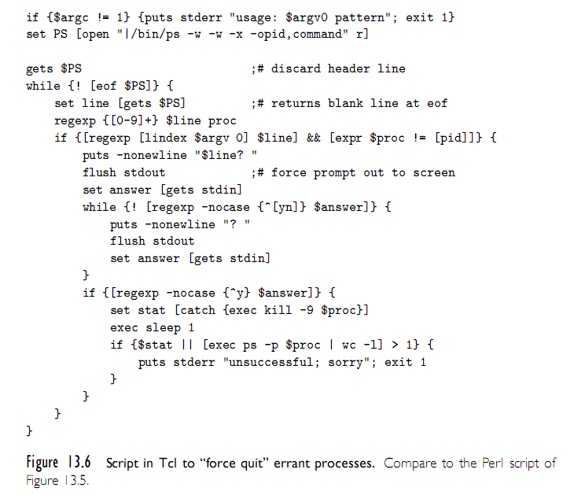
Tcl example
Copyright © 2009 Elsevier

Slide 25
“Glue” languages: Python and Ruby
“Glue” Languages and General Purpose Scripting
  Perl and Tcl are roughly contemporaneous: both were initially developed in the late 1980s
    Perl was originally intended for glue and text processing applications
    Tcl was originally an extension language, but soon grew into glue applications
  Python and Ruby came later, and that extra time is reflected in their design.
  Both really came out of a motivation by their users to “do it the right way”, not because there was no available tool.
Copyright © 2009 Elsevier

Slide 26
“Glue” languages: Python
Python was originally developed by Guido van Rossum at CWI in Amsterdam, the Netherlands, in the early 1990s
  He continued his work at CNRI in Reston, Virginia, beginning in 1995
  In 2000 the Python team moved to BeOpen.com, and to Digital Creations
  Recent versions of the language are owned by the Python Software
    All releases are Open Source.
Python features:
  First fully object-oriented scripting language.
  Standard library is just as rich as Perl, but partitioned into namespaces more like C++ (so that those modules must be imported).
  Perhaps most distinctively (and controversial), cares about indentation.
Copyright © 2009 Elsevier

Slide 27
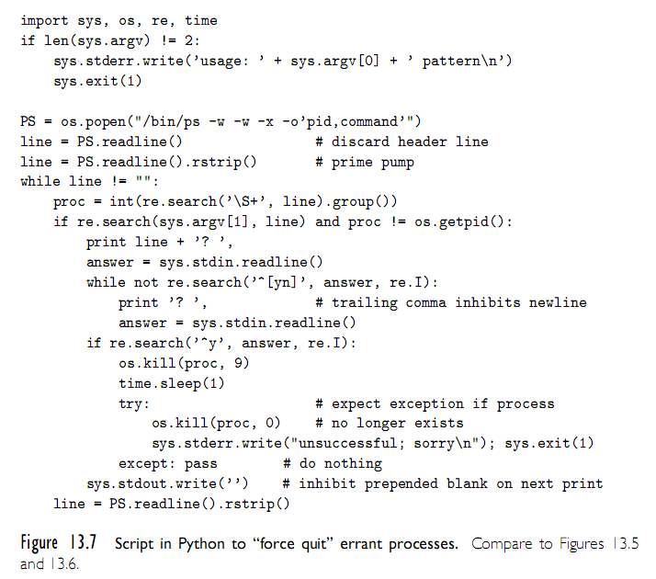
Python Example
Copyright © 2009 Elsevier

Slide 28
“Glue” languages: Ruby
Ruby
  As the popularity of scripting grew in the 1990s, users were motivated to develop additional languages, to provide additional features, address the needs of specific application domains or support a style of programming.
  Developed in 1990 by Matsumoto: “I wanted a language more powerful than Perl, and more object-oriented than Python.”
  Spread rapidly after 2001, partially due to the popular Ruby On Rails web-development framework.
  Notable features:
    Everything is an object (like in Smalltalk).
    Powerful use of blocks and iterators.
    Classes can inherit code from modules (not just other classes).
  See Fig. 13.8 for our same script in Ruby.
Copyright © 2009 Elsevier

