Slide 1
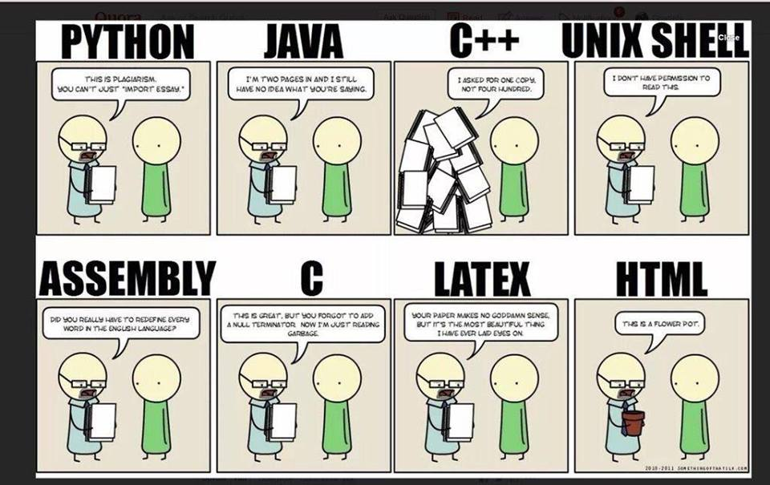

Chapter 13 :: Scripting Languages
Copyright © 2009 Elsevier

Slide 2
Another Problem Domain
Extension Languages
  An extension language is something that allows a user to create new commands inside a program
Most commercial products have their own unique scripting languages to do this
  Examples: AutoCAD, Flash
Some are done using existing languages:
  Examples: Adobe with JavaScript, Applescript on a mac, VB on a PC, AOLServer using Tcl, etc
Formally, to admit extension, a tool must:
  Incorporate or communicate with an interpreter for a scripting language
  Provide hooks to allow scripts to call existing commands
  Allow the user to tie new commands to user interface
Copyright © 2009 Elsevier

Slide 3
Extension languages
An example: one of the oldest existing extension mechanisms is that of the emacs text editor, used to write this book
  Many come standard with emacs, although users may not take advantage of them
  In emacs, built in functionality is actually pretty small – most good stuff comes from extensions that are just standard now
  Book has an example (fig 13.9) – see next slide
Copyright © 2009 Elsevier

Slide 4
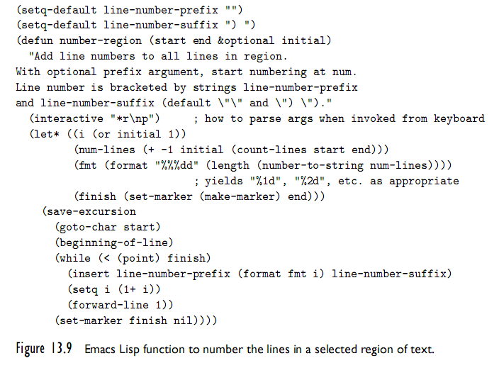
Problem Domains
Copyright © 2009 Elsevier

Slide 5
Scripting the World Wide Web
Much of the web is static, but the need for dynamic content is increasing
Scripts are a key component of this dynamic content, with two options:
  Server side: content should (or must) be controlled by service provider
  Client side: when proprietary information is not needed
Original mechanism: Common Gateway Interface (CGI) scripts
Since then, other options have evolved.
  Client side scripts
  Applets
  HTML itself
Copyright © 2009 Elsevier

Slide 6
CGI scripts: the beginning
A CGI script is an executable program residing in a special directory known to the web server program
  When a client requests the URI corresponding to such a program, the server executes the program and sends its output back to the client
    this output needs to be something that the browser will understand: typically HTML.
CGI scripts may be written in any language available on the server
  Historically, Perl is particularly popular:
    its string-handling and “glue” mechanisms are suited to generating HTML
    it was already widely available during the early years of the web
Copyright © 2009 Elsevier

Slide 7
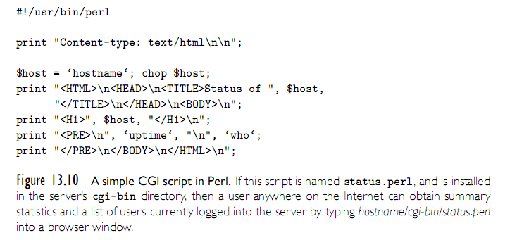
CGI Perl script
Copyright © 2009 Elsevier

Slide 8
Server side scripts
Though widely used, CGI scripts have several disadvantages:
  The web server must launch each script as a separate program, with potentially significant overhead
  Scripts must generally be installed in a trusted directory by trusted system administrators
  The name of the script appears in the URI (typically with directory info), so static and dynamic pages look different to end users
  Each script must generate not only dynamic content, but also the HTML tags that are needed to format and display it, which is annoying to code
Most web servers now provide ways for scripts in supported languages to be embedded in the web page
  Then the web server can interpret these directly, without launching external program, and replace them before they are sent to the client
Copyright © 2009 Elsevier

Slide 9
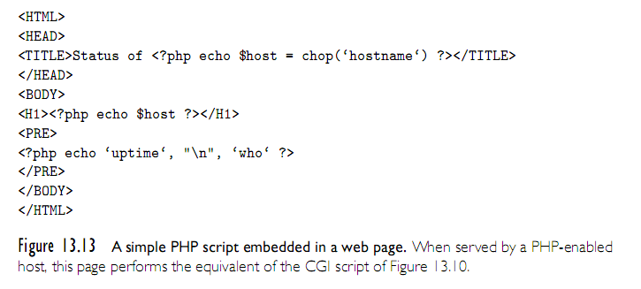
PHP sample script
Copyright © 2009 Elsevier

Slide 10
Client side scripts
Embedded server-side scripts are generally faster than CGI script, communication across the Internet is still too slow for interactive pages
  Real time changes in the page can’t be sent across the internet!
Client-side scripts, by contrast, require an interpreter on the client’s machine
  There is a powerful incentive for convergence in client-side scripting languages: most designers want their pages to be viewable by as wide an audience as possible
  (This is a huge different with server side, where client only ever gets html)
Copyright © 2009 Elsevier

Slide 11
Client side scripts - options
Visual basic is commonly used for explorer, but not so much others
Most common is probably JavaScript (probably because it was just in the right place at the right time, rather than any native virtue)
  JavaScript can interact with almost any part of HTML pages through use of the Document Object Model (DOM) in HTML specifications.
Copyright © 2009 Elsevier

Slide 12
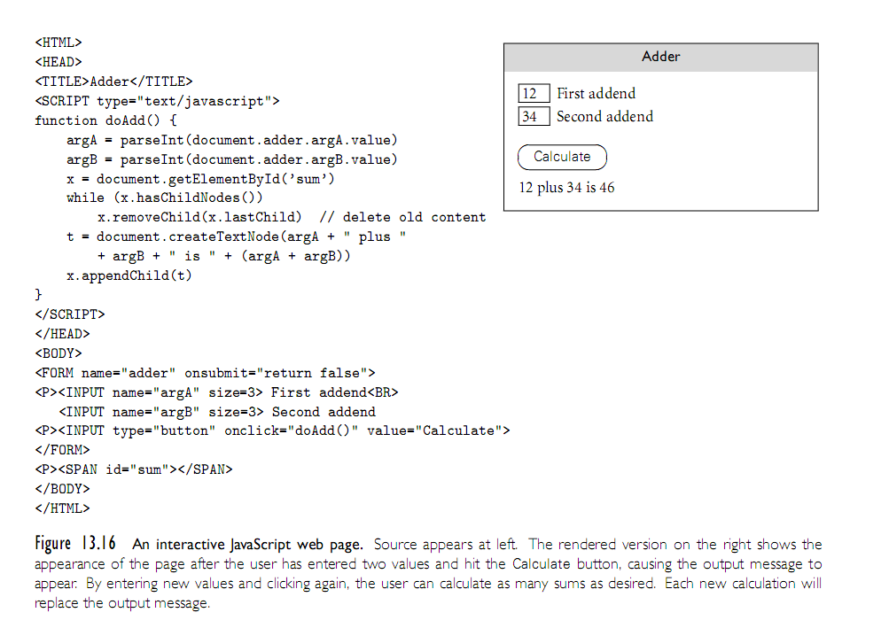
JavaScript
Copyright © 2009 Elsevier

Slide 13
Java and HTML
Java applets are an alternative to client side scripts
  Browsers will instead support plug-ins that assume responsibility for a particular part of the page, where it can display anything it wants
  To support execution of applets, most modern browsers contain a Java virtual machine.
  Historically, plug-ins exist for content that HTML supported poorly, such as animations and video
Example:
<embed type=“application/x-java-applet” code=“Clock.class”>
Copyright © 2009 Elsevier

Slide 14
Other embedded scripts
The JVM is not the only option:
  As of 2015, the most widely used plug-in is actually Adobe’s Flash Player
  It is scriptable, but is almost more of a multimedia display engine rather than a general purpose tool
Worthwhile note: plugins are notorious for security issues:
  They almost always require access to OS
  Not always upgraded by the user
  Not really owned by the browser, either
HTML 5 expansion is really due to these issues.
Copyright © 2009 Elsevier

Slide 15
Innovative Features
Earlier we listed several common characteristics of scripting languages:
  both batch and interactive use
  economy of expression
  lack of declarations; simple scoping rules
  flexible dynamic typing
  easy access to other programs
  sophisticated pattern matching and string manipulation
  high level data types
Copyright © 2009 Elsevier

Slide 16
Innovative Features: Scope and Names
Most scripting languages do not require variables to be declared
  Perl and JavaScript permit optional declarations - sort of compiler-checked documentation
  Perl can be run in a mode that requires declarations
With or without declarations, most scripting languages use dynamic typing
  The interpreter can perform type checking at run time, or coerce values when appropriate
  Tcl is unusual in that all values—even lists—are represented internally as strings
Copyright © 2009 Elsevier

Slide 17
Innovative Features: nesting and scope
Nesting and scoping conventions vary quite a bit
  Scheme, Python, JavaScript provide the classic combination of nested subroutines and static (lexical) scope
  Tcl allows subroutines to nest, but uses dynamic scope
  Named subroutines (methods) do not nest in PHP or Ruby
    Perl and Ruby join Scheme, Python, and JavaScript in providing firstclass anonymous local subroutines
  Nested blocks are statically scoped in Perl
  In Ruby, they are part of the named scope in which they appear
  Scheme, Perl, Python provide for variables captured in closures
  PHP and the major glue languages (Perl, Tcl, Python, Ruby) all have sophisticated namespace rules
    mechanisms for information hiding and the selective import of names from separate modules
Copyright © 2009 Elsevier

Slide 18
Innovative Features: scope
Undeclared variables with static scope present an interesting issue: how do we know if x is local, global, or in-between (if scopes can nest)?
  In Perl, all variables are global unless otherwise specified.
  In PHP, local unless explicitly imported.
  Ruby has only two levels: $foo is global, foo is local; @foo is instance of current object, and @@foo is instance variable of current object’s class
  In Python and R, all variables are local by default, unless explicitly imported
Copyright © 2009 Elsevier

Slide 19
Innovative Features: scope
Scope in Python
  In Python, all variables are local by default, unless explicitly imported:
  i=1; j=3
  def outer():
  def middle(k):
  def inner():
  global i #from main program, not outer
  i = 4
  inner()
  return i,j,k #3 element tuple
  i=2
  return middle(j) #old (global) j
  print outer()
  print i,j
  This prints: (2,3,3)
  4 3
Copyright © 2009 Elsevier

Slide 20
Innovative Features: scope
Scope in Python
  By default, there is no way for a nested scope to write to a non-local or non-global scope - so in previous example, inner could not modify outer’s i variable.
R has an interesting convention:
  Normal assignment puts value into the local variable:
  i <- 4
  Superassignment puts value into whatever variable would be found under normal (static) scoping rules:
  i <<- 4
Tcl uses dynamic scoping, but in an odd way - the programmer must request other scopes explicitly:
upvar i j ;#j is the local name for caller’s I
uplevel 2 {puts [expr $a + $b] }
#executes ‘puts’ two scopes up on dynamic chain
Copyright © 2009 Elsevier

Slide 21
Innovative Features: Pattern matching
Regular expressions are present in many scripting languages and related tools employ extended versions of the notation
  extended regular expressions (which we already saw) in sed and awk, Perl, Tcl, Python, and Ruby
  grep, the stand-alone Unix is a pattern-matching tool, is another useful program that you might be familiair with
In general, two main groups.
  The first group includes awk, egrep (the most widely used of several different versions of grep), the regex routines of the C standard library, and older versions of Tcl
    These implement REs as defined in the POSIX standard
  Languages in the second group follow the lead of Perl, which provides a large set of extensions, sometimes referred to as “advanced REs”
Copyright © 2009 Elsevier

Slide 22
Pattern matching: POSIX REs
Basic operations are familiar:
/ab(cd|ef)g*/ - Matches abcd, abcdg, abefg, abefgg, etc.
Other quantifiers:
  ?: 0 or 1 repetitions
  +: 1 or more repetitions
  {n}: exactly n repetitions
  {n,}: at least n repetitions
  {n,m}: between n and m repetitions
  ^ and $ force the match to be at the beinning or end of the line
  Brackets can indicate a character class: [aeiou] - any vowel
  Ranges: [0-9]
  A dot . matches any single character
  ^ before a character class is negation
Copyright © 2009 Elsevier

Slide 23
Pattern matching: extended REs
Perl adds on to this extensively.
Example:
$_ = “albatross”;
if (/ba.*s+/) … #true
if (/^ba.*s+/) … #false - no match at start
=~ tests if it matches, !~ tests if it does not (or defaults to checking against $_, if not specified)
Substitution is done by s///:
$foo = “albatross”;
$foo =~ s/lbat/c; #now across
Copyright © 2009 Elsevier

Slide 24
Pattern matching: extended REs
Variations on normal REs:
  Trailing i makes the match case insensitive.
  $foo = “Albatross”;
  if ($foo =~ /^al/i) … #true
  Trailing g will replace all occurances.
  $foo = “albatross”;
  $foo =~ s/[aeiou]/-/g … # “-lb-tr-ss”
  Trailing x has Perl ignore all comments and embedded white space in the pattern, so that you can break up long patterns into multiple lines.
Copyright © 2009 Elsevier

Slide 25
Pattern matching: greedy matches
If multiple matches are possible, it will take the “left-most longest” possible one. For example, in the string abcbcbcde, the pattern /(bc)+/ will match abcbcbcde.
This is knows as the “greedy” match.
Other options:
  *? matches the smallest number of instances of the preceeding subexpression that will allow it to succeed.
  +? matches at least one instance, but no more than necessary
  ?? matches either 0 or 1 instance, with a preference for 0
Copyright © 2009 Elsevier

Slide 26
Innovative Features: Data Types
As we have seen, scripting languages don’t generally require (or even permit) the declaration of types for variables
Most perform extensive run-time checks to make sure that values are never used in inappropriate ways
Some languages (e.g., Scheme, Python, and Ruby) are relatively strict about this checking
  When the programmer wants to convert from one type to another, it must say so explicitly
Perl (and likewise Rexx and Tcl) takes the position that programmers should check for the errors they care about
  in the absence of such checks the program should do something reasonable
Copyright © 2009 Elsevier

Slide 27
Innovative Features: Data Types
Numeric types have a bit more variation across languages, but emphasis is universally that the programmer shouldn’t worry about the issue unless necessary.
Won’t say too much here, except be cautious about arithmetic if it matters to your program.
Some of these even store numbers as strings, so calculations may not always be what you expect, although most do a good job of auto-converting if needed.
Copyright © 2009 Elsevier

Slide 28
Innovative Features: Data Types
For composite types, a heavy emphasis is on mappings (also called dictionaries, hashes, or associated arrays).
  Generally these are similar to arrays, but access time depends upon a hash funtion.
  Example:
  director = {}
  director[‘Star Wars’] = ‘George Lucas’
  director[‘The Princess Bride’] = ‘Rob Reiner’
  print director[‘Star Wars’]
  print ‘Buffy’ in director
Behind the scenes, this is actually using a hash function. Still O(1) access time (mostly), but the constant is not nearly as fast as normal array access.
Copyright © 2009 Elsevier

Slide 29
Innovative Features
Object Orientation
  Perl 5 has features that allow one to program in an object-oriented style
  PHP and JavaScript have cleaner, more conventional-looking object-oriented features
    both allow the programmer to use a more traditional imperative style
  Python and Ruby are explicitly and uniformly object-oriented
  Perl uses a value model for variables; objects are always accessed via pointers
  In PHP and JavaScript, a variable can hold either a value of a primitive type or a reference to an object of composite type.
    In contrast to Perl, however, these languages provide no way to speak of the reference itself, only the object to which it refers
Copyright © 2009 Elsevier

Slide 30
Innovative Features
Object Orientation (2)
  Python and Ruby use a uniform reference model
  Classes are themselves objects in Python and Ruby, much as they are in Smalltalk
  They are types in PHP, much as they are in C++, Java, or C#
  Classes in Perl are simply an alternative way of looking at packages (namespaces)
  JavaScript, remarkably, has objects but no classes
    its inheritance is based on a concept known as prototypes
  While Perl’s mechanisms suffice to create object-oriented programs, dynamic lookup makes both PHP and JavaScript are more explicitly object oriented
Copyright © 2009 Elsevier

