Slide 1
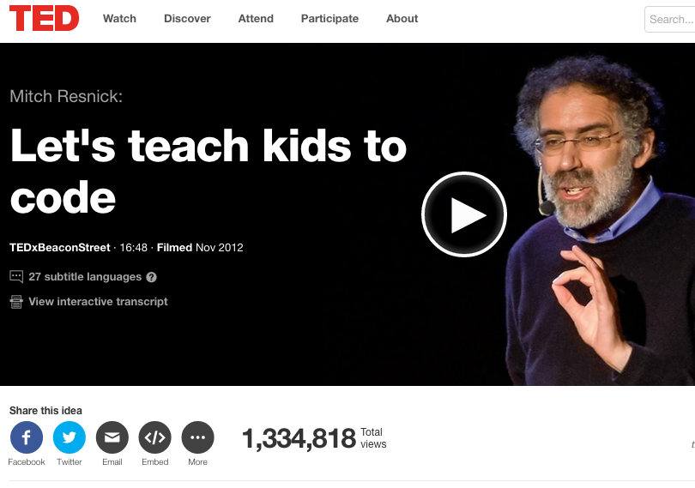
CS education: teaching computer science

Slide 2
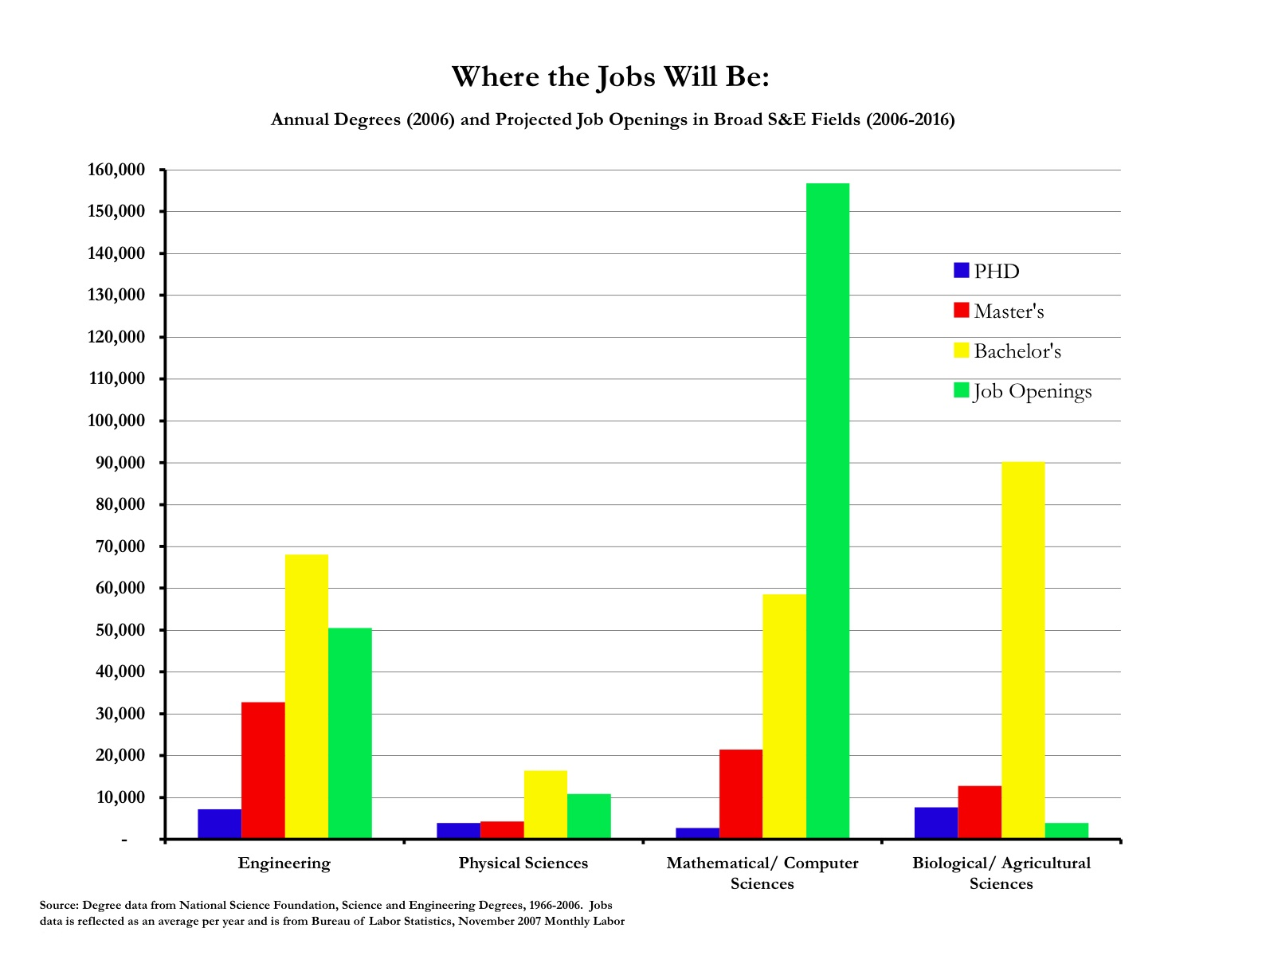
Teaching programming
Teaching computer science has become a huge industry:
Huge job growth
Not enough CS-trained people to fill need

Slide 3
Teaching languages
Not enough CS majors of any type
Combined with lack of diversity and higher drop out rates in CS courses, this is a matter of national concern
President Obama’s state of the union this year: "In the coming years, we should build on that progress, by ... offering every student the hands-on computer science and math classes that make them job-ready on Day 1."
As a result, CS education has grown in recent years, with a strong emphasis on how to introduce coding to kids
Alice and Scratch are perhaps the earliest serious efforts into this area, and are still probably the dominant choices
Today: I plan to give an overview of various levels and options, since this is a growing trend in CS that you all will probably have to answer questions about at some point.

Slide 4
Alice
Designed in mid-90’s by Randy Pausch, a professor at CMU who focused on HCI and design
“Alice is an innovative 3D programming environment that makes it easy to create an animation for telling a story, playing an interactive game, or a video to share on the web. Alice is a freely available teaching tool designed to be a student's first exposure to object-oriented programming. It allows students to learn fundamental programming concepts in the context of creating animated movies and simple video games. In Alice, 3-D objects (e.g., people, animals, and vehicles) populate a virtual world and students create a program to animate the objects.”
--alice.org

Slide 5
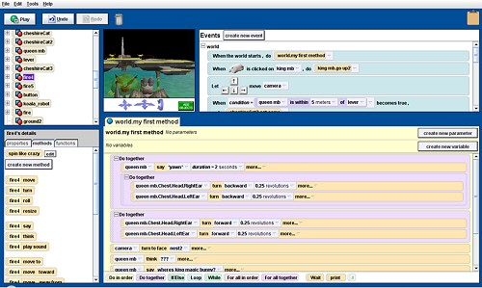
Alice (cont)

Slide 6
Alice details:
Easy to use interface (although does require reading)
Interpreted
Fully object oriented, and focused on causing 3D environment and characters to change
Several versions:
3.1 is designed to end with students knowing Java by the end of a course
2.3 is a more gentle tool, focused on storytelling
Either has a rich repository of tools and examples, although 2.3 is perhaps a bit better supported
Comes with a pool of 3d objects, but can also design and import your own (using other tools)

Slide 7
Scratch
Created by Mitchel Resnick and the MIT Media Lab Lifelong Kindergarten Group, released first in 2002
Current version (v2) is Flash based, and runs through a web-browser
Can be used for storytelling as well, but also can be used for other types of programming
Functions are more limited – they are not first class objects
Limited file I/O, but can interface with other systems like Lego Midstorms (which we’ll talk about soon)
Supports 1d arrays, floating point scalars and strings, but limited string functionality
Based on an older language Squeak (which is Smalltalk based)

Slide 8
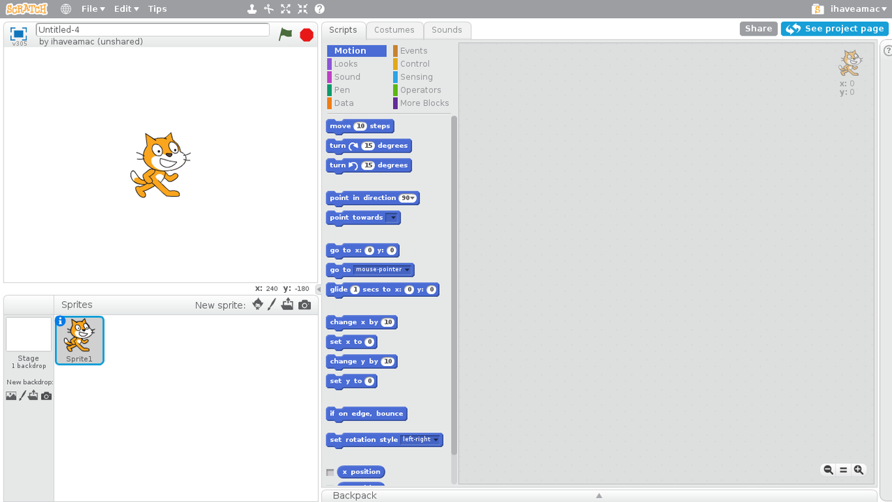
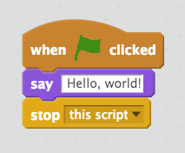
Using Scratch:

Slide 9
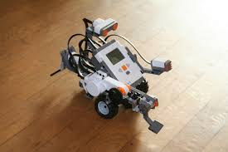
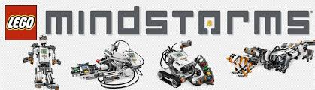
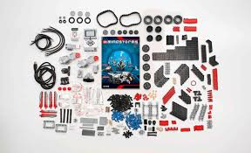
Lego programming
(My personal favorite!)

Slide 10
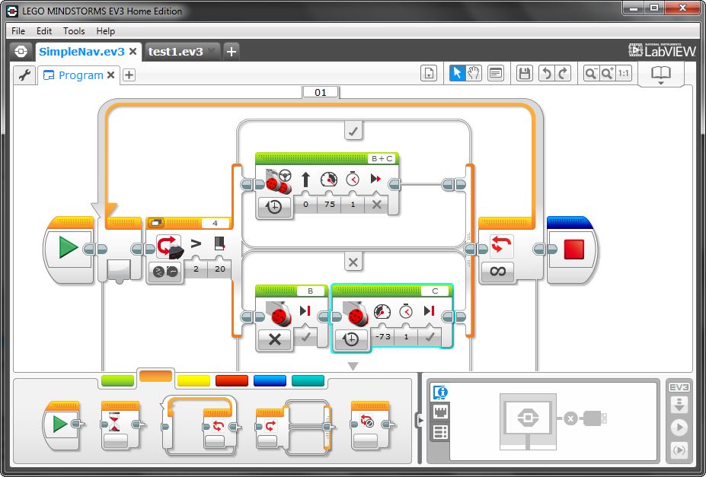
Mindstorms programs
The language:

Slide 11
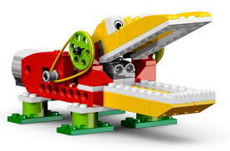
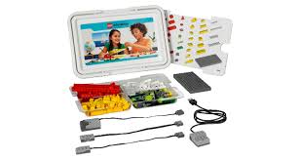
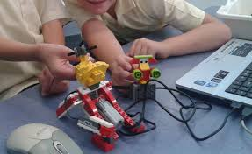
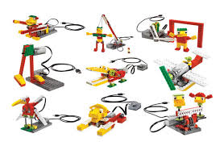
The Lego Wedo
For younger kids:

Slide 12
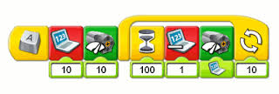
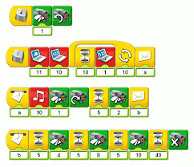
Wedo program
The language:

Slide 13
Lego programming
This language actually goes back to the MIT media lab as well, originally – they developed Brick Logo
Programming is GUI based (at both levels), although can interface with C, Java, Python, etc.
Latest version is Lego Minstorms EV3, in 2013
Innovative feature: this takes the “graphical” element you see in other languages to an entire new level
Allows functions (in a sense) as you can form a “myblock” to repeat actions and send in parameters to these

Slide 14
Lego programming
This language actually goes back to the MIT media lab as well, originally – they developed Brick Logo
Programming is GUI based (at both levels), although can interface with C, Java, Python, etc.
Latest version is Lego Minstorms EV3, in 2013
Innovative feature: this takes the “graphical” element you see in other languages to an entire new level
Allows functions (in a sense) as you can form a “myblock” to repeat actions and send in parameters to these

Slide 15
Lego robots in action
Minstorms:
https://www.youtube.com/watch?v=dJSeMeAGmXE
Wedo:
https://www.youtube.com/watch?v=w03n-Y18-9I

Slide 16
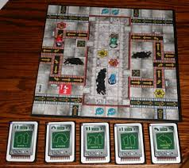
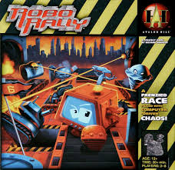
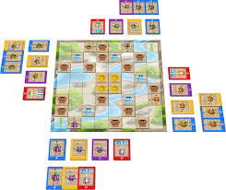
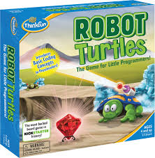
Newer additions: games
The board game Robo Rally:
Or Robot Turtles:

Slide 17
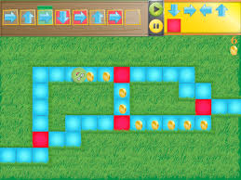
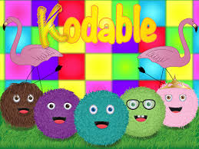
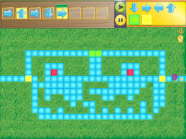
Tablet games
Example: Kodable

