Slide 1

Chapter 11 :: Logic Languages
Based on Programming Language Pragmatics
Michael L. Scott
And other online sources (see links on schedule page)
Copyright © 2009 Elsevier

Slide 2
Prolog: Recap
A logical language, based on predicates.
Often described as a language where you tell the computer what to do, and NOT how to do it.
Can lead to surprisingly concise code for surprisingly difficult problems – but can also have surprisingly bad runtimes!
Last time: predicates, :=, variables, and unification
Copyright © 2009 Elsevier

Slide 3
Variables and unification
Unification can be defined as follows:
  Two terms unify if they are the same term or if they contain variables that can be uniformly instantiated with terms in such a way that the resulting terms are equal.
But there’s a lot of subtlety here, and this is a powerful concept.
A simple example – consider the following two predicates:
vertical(line(point(X,Y),point(X,Z))).
horizontal(line(point(X,Y),point(Z,Y))).
  Essentially, just defining the concept of horizontal and vertical lines.
Copyright © 2009 Elsevier

Slide 4
Variables and unification
A simple example – consider the following two predicates:
vertical(line(point(X,Y),point(X,Z))).
horizontal(line(point(X,Y),point(Z,Y))).
What can we do with this?
  ?- vertical(line(point(1,1),point(1,3))).
  true.
  ?- vertical(line(point(1,1),point(3,2))).
  false.
  ?- horizontal(line(point(1,1),point(2,Y))).
  Y = 1.
  ?- horizontal(line(point(2,3),P)).
  P = point(_G277, 3).
Copyright © 2009 Elsevier

Slide 5
Unification behind the scenes
Another example:
loves(vincent,mia).
  loves(marcellus,mia).
  jealous(A,B):- loves(A,C), loves(B,C).
Query
?- jealous(X,Y).
The only way to unify this query is using the third rule, and there are two ways to do this.
Either way, Y gets bound to mia, but then there are 4 possible solutions.
Copyright © 2009 Elsevier

Slide 6
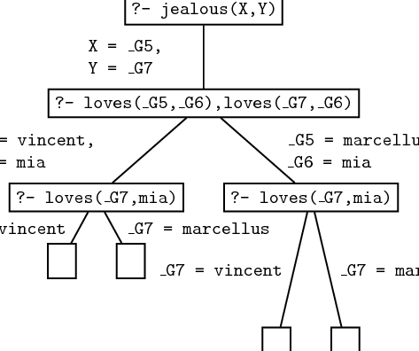
Unification behind the scenes
Copyright © 2009 Elsevier

Slide 7
Recursion
We actually saw some recursive definitions last time, but let’s look a little closer at one.
child(anne,bridget).
child(bridget,caroline).
child(caroline,donna).
child(donna,emily).
descend(X,Y) :- child(X,Y).
descend(X,Y) :- child(X,Z), descend(Z,Y).
This final rule allows the “child” relationship to chain indefinitely when unifying – which is the correct notion to use for descendants!
Copyright © 2009 Elsevier

Slide 8
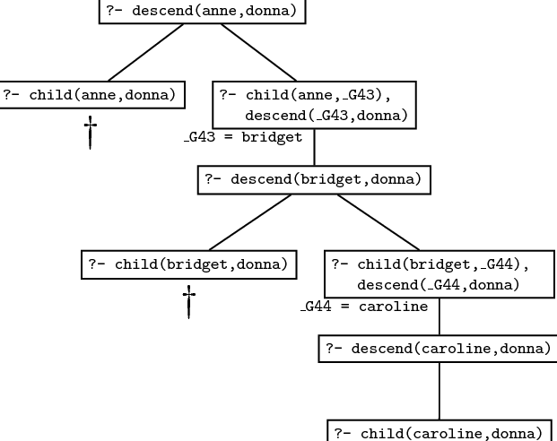
Recursion
Unification then searches the database:
Copyright © 2009 Elsevier

Slide 9
Recursion
Note that order can matter! If I change the two rules:
descend(X,Y) :- child(X,Y).
descend(X,Y) :- child(X,Z), descend(Z,Y).
If I swap the two rules, it will still work correctly.
However, if I change the second to be:
descend(X,Y) :- descend(Z,Y), child(X,Z).
Then infinite loops will abound, since Prolog will attempt to go down an infinitely long tree of descends.
(We’ll see more on this later.)
Copyright © 2009 Elsevier

Slide 10
Prolog: Lists
Lists are useful enough that prolog has built in support.
Structure: [] is the empty list, and . is a built in concatenation (like : in Haskell). So a list is:
.(a, .(b, .(c, [])))
Can also be written with “tail” structure:
[a, b, c]
[a | [b,c]]
[a, b | [c]]
[a, b, c | []]
Copyright © 2009 Elsevier

Slide 11
Prolog: Lists
A demo:
?- [X|Y]=[[],dead(z),[2,[b,c]],[],Z].
X = []
Y = [dead(z),[2,[b,c]],[],Z]
Note: Z stayed unbound – some systems will represent this as _7800 in the last spot and then say Z = _7800.
Otherwise, variables bind as we expect.
Lists don’t have to be of same “type”, for any sense of type.
Copyright © 2009 Elsevier

Slide 12
Prolog: Lists
This pattern matching is both handy and powerful:
?- [X1,X2,X3,X4|Tail] =
[[], dead(z), [2, [b, c]], [], Z].
X1 = [],
X2 = dead(z),
X3 = [2, [b, c]],
X4 = [],
Tail = [Z].
Copyright © 2009 Elsevier

Slide 13
Prolog: Lists
List predicates:
member(X, [X | _]).
member(X, [_ | T]) :- member(x,T).
sorted([]).
sorted([_]).
sorted([A, B | T]) :- A =< B,
sorted([B | T]).
Copyright © 2009 Elsevier

Slide 14
Prolog: Lists
Even crazier:
append([], A, A).
append([H | T], A, [H | L]) :-
append(T, A, L).
Now using it (note – prolog already has it coded!):
?- append([a, b, c], [d, e], L).
L = [a, b, c, d, e]
?- append(X, [d, e], [a, b, c, d, e]).
X = [a, b, c]
?- append([a, b, c], Y, [a, b, c, d, e]).
Y = [d, e]
Copyright © 2009 Elsevier

Slide 15
Exercise: Lists
Write a predicate second(X,List) which checks if X is the second element of List.
Write a predicate swap12(List1,List2) which checks if List1 is identical to List2, except with the first two elements exchanged.
(Email these to me as usual.)
Copyright © 2009 Elsevier

Slide 16
Prolog
Arithmetic: The '=' operator determines whether its operands can be unified
?- A = 37.
A = 37
yes
?- 2 = 2.
yes
Math operators are functors (structure names), not functions
?- (2+3) = 5
no
Copyright © 2009 Elsevier

Slide 17
Prolog
For math we use the built-in operator is
?- is(X, 1+2).
X = 3
yes
?- X is 1+2.
X = 3
yes
% LHS of 'is' must be as-yet uninstantiated
?- 1+2 is 4-1.
no
% RHS of 'is' must already be instantiated
?- X is Y.
<error>
Copyright © 2009 Elsevier

Slide 18
Prolog
When it attempts resolution, the Prolog interpreter pushes the current goal onto a stack, makes the first term in the body the current goal, and goes back to the beginning of the database and starts looking again
If it gets through the first goal of a body successfully, the interpreter continues
with the next one
If it gets all the way through the body, the goal is satisfied and it backs up a level and proceeds
Copyright © 2009 Elsevier

Slide 19
Prolog
If it fails to satisfy the terms in the body of a rule, the interpreter undoes the unification of the left hand side (this includes uninstantiating any variables that were given values as a result of the unification) and keeps looking through the database for something else with which to unify (This process is called BACKTRACKING)
If the interpreter gets to the end of database without succeeding, it backs out a level (that's how it might fail to satisfy something in a body) and continues from there
Copyright © 2009 Elsevier

Slide 20
Prolog: backtracking
We can visualize backtracking search as a tree in which the top-level goal is the root and the leaves are facts (see Figure 11.1 - next 2 slides)
  The children of the root are all the rules and facts with which the goal can unify
  The interpreter does an OR across them: one of them must succeed in order for goal to succeed
  The children of a node in the second level of the tree are the terms in the body of the rule
  The interpreter does an AND across these: all of them must succeed in order for parent to succeed
  The overall search tree then consists of alternating AND and OR levels
Copyright © 2009 Elsevier

Slide 21
Prolog - backtracking
A simple example:
rainy(seattle).
rainy(rochester).
cold(rochester).
snowy(X) :- rainy(X), cold(X).
Suppose we then type in:
snowy(C)
How does prolog attempt to resolve?
Copyright © 2009 Elsevier

Slide 22
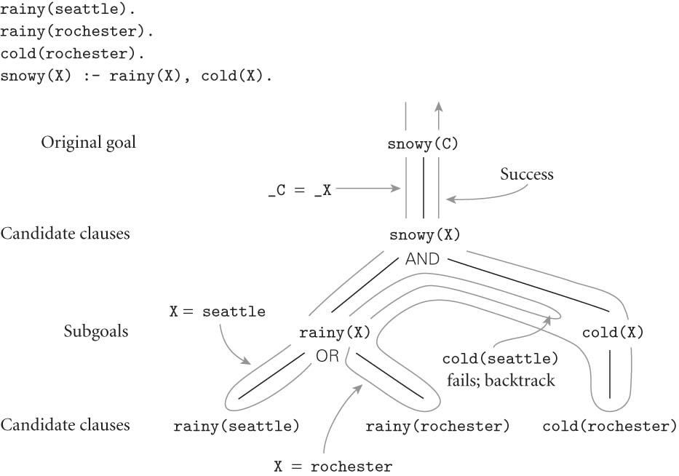
Prolog
FIGURE 11.1
Copyright © 2009 Elsevier

