Slide 1

Chapter 11 :: Logic Languages
Based on Programming Language Pragmatics
Michael L. Scott
And other online sources (see links on schedule page)
Copyright © 2009 Elsevier

Slide 2
Prolog
When it attempts resolution, the Prolog interpreter pushes the current goal onto a stack, makes the first term in the body the current goal, and goes back to the beginning of the database and starts looking again
If it gets through the first goal of a body successfully, the interpreter continues
with the next one
If it gets all the way through the body, the goal is satisfied and it backs up a level and proceeds
Copyright © 2009 Elsevier

Slide 3
Prolog
If it fails to satisfy the terms in the body of a rule, the interpreter undoes the unification of the left hand side (this includes uninstantiating any variables that were given values as a result of the unification) and keeps looking through the database for something else with which to unify (This process is called BACKTRACKING)
If the interpreter gets to the end of database without succeeding, it backs out a level (that's how it might fail to satisfy something in a body) and continues from there
Copyright © 2009 Elsevier

Slide 4
Prolog: backtracking
We can visualize backtracking search as a tree in which the top-level goal is the root and the leaves are facts (see Figure 11.1 - next 2 slides)
  The children of the root are all the rules and facts with which the goal can unify
  The interpreter does an OR across them: one of them must succeed in order for goal to succeed
  The children of a node in the second level of the tree are the terms in the body of the rule
  The interpreter does an AND across these: all of them must succeed in order for parent to succeed
  The overall search tree then consists of alternating AND and OR levels
Copyright © 2009 Elsevier

Slide 5
Prolog - backtracking
A simple example:
rainy(seattle).
rainy(rochester).
cold(rochester).
snowy(X) :- rainy(X), cold(X).
Suppose we then type in:
snowy(C)
How does prolog attempt to resolve?
Copyright © 2009 Elsevier

Slide 6
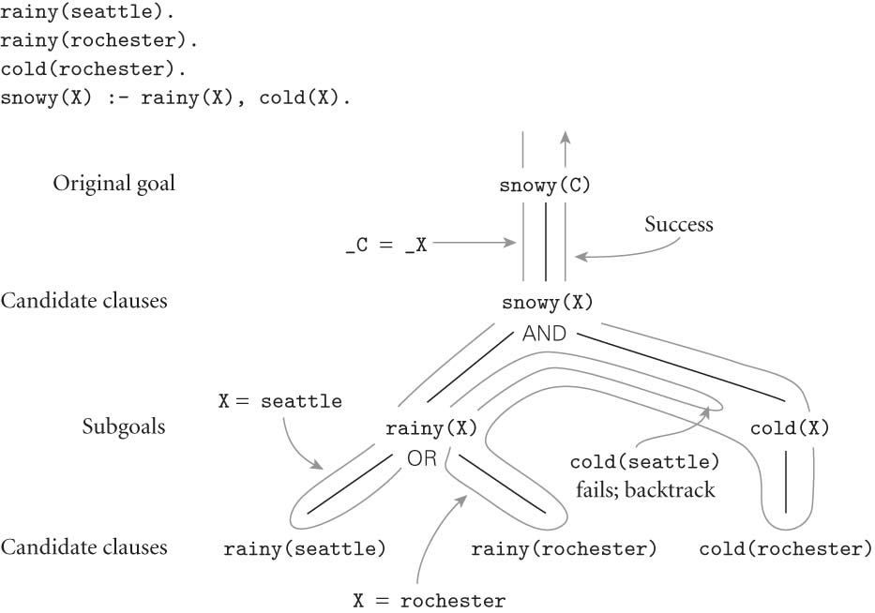
Prolog
FIGURE 11.1
Copyright © 2009 Elsevier

Slide 7
Prolog: Path Example
Be careful of ordering!
Consider this example describing paths in graphs:
edge(a, b). edge(b,c). edge(c,d).
edge(d, e). edge(b, e). edge(d, f).
path(X, X).
path(X, Y):- edge(Z, Y), path(X, Z).
If the two terms on the last clause were reversed, the program would be less efficient. Why?
If we were to flip order of the last 2 clauses, things get even worse!
Copyright © 2009 Elsevier

Slide 8
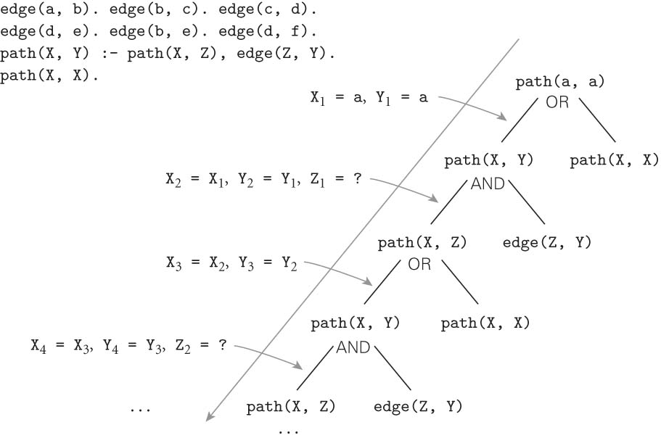
Prolog: Path Example cont.
If we were to flip order of the last 2 clauses, things get even worse! Figure 11.2:
Copyright © 2009 Elsevier

Slide 9
Prolog
PROLOG IS NOT PURELY DECLARATIVE
  The ordering of the database and the left-to-right pursuit of sub-goals gives a deterministic imperative semantics to searching and backtracking
  Changing the order of statements in the database can give you different results
    It can lead to infinite loops
    It can certainly result in inefficiency
Copyright © 2009 Elsevier

Slide 10
Prolog
parent(a,b). % a is the parent of b
parent(a,d).
parent(a,k).
parent(k,l).
parent(k,m).
parent(b,e).
parent(b,f).
parent(f,g).
parent(f,h).
parent(f,i).
ancestor(X,Y) :- parent(X,Y).
ancestor(X,Y) :- parent(Z,Y), ancestor(X,Z).
Copyright © 2009 Elsevier

Slide 11
Prolog
Then the question
?- ancestor(U,h).
generates the answers
U = f;
U = b;
U = a;
no
The question
?- ancestor(b,U).
generates all nodes in the subtree rooted in b
Copyright © 2009 Elsevier

Slide 12
Prolog
If we change the order of the two ancestor rules, we get different execution orders:
?- ancestor(U,h).
U = a;
U = b;
U = f;
no
If we change the order of the subgoals in the compound rule,
ancestor(X,Y) :- ancestor(X,Z), parent(Z,Y).
we run into an infinite loop (see also Figure 11.2)
Copyright © 2009 Elsevier

Slide 13
Imperative Control Flow
Some options in Prolog actually alter the flow of control. Recall this example::
member(X, [X | _]).
member(X, [_ | T]) := member(X,T).
If a given atom a is in the list n times, the the goal ?- member(a,L)can succeed n times.
This can be very inefficient in some cases, since we may have some other goal to satisfy that could fail:
  prime_candidate(X) := member(X, candidates),
  prime(X).
  (Here, if a is in the list of candidates more than once, we’ll waste time checking for it that number of times, when we already “know” that prime(a) will just fail.)
Copyright © 2009 Elsevier

Slide 14
Control flow - the cut
We can save time by cutting off all future searches for a after the first time it is found:
member(X, [X | _]) :- !.
member(X, [_ | T]) := member(X,T).
The cut is the ! on the right hand side. This says that if X is the head of L, we should not attempt to unify member(X,L)with the left-hand side of the second rule. Essentially, the cut forces us to commit to the first rule only.
Copyright © 2009 Elsevier

Slide 15
Control flow - \=
Another option is to force the first element of the list to not be equal to X in the second rule:
member(X, [X | _]) :- !.
member(X, [H | T]) := X \= H, member(X,T).
The statement X \= H is equivalent to the statement \+(X = H). In essence, \+ is a bit like a not (which is how it is written in some versions of Prolog).
Copyright © 2009 Elsevier

Slide 16
Control flow - back to the cut
One really interesting use of ! is as an equivalent to if-then-else statements:
statement := condition, !, then_part.
statement := else_part.
Here, the cut commits us to the first part if condition is true, which means we will never go to the second rule.
However, if the condition comes back as false (i.e. no derivation is found to make it true), then we’ll move onto the second rule and try to find if it can be satisfied.
Copyright © 2009 Elsevier

Slide 17
Control flow - the fail predicate
The fail predicate always fails.
It can be quite useful to force certain actions. For example, the \+ can be implemented using fail and !: =\+(X=H) :- (X=H), !, fail.
It can also be used to generate a type of “looping” behavior. As an example, recall our append code:
append([], A, A).
append([H | T], A, [H | L]) :-
append(T, A, L).
If we write append(A,B,L) where L is instantiated but A and B are not, we can use this to generate possible lists.
Copyright © 2009 Elsevier

Slide 18
Control flow - the fail predicate
If we write append(A,B,L) where L is instantiated by A and B are not, we can use this to generate possible lists:
print_lists(L) :-
append(A,B,L), write(A),
write(‘ ‘), write(B),
nl, fail.
The output if we call print_lists([a, b, c]) will be:
  [] [a, b, c]
  [a] [b, c]
  [a, b] [c]
  [a, b, c] []
  No
Copyright © 2009 Elsevier

Slide 19
Looping and unbounded generators
The following generates all of the natural numbers:
natural(1).
natural(N) :- natural(M), N is M+1.
We can then use this to print out the first n numbers:
  my_loop(N) := natural(I),
  write(I), nl,
  I = N, !.
  So long as I is less than N, the equality predicate will fail and backtracking will pursue another alternative for natural. If I is equal to N, then the cut will execute, committing us to the final value of I and terminating this loop.
Copyright © 2009 Elsevier

Slide 20
Looping and unbounded generators
This programming idiom - an unbounded generator with a test-cut terminator - is know as generate-and-test.
This combination is generally used with side effects, such as I/O or modification of the database.
For example, we could use such a construct to add values to the database until some threshold is met.
Copyright © 2009 Elsevier

Slide 21
I/O in prolog
Prolog provides several I/O predicates, such as:
  write and nl for output, read for input
  see and tell can redirect input and output to different files.
  get and put read individual characters.
  consult and reconsult add database clauses from a file, so that they don’t have to be entered by hand.
Copyright © 2009 Elsevier

Slide 22
Database Manipulation
Prolog is homoiconic: it can represent itself (like Scheme).
It can also modify itself:
  ?- rainy(X)
  X = seattle ;
  X = rochester ;
  No
  ?- assert(rainy(syracuse)).
  Yes
  ?- retract(rainy(rochester)).
  Yes
  ?- rainy(X)
  X = seattle ;
  X = syracuse ;
  No
Copyright © 2009 Elsevier

Slide 23
Additional predicates
The goal functor(T, F, N) succeeds if and only if T is a term with functor F and arity N:
  ?- functor(foo(a,b,c), foo, 3).
  Yes
  ?- functor(foo(a,b,c), F, N).
  F = foo
  N = 3
  ?- functor(T, foo, 3).
  T = foo(_10, _37, _24)
The goal arg(N, T, A) succeeds if and only if its first two arguments are instantiated, N is a number, and A is the Nth argument of T:
  ?- arg(3, foo(a,b,c), A).
  A = c
Copyright © 2009 Elsevier

Slide 24
Using arg and functor
We can use these together to create an arbitrary term:
  ?- functor(T, foo, 3), arg(1, T, a), arg(2, T, b), arg(3, T, c)
  T = foo(a, b, c)
We can also use =.. for this:
  ?- T =.. [foo, a, b, c]
  T = foo(a,b,c)
  ?- foo(a,b,c) =.. [F, A1, A2, A3]
  F = foo
  A1 = a
  A2 = b
  A3 = c
Copyright © 2009 Elsevier

Slide 25
Dynamic goals
Taken together, we can attempt to satisfy goals that are created at run-time only:
  param_loop(L, H, F) :- natural(I), I >= L,
  G =.. [F, I], call(G), I=H, !.
Then calling:
  ?- param_loop(5, 10, write).
  5678910
  Yes
Copyright © 2009 Elsevier

Slide 26
A final example
It is worth reiterating that prolog is NOT really a traditional language which executes statements in a von Neumann-like way.
Prolog does provide some mechanisms for this, but they can be very inefficient (especially if you’re not used to the language).
  sort(L1, L2) := permutation(L1, L2), sorted(L2).
  permutation([], []).
  permutation(L, [H | T]) :-
  append(P, [H | S], L),
  append(P, S, W),
  permutation(W,T).
If this looks confusing, don’t worry. We’re essentially saying L2 is a sorted version of L1 if it’s a permutation of L1 and it is sorted.
This version takes exponential time. Why?
Copyright © 2009 Elsevier

Slide 27
A final example: quicksort
Implementing something like quick sort is possible:
  quicksort([], []).
  quicksort([A, L1], L2) :- partition(A, L1, P1, S1),
  quicksort(P1, P2), quicksort(S1, S2),
  append(P2, [A | S2], L2).
  partition(A, [], [], []).
  partition(A, [H | T], [H | P], S) :- A >= H, partition(A, T, P, S).
  partition(A, [H | T], [P], [H | S]) :- A =< H, partition(A, T, P, S).
Copyright © 2009 Elsevier

Slide 28
Conclusions
Like other forms of programming, logic languages are linked to constructive proofs.
But imperative and functional languages are in some sense a proof in and of themselves, since they compute something.
In contract, a logic language is a set of axioms from which the computer itself tried to construct the proof.
Logic langauges also don’t have the full power of computation (Turing machines or lambda calculus). They are based on propositional logic, and even there lack the full power due to practical considerations.
Generally, these are used in problems where relationships and searching are emphasized.
Copyright © 2009 Elsevier

