Slide 1

Chapter 3::
Names, Scopes, and Bindings
Programming Language Pragmatics
Michael L. Scott
Copyright © 2009 Elsevier

Slide 2
This week
Homework 2 due Wednesday
Homework 3 is up, and is due next week
Substitute in two weeks
  He’ll cover parsing, so we are jumping a bit in the book, to chapter 3
  (Yes, you’ll still have a homework over that material, so you should come to class!)

Slide 3
Name, Scope, and Binding
A name is exactly what you think it is
  Most names are identifiers
  symbols (like '+') can also be names
A binding is an association between two things, such as a name and the thing it names
The scope of a binding is the part of the program (textually) in which the binding is active
Copyright © 2009 Elsevier

Slide 4
Binding
Binding Time is the point at which a binding is created or, more generally, the point at which any implementation decision is made
Many different times at which this can be decided:
  language design time
    Decide primitive types, available constructors, etc.
  language implementation time
    Decide precision, stack/heap issues, etc.
Copyright © 2009 Elsevier

Slide 5
Binding
Possible times (cont.):
  program writing time
    Programmer chooses algorithms, names, etc.
  compile time
    Compiler must plan for data layout
  link time
    Standard libraries are imported, compiler decides layout of whole program in memory
  load time
    Actual choice of physical addresses
Copyright © 2009 Elsevier

Slide 6
Binding
Possible times (cont.):
  run time
    Must finalize value/variable bindings, sizes of strings
    Note that run time includes:
      program start-up time
      module entry time
      elaboration time (point a which a declaration is first "seen")
      procedure entry time
      block entry time
      statement execution time
Copyright © 2009 Elsevier

Slide 7
Binding
The terms STATIC and DYNAMIC are generally used to refer to things bound before run time and at run time, respectively
  These are not terribly precise terms, though
The importance of static versus dynamic in a language is key – a fundamental aspect of design and use!
Copyright © 2009 Elsevier

Slide 8
Binding
In general, early binding times are associated with greater efficiency
Later binding times are associated with greater flexibility
Compiled languages tend to have early binding times
Interpreted languages tend to have later binding times
Today we talk about the binding of identifiers to the variables they name
Copyright © 2009 Elsevier

Slide 9
Binding
Scope rules are what really control bindings in a program and a language
  Fundamental to all programming languages is the ability to name data, i.e., to refer to data using symbolic identifiers rather than addresses
  Note however that not all data is named! For example, dynamic storage in C or Pascal is referenced by pointers, not names
Copyright © 2009 Elsevier

Slide 10
Lifetime and Storage Management
Key events
  creation of objects
  creation of bindings
  references to variables (which use bindings)
  (temporary) deactivation of bindings
  reactivation of bindings
  destruction of bindings
  destruction of objects
Copyright © 2009 Elsevier

Slide 11
Lifetime and Storage Management
The period of time from creation to destruction is called the lifetime of a binding
  If object outlives binding it's garbage
  If binding outlives object it's a dangling reference
The textual region of the program in which the binding is active is its scope
In addition to talking about the scope of a binding, we sometimes use the word scope as a noun all by itself, without an indirect object
Copyright © 2009 Elsevier

Slide 12
Lifetime and Storage Management
Storage Allocation mechanisms
  Static
  Stack
  Heap
Each stores different type of information, and (in general) each type is used in most modern programming languages, although level of control given to the programmer varies heavily.
Copyright © 2009 Elsevier

Slide 13
Lifetime and Storage Management
Static allocation is for:
  Actual code
  Global variables
  Static or own variables
  Explicit constants (including strings, sets, etc)
  Scalars may be stored in the instructions
Used whenever an absolute address will be retained through the entire program execution.
Copyright © 2009 Elsevier

Slide 14
Lifetime and Storage Management
The “stack” is for
  parameters
  local variables
  temporaries
Why a stack?
  To allocate space for recursive routines
  (not always necessary, i.e. in FORTRAN – no recursion)
  To reuse space
  (in all programming languages)
Copyright © 2009 Elsevier

Slide 15
Lifetime and Storage Management
Contents of a stack frame (next slide - Figure 3.1 in book):
  arguments and returns
  local variables
  temporaries
  bookkeeping (saved registers, line number static link, etc.)
Local variables and arguments are assigned fixed OFFSETS from the stack pointer or frame pointer at compile time
Copyright © 2009 Elsevier

Slide 16
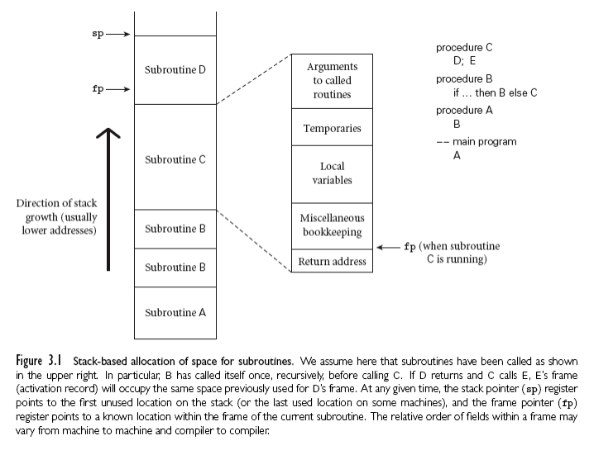
Lifetime and Storage Management
Copyright © 2009 Elsevier

Slide 17
Lifetime and Storage Management
Maintenance of stack is responsibility of calling sequence, as well as the subroutine prolog and epilog
  space is saved by putting as much in the prolog and epilog as possible
  time may be saved by
    putting stuff in the caller instead
    combining what is known in both places
    (interprocedural optimization)
Copyright © 2009 Elsevier

Slide 18
Lifetime and Storage Management
The heap is for dynamically allocated data, such as:
  Linked data structures
  Fully general strings
  Lists
  Sets
  Anything else whose size may change during course of the program’s runtime
Downside: need memory management strategies that are more complex.
Copyright © 2009 Elsevier

Slide 19
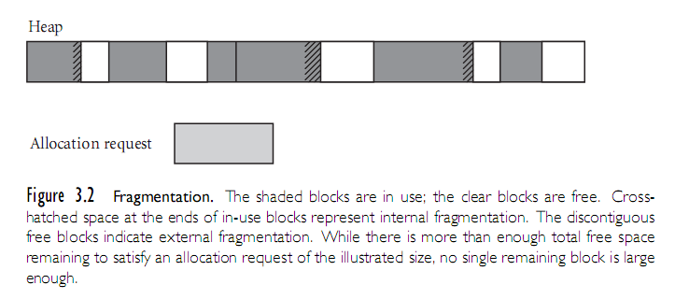
The heap
Heap for dynamic allocation
Heap for dynamic allocation
Copyright © 2009 Elsevier
Copyright © 2009 Elsevier

Slide 20
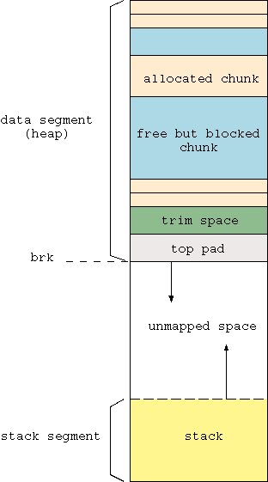
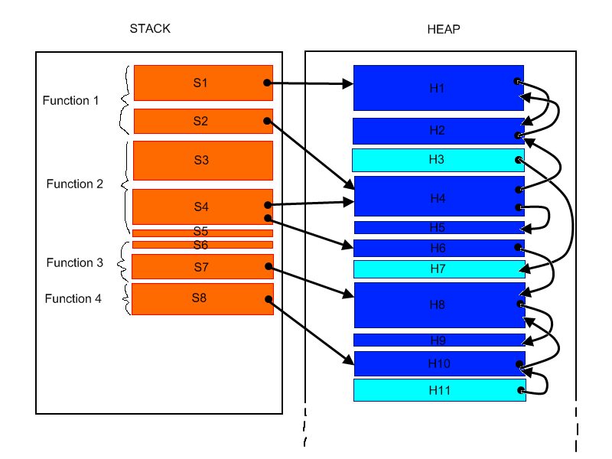
The heap and the stack
The heap and the stack are closely linked.
Copyright © 2009 Elsevier
Copyright © 2009 Elsevier

Slide 21
Scope Rules
A scope is a program section of maximal size in which no bindings change, or at least in which no re-declarations are permitted (see below)
In most languages with subroutines, we OPEN a new scope on subroutine entry. This includes:
  create bindings for new local variables,
  deactivate bindings for global variables that are re-declared (these variable are said to have a "hole" in their scope)
  make references to variables
Copyright © 2009 Elsevier

Slide 22
Examples of Scope
Scope can also refer to something other than subroutine call.
Example (which may look familiar):
  void test() {
  SmartStack<string> r;
  r.push("X"); r.push("Y"); r.push("Z");
  cout << "r "; printStack(r);
  // enter new scope so that t can be constructed
  if (true) {
  SmartStack<string> t(r);
  t.pop(); t.push(“W”);
  cout << "r "; printStack(r);
  cout << "t "; printStack(t);
  } // t is destroyed
  } // r is destroyed
Copyright © 2009 Elsevier

Slide 23
Scope Rules
On subroutine exit, the scope must be updated:
  destroy bindings for local variables
  reactivate bindings for global variables that were deactivated
Algol 68:
  ELABORATION = process of creating bindings when entering a scope
Ada (re-popularized the term elaboration):
  storage may be allocated, tasks started, even exceptions propagated as a result of the elaboration of declarations
Copyright © 2009 Elsevier

Slide 24
Static scope
With static (or lexical) scope rules, a scope is defined in terms of the physical (lexical) structure of the program.
  The determination of scopes can be made by the compiler
  All bindings for identifiers can be resolved by examining the program
  Typically, we choose the most recent, active binding made at compile time
  Most compiled languages, C and Pascal included, employ static scope rules
Copyright © 2009 Elsevier

Slide 25
Static scope
Initially, simple versions (such as early Basic) had only 1 scope - the entire program.
Later, distinguished between local and global (such as in Fortran).
Generally speaking, a local variable only “exists” during the single execution of that subroutine. So the variable is recreated and reinitialized each time it enters that procecdure or subroutine. (Think of variables in C created in a loop, and which don’t exist outside the loop.)
Copyright © 2009 Elsevier

Slide 26
Overriding the static scope
C and other languages allow the coder to override this, so that your value is not re-initialized each time.
Example:
  /* Place into s a new name beginning with L and continuing with a new ASCII number of each integer.
  Each time this is called, the value is incremented
  */
  void label_name (char *s) {
  static short int n; /* C will initialize this to 0
  sprintf(s, “L%d\0”, ++n); /* “print” output to s
  }
Copyright © 2009 Elsevier

Slide 27
Most closely nested rule
The classical example of static scope rules is the most closely nested rule used in block structured languages such as Algol 60 and Pascal. (You’ve seen something similar in C++.)
  An identifier is known in the scope in which it is declared and in each enclosed scope, unless it is re-declared in an enclosed scope
  To resolve a reference to an identifier, we examine the local scope and statically enclosing scopes until a binding is found
Copyright © 2009 Elsevier

Slide 28
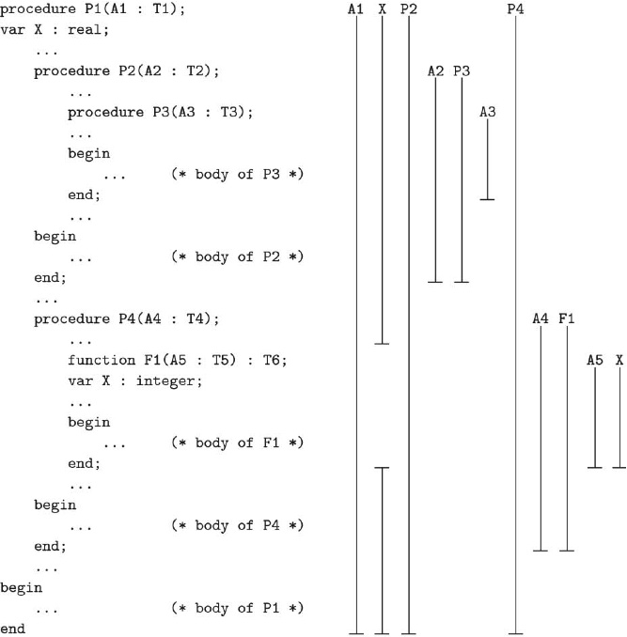
Nesting in Pascal
Fig. 3.3:
  An
  example
Copyright © 2009 Elsevier

Slide 29
Accessing other scopes
In previous example, the global x is “hidden” during part of a subroutine because of a local variable; called a hole in its scope.
Sometimes can scope to a different binding. (Remember :: in C++? Used to get access to functions we loaded from the STL.)
Examples
  In Ada, can say my_proc.X
  In python, self.variable
  In C++, ::X is a global variable X (regardless of current subroutine)
Copyright © 2009 Elsevier

Slide 30
Object Orientation
We will see classes - a relative of modules - later on, when discussing abstraction and object-oriented languages.
  These have even more sophisticated (static) scope rules
Indeed, in classes, scope is extended even to methods.
  Example: We say mystack.push(5), not push(mystack, 5)
  The function exists for every stack, and the particular instance of the stack we are working on is passed as a separate, hidden parameter.
  The self variable in python as a perfect example of this, but it is more subtle in other languages.
Copyright © 2009 Elsevier

Slide 31
Open and closed scope
Modules where names must be explicitly imported are called closed scopes. Import commands are used to explicitly load things.
  Reduce name conflicts, and force the program to declare which other modules it depends on.
Python is an example of a selectively open scope.
  Here, if a name foo is from a module A, its data is automatically visible as A.foo from another module.
  Will be available as simply foo if we explicitly import.
    You may have done this for math, system, or networking libraries in that class.
Copyright © 2009 Elsevier

Slide 32
Scope Rules
Note that the bindings created in a subroutine are destroyed at subroutine exit
  The modules of Modula, Ada, etc., give you closed scopes without the limited lifetime
  Bindings to variables declared in a module are inactive outside the module, not destroyed
  The same sort of effect can be achieved in many languages with own (Algol term) or static (C term) variables
    (see previous static example we covered yesterday)
Copyright © 2009 Elsevier

Slide 33
Scope Rules
Access to non-local variables: static links
Each frame points to the frame of the (correct instance of) the routine inside which it was declared
  In the absence of formal subroutines, correct means closest to the top of the stack
  You access a variable in a scope k levels out by following k static links and then using the known offset within the frame thus found
Copyright © 2009 Elsevier

Slide 34
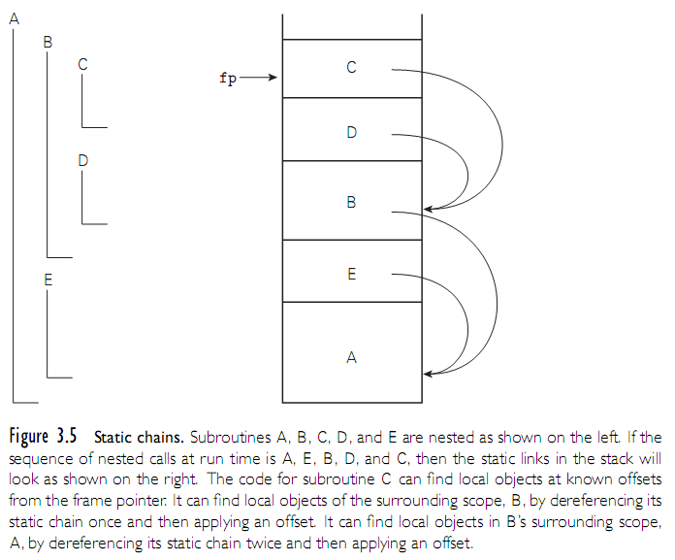
Scope Rules
Copyright © 2009 Elsevier

Slide 35
Classes and Scopes
Object orientation takes this idea of static scope and extends it even further, since classes have their own scope with local variables (both in the class and in each function.)
Rules are essentially unchanged from the rules for that language, with perhaps a few extensions:
  Example: In C++, one object can access private variables of another object as long as they are of the same type. (Think of copy constructors or operator= in any of our data structures class.)
  Another example: Python goes the other direction: no variables are formally declared, and no variables are private to the class
Copyright © 2009 Elsevier

Slide 36
Declaration order
Declaration order can be a key concept: Does on object exist in its scope before it is created?
Answer - depends on the language.
Example (in Pascal):
  const N = 10;
  …
  procedure foo;
  const
  M = N; (* semantic error because of next line*)
  …
  N = 20; (* declares N to be in ENTIRE scope of foo*)
  Compiler will complain that N is being used “before its declaration” when it gets to M = N; line
Copyright © 2009 Elsevier

Slide 37
Declaration order
Even worse example (in Pascal again):
  const N = 10;
  …
  procedure foo;
  const M = N; (* semantic error because of next line*)
  …
  var
  N : real;
  Compiler will complain that N is not a constant.
In order to detect the scope, Pascal must scan the entire scope and determine hiding variables. This has been fixed in some newer versions, so scope is only from declaration on.
Copyright © 2009 Elsevier

Slide 38
Declaration order: C# and Python
Another (bad) example in C#:
  class A {
  const int N = 10;
  void foo() {
  const int M = N; //uses N before inner declaration
  const int N = 20;
  Compiler will complain that N is used before its declaration.
Python goes the other direction, and says every variable is local. The only variables in some subroutine are those created locally (or sent as input parameters), so x in a function and x in the main or some other place are totally separate.
Copyright © 2009 Elsevier

Slide 39
Declaration order in C++
C and C++ separates definition from declaration.
  A definition must give a name and type for the data, but is not required to initialize it.
Example (taken again from data structures):
  //Iterator for Binary Tree class
  class Iterator {
  private:
  Node* _current; //pointer to current node
  BinaryTree* _tree;//pointer to tree I belong to
  …
  };
Note that the BinaryTree pointer is used before the class has been finished! It is a pointer, so the compiler already knows the size, which means we can use it after BinaryTrees have been declared even if we don’t have the details yet.
Copyright © 2009 Elsevier

Slide 40
Scope Rules
The key idea in static scope rules is that bindings are defined by the physical (lexical) structure of the program.
With dynamic scope rules, bindings depend on the current state of program execution
  They cannot always be resolved by examining the program because they are dependent on calling sequences
  To resolve a reference, we use the most recent, active binding made at run time
Copyright © 2009 Elsevier

Slide 41
Dynamic Scope
Dynamic scope rules are usually encountered in interpreted languages
  early LISP dialects assumed dynamic scope rules.
Such languages do not normally have type checking at compile time because type determination isn't always possible when dynamic scope rules are in effect
Copyright © 2009 Elsevier

Slide 42
Scope Rules
Example: Static vs. Dynamic
program scopes (input, output );
var a : integer;
procedure first;
begin a := 1; end;
procedure second;
var a : integer;
begin first; end;
begin
a := 2; second; write(a);
end.
Copyright © 2009 Elsevier

Slide 43
Scope Rules
Example: Static vs. Dynamic
If static scope rules are in effect (as would be the case in Pascal), the program prints a 1
If dynamic scope rules are in effect, the program prints a 2
Why the difference? At issue is whether the assignment to the variable a in procedure first changes the variable a declared in the main program or the variable a declared in procedure second
Copyright © 2009 Elsevier

Slide 44
Example: Static vs. Dynamic
Dynamic scope rules require that we choose the most recent, active binding at run time.
  At run time we create a binding for a when we enter the main program.
  Then we create another binding for a when we enter procedure second.
  This is the most recent, active binding when procedure first is executed.
  Thus, we modify the variable local to procedure second, not the global variable.
  However, we write the global variable because the variable a local to procedure second is no longer active.
Copyright © 2009 Elsevier

Slide 45
Scope Rules: Static vs. Dynamic
Perhaps the most common use of dynamic scope rules is to provide implicit parameters to subroutines
  Example: Set default base to print numbers in, or set precision of reals, as we did in Python.
This is generally considered bad programming practice nowadays
    Alternative mechanisms exist
      static variables that can be modified by auxiliary routines
      default and optional parameters
Copyright © 2009 Elsevier

Slide 46
Names within a scope
Aliasing
  What are aliases good for?
    space saving - modern data allocation methods are better
    multiple representations
    linked data structures
  Also, aliases arise in parameter passing as an (sometimes unfortunate) side effect
    Euclid scope rules are designed to prevent this
Copyright © 2009 Elsevier

Slide 47
C++ aliasing - passing by reference
Consider the following example:
  double sum, sum_of_squares;
  …
  void accumulate(double& x) {
  sum += x;
  sum_of_squares += x * x;
  }
  …
  accumulate(sum);
Easy to make a mistake by passing something accidentally.
Somewhat common error, which is why some languages moved to making subroutines closed scopes. Explicit import lists allow the compiler to detect when an alias is being created.
Copyright © 2009 Elsevier

Slide 48
Names within a scope
Overloading
  some overloading happens in almost all languages
    integer + v. real +
    read and write in Pascal
    print in Python
  some languages get into overloading in a big way
    Ada
    C++ (and hence Java and C#)
Copyright © 2009 Elsevier

Slide 49
Names and scope
It's worth distinguishing between some closely related concepts
  overloaded functions - two different things with the same name; in C++
    overload norm
    int norm (int a){return a>0 ? a : -a;)
    complex norm (complex c ) { // ...
  polymorphic functions -- one thing that works in more then one way
    Code takes a list of types, where the types have some commonality that will be exploited.
    Used in Ada and smalltalk, primarily
Copyright © 2009 Elsevier

Slide 50
Names and scope
It's worth distinguishing between some closely related concepts (cont.)
  generic functions: a syntactic template that can be instantiated in more than one way at compile time.
    via macro processors in C++
    built-in in C++ - remember templates?
    also used in others – Clu and Ada also allow them given proper context to tell which version should be used.
Copyright © 2009 Elsevier

Slide 51
Binding of Referencing Environments
Accessing variables with dynamic scope:
  (1) keep a stack (association list) of all active variables
    When you need to find a variable, hunt down from top of stack
    This is equivalent to searching the activation records on the dynamic chain
Copyright © 2009 Elsevier

Slide 52
Binding of Referencing Environments
Accessing variables with dynamic scope:
  (2) keep a central table with one slot for every variable name
    If names cannot be created at run time, the table layout (and the location of every slot) can be fixed at compile time
    Otherwise, you'll need a hash function or something to do lookup
    Every subroutine changes the table entries for its locals at entry and exit.
Copyright © 2009 Elsevier

Slide 53
Binding of Referencing Environments
(1) gives you slow access but fast calls
(2) gives you slow calls but fast access
In effect, variable lookup in a dynamically-scoped language corresponds to symbol table lookup in a statically-scoped language
Because static scope rules tend to be more complicated, however, the data structure and lookup algorithm also have to be more complicated
Copyright © 2009 Elsevier

Slide 54
Binding of Referencing Environments
The referencing environment of a statement at run time is the set of active bindings
A referencing environment corresponds to a collection of scopes that are examined (in order) to find a binding.
Copyright © 2009 Elsevier

Slide 55
Binding of Referencing Environments
Scope rules (dynamic versus static) determine that collection and its order
In contrast, binding rules determine which instance of a scope should be used to resolve references when calling a procedure that was passed as a parameter
  they govern the binding of referencing environments to formal procedures
Copyright © 2009 Elsevier

Slide 56
Binding Rules
Shallow binding means that the referencing environment will be set at run time, so (for example) when dynamic scoping is in effect, a necessary variable for one function can be declared and initialized just before being called.
  Generally the default in languages that have dynamic scoping.
  Matters most when a subroutine is passed as a parameter to another function.
Copyright © 2009 Elsevier

Slide 57
Binding Rules
In contract, deep binding assumes that the referencing environment should always be the same; generally it is set the first time the function is passed as a parameter.
  Generally the norm is static scope languages.
  Won’t matter for global or local, but for “in between” levels
  This means irrelevant in languages like C, which has no nested subroutines, but can be very relevant in others.
Copyright © 2009 Elsevier

Slide 58
First class values
A value has first class status if it can be passed, returned, or assigned.
Second class values can be passed as parameters, but not returned or assigned.
Third class cannot even be passed as a parameter.
Examples:
  Labels are third class values in most languages, although some exceptions (Algol).
  Subroutines are the most interesting: first class in all functional and most scripting languages. Sort of first class in C/C++, although no true lambda expressions; second class in most other languages.
Copyright © 2009 Elsevier

Slide 59
Separate Compilation
Separately-compiled files in C provide a sort of poor person's modules:
  Rules for how variables work with separate compilation are messy
  Language has been jerry-rigged to match the behavior of the linker
  Static on a function or variable outside a function means it is usable only in the current source file
    This static is a different notion from the static variables inside a function
Copyright © 2009 Elsevier

Slide 60
Separate Compilation
Separately-compiled files in C (continued)
  Extern on a variable or function means that it is declared in another source file
  Functions headers without bodies are extern by default
  Extern declarations are interpreted as forward declarations if a later declaration overrides them
Copyright © 2009 Elsevier

Slide 61
Separate Compilation
Separately-compiled files in C (continued)
  Variables or functions (with bodies) that don't say static or extern are either global or common (a Fortran term)
    Functions and variables that are given initial values are global
    Variables that are not given initial values are common
  Matching common declarations in different files refer to the same variable
    They also refer to the same variable as a matching global declaration
Copyright © 2009 Elsevier

Slide 62
Conclusions
The morals of the story:
  language features can be surprisingly subtle
  designing languages to make life easier for the compiler writer can be a GOOD THING
  most of the languages that are easy to understand are easy to compile, and vice versa
Copyright © 2009 Elsevier

Slide 63
Conclusions
A language that is easy to compile often leads to
  a language that is easy to understand
  more good compilers on more machines (compare Pascal and Ada!)
  better (faster) code
  fewer compiler bugs
  smaller, cheaper, faster compilers
  better diagnostics
Copyright © 2009 Elsevier

