Slide 1
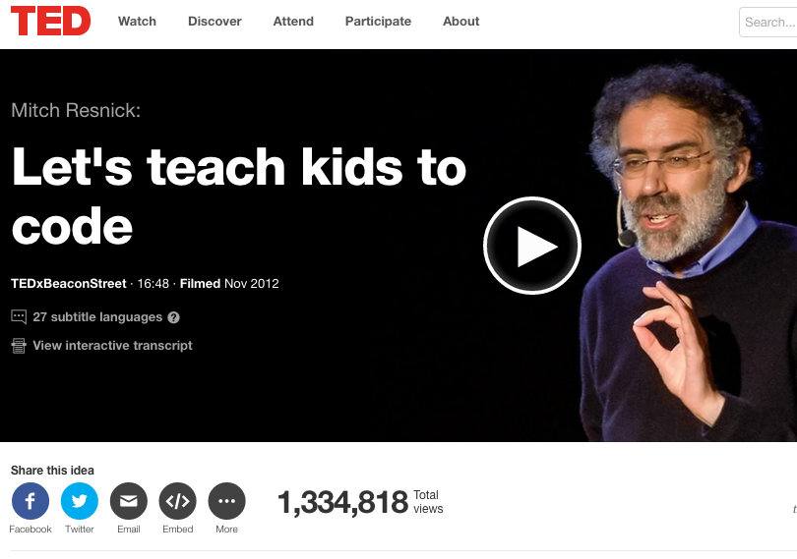
CS education: teaching computer science

Slide 2
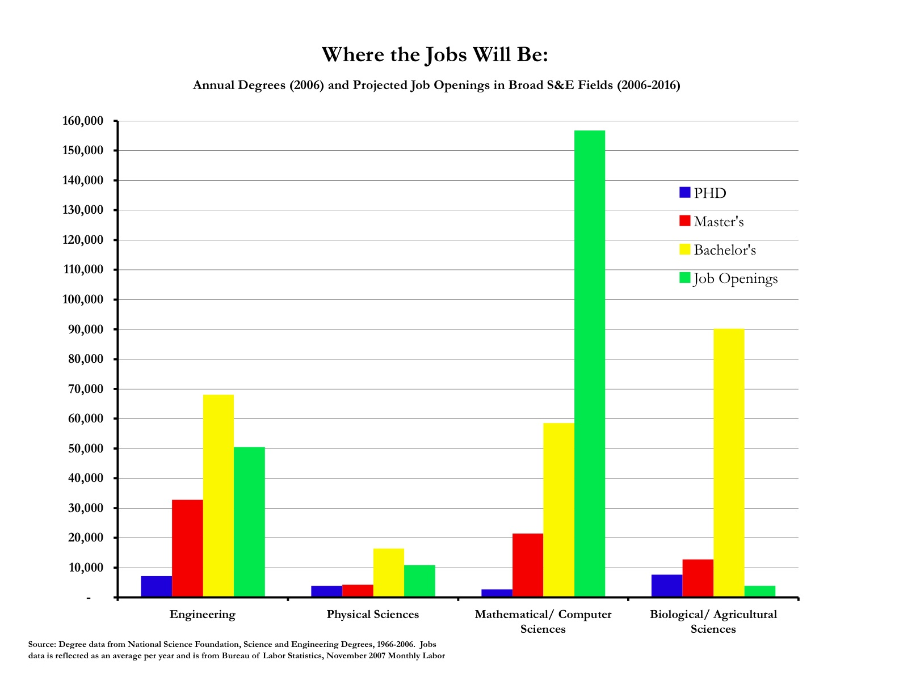
Teaching programming
Teaching computer science has become a huge industry:
Huge job growth
Not enough CS-trained people to fill need

Slide 3
Teaching languages
Not enough CS majors of any type
Combined with lack of diversity and higher drop out rates in CS courses, this is a matter of national concern
President Obama’s state of the union in 2016: "In the coming years, we should build on that progress, by ... offering every student the hands-on computer science and math classes that make them job-ready on Day 1."
As a result, CS education has grown in recent years, with a strong emphasis on how to introduce coding to kids
Alice and Scratch are perhaps the earliest serious efforts into this area, and are still probably the dominant choices
We’ll talk about several alternatives, and see two seriously:
Lego programming (because I love it)
Scratch – the one I know the best

Slide 4
Alice
Designed in mid-90’s by Randy Pausch, a professor at CMU who focused on HCI and design
“Alice is an innovative 3D programming environment that makes it easy to create an animation for telling a story, playing an interactive game, or a video to share on the web. Alice is a freely available teaching tool designed to be a student's first exposure to object-oriented programming. It allows students to learn fundamental programming concepts in the context of creating animated movies and simple video games. In Alice, 3-D objects (e.g., people, animals, and vehicles) populate a virtual world and students create a program to animate the objects.”
--alice.org

Slide 5
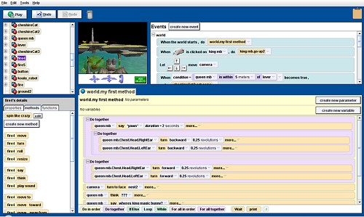
Alice (cont)

Slide 6
Alice details:
Easy to use interface (although does require reading)
Interpreted
Fully object oriented, and focused on causing 3D environment and characters to change
Several versions:
3.1 is designed to end with students knowing Java by the end of a course
2.3 is a more gentle tool, focused on storytelling
Either has a rich repository of tools and examples, although 2.3 is perhaps a bit better supported
Comes with a pool of 3d objects, but can also design and import your own (using other tools)

Slide 7
Scratch
Created by Mitchel Resnick and the MIT Media Lab Lifelong Kindergarten Group, released first in 2002
Current version (v2) is Flash based, and runs through a web-browser
Can be used for storytelling as well, but also can be used for other types of programming
Functions are more limited – they are not first class objects
Limited file I/O, but can interface with other systems like Lego Midstorms (which we’ll talk about soon)
Supports 1d arrays, floating point scalars and strings, but limited string functionality
Based on an older language Squeak (which is Smalltalk based)

Slide 8
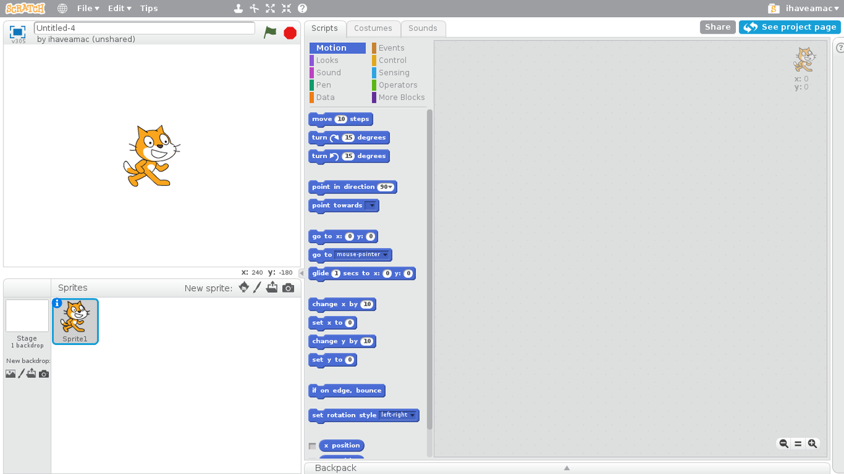
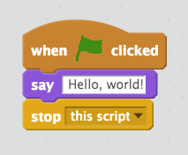
Using Scratch:

Slide 9
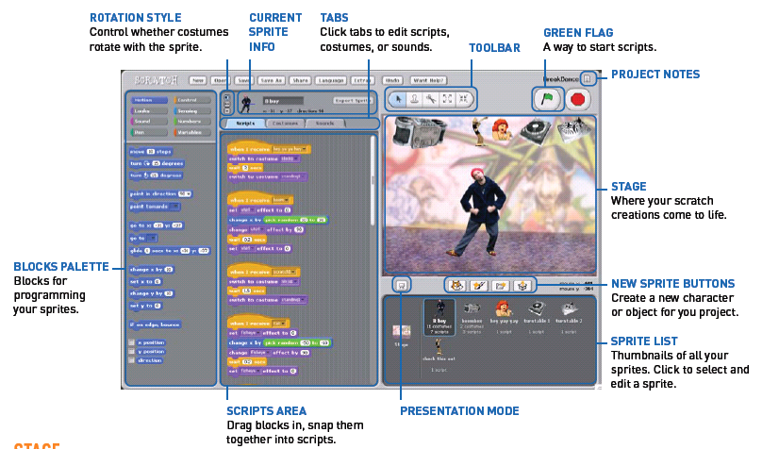
Using Scratch:

Slide 10

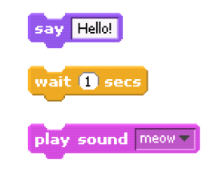
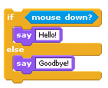

Control flow in Scratch
Statements in Scratch
Booleans and conditionals

Slide 11

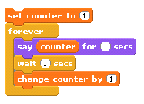

Control flow in Scratch
Loops
Variables

Slide 12
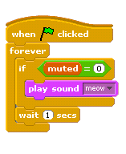
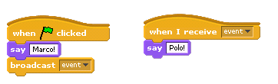
Control flow in Scratch
Events
Threads

Slide 13
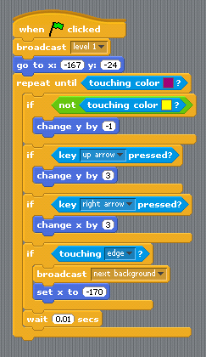
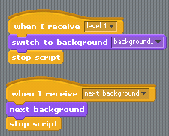
Building things in scratch
In a game (for example), events can be used to change levels.

Slide 14
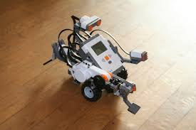

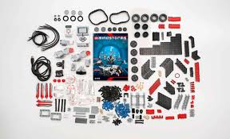
Lego programming
(My personal favorite!)

Slide 15
Lego programming
This language actually goes back to the MIT media lab as well, originally – they developed Brick Logo
Programming is GUI based (at both levels that I’ll discuss), although can interface with C, Java, Python, etc.
Latest version is Lego Minstorms EV3, in 2013
Innovative feature: this takes the “graphical” element to an entire new level
Allows functions (in a sense) as you can form a “myblock” to repeat actions and send in parameters to these

Slide 16
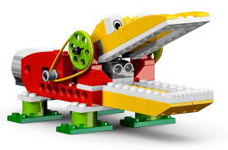
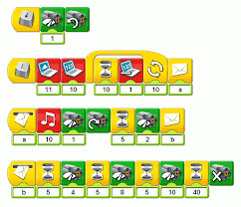
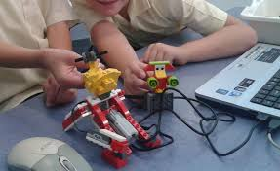
The Lego Wedo
For younger kids:

Slide 17
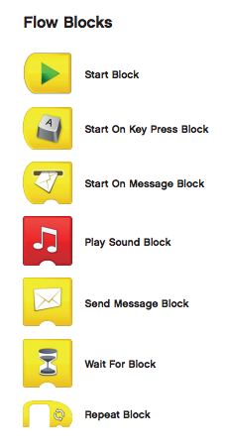
WeDo: details
Basic functionality that you’d expect
Notable feature: no reading is needed!
Start block is required, and from there do basic actions with these

Slide 18
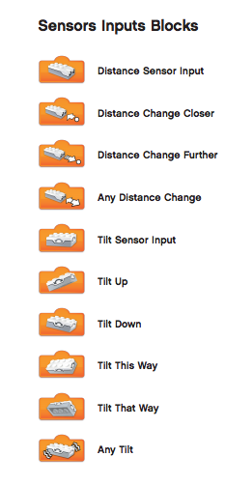
WeDo sensors
The sensor blocks then detect basic events in the model
Usually, you use these to trigger some action, like the bird chirping or the alligator closing its mouth

Slide 19
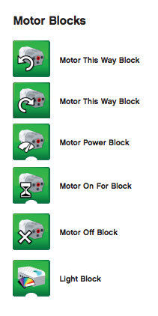
WeDo motor
The motor blocks trigger actual motion in the model
Not required, but usually the most fun
Again, emphasis is on simple design, but very limited functionality is available on these

Slide 20
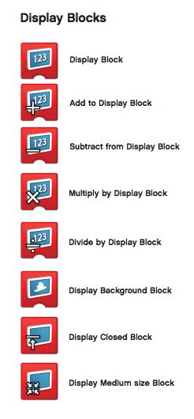
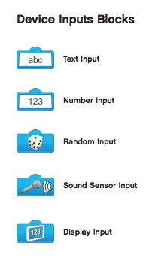
WeDo: other elements
Also blocks to allow input and output

Slide 21
WeDo example
Demo a simple program…

Slide 22
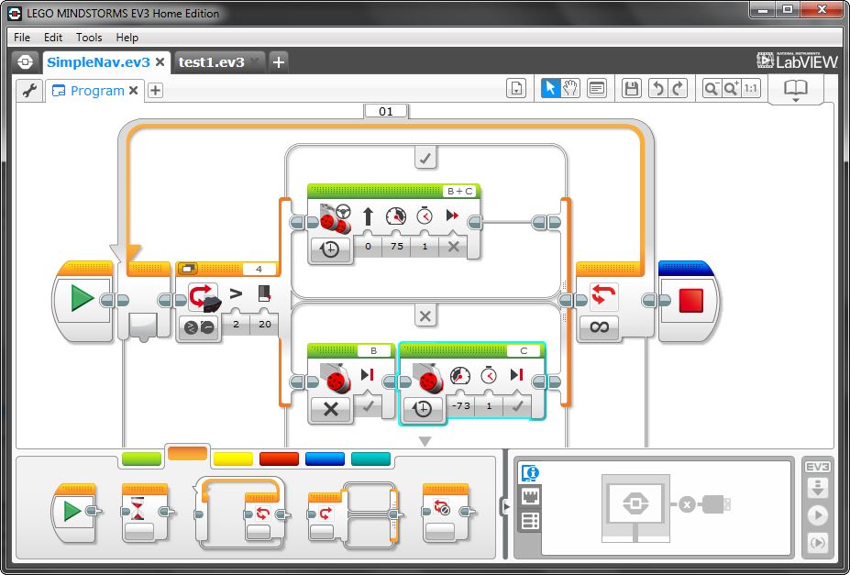
Mindstorms programs
The language:

Slide 23
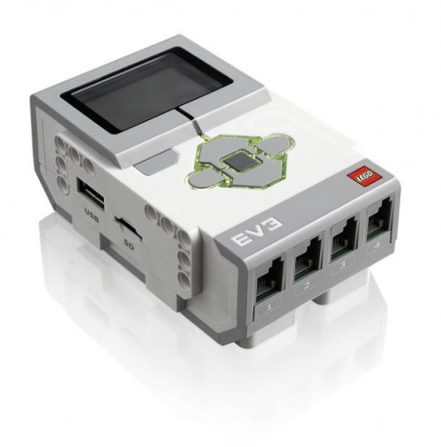
The hardware
USB Port for Connection to Computer
Motor Output Ports
LCD Display Screen
Navigation Buttons
USB port for WiFi
Memory Expansion
Sensor Input Ports
Notes:
§ EV3 “brick”
· Have students compare these to human capabilities (brain)
· Controls motors, lights and LCD screen based on instructions and sensory input

Slide 24
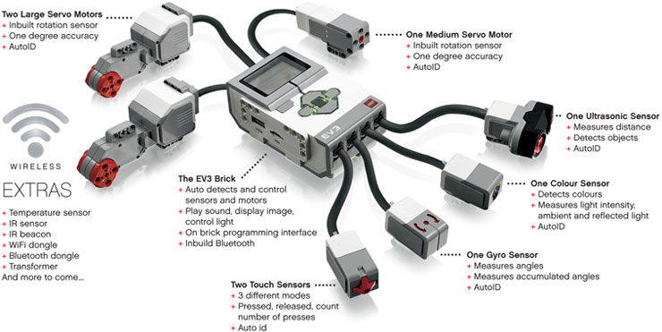
More hardware

Slide 25
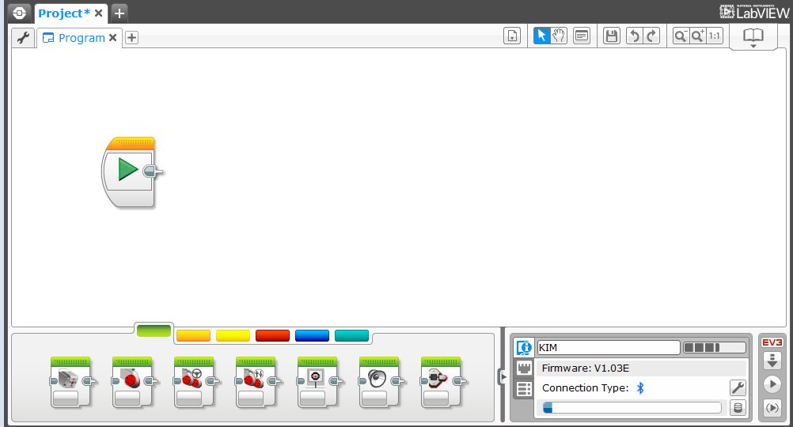
The programming environment
Programming Area or Canvas
Programming Blocks in
6 Colored Tabs
Brick Status & Downloading

Slide 26
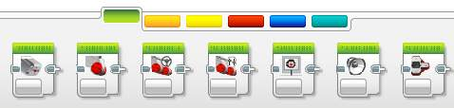
Control blocks
All color coded:
ACTION BLOCKS
Move, Large & Medium Motor, Display…
FLOW BLOCKS
Start, Wait, Loop, Switch, Loop Interrupt
SENSOR BLOCKS
Brick Buttons, Gyro, Color, Ultrasonic
1
2
3
1
2
3
4
5
6
DATA OPERATIONS
Variables, Array, Logic, Math, Compare…
ADVANCED BLOCKS
Data Logging, Unregulated Motor…
MY BLOCKS
Custom Blocks you create
4
5
6

Slide 27
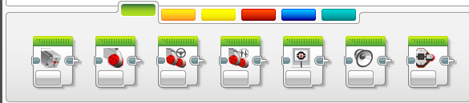
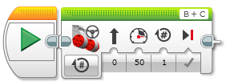
How to program
The GUI interface is very similar to the WeDo one:
STEP 1: Green Block Tab, Click and hold any block and drag to programming area
STEP 2: Drop next to the Start Block (the green arrow, just like the first one)

Slide 28
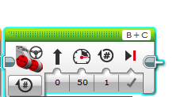

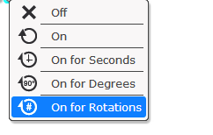
The blocks
Each block has a variety of settings to play with
For example, the move block:
B
C
Mode of operation
Brake/Coast
Steering: Straight or turn
Power/Speed
Duration/Distance

Slide 29

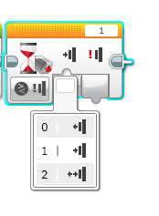

Simple programs:
Program your robot to move straight until you tap the sensor with your hand.
B
0 = released
1 = pressed
2 = bumped
C
Hint: You will combine: Move Steering + Wait Block

Slide 30
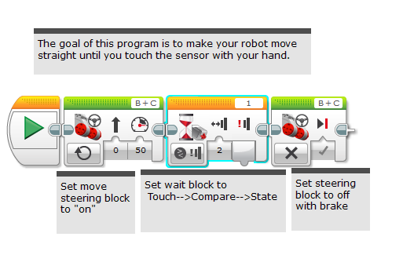
Solution:

Slide 31
Another:
Program your robot to move until it hits the edge of a wall. Then back up and turn right 90 degrees.
0 = released
1 = pressed
2 = bumped
B
C
Hint: You will combine Move Steering + Turning + Wait Block

Slide 32
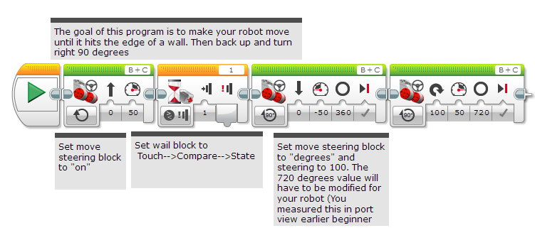
Solution:

Slide 33
Lego robots in action
Minstorms:
https://www.youtube.com/watch?v=dJSeMeAGmXE
Wedo:
https://www.youtube.com/watch?v=w03n-Y18-9I

Slide 34
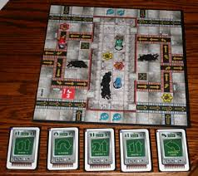
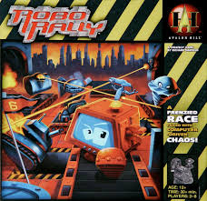
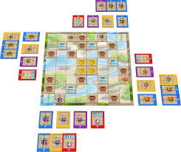
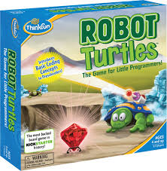
Newer additions: games
The board game Robo Rally:
Or Robot Turtles:

Slide 35
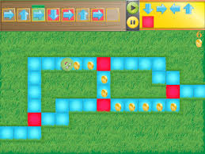
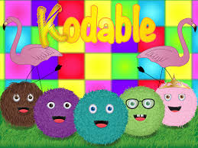
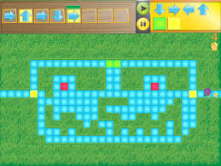
Tablet games
Example: Kodable

