Slide 1
More on flex

Slide 2
Flex - compiling
Let’s compile one of our simple examples from last time
Log into hopper
Copy count.lex from the schedule page into a file on your account
Also look at it again and be sure you remember the basic syntax
Compile (and check the .c output!):
flex count.lex
gcc lex.yy.c –lfl
./a.out > somefile

Slide 3
States
States are activated using BEGIN
INITIAL is the default state
The rest are defined in the first section, using %s or %x
%s is inclusive, where patterns not marked with a state can also match
%x is usually more useful
When the scanner is in a particular state, patterns will only match that have that state next to them in the rules section

Slide 4
Example
Consider a scanner which recognizes (and discards) C comments while maintaining a count of the current input line
%x comment
%%
int line_num = 1;
"/*" BEGIN(comment);
<comment>[^*\n]* /* eat anything that's not a '*' */
<comment>"*"+[^*/\n]* /* eat up '*'s not followed by '/'s */
<comment>\n ++line_num;
<comment>"*"+"/" BEGIN(INITIAL);

Slide 5
Next homework
Your next homework will dive into this
To warm up, the first part is for you to understand a more complex program, a Swedish Chef translator
Part 2 asks you to use flex to translate text or IM-speak
i.e. if you scan LOL, replace it with “laugh out loud”
Part 3 asks you to add capitalization
Will need states to understand when you’re inside a sentence

Slide 6
Limitations of regular languages
Certain languages are simply NOT regular.
Example: Consider the language 0^{n}1^{n}
How would you do a regular expression of DFA/NFA for this one?

Slide 7
Beyond regular expressions
So: we need things that are stronger than regular expressions
A simple (but more real world) example of this:
consider 52 + 2**10
Scanning or tokenizing will recognize this
But how to we add order precedence?
(Ties back to those parse trees we saw last week)

Slide 8
Beyond regular expressions
Generalizing: we need to recognize nested expressions
expr -> id | number | -expr |
(expr)| expr op expr
op -> + | - | * | /
Regular expressions can’t quite manage this, since could do ((((x + 7) * 2) + 3) - 1)
At its heart, this is the 0^{n}1^{n}, since need to match parenthesis on any input

Slide 9
Context Free Languages
CFGs are this stronger class we need for parsing
Described in terms of productions
Called Backus-Normal Form, or BNF
Formally:
A set of terminals T
A set of non-terminals N
A start symbol S (always non-terminal)
A set of productions

Slide 10
An example: 0^{n}1^{n}, n > 0
My terminals: 0 and 1
Usually these are the tokens in the language
Non-terminal: only need one, S
Rules:
S -> 0S1
S -> 01
How we parse: apply rules and see if can get to the final string via these rules
Demo on board…

Slide 11
Another
How would we alter this previous example to show that the set of all binary palindromes can be recognized by a CFG?

Slide 12
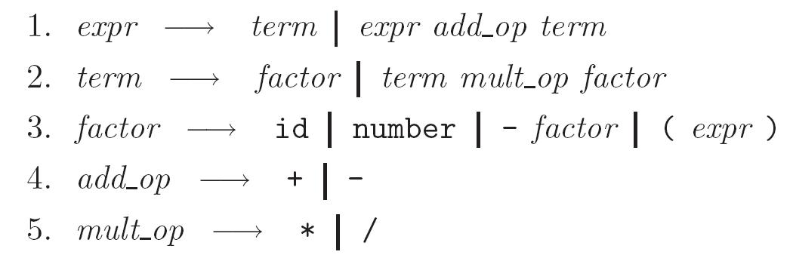
An example from the book:
Expressions in a simple math language
Goal: capture that multiplication and division happen AFTER + and –
Example: 3 + 4 * 5

Slide 13
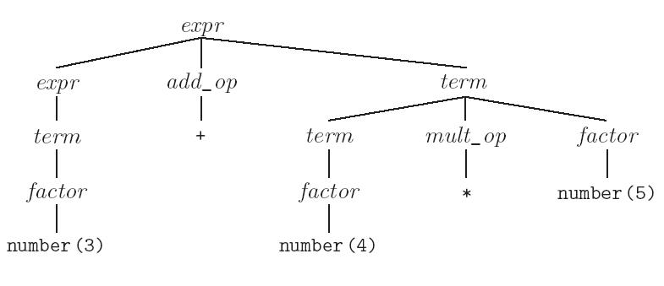
Resulting parse tree
Note that the final parse tree captures precedence:

