Slide 1
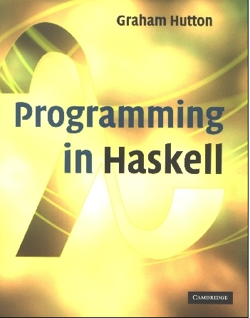
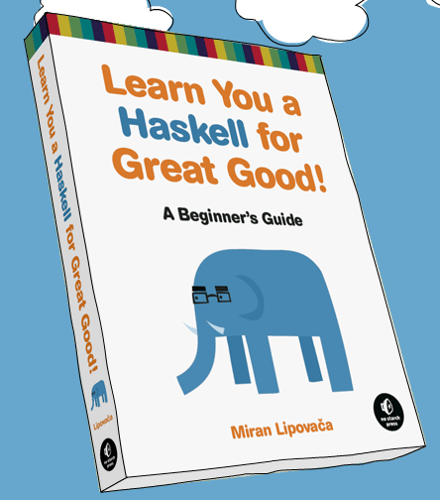
PROGRAMMING IN HASKELL
An Introduction
Based on lecture notes by Graham Hutton
The book “Learn You a Haskell for Great Good”
(and a few other sources)

Slide 2
Midterm recap
35.5 | 0.507142857
48 | 0.685714286
48 | 0.685714286
48.5 | 0.692857143
51 | 0.728571429
52.5 | 0.75
58.5 | 0.835714286
60 | 0.857142857
60 | 0.857142857
60.5 | 0.864285714
61 | 0.871428571
63 | 0.9
63.5 | 0.907142857
65 | 0.928571429
66.5 | 0.95
67 | 0.957142857
67.5 | 0.964285714
67.5 | 0.964285714
68 | 0.971428571
69.5 | 0.992857143
71 | 1.014285714
71.5 | 1.021428571
72 | 1.028571429
73.5 | 1.05
Total was 80 points
  I scaled and graded out of 70 points.
Distribution range
Midsemester grades have been entered
  Did not drop the lowest homework, as only 3 have been graded so far
  4th is almost done!
Check blackboard to be sure my numbers match yours

Slide 3
What is a Functional Language?
Opinions differ, and it is difficult to give a precise definition, but generally speaking:
Functional programming is style of programming in which the basic method of computation is the application of functions to arguments;
A functional language is one that supports and encourages the functional style.

Slide 4
Example
Summing the integers 1 to 10 in Java:
total = 0;
for (i = 1; i ≤ 10; ++i)
total = total+i;
The computation method is variable assignment.

Slide 5
Example
Summing the integers 1 to 10 in Haskell:
sum [1..10]
The computation method is function application.

Slide 6
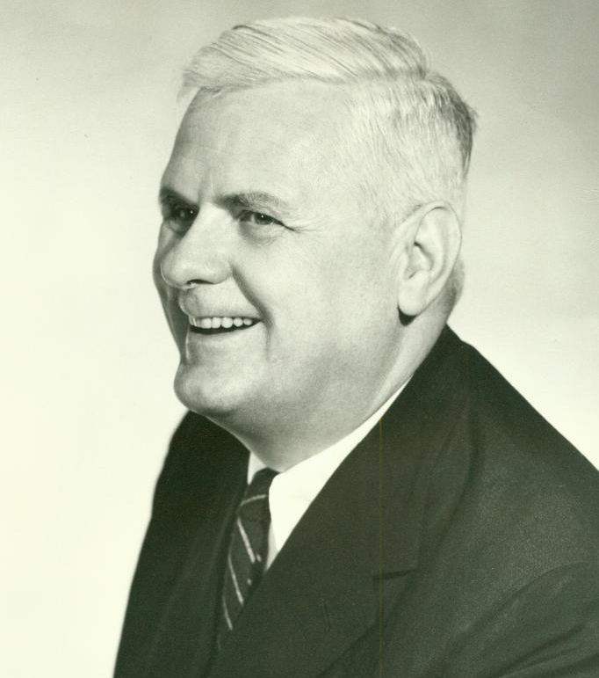
Historical Background
1930s:
Alonzo Church develops the lambda calculus, a simple but powerful theory of functions.

Slide 7
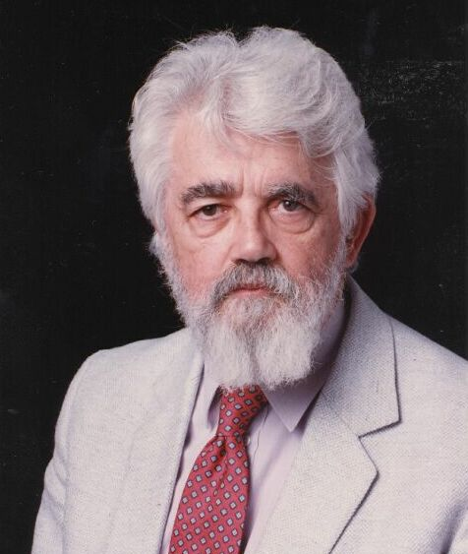
Historical Background
1950s:
John McCarthy develops Lisp, the first functional language, with some influences from the lambda calculus, but retaining variable assignments.

Slide 8
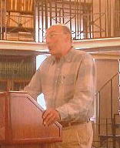
Historical Background
1960s:
Peter Landin develops ISWIM, the first pure functional language, based strongly on the lambda calculus, with no assignments.

Slide 9
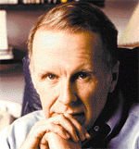
Historical Background
1970s:
John Backus develops FP, a functional language that emphasizes higher-order functions and reasoning about programs.

Slide 10
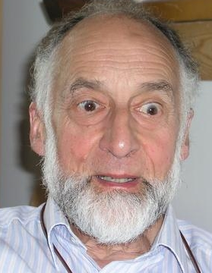
Historical Background
1970s:
Robin Milner and others develop ML, the first modern functional language, which introduced type inference and polymorphic types.

Slide 11

Historical Background
1970s - 1980s:
David Turner develops a number of lazy functional languages, culminating in the Miranda system.

Slide 12
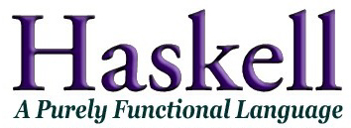
Historical Background
1987:
An international committee of researchers initiates the development of Haskell, a standard lazy functional language.
Partially in response to “Can programming be liberated from the Von Neuman style?”, by John Backus.
(Named in honor of logician Haskell B. Curry.)

Slide 13
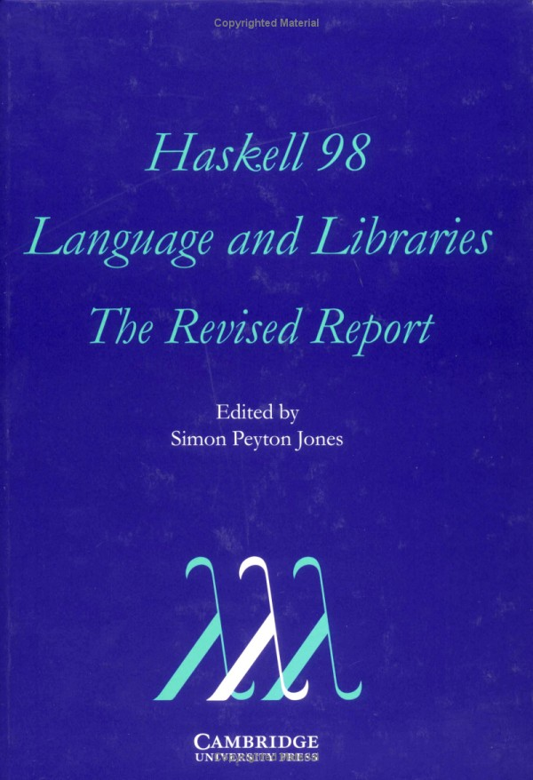
Historical Background
2003:
The committee publishes the Haskell 98 report, defining a stable version of the language.

Slide 14
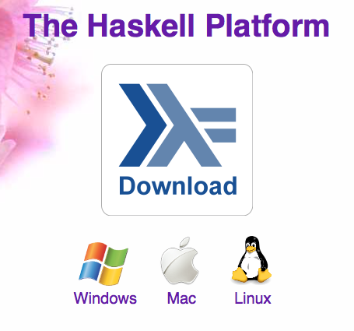
Historical Background
2003-date:
Standard distribution, library support, new language features, development tools, use in industry, influence on other languages, etc.

Slide 15
A Taste of Haskell
f [] = []
f (x:xs) = f ys ++ [x] ++ f zs
where
ys = [a | a ← xs, a ≤ x]
zs = [b | b ← xs, b > x]
?

Slide 16
Basic Structure
Purely function
Lazy evaluation
Statically typed with strong typing
Uses type inference (like Python)
VERY concise – small and elegant code
Types are KEY (like Java or C – but more)
Features we care about:
On turing
Website with interface (somewhat limited functionality)
Free and easy to download locally

Slide 17
Glasgow Haskell Compiler
GHC is the leading implementation of Haskell, and comprises a compiler and interpreter;
The interactive nature of the interpreter makes it well suited for teaching and prototyping;
GHC is freely available from:
www.haskell.org/platform

Slide 18
Starting GHC
The GHC interpreter can be started from the Unix command prompt % by simply typing ghci:
% ghci
GHCi, version 7.4.1: http://www.haskell.org/ghc/ :? for help
Loading package ghc-prim ... linking ... done.
Loading package integer-gmp ... linking ... done.
Loading package base ... linking ... done.
Prelude>

Slide 19
The GHCi prompt > means that the interpreter is ready to evaluate an expression.
For example:
> 2+3*4
14
> (2+3)*4
20
> sqrt (3^2 + 4^2)
5.0

Slide 20
The Standard Prelude:
List Madness!
Haskell comes with a large number of standard library functions. In addition to the familiar numeric functions such as + and *, the library also provides many useful functions on lists.
Select the first element of a list:
> head [1,2,3,4,5]
1

Slide 21
Remove the first element from a list:
> tail [1,2,3,4,5]
[2,3,4,5]
Select the nth element of a list:
> [1,2,3,4,5] !! 2
3
Select the first n elements of a list:
> take 3 [1,2,3,4,5]
[1,2,3]

Slide 22
Remove the first n elements from a list:
> drop 3 [1,2,3,4,5]
[4,5]
Calculate the length of a list:
> length [1,2,3,4,5]
5
Calculate the sum of a list of numbers:
> sum [1,2,3,4,5]
15

Slide 23
Calculate the product of a list of numbers:
> product [1,2,3,4,5]
120
Append two lists:
> [1,2,3] ++ [4,5]
[1,2,3,4,5]
Reverse a list:
> reverse [1,2,3,4,5]
[5,4,3,2,1]

Slide 24
Function Application
In mathematics, function application is denoted using parentheses, and multiplication is often denoted using juxtaposition or space.
f(a,b) + c d
Apply the function f to a and b, and add the result to the product of c and d.

Slide 25
In Haskell, function application is denoted using space, and multiplication is denoted using *.
f a b + c*d
As previously, but in Haskell syntax.

Slide 26
Moreover, function application is assumed to have higher priority than all other operators.
f a + b
Means (f a) + b, rather than f (a + b).

Slide 27
Examples
Mathematics
Haskell
f(x)
f x
f(x,y)
f x y
f(g(x))
f (g x)
f(x,g(y))
f x (g y)
f(x)g(y)
f x * g y

Slide 28
Types
All computation in Haskell is done via evaluation of expressions to get values.
Every value has an associated type, and is a first class object.
Examples:
Integer
Char
Integer->Integer
[a] -> Integer

Slide 29
Types in Haskell
If evaluating an expression e would produce a value of type t, then e has type t, written
e :: t
Every well formed expression has a type, which can be automatically calculated at compile time using a process called type inference.

Slide 30
All type errors are found at compile time, which makes programs safer and faster by removing the need for type checks at run time.
In GHCi, the :type command calculates the type of an expression, without evaluating it:
> not False
True
> :type not False
not False :: Bool

Slide 31
My First Script
When developing a Haskell script, it is useful to keep two windows open, one running an editor for the script, and the other running GHCi.
Start an editor, type in the following two function definitions, and save the script as test.hs:
myDouble x = x + x
myQuadruple x = double (double x)

Slide 32
Leaving the editor open, in another window start up GHCi with the new script:
% ghci test.hs
Now both the standard library and the file test.hs are loaded, and functions from both can be used:
> myQuadruple 10
40
> take (double 2) [1,2,3,4,5,6]
[1,2,3,4]

Slide 33
Leaving GHCi open, return to the editor, add the following two definitions, and resave:
myFactorial n = product [1..n]
myAverage ns = sum ns `div` length ns
Note:
div is enclosed in back quotes, not forward;
x `f` y is just syntactic sugar for f x y.
So this is just saying “div (sum ns) (length ns)

Slide 34
GHCi does not automatically detect that the script has been changed, so a reload command must be executed before the new definitions can be used:
> :reload
Reading file "test.hs"
> factorial 10
3628800
> average [1,2,3,4,5]
3

Slide 35
Functions are often done using pattern matching, as well as a declaration of type (more later):
head :: [a] -> a
head (x:xs) = x
Now you try one…

Slide 36
Exercise
Write a program to find the number of elements in a list. Here’s how to start:
myLength :: [a] -> Int
myLength [] =
myLength (x:xs) =
How do you test this to be sure it works?
(Copy your function into an email to me.)

