Slide 1
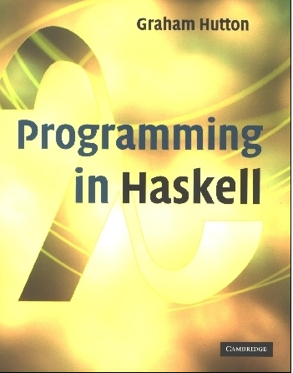
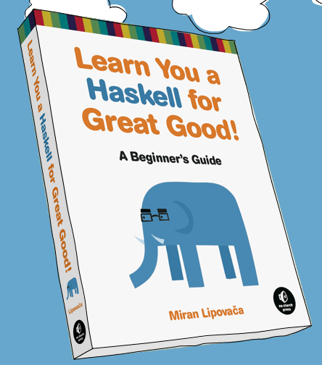
PROGRAMMING IN HASKELL
Lecture 2
Based on lecture notes by Graham Hutton
The book “Learn You a Haskell for Great Good”
(and a few other sources)

Slide 2
Glasgow Haskell Compiler
GHC is the leading implementation of Haskell, and comprises a compiler and interpreter;
The interactive nature of the interpreter makes it well suited for teaching and prototyping;
GHC is freely available from:
www.haskell.org/platform

Slide 3
Starting GHC
The GHC interpreter can be started from the Unix command prompt % by simply typing ghci:
% ghci
GHCi, version 7.4.1: http://www.haskell.org/ghc/ :? for help
Loading package ghc-prim ... linking ... done.
Loading package integer-gmp ... linking ... done.
Loading package base ... linking ... done.
Prelude>

Slide 4
My First Script
When developing a Haskell script, it is useful to keep two windows open, one running an editor for the script, and the other running GHCi.
Start an editor, type in the following two function definitions, and save the script as test.hs:
myDouble x = x + x
myQuadruple x = myDouble (myDouble x)

Slide 5
Leaving the editor open, in another window start up GHCi with the new script:
% ghci test.hs
Now both the standard library and the file test.hs are loaded, and functions from both can be used:
> myQuadruple 10
40
> take (double 2) [1,2,3,4,5,6]
[1,2,3,4]

Slide 6
Leaving GHCi open, return to the editor, add the following two definitions, and resave:
myFactorial n = product [1..n]
myAverage ns = sum ns `div` length ns
Note:
div is enclosed in back quotes, not forward;
x `f` y is just syntactic sugar for f x y.
So this is just saying “div (sum ns) (length ns)

Slide 7
GHCi does not automatically detect that the script has been changed, so a reload command must be executed before the new definitions can be used:
> :reload
Reading file "test.hs"
> factorial 10
3628800
> average [1,2,3,4,5]
3

Slide 8
Useful GHCi Commands
Command Meaning
:load name load script name
:reload reload current script
:edit name edit script name
:edit edit current script
:type expr show type of expr
:? show all commands
:quit quit GHCi

Slide 9
Naming Requirements
Function and argument names must begin with a lower-case letter. For example:
myFun
fun1
arg_2
x’
By convention, list arguments usually have an s suffix on their name. For example:
xs
ns
nss

Slide 10
The Layout Rule
In a sequence of definitions, each definition must begin in precisely the same column:
a = 10
b = 20
c = 30
a = 10
b = 20
c = 30
a = 10
b = 20
c = 30

Slide 11
The layout rule avoids the need for explicit syntax to indicate the grouping of definitions.
a = b + c
where
b = 1
c = 2
d = a * 2
a = b + c
where
{b = 1;
c = 2}
d = a * 2
means
implicit grouping
explicit grouping

Slide 12
Exercise
Fix the syntax errors in the program below, and test your solution using GHCi.
N = a ’div’ length xs
where
a = 10
xs = [1,2,3,4,5]
(Copy your corrected version into an email to me, but don’t send yet.)

Slide 13
What is a Type?
A type is a name for a collection of related values. For example, in Haskell the basic type
Bool
contains the two logical values:
False
True

Slide 14
Type Errors
Applying a function to one or more arguments of the wrong type is called a type error.
> 1 + False
Error
1 is a number and False is a logical value, but + requires two numbers.

Slide 15
Types in Haskell
If evaluating an expression e would produce a value of type t, then e has type t, written
e :: t
Every well formed expression has a type, which can be automatically calculated at compile time using a process called type inference.

Slide 16
All type errors are found at compile time, which makes programs safer and faster by removing the need for type checks at run time.
In GHCi, the :type command calculates the type of an expression, without evaluating it:
> not False
True
> :type not False
not False :: Bool

Slide 17
Basic Types
Haskell has a number of basic types, including:
Bool
- logical values
Char
- single characters
String
- strings of characters
Int
- fixed-precision integers
Integer
- arbitrary-precision integers
Float
- floating-point numbers

Slide 18
List Types
A list is sequence of values of the same type:
[False,True,False] :: [Bool]
[’a’,’b’,’c’,’d’] :: [Char]
In general:
[t] is the type of lists with elements of type t.

Slide 19
Note:
The type of a list says nothing about its length:
[False,True] :: [Bool]
[False,True,False] :: [Bool]
The type of the elements is unrestricted. For example, we can have lists of lists:
[[’a’],[’b’,’c’]] :: [[Char]]

Slide 20
Tuple Types
A tuple is a sequence of values of different types:
(False,True) :: (Bool,Bool)
(False,’a’,True) :: (Bool,Char,Bool)
In general:
(t1,t2,…,tn) is the type of n-tuples whose ith components have type ti for any i in 1…n.

Slide 21
Note:
The type of a tuple encodes its size:
(False,True) :: (Bool,Bool)
(False,True,False) :: (Bool,Bool,Bool)
The type of the components is unrestricted:
(’a’,(False,’b’)) :: (Char,(Bool,Char))
(True,[’a’,’b’]) :: (Bool,[Char])

Slide 22
Function Types
A function is a mapping from values of one type to values of another type:
not :: Bool → Bool
isDigit :: Char → Bool
In general:
t1 → t2 is the type of functions that map values of type t1 to values to type t2.

Slide 23
Note:
The arrow → is typed at the keyboard as ->.
The argument and result types are unrestricted. For example, functions with multiple arguments or results are possible using lists or tuples:
add :: (Int,Int) → Int
add (x,y) = x+y
zeroto :: Int → [Int]
zeroto n = [0..n]

Slide 24
Exercise
What are the types of the following values?
[’a’,’b’,’c’]
(’a’,’b’,’c’)
[(False,’0’),(True,’1’)]
([False,True],[’0’,’1’])
[tail,init,reverse]
(Again, add this to that email.)

Slide 25
Functions are often done using pattern matching, as well as a declaration of type (more later):
head :: [a] -> a
head (x:xs) = x
Now you try one…

Slide 26
Exercise
Write a function in your script that will find the last element in a list. For example:
Prelude> myLast [1,2,3,4]
4
Prelude> myLast [‘x’,’y’,’z’]
z
Note that your first line should be declaration plus type, and from there use pattern matching and recursion.
(Again, add this to that email.)

Slide 27
Curried Functions
Functions with multiple arguments are also possible by returning functions as results:
myAdd :: Int → (Int → Int)
myAdd x y = x+y
myAdd takes an integer x and returns a function myAdd x. In turn, this function takes an integer y and returns the result x+y.

Slide 28
Note:
add and add’ produce the same final result, but add takes its two arguments at the same time, whereas myAdd takes them one at a time:
add :: (Int,Int) → Int
myAdd :: Int → (Int → Int)
Functions that take their arguments one at a time are called curried functions, celebrating the work of Haskell Curry on such functions.

Slide 29
Functions with more than two arguments can be curried by returning nested functions:
mult :: Int → (Int → (Int → Int))
mult x y z = x*y*z
mult takes an integer x and returns a function mult x, which in turn takes an integer y and returns a function mult x y, which finally takes an integer z and returns the result x*y*z.

Slide 30
Why is Currying Useful?
Curried functions are more flexible than functions on tuples, because useful functions can often be made by partially applying a curried function.
For example:
add’ 1 :: Int → Int
take 5 :: [Int] → [Int]
drop 5 :: [Int] → [Int]

Slide 31
Currying Conventions
To avoid excess parentheses when using curried functions, two simple conventions are adopted:
The arrow → associates to the right.
Int → Int → Int → Int
Means Int → (Int → (Int → Int)).

Slide 32
As a consequence, it is then natural for function application to associate to the left.
mult x y z
Means ((mult x) y) z.
Unless tupling is explicitly required, all functions in Haskell are normally defined in curried form.

Slide 33
Polymorphic Functions
A function is called polymorphic (“of many forms”) if its type contains one or more type variables.
length :: [a] → Int
for any type a, length takes a list of values of type a and returns an integer.

Slide 34
Note:
Type variables can be instantiated to different types in different circumstances:
> length [False,True]
2
> length [1,2,3,4]
4
a = Bool
a = Int
Type variables must begin with a lower-case letter, and are usually named a, b, c, etc.

Slide 35
Many of the functions defined in the standard prelude are polymorphic. For example:
fst :: (a,b) → a
head :: [a] → a
take :: Int → [a] → [a]
zip :: [a] → [b] → [(a,b)]
id :: a → a

Slide 36
Ranges in Haskell
As already discussed, Haskell has extraordinary range capability on lists:
ghci> [1..15]
[1,2,3,4,5,6,7,8,9,10,11,12,13,14,15]
ghci> ['a'..'z']
"abcdefghijklmnopqrstuvwxyz"
ghci> ['K'..'Z']
"KLMNOPQRSTUVWXYZ”
ghci> [2,4..20]
[2,4,6,8,10,12,14,16,18,20]
ghci> [3,6..20]
[3,6,9,12,15,18]

Slide 37
Ranges in Haskell
But be careful:
ghci> [0.1, 0.3 .. 1]
[0.1,0.3,0.5,0.7,0.8999999999999999,1.0999999999999999]
(I’d recommend just avoiding floating point in any range expression in a list – imprecision is just too hard to predict.)

Slide 38
Infinite Lists
Can be very handy – these are equivalent:
[13,26..24*13]
take 24 [13,26..]
A few useful infinite list functions:
ghci> take 10 (cycle [1,2,3])
[1,2,3,1,2,3,1,2,3,1]
ghci> take 12 (cycle "LOL ")
"LOL LOL LOL "
ghci> take 10 (repeat 5)
[5,5,5,5,5,5,5,5,5,5]

Slide 39
List Comprehensions
Very similar to standard set theory list notation:
ghci> [x*2 | x <- [1..10]]
[2,4,6,8,10,12,14,16,18,20]
Can even add predicates to the comprehension:
ghci> [x*2 | x <- [1..10], x*2 >= 12]
[12,14,16,18,20]
ghci> [ x | x <- [50..100], x `mod` 7 == 3]
[52,59,66,73,80,87,94]

Slide 40
List Comprehensions
Can even combine lists:
ghci> let nouns = ["hobo","frog","pope"]
ghci> let adjectives =
["lazy","grouchy","scheming"]
ghci> [adjective ++ " " ++ noun | adjective
<- adjectives, noun <- nouns]
["lazy hobo","lazy frog","lazy pope","grouchy hobo","grouchy frog",
"grouchy pope","scheming hobo","scheming frog","scheming pope"]

Slide 41
Exercise
Write a function called myodds that takes a list and filters out just the odds using a list comprehension.
Then test it by giving it an infinite list, but then only “taking” the first 12 elements.
Note: Your code will start with something like:
myodds xs = [ put your code here ]

