Slide 1

Chapter 12 :: Logic Languages
Based on Programming Language Pragmatics
Michael L. Scott
And other online sources (see links on schedule page)
Copyright © 2009 Elsevier

Slide 2
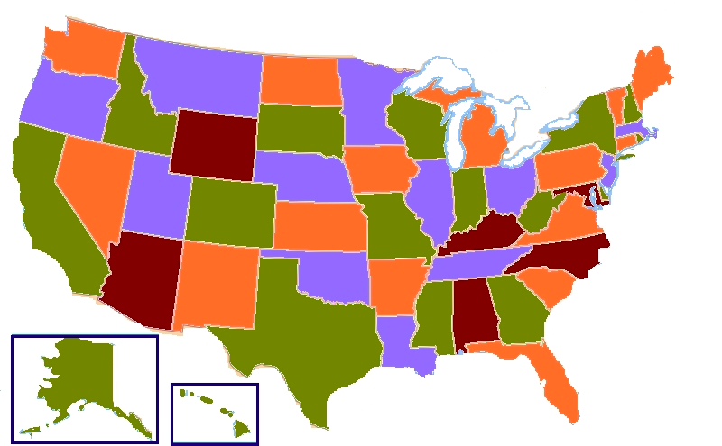
Prolog – an example to recap
Consider 4 coloring a map.
Classical example of an NP-Hard problem, so the best we can hope for is exponential time.
NOT easy to code in many languages:
  http://www.cplusplus.com/forum/general/123813/
  https://handcraftsman.wordpress.com/2015/06/21/four-coloring-a-graph-of-u-s-states-with-python-and-a-ga/
  http://www.sanfoundry.com/java-program-graph-coloring-algorithm/
Copyright © 2009 Elsevier

Slide 3
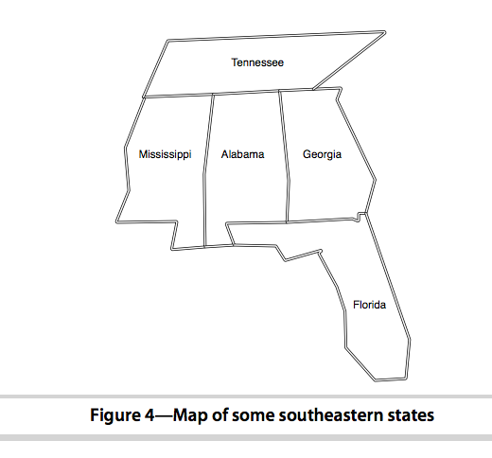
Prolog – 3 coloring:
Let’s try a small example of this in prolog
  Extending bigger is easy, since will just need more predicates for neighbors
Base assertions will just be that colors need to be different, and neighbors can’t be the same
  See code on webpage
Copyright © 2009 Elsevier

Slide 4
Prolog – 4 coloring:
There are also other ways to do this, that pull in more logic (which we’ll be talking about today).
See (for example):
  https://bernardopires.com/2013/10/try-logic-programming-a-gentle-introduction-to-prolog/
  https://www.cpp.edu/~jrfisher/www/prolog_tutorial/2_1.html
Let’s dive more into these logical constructs today, and then come back to these examples
Copyright © 2009 Elsevier

Slide 5
Control flow - the fail predicate
The fail predicate always fails.
It can be quite useful to force certain actions. For example, the \+ can be implemented using fail and !: =\+(X=H) :- (X=H), !, fail.
It can also be used to generate a type of “looping” behavior. As an example, recall our append code:
append([], A, A).
append([H | T], A, [H | L]) :-
append(T, A, L).
If we write append(A,B,L) where L is instantiated but A and B are not, we can use this to generate possible lists.
Copyright © 2009 Elsevier

Slide 6
Control flow - the fail predicate
If we write append(A,B,L) where L is instantiated by A and B are not, we can use this to generate possible lists:
print_lists(L) :-
append(A,B,L), write(A),
write(‘ ‘), write(B),
nl, fail.
The output if we call print_lists([a, b, c]) will be:
  [] [a, b, c]
  [a] [b, c]
  [a, b] [c]
  [a, b, c] []
  No
Copyright © 2009 Elsevier

Slide 7
Looping and unbounded generators
The following generates all of the natural numbers:
natural(1).
natural(N) :- natural(M), N is M+1.
We can then use this to print out the first n numbers:
  my_loop(N) := natural(I),
  write(I), nl,
  I = N, !.
  So long as I is less than N, the equality predicate will fail and backtracking will pursue another alternative for natural. If I is equal to N, then the cut will execute, committing us to the final value of I and terminating this loop.
Copyright © 2009 Elsevier

Slide 8
Looping and unbounded generators
This programming idiom - an unbounded generator with a test-cut terminator - is know as generate-and-test.
This combination is generally used with side effects, such as I/O or modification of the database.
For example, we could use such a construct to add values to the database until some threshold is met.
Copyright © 2009 Elsevier

Slide 9
I/O in prolog
Prolog provides several I/O predicates, such as:
  write and nl for output, read for input
  see and tell can redirect input and output to different files.
  get and put read individual characters.
  consult and reconsult add database clauses from a file, so that they don’t have to be entered by hand.
Copyright © 2009 Elsevier

Slide 10
Database Manipulation
Prolog is homoiconic: it can represent itself (like Scheme).
It can also modify itself:
  ?- rainy(X)
  X = seattle ;
  X = rochester ;
  No
  ?- assert(rainy(syracuse)).
  Yes
  ?- retract(rainy(rochester)).
  Yes
  ?- rainy(X)
  X = seattle ;
  X = syracuse ;
  No
Copyright © 2009 Elsevier

Slide 11
Additional predicates
The goal functor(T, F, N) succeeds if and only if T is a term with functor F and arity N:
  ?- functor(foo(a,b,c), foo, 3).
  Yes
  ?- functor(foo(a,b,c), F, N).
  F = foo
  N = 3
  ?- functor(T, foo, 3).
  T = foo(_10, _37, _24)
The goal arg(N, T, A) succeeds if and only if its first two arguments are instantiated, N is a number, and A is the Nth argument of T:
  ?- arg(3, foo(a,b,c), A).
  A = c
Copyright © 2009 Elsevier

Slide 12
Using arg and functor
We can use these together to create an arbitrary term:
  ?- functor(T, foo, 3), arg(1, T, a), arg(2, T, b), arg(3, T, c)
  T = foo(a, b, c)
We can also use =.. for this:
  ?- T =.. [foo, a, b, c]
  T = foo(a,b,c)
  ?- foo(a,b,c) =.. [F, A1, A2, A3]
  F = foo
  A1 = a
  A2 = b
  A3 = c
Copyright © 2009 Elsevier

Slide 13
Dynamic goals
Taken together, we can attempt to satisfy goals that are created at run-time only:
  param_loop(L, H, F) :- natural(I), I >= L,
  G =.. [F, I], call(G), I=H, !.
Then calling:
  ?- param_loop(5, 10, write).
  5678910
  Yes
Copyright © 2009 Elsevier

Slide 14
My favorite example
It is worth reiterating that prolog is NOT really a traditional language which executes statements in a von Neumann-like way.
Prolog does provide some mechanisms for this, but they can be very inefficient (especially if you’re not used to the language).
  sort(L1, L2) := permutation(L1, L2), sorted(L2).
  permutation([], []).
  permutation(L, [H | T]) :-
  append(P, [H | S], L),
  append(P, S, W),
  permutation(W,T).
If this looks confusing, don’t worry. We’re essentially saying L2 is a sorted version of L1 if it’s a permutation of L1 and it is sorted.
This version takes exponential time. Why?
Copyright © 2009 Elsevier

Slide 15
Sorting: quicksort
Implementing something like quick sort is possible:
  quicksort([], []).
  quicksort([A, L1], L2) :- partition(A, L1, P1, S1),
  quicksort(P1, P2), quicksort(S1, S2),
  append(P2, [A | S2], L2).
  partition(A, [], [], []).
  partition(A, [H | T], [H | P], S) :- A >= H, partition(A, T, P, S).
  partition(A, [H | T], [P], [H | S]) :- A =< H, partition(A, T, P, S).
Copyright © 2009 Elsevier

Slide 16
A final example: DFAs
As a final example, prolog is also really good and simulating DFAs and NFAs.
We’ll talk about DFAs, but NFAs are your homework!
My example: taken from
  https://www.cpp.edu/~jrfisher/www/prolog_tutorial/2_14.html
Things to note:
  This prints for you!
  The transition function takes an input and moves along an “arrow”
  For NFAs, your job will be to add multiple possible transitions and empty transitions
Copyright © 2009 Elsevier

Slide 17
Conclusions
Bigger examples are everywhere online
  I really like the Sudoku example in your recommended text (you can find this chapter online for free, in fact), but it was really too long for class.
First used for language processing, but good also for games, web analysis, AI, scheduling, and other things.
  Often really found in a larger applications, not solo.
Weaknesses:
  Not general purpose – definitely a niche language.
  Computationally intensive, so not good on big data.
  Can be hard to manage recursion (even more so than functional).
Copyright © 2009 Elsevier

Slide 18
Conclusions
Two major steps:
  Build a knowledge base
  Compile this base and ask questions
Core computation is unification, as opposed to variables or functions.
Serious learning curve! We’ve only tasted it briefly, so use this cautiously.
  Lots of people say this takes years to get good at, but finding places it can be applied can make life much easier.
My takeaway for you: some models of computation are just very different, but have their unique strengths.
Copyright © 2009 Elsevier

