Slide 1
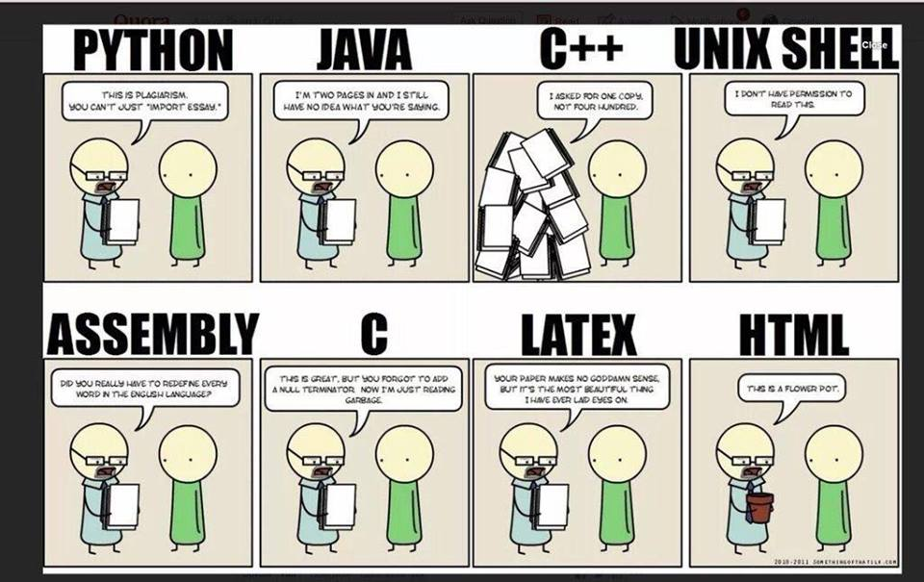

Chapter 14 :: Scripting Languages
Programming Language Pragmatics
Michael L. Scott
Copyright © 2009 Elsevier

Slide 2
What Is A Scripting Language
Modern scripting languages have two principal sets of ancestors.
  command interpreters or “shells” of traditional batch and “terminal” (command-line) computing
    IBM’s JCL, MS-DOS command interpreter, Unix sh and csh
  various tools for text processing and report generation
    IBM’s RPG, and Unix’s sed and awk.
From these evolved
  Rexx, IBM’s “Restructured Extended Executor,” which dates from 1979
  Perl, originally devised by Larry Wall in the late 1980s, and now (still?) the most widely used general purpose scripting language.
  Other general purpose scripting languages include Tcl (“tickle”), Python, Ruby, VBScript or Powershell (for Windows) and AppleScript (for the Mac)
Copyright © 2009 Elsevier

Slide 3
Common Characteristics:
Both batch and interactive use
  While a few languages (e.g. Perl) have a compiler that requires the entire source program, almost all scripting languages either compile or interpret line by line
  Many “compiled” versions are actually completely equivalent to the interpreter running behind the scenes (like in Python).
Copyright © 2009 Elsevier

Slide 4
Common Characteristics:
Economy of expression
  Two variants: some make heavy use of punctuation and short identifiers (like Perl), while others emphasize “English-like” functionality (like Python)
Either way, things get shorter. Java versus Python (or Ruby or Perl):
  class Hello {
  public static void main(String[] args) {
  System.out.println(“Hello, world!”);
  }
  print “Hello, world!\n”
Copyright © 2009 Elsevier

Slide 5
Common Characteristics:
Lack of declarations; simple scoping rules.
  While the rules vary, they are generally fairly simple and additional syntax is necessary to alter them.
    In Perl, everything is of global scope by default, but optional parameters can limit the scope to local
    In PHP, everything is local by default, and any global variables must be explicitly imported.
    In Python, everything is local to the block in which the assignment appears, and special syntax is required to assign a variable in a surrounding scope.
Copyright © 2009 Elsevier

Slide 6
Common Characteristics:
Flexible dynamic typing
  In PHP, Python and Ruby, the type of a variable is only checked right before use
  In Perl, Rexx, or Tcl, things are even more dynamic:
  $a = “4”
  print $a . 3 . “\n”
  print $a + 3 . “\n”
  Outputs the following:
  43
  7
Copyright © 2009 Elsevier

Slide 7
Common Characteristics:
Easy access to other programs
  While all languages provide support for OS functionality, scripting languages generally provide amazing and much more fundamental built-in support.
  Examples include directory and file manipulation,
  I/O modules, sockets, database access, password and
  authentication support, and network
  communications.
Copyright © 2009 Elsevier

Slide 8
Common Characteristics:
Sophisticated pattern matching and string manipulation
  Perl is perhaps the master of this, but it traces back to the text processing sed/awk ancestry.
  These are generally based on extended regular expression (which we already saw a bit of when using lex at the beginning).
Copyright © 2009 Elsevier

Slide 9
Common Characteristics:
High level data types
  In general, scripting languages provide support for sets, dictionaries, lists and tuples (at a minimum).
  While languages like C++ and Java have these, they usually need to be imported separately.
  Behind the scenes, optimizations like arrays indexed using hash tables are quite common.
  Garbage collection is always automatic, so user never has to deal with heap/stack issues.
Copyright © 2009 Elsevier

Slide 10
Problem Domains
Some general purpose languages—Scheme and Visual Basic in particular—are widely used for scripting
Conversely, some scripting languages, including Perl, Python, and Ruby, are intended by their designers for general purpose use, with features intended to support “programming in the large”
  modules, separate compilation, reflection, program development environments
For the most part, however, scripting languages tend to see their principal use in well defined problem domains
Copyright © 2009 Elsevier

Slide 11
Problem Domains: Scripts
Shell Languages
  They have features designed for interactive use
  Provide a wealth of mechanisms to manipulate file names, arguments, and commands, and to glue together other programs
    Most of these features are retained by more general scripting languages
  We consider a few of them - full details can be found in the bash man page, or in various on-line tutorials:
    Filename and Variable Expansion
    Tests, Queries, and Conditions
    Pipes and Redirection
    Quoting and Expansion
    Functions
    The #! Convention
Copyright © 2009 Elsevier

Slide 12
Scripts
History
  These began as the simple command languages which allowed a user to process punch-cards.
  For example, the control card at the front could indicate that the coming cards were:
    a program to be compiled
    input for a program that had already been compiled
    machine language for the compiler itself
  Control cards later in the deck could be used to:
    check exit status of the program, and decide what to do next
  Lasting effects: In general, no way to backup! Many of these scripting languages have little-to-no iteration.
Copyright © 2009 Elsevier

Slide 13
Scripts
History (cont.)
  Scripting languages gradually become more sophisticated as computers began to time-share.
  In 1964, Pouzin gave a design for a more complex command language, which he called a “shell”.
  This design was the inspiration for Thompson in the design of the Unix shell in 1973.
  In the mid-1970’s, Bourne and Mashey separately added control flow and variables; Bourne’s eventually became the standard in Unix, called sh.
  Most common today is bash, the “Bourne-again” shell, but others still exist: csh, tcsh, ksh, sh…
Copyright © 2009 Elsevier

Slide 14
Scripts: Filename and variable expansion
Wilcard expansion, or “globbing” (after original unix command glob) allow us to get any files matching input constrants.
Examples:
  ls *.pdf
  ls fig?.pdf
  ls fig[0-9].pdf
  ls fig3.{eps,pdf}
More complex:
  for fig in *eps; do ps2pdf $fig; done
  for fig in *.eps
  do
  ps2pdf $fig
  done
Copyright © 2009 Elsevier

Slide 15
Scripts: Tests and Queries
Can modify the previous to only call ps2pdf on missing pdf files.
Example: (-nt checks if left file is newer than right, and % removes the trailing .eps from variable $fig)
  for fig in *.eps
  do
  target = ${fig%.eps}.pdf
  if [$fig -nt $target]
  then
  ps2pdf $fig
  fi
  done
Copyright © 2009 Elsevier

Slide 16
Scripts: Pipes and redirection
Perhaps most significant feature of Unix shell was the ability to chain commands together, “piping” the output of one as the input of another
Example (run in your homework directory): echambe5@turing:~/…/homework$ ls *.pdf | grep hw
hw10.pdf
hw2.pdf
hw4.pdf
hw5.pdf
hw7.pdf
hw8.pdf
Copyright © 2009 Elsevier

Slide 17
Scripts: Pipes and redirection
These can get even more complex:
for fig in *; do echo ${fig%.*}; done | sort -u | wc -l
Explanation:
  The for loop prints the names of all files with extensions removed
  The sort -u removes duplicates
  The wc -l counts the number of lines
Final output: the number of files in our current directory with fig in the title, not distinguishing between files with different extensions but the same line (like file1.eps, file1.pdf, and file1.jpeg).
Copyright © 2009 Elsevier

Slide 18
Scripts: Pipes and redirection
You can also redirect output to a file with > (output to file) or >> (append to a file).
Example: Put a list of figures in a file:
for fig in *; do echo ${fig%.*}; done
| sort -u > all_figs
I often grade homework with <, which reads input from a file (so that I don’t have to type in the same sequence of commands repeatedly).
Copyright © 2009 Elsevier

Slide 19
Scripts: Functions
Can define your own fuctions, as well.
Example:
function ll () {
ls -l “$@”
}
This allows you to type ll instead of ls -l at the prompt.
In this, $1 would be first parameter, $2 the second, etc, so $@ represents the entire parameter list.
What do the double quotes do again?
Copyright © 2009 Elsevier

Slide 20
Scripts: The !# syntax
To run a script in a file:
./my_script
This reads the input line by line - but it’s not an executable.
Most version of UNIX can make it a script:
  Mark it as executable: i.e. chmod +x my_script
  Begin the script with a control sequence telling it how to run it: #!/bin/bash
This syntax is not just for bash - used also for Perl, Python, etc.
Copyright © 2009 Elsevier

Slide 21
A Python example
#!/usr/bin/python
import sys
import smtplib
import os
import time
# configurations
instructor = 'Erin Chambers'
instructorEmail = 'echambe5@slu.edu'
subject = "CS 3200: Grade for Assignment 2"
testonly = False # for testing script
Copyright © 2009 Elsevier

Slide 22
A Python example
# send email to student with copy of the file
def send(email, contents):
# Format the email itself
emailBody = """From: %s <%s>
To: %s
Subject: %s
%s
""" % (instructor, instructorEmail, email, subject, contents)
# send it
message = '\r\n'.join(emailBody.split('\n'))
if testonly:
lines = message.split('\r\n')
for i in range(8):
print lines[i]
return
smtp = smtplib.SMTP('slumailrelay.slu.edu')
smtp.sendmail(instructorEmail, [email], message)
print 'Email has been sent to', email
time.sleep(1) # avoid sending email to quickly
Copyright © 2009 Elsevier

Slide 23
A Python example
if len(sys.argv) != 2:
print 'Usage: sendSLUmail addrbook directory'
exit(1)
# read address book
addressbook = {}
abf = file(sys.argv[1])
for a in abf:
student, address = tuple(a.split())
addressbook[student] = address
# Augment the subject
#subject += sys.argv[2]
Copyright © 2009 Elsevier

Slide 24
A Python example
# get the directory
#directory = "Assignment" + sys.argv[2]
directory = "."
for ent in os.listdir(directory):
cur = ent
if os.path.isdir(cur):
email = addressbook[ent]
resp = cur + '/midsemester.txt'
if os.access(resp, os.R_OK):
# get contents of file
contents = file(resp).read()
send(email, contents)
else:
print ent, "has no Response"
Copyright © 2009 Elsevier

Slide 25
A second domain: text processing
Shell languages are heavily string dominated.
  For example, raw_input in Python defaults to strings, and string manipulation is quite extensive.
However, they are also quite a poor choice for text editing, since common tasks that an editor like vi or emacs can do are not easy to implement.
Examples:
  Insertion
  Deletion
  Search and replace
  Bracket matching
  Forward and backward motion over text
Copyright © 2009 Elsevier

Slide 26
Text processing
Example: Suppose we want to extract all headers from an html page.
Can use an editor to search for each tag, find the matching tag, and delete both of them - but it is tedious.
In sed, this is easy:
  Use pattern matching to find a tag like <h1>
  Delete it in the current line
  Print any lines that don’t have the matching closing tag (like </h1> or </H1>)
  Finally, delete the line minus the closing tag
Copyright © 2009 Elsevier

Slide 27
Text processing: sed
Sed is a unix utility for parsing text.
  Simple and (very) compact.
Designed by Lee McMahon of Bell Labs in 1973-1974.
Based on “ed”, an interactive editor that was commonly used then.
Essentially wanted something better than grep for parsing through and searching for matches, so included more regular expression support.
  Still command line based, though, so limited.
Copyright © 2009 Elsevier

Slide 28
Text processing with Sed
Can clearly see the editor heritage here:
  Commands are generally very simple - usually only a single character.
  No real variables beyond the current line being matched.
As a result, sed is quite limited. Generally, used most for simple, 1-line programs.
Example: The following reads from standard input and removes any blank lines:
sed -e’/^[[:space:]]*$d’
Copyright © 2009 Elsevier

Slide 29
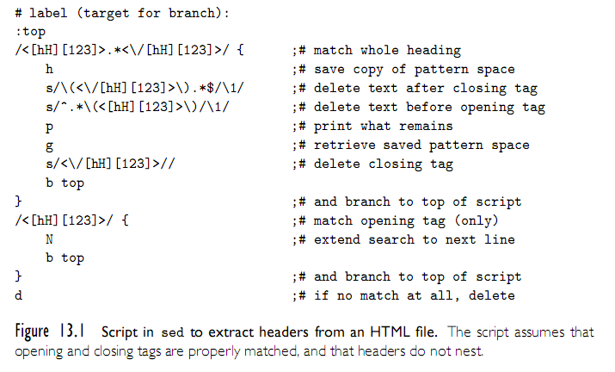
Text processing with Sed
Text Processing and Report Generation
  Sed
Copyright © 2009 Elsevier

Slide 30
Text processing with Awk
Awk was designed in 1977 by Aho, Weinberger and Kernighan to address Sed’s limitations.
This language is the “link” between Sed and the more full-featured scripting languages; still reads one line at a time, but gives better syntax and functionality.
Each program consists of a set of patterns, each of which has an associated action.
Current input line is always $0, and it has functions such as getline and substr(s, a, b).
Also has loops and other basic constructs, and supports regular expressions.
Copyright © 2009 Elsevier

Slide 31
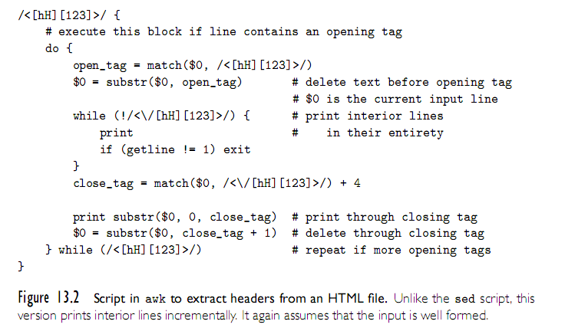
Awk
Text Processing and Report Generation
  Awk
Copyright © 2009 Elsevier

Slide 32
More Awk
Awk’s coolest features are fields and associative arrays.
By default, awk parses each input line into words (called fields), delineated by white space (although you can change this) - a bit like split() in Python.
These fields are pseudovariables available as $1, $2, etc.
Example: awk ‘{print $2}’
  Prints the second word of every line in standard input
Associative arrays are essentially like Python’s dictionaries - you have an array, but no numeric indices.
Copyright © 2009 Elsevier

Slide 33
Awk Example:
BEGIN { #noise words
nw[“a”] = 1; nw[“an”] = 1; nw[“and”] = 1; nw[“but”] = 1; nw[“by”] = 1; nw[“for”] = 1; nw[“from”] = 1; nw[“in”] = 1; nw[“into”] = 1; nw[“of”] = 1; nw[“or”] = 1; nw[“the”] = 1; nw[“to”] = 1;
}
{
for (i=1; i<= NF; i++) {
if (!nw[$i] || i==0 || $(i-1)~/[:-]$/) {
#capitalize the word
$i = toupper(substr($i, 1, 1)) substr($i,2)
}
printf $i “ “;
}
printf “\n”;
}
Copyright © 2009 Elsevier

Slide 34
Newer text processing: Perl
Perl was originally developed by Larry Wall in 1987, while he was working at the NSA
The original version was an attempt to combine sed, awk, and sh
It was a Unix-only tool, meant primarily for text processing (the name stands for “practical extraction and report language”)
  over the years Perl has grown into a large and complex language
Perl is almost certainly the most popular and widely used scripting language
It is also fast enough for general purpose use, and includes separate compilation, modularization, and dynamic library mechanisms appropriate for large-scale projects
It has been ported to almost every known operating system
Copyright © 2009 Elsevier

Slide 35
Simple intro to Perl
Your first script:
#!/usr/local/bin/perl
print ”Hello world!\n";
Variables start with a $:
$apple_count = 5;
$count_report = "There are $apple_count apples.";
print "The report is: $count_report\n";
Output from the above is: “The report is: There are 5 apples.”
Copyright © 2009 Elsevier

Slide 36
Perl: string details
Regular expressions are in slashes, and matching is with the =~
$sentence =~ /the/
  The above is true if the string “the” appears in variable $
Simple pattern replacement: The following prints “Hello mom!”
$mystring = "Hello world!";
$mystring =~ s/world/mom/;
print $mystring;
Does a string contain a digit: the following prints “Yes”
$mystring = "[2004/04/13] The date of this article.";
if($mystring =~ m/\d/) { print "Yes"; }
Copyright © 2009 Elsevier

Slide 37
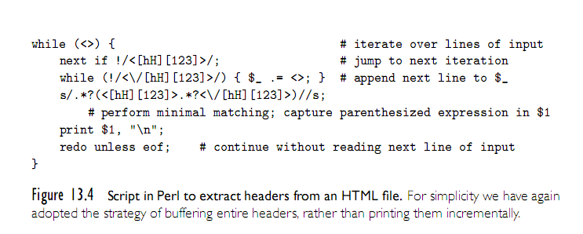
Perl Example
Copyright © 2009 Elsevier

Slide 38
Mathematical Languages
While a slightly different setup, it’s worth mentioning the languages that have evolved to serve mathematics and statistics.
Originated in APL (or “A Programming Language”), which was designed in the 1960’s by Kenneth Iverson to emphasize concise, elegant expressions for mathematical algorithms.
Modern successors: Maple, Matlab, and Mathematica.
  Each of these has its own strengths, but all support numerical methods, symbolic mathematics, mathematical modeling, and real arithmetic.
Copyright © 2009 Elsevier

Slide 39
Mathematical Languages: Maple
Maple focuses on doing computer algebra well. (NOT college algebra – group theory and symbolic computation).
Dynamically typed, imperative, with lexical scoping.
Goal was a powerful symbolic language that could run on low cost computers (in the 1980’s). Coded it with a small C kernal, and released in 1982.
Can do all the basics – integration, series expansion, plotting, Laplace transforms, etc.
Copyright © 2009 Elsevier

Slide 40
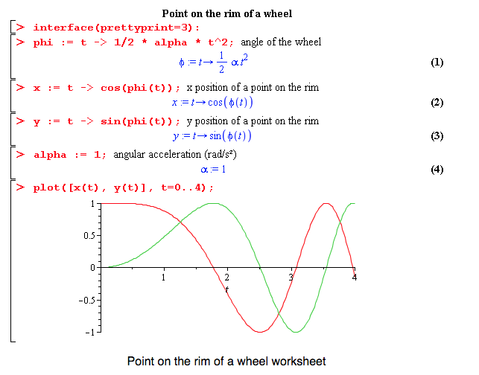
Mathematical Languages: Maple
Copyright © 2009 Elsevier

Slide 41
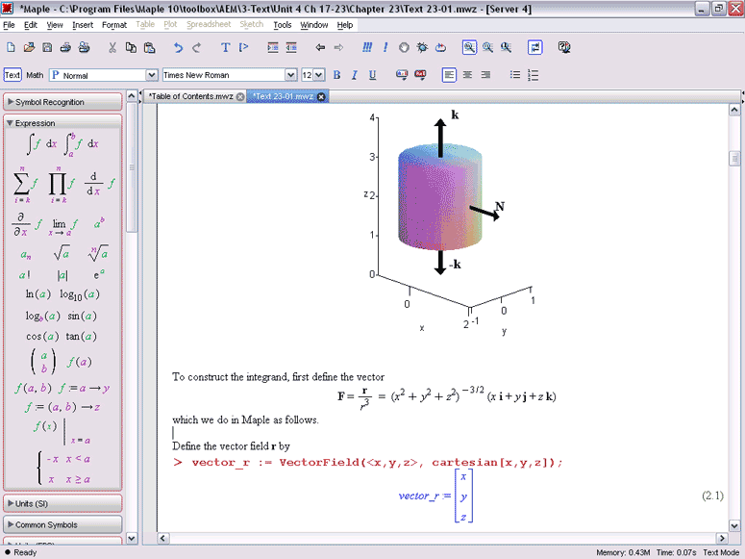
Mathematical Languages: Maple
Copyright © 2009 Elsevier

Slide 42
Mathematical Languages: Matlab
Designed in the late 1970’s by a professor who wanted to give students access to certain functionality without having to learn FORTRAN.
Specialty and strength is really numerical computing – less symbolic and more handling operations on large matrices.
  Optional packages add symbolic computing, but not really as strong in this area.
Dynamic and weakly typed, with support for object oriented programming.
Copyright © 2009 Elsevier

Slide 43
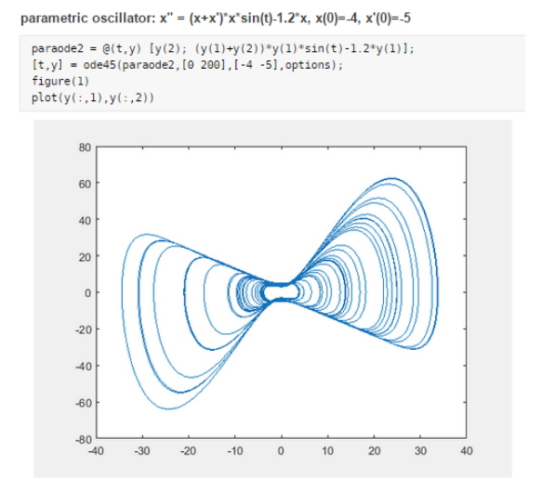
Mathematical Languages: Matlab
Copyright © 2009 Elsevier

Slide 44
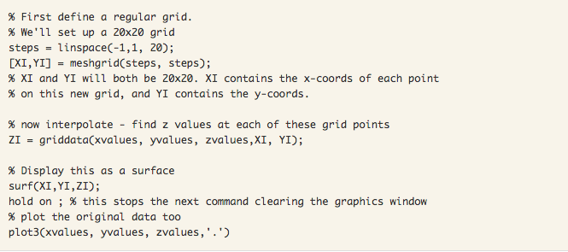
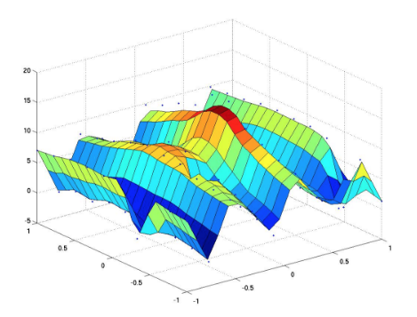
Mathematical Languages: Matlab
Copyright © 2009 Elsevier

Slide 45
Mathematical Languages: Mathematica
Designed by Stephen Wolfram while at U of I
Supports procedural, functional, and object oriented paradigms (although really functional at heart).
Strength is the sheer amount of supported libraries and tools – data and image visualization and processing, symbolic computations, and numerical operations, as well as more traditional mathematical tools.
Underneath, two parts: kernal and front end.
Copyright © 2009 Elsevier

Slide 46
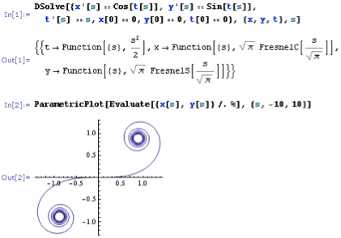
Mathematical Languages: Mathematica
Copyright © 2009 Elsevier

Slide 47
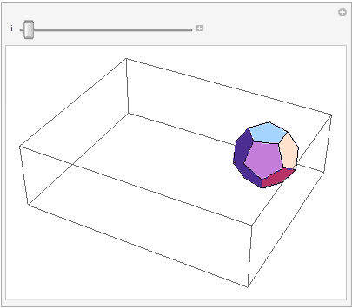
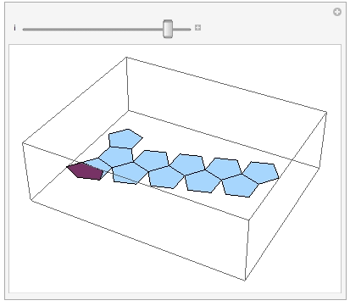
Mathematical Languages: Mathematica
Copyright © 2009 Elsevier

Slide 48
Statistical Languages
Similarly, S and R evolved to serve the statistics community.
S was designed in the late 1970’s at Bell Labs, and is the dominant commercial language.
R is the (mostly) compatible open-source alternative, which seems to be taking over.
Features:
  Multidimensional array and list types
  Array slices
  Call-by-need parameters
  First-class functions
  Unlimited extent
Copyright © 2009 Elsevier

Slide 49
Statistical Languages: R example
library(caTools) #external package providing write.gif function
jet.colors <- colorRampPalette(c("#00007F", "blue", "#007FFF", "cyan", "#7FFF7F”,"yellow", "#FF7F00", "red", "#7F0000"))
m <- 1200 # define size
C <- complex( real=rep(seq(-1.8,0.6, length.out=m), each=m ),
imag=rep(seq(-1.2,1.2, length.out=m), m ) )
C <- matrix(C,m,m) #reshape as square matrix of complex numbers
Z <- 0 # initialize Z to zero
X <- array(0, c(m,m,20)) # initialize output 3D array
for (k in 1:20) { # loop with 20 iterations
Z <- Z^2+C # the central difference equation
X[,,k] <- exp(-abs(Z)) # capture results
}
write.gif(X, "Mandelbrot.gif", col=jet.colors, delay=1000)
Copyright © 2009 Elsevier

Slide 50

Statistical Languages: R example
Copyright © 2009 Elsevier

Slide 51
Another Problem Domain
Extension Languages
  An extension language is something that allows a user to create new commands inside a program
Most commercial products have their own unique scripting languages to do this
  Examples: AutoCAD, Flash
Some are done using existing languages:
  Examples: Adobe with JavaScript, Applescript on a mac, VB on a PC, AOLServer using Tcl, etc
Formally, to admit extension, a tool must:
  Incorporate or communicate with an interpreter for a scripting language
  Provide hooks to allow scripts to call existing commands
  Allow the user to tie new commands to user interface
Copyright © 2009 Elsevier

Slide 52
Scripting the World Wide Web
Much of the web is static, but the need for dynamic content is increasing
Scripts are a key component of this dynamic content, with two options:
  Server side: content should (or must) be controlled by service provider
  Client side: when proprietary information is not needed
Original mechanism: Common Gateway Interface (CGI) scripts
Since then, other options have evolved.
  Client side scripts
  Applets
  HTML itself
Copyright © 2009 Elsevier

Slide 53
CGI scripts: the beginning
A CGI script is an executable program residing in a special directory known to the web server program
  When a client requests the URI corresponding to such a program, the server executes the program and sends its output back to the client
    this output needs to be something that the browser will understand: typically HTML.
CGI scripts may be written in any language available on the server
  Historically, Perl is particularly popular:
    its string-handling and “glue” mechanisms are suited to generating HTML
    it was already widely available during the early years of the web
Copyright © 2009 Elsevier

Slide 54
Client side scripts
Embedded server-side scripts are generally faster than CGI script
  Communication across the Internet is still too slow for interactive pages
  Real time changes in the page can’t be sent across the internet!
Client-side scripts, by contrast, require an interpreter on the client’s machine
  There is a powerful incentive for convergence in client-side scripting languages: most designers want their pages to be viewable by as wide an audience as possible
  (This is a huge different with server side, where client only ever gets html)
Copyright © 2009 Elsevier

Slide 55
Client side scripts - options
Visual basic is commonly used for explorer, but not so much others
Most common is probably JavaScript (probably because it was just in the right place at the right time, rather than any native virtue)
  JavaScript can interact with almost any part of HTML pages through use of the Document Object Model (DOM) in HTML specifications.
Copyright © 2009 Elsevier

Slide 56
HTML itself
As of html 5, there is considerable scripting/programming capability embedded in html itself
At its heart still a mark-up language
But incorporates:
  Better multimedia and graphical content
  More API support (esp. Javascript)
  DOM, to allow various parts of the page to interact (safely)
Won’t have time to go into many details, but many good resources:
  https://developer.mozilla.org/en-US/docs/Web/Guide/HTML/HTML5
Copyright © 2009 Elsevier

Slide 57
Recap: Innovative Features
Earlier we listed several common characteristics of scripting languages:
  both batch and interactive use
  economy of expression
  lack of declarations; simple scoping rules
  flexible dynamic typing
  easy access to other programs
  sophisticated pattern matching and string manipulation
  high level data types
Copyright © 2009 Elsevier

