Slide 1

Chapters 7 and 8:: Data Types
Programming Language Pragmatics
Michael L. Scott
Copyright © 2009 Elsevier

Slide 2
Data Types
We all have developed an intuitive notion of what types are, but what's behind the intuition?
  collection of values from a "domain" (the denotational approach)
  internal structure of a bunch of data, described down to the level of a small set of fundamental types (the structural approach)
  equivalence class of objects (the implementor's approach)
  collection of well-defined operations that can be applied to objects of that type (the abstraction approach)
Copyright © 2009 Elsevier

Slide 3
Data Types
Denotational are a more formal, mathematical view of things.
We generally combine a structural approach with the abstraction approach in object oriented programming: a set of data plus operations defined on that data.
Copyright © 2009 Elsevier

Slide 4
Data Types
What are types good for?
  implicit context
  checking - make sure that certain meaningless operations do not occur
    type checking cannot prevent all meaningless operations
    but it catches enough of them to be useful
Polymorphism results when the compiler finds that it doesn't need to know certain things
Copyright © 2009 Elsevier

Slide 5
Data Types
Strong typing has become a popular buzz-word
  like structured programming
  informally, it means that the language prevents you from applying an operation to data on which it is not appropriate
Different from static typing, which means that the compiler can do all the checking at compile time
Copyright © 2009 Elsevier

Slide 6
Type Systems
Examples
  Pascal is almost statically typed
  Java is strongly typed, with a non-trivial
  mix of things that can be checked statically and things that have to be checked dynamically
  C is not strongly typed (think bool/int, or int/char), but it is statically typed
  Python is strongly typed, but is dynamic and not static
Copyright © 2009 Elsevier

Slide 7
Type Systems
Common terms:
  discrete types – countable
    integer
    boolean
    char
    enumeration
    subrange
  Scalar types - one-dimensional
    discrete
    real
Copyright © 2009 Elsevier

Slide 8
Type Systems
Composite types:
  records (or structures)
  arrays
    strings are perhaps the most useful here
  sets
  pointers
  lists: usually defined recursively
  files
Copyright © 2009 Elsevier

Slide 9
Type Systems
Orthogonality, which we’ve discussed before, is a useful goal in the design of a language, particularly its type system
  A collection of features is orthogonal if there are no restrictions on the ways in which the features can be combined (analogy
  to vectors)
Copyright © 2009 Elsevier

Slide 10
Type Systems
For example
  Pascal is more orthogonal than Fortran, (because it allows arrays of anything, for instance), but it does not permit variant records as arbitrary fields of other records (like having a list of vectors, for example)
Orthogonality is nice primarily because it makes a language easy to understand, easy to use, and easy to reason about
Copyright © 2009 Elsevier

Slide 11
Type Checking
A type system has rules for
  type equivalence (when are the types of two values the same?)
  type compatibility (when can a value of type A be used in a context that expects type B?)
  type inference (what is the type of an expression, given the types of the operands?)
Copyright © 2009 Elsevier

Slide 12
Type Checking
Type compatibility / type equivalence
  Compatibility is the more useful concept, because it tells you what you can DO
  The terms are often (incorrectly, but we do it too) used interchangeably.
  If 2 types are equivalent, then they are pretty much automatically compatible, but compatible types do NOT need to be equivalent.
Copyright © 2009 Elsevier

Slide 13
Type Checking
Certainly format does not matter:
struct { int a, b; }
is the same as
struct {
int a, b;
}
We also want them to be the same as
    struct {
    int a;
    int b;
    }
Copyright © 2009 Elsevier

Slide 14
Structural Equivalence
But should:
    struct {
    int a;
    int b;
    }
Be the same as:
    struct {
    int b;
    int a;
    }
Most languages say no, but some (like ML) say yes.
Copyright © 2009 Elsevier

Slide 15
Type Checking
Two major approaches: structural equivalence and name equivalence
  Name equivalence is based on declarations
  Structural equivalence is based on some notion of meaning behind those declarations
  Name equivalence is more fashionable these days
Copyright © 2009 Elsevier

Slide 16
Name Equivalence
There are at least two common variants on name equivalence
  The differences between all these approaches boils down to where you draw the line between important and unimportant differences between type descriptions
  In all three schemes described in the book, we begin by putting every type description in a standard form that takes care of "obviously unimportant" distinctions like those above
Copyright © 2009 Elsevier

Slide 17
Name Equivalence
For example, the issue of aliasing. Should aliased types be considered the same?
Example:
TYPE cel_temp = REAL;
faren_temp = REAL;
VAR c : cel_temp;
f : faren_temp;
…
f := c; (* should this raise an error? *)
With strict name equivalence, the above raises an error. Loose name equivalence would allow it.
Copyright © 2009 Elsevier

Slide 18
Structural Equivalence
Structural equivalence depends on simple comparison of type descriptions substitute out all names
  expand all the way to built-in types
Original types are equivalent if the expanded type descriptions are the same
Copyright © 2009 Elsevier

Slide 19
Type Casting
Most programming languages allow some form of type conversion (or casting), where the programmer can change one type of variable to another.
We saw a lot of this in Python:
  Every print statement implicitly cast variables to be strings. We even coded this in our own classes.
  Example from Point class:
    def __init__(self):
    return ‘<‘ + str(self._x) + ‘,’ + str(self._y) + ‘>’
Copyright © 2009 Elsevier

Slide 20
Type Casting
Coercion
  When an expression of one type is used in a context where a different type is expected, one normally gets a type error
  But what about
  var a : integer; b, c : real;
  ...
  c := a + b;
Copyright © 2009 Elsevier

Slide 21
Type Casting
Coercion
  Many languages allow things like this, and COERCE an expression to be of the proper type
  Coercion can be based just on types of operands, or can take into account expected type from surrounding context as well
  Fortran has lots of coercion, all based on operand type
Copyright © 2009 Elsevier

Slide 22
Type Coercion
C has lots of coercion, too, but with simpler rules:
  all floats in expressions become doubles
  short int and char become int in expressions
  if necessary, precision is removed when assigning into LHS
Copyright © 2009 Elsevier

Slide 23
Type Checking
In effect, coercion rules are a relaxation of type checking.
  Recent thought is that this is probably a bad idea.
  Languages such as Modula-2 and Ada do not permit coercions.
  C++, however, goes crazy with them, and they can be one of the hardest parts of the language to understand.
Copyright © 2009 Elsevier

Slide 24
Type Checking
There are some hidden issues in type checking that we usually ignore.
For example, consider x + y. If one of them is a float and one an int, what happens?
  Cast to float. What does this mean for performance?
What type of runtime checks need to be performed? Can they be done at compile time? Is precision lost?
In some ways, there are good reasons to prohibit coercion, since it allows the programmer to completely ignore these issues.
Copyright © 2009 Elsevier

Slide 25
Type Checking
Make sure you understand the difference between
  type conversions (explicit)
  type coercions (implicit)
  sometimes the word 'cast' is used for conversions (C is guilty here)
Copyright © 2009 Elsevier

Slide 26
Records (or structures)
Records
  usually laid out contiguously
  possible holes for alignment reasons
  smart compilers may re-arrange fields to minimize holes (C compilers promise not to)
  implementation problems are caused by records containing dynamic arrays
    we won't be going into that in any detail
Copyright © 2009 Elsevier

Slide 27
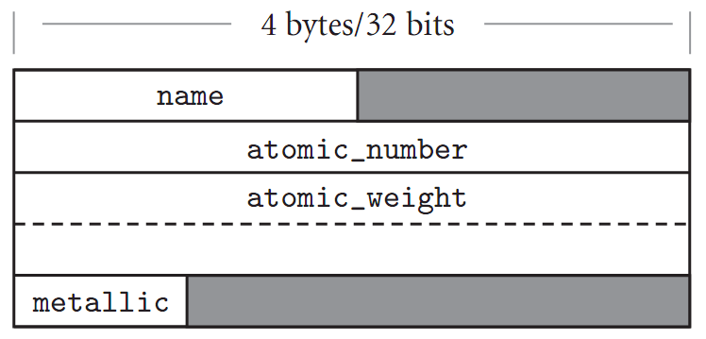
Records (Structures)
Memory layout and its impact (structures)
Figure 7.1 Likely layout in memory for objects of type element on a 32-bit machine. Alignment restrictions lead to the shaded “holes.”
Copyright © 2009 Elsevier

Slide 28
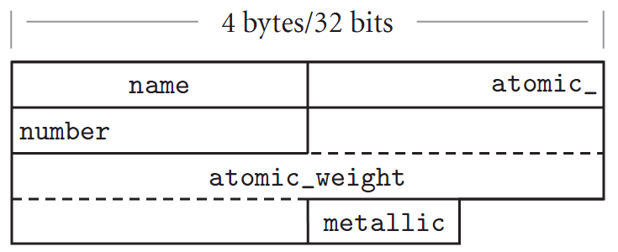
Records (Structures)
Memory layout and its impact (structures)
Figure 7.2 Likely memory layout for packed element records. The atomic_number and atomic_weight ﬁelds are nonaligned, and can only be read or written (on most machines) via multi-instruction sequences.
Copyright © 2009 Elsevier

Slide 29
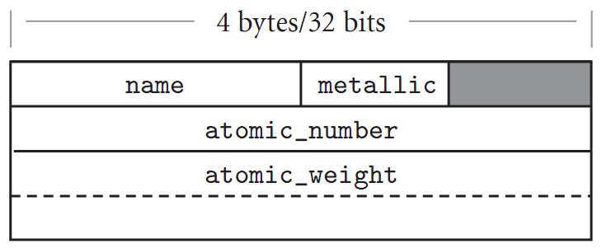
Records (Structures)
Memory layout and its impact (structures)
Figure 7.3 Rearranging record ﬁelds to minimize holes. By sor ting ﬁelds according to the size of their alignment constraint, a compiler can minimize the space devoted to holes, while keeping the ﬁelds aligned.
Copyright © 2009 Elsevier

Slide 30
Variants (Unions)
Unions (variant records)
  overlay space
  cause problems for type checking
Lack of tag means you don't know what is there
Ability to change tag and then access fields hardly better
  can make fields "uninitialized" when tag is changed (requires extensive run-time support)
  can require assignment of entire variant, as in Ada
Copyright © 2009 Elsevier

Slide 31
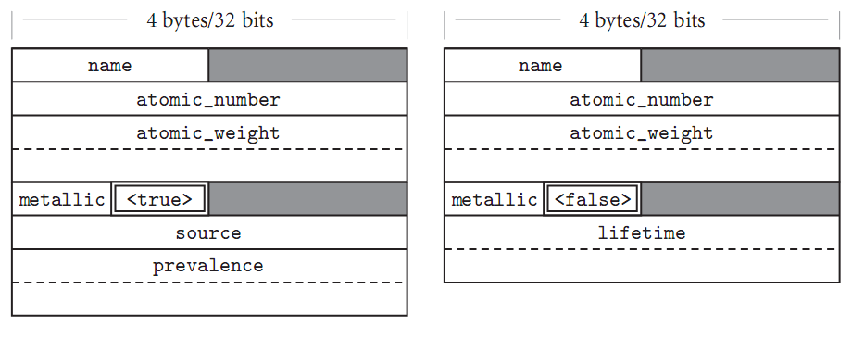
Variants (Unions)
Memory layout and its impact (unions)
Figure 7.15 (CD) Likely memory layouts for element variants. The value of the naturally occurring ﬁeld (shown here with a double border) determines which of the interpretations of the remaining space is valid. Type string_ptr is assumed to be represented by a (four-byte) pointer to dynamically allocated storage.
Copyright © 2009 Elsevier

Slide 32
Variants (Unions)
C/C++ syntax:
union <name> {
<datatype> <1st variable name>
…
<datatype> <nth variable name>
} <union variable name>
Example: next slide
Copyright © 2009 Elsevier

Slide 33
Variants (Unions)
C/C++ example:
union S
{
std::int32_t n; // occupies 4 bytes
std::uint16_t s[2]; // occupies 4 bytes
std::uint8_t c; // occupies 1 byte
}; // the whole union occupies 4 bytes
int main()
{
S s = {0x12345678}; // initializes the first member, s.n is now the active member
// at this point, reading from s.s or s.c is undefined behavior
std::cout << std::hex << "s.n = " << s.n << '\n';
s.s[0] = 0x0011; // s.s is now the active member
// at this point, reading from n or c is UB but most compilers define it
std::cout << "s.c is now " << +s.c << '\n' // 11 or 00, depending on platform
<< "s.n is now " << s.n << '\n'; // 12340011 or 00115678
}
Copyright © 2009 Elsevier

Slide 34
Variants (Unions)
In COBOL, 2 ways:
01 PERSON-REC.
05 PERSON-NAME.
10 PERSON-NAME-LAST PIC X(12).
10 PERSON-NAME-FRST PIC X(16).
10 PERSON-NAME-MID PIC X.
05 PERSON-ID PIC 9(9) PACKED-DECIMAL.
01 PERSON-DATA RENAMES PERSON-REC.
01 VERS-INFO.
05 VERS-NUM PIC S9(4) COMP.
05 VERS-BYTES PIC X(2)
REDEFINES VERS-NUM.
Copyright © 2009 Elsevier
Notes:
Keyword renames – effectively maps a 2nd alaphanumeric data item on top of memory location of previous item. In first, have group containing another group and a numberic data item. Then PERSON-DATA is defined as a renaming, and treats contents just as character data.
Another – VERS-NUM is defined as a 2 byte binary integer containing a version number. A second data item VERS-BYTES is defined as a two-character alphanumeric variable. Since the second item is redefined over the first item, the two items share the same address in memory, and therefore share the same underlying data bytes. The first item interprets the two data bytes as a binary value, which the second interprets the bytes as character values.

Slide 35
Arrays
Arrays are the most common and important composite data type, dating from Fortran
Unlike records, which group related fields of disparate types, arrays are usually homogeneous
Semantically, they can be thought of as a mapping from an index type to a component or element type
Copyright © 2009 Elsevier

Slide 36
Array requirements
Most languages require that the index be discrete; some (such as Fortran) require it to be an integer; some scripting languages even allow non-discrete types
  With non-discrete, need some kind of mapping such as a hash table to get into the actual array
Generally, the element type can be anything, although some (again such as early Fortran) require it to be a scalar.
A slice or section is a rectangular portion of an array (See figure on next slide.)
  Usually indicated with (i) (eg Fortran and Ada) or [i] (eg C or Pascal)
Copyright © 2009 Elsevier

Slide 37
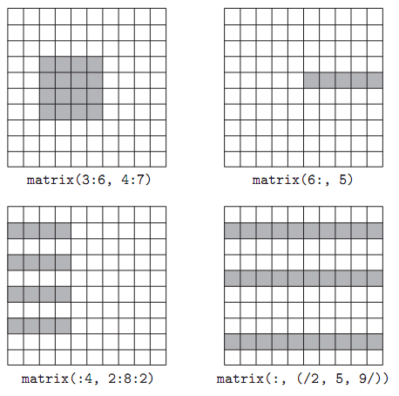
Arrays
Figure 7.4 Array slices(sections) in Fortran90. Much like the values in the header of an enumeration-controlled loop (Section6.5.1), a: b: c in a subscript indicates positions a, a+c, a+2c, ...through b. If a or b is omitted, the corresponding bound of the array is assumed. If c is omitted, 1 is assumed. It is even possible to use negative values of c in order to select positions in reverse order. The slashes in the second subscript of the lower right example delimit an explicit list of positions.
Copyright © 2009 Elsevier

Slide 38
Arrays: Declaration
In C:
  char upper[26];
In Pascal:
  Var upper : array [‘a’..’z’] of char;
In Fortran:
  character, dimension (1:26) :: upper
  character (26) upper ! shorthand
Note that in C, we start counting at 0, but that is NOT true in Fortran.
Copyright © 2009 Elsevier

Slide 39
Arrays
Dimensions, Bounds, and Allocation
  global lifetime, static shape — If the shape of an array is known at compile time, and if the array can exist throughout the execution of the program, then the compiler can allocate space for the array in static global memory
  local lifetime, static shape — If the shape of the array is known at compile time, but the array should not exist throughout the execution of the program, then space can be allocated in the subroutine’s stack frame at run time.
  local lifetime, shape bound at elaboration time
Copyright © 2009 Elsevier

Slide 40
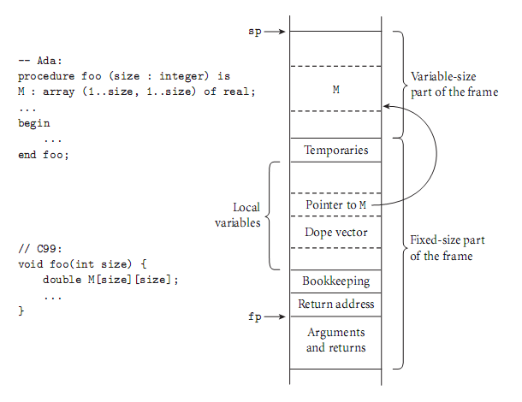
Arrays
Figure 7.6 Elaboration-time allocation of arrays in Ada or C99.
Copyright © 2009 Elsevier

Slide 41
Array layouts
Contiguous elements (see Figure 7.7)
  column major: A[2,4] is followed by A[3,4]
    only in Fortran
    reason seems to be to accommodate idiosyncrasies of IBM computer it was created on
  row major: so A[2,4] is followed by A[2,5] in memory
    used by everybody else
    makes array [a..b, c..d] the same as array [a..b] of array [c..d]
Copyright © 2009 Elsevier

Slide 42
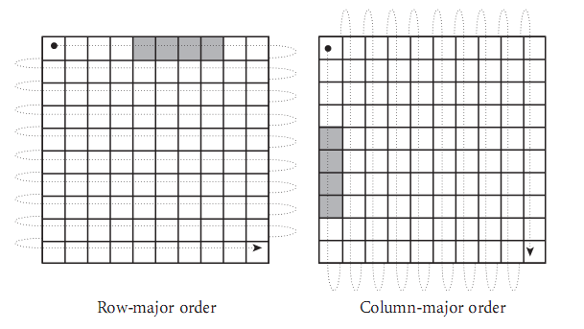
Arrays
Figure7.7 Row- and column-major memory layout for two-dimensional arrays. In row-major order, the elements of a row are contiguous in memory; in column-major order, the elements of a column are contiguous. The second cache line of each array is shaded, on the assumption that each element is an eight-byte ﬂoating-point number, that cache lines are 32 bytes long (a common size), and that the array begins at a cache line boundary. If the array is indexed from A[0,0] to A[9,9], then in the row-major case elements A[0,4] through A[0,7] share a cache line; in the column-major case elements A[4,0] through A[7,0] share a cache line.
Copyright © 2009 Elsevier

Slide 43
Array layouts: why we care
Layout makes a big difference for access speed - one trick in high performance computing is simply to set up your code to go in row major order
(Bad) Example:
  for i = 1 to n
  for j = 1 to n
  A[j][i] = value
Copyright © 2009 Elsevier

Slide 44
Arrays
Two layout strategies for arrays (see next slide):
  Contiguous elements
  Row pointers
Row pointers
  an option in C
  allows rows to be put anywhere - nice for big arrays on machines with segmentation problems
  avoids multiplication
  nice for matrices whose rows are of different lengths
    e.g. an array of strings
  requires extra space for the pointers
Copyright © 2009 Elsevier

Slide 45
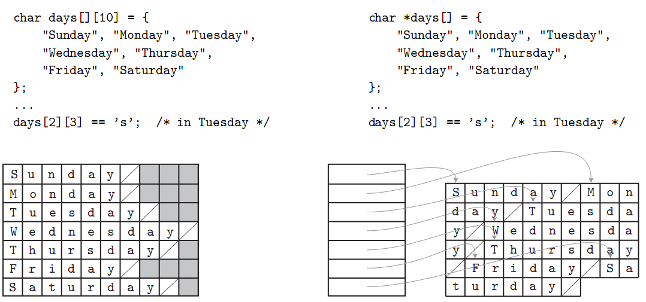
Arrays
Figure 7.8 Contiguous array allocation v. row pointers in C. The declaration on the left is a true two-dimensional array. The slashed boxes are NUL bytes; the shaded areas are holes. The declaration on the right is a ragged array of pointers to arrays of character s. In both cases, we have omitted bounds in the declaration that can be deduced from the size of the initializer (aggregate). Both data structures permit individual characters to be accessed using double subscripts, but the memory layout (and corresponding address arithmetic) is quite different.
Copyright © 2009 Elsevier

Slide 46
Arrays: Address calculations
Example: Suppose we have a 3d array:
A : array [L1..U1] of array [L2..U2] of array [L3..U3] of elem;
D1 = U1-L1+1
D2 = U2-L2+1
D3 = U3-L3+1
Let
S3 = size of elem
S2 = D3 * S3 (* size of a row *)
S1 = D2 * S2 (* size of a plane *)
Then calculating A[i,j,k] each time is:
(Address of A) + (i-L1)*S1 + (j-L2)*S2 + (k-L3)*S3
Copyright © 2009 Elsevier

Slide 47
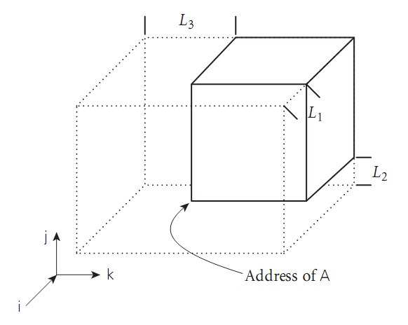
Arrays
Figure 7.9 Virtual location of an array with nonzero lower bounds. By computing the constant portions of an array index at compile time,
we effectively index into an array whose starting address is offset in memory, but whose lower bounds are all zero.
Copyright © 2009 Elsevier

Slide 48
Arrays
Example (continued)
We could compute all that at run time, but we can make do with fewer subtractions:
== (i * S1) + (j * S2) + (k * S3)
+ address of A
- [(L1 * S1) + (L2 * S2) + (L3 * S3)]
The stuff in square brackets is compile-time constant that depends only on the type of A
Copyright © 2009 Elsevier

Slide 49
Strings
Strings are really just arrays of characters
They are often special-cased, to give them flexibility (like polymorphism
or dynamic sizing) that is not available for arrays in general
  It's easier to provide these things for strings than for arrays in general because strings are one-dimensional and (more important) non-circular
Copyright © 2009 Elsevier

Slide 50
Sets
We learned about a lot of possible implementations
Bit sets are what usually get built into programming languages
Things like intersection, union, membership, etc. can be implemented efficiently with bitwise logical instructions
Some languages place limits on the sizes of sets to make it easier for the implementor, since even bit vectors get large for large sets
  There is really no need for this, since generally these sets are sparse, so can use hash tables to implement effectively.
Copyright © 2009 Elsevier

Slide 51
Pointers And Recursive Types
Pointers serve two purposes:
  efficient (and sometimes intuitive) access to elaborated objects (as in C)
  dynamic creation of linked data structures, in conjunction with a heap storage manager
Several languages (e.g. Pascal) restrict pointers to accessing things in the heap
Pointers are used with a value model of variables
  They aren't needed with a reference model, like Python. Why?
Copyright © 2009 Elsevier

Slide 52
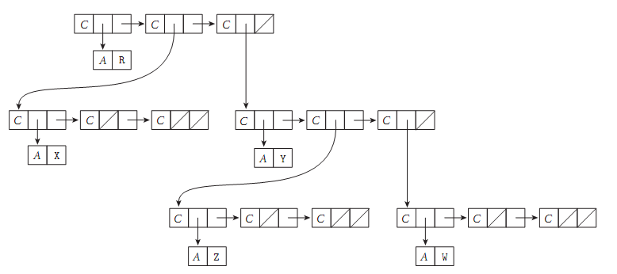
Pointers And Recursive Types
Figure 7.11 Implementation of a tree in Lisp. A diagonal slash through a box indicates a null pointer. The C and A tags serve to distinguish the two kinds of memory blocks: cons cells and blocks containing atoms.
Copyright © 2009 Elsevier

Slide 53
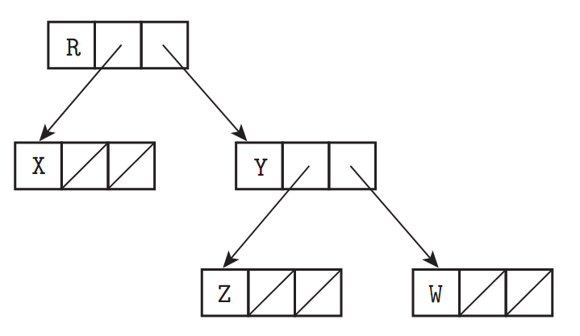
Pointers And Recursive Types
Figure 7.12 Typical implementation of a tree in a language with explicit pointers. As in Figure 7.11, a diagonal slash through a box indicates a null pointer.
Copyright © 2009 Elsevier

Slide 54
Pointers And Recursive Types in C
C pointers and arrays
int *a == int a[]
int **a == int *a[]
BUT equivalences don't always hold
  Specifically, a declaration allocates an array if it specifies a size for the first dimension
  otherwise it allocates a pointer
  int **a, int *a[]; \\pointer to pointer to int
  int *a[n]; \\n-element array of row pointers
  int a[n][m]; \\2-d array
Copyright © 2009 Elsevier

Slide 55
Pointers And Recursive Types in C
Given this initialization:
int n;
int *a;
int b[10];
a = b;
Note that the following are equivalent:
n = a[3];
n = *(a+3);
Copyright © 2009 Elsevier

Slide 56
Pointers And Recursive Types
Compiler has to be able to tell the size of the things to which you point
  So the following aren't valid:
  int a[][] bad
  int (*a)[] bad
  C declaration rule: read right as far as you can (subject to parentheses), then left, then out a level and repeat
  int *a[n], n-element array of pointers to integer
  int (*a)[n], pointer to n-element array of integers
Copyright © 2009 Elsevier

Slide 57
Pointers And Recursive Types
Problems with dangling pointers are due to
  explicit deallocation of heap objects
    only in languages that have explicit deallocation
  implicit deallocation of elaborated objects
Two implementation mechanisms to catch dangling pointers
  Tombstones
  Locks and Keys
Copyright © 2009 Elsevier

Slide 58
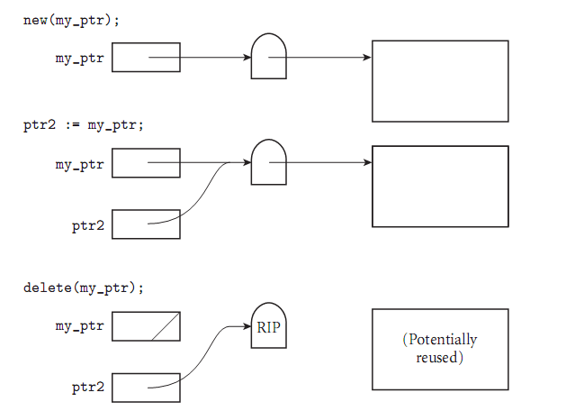
Pointers And Recursive Types
Figure 7.17 (CD) Tombstones. A valid pointer refers to a tombstone that in turn refers to an object. A dangling reference refers to an “expired” tombstone.
Copyright © 2009 Elsevier

Slide 59
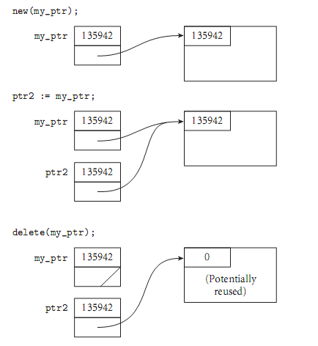
Pointers And Recursive Types
Figure 7.18 (CD) Locks and Keys. A valid pointer contains a key that matches the lock on an object in the heap. A dangling reference is unlikely to match.
Copyright © 2009 Elsevier

Slide 60
Pointers And Recursive Types
Problems with garbage collection
  many languages leave it up to the programmer to design without garbage creation - this is VERY hard
  others arrange for automatic garbage collection
  reference counting
    does not work for circular structures
    works great for strings
    should also work to collect unneeded tombstones
Copyright © 2009 Elsevier

Slide 61
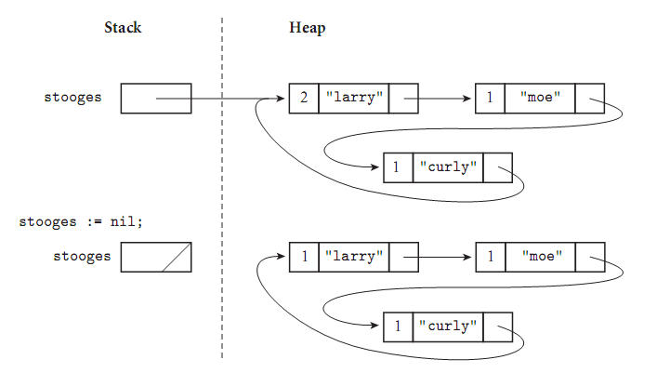
Pointers And Recursive Types
Garbage collection with reference counts
Figure 7.13 Reference counts and circular lists. The list shown here cannot be found via any program variable, but because it is circular, every cell contains a nonzero count.
Copyright © 2009 Elsevier

Slide 62
Pointers And Recursive Types
Mark-and-sweep
  commonplace in Lisp dialects
  complicated in languages with rich type structure, but possible if language is strongly typed
  achieved successfully in Cedar, Ada, Java, Modula-3, ML
  complete solution impossible in languages that are not strongly typed
  conservative approximation possible in almost any language (Xerox Portable Common Runtime approach)
Copyright © 2009 Elsevier

Slide 63
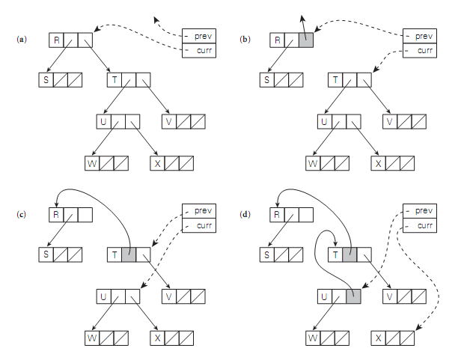
Pointers And Recursive Types
Figure 7.14 Heap exploration via pointer reversal.
Copyright © 2009 Elsevier

Slide 64
Lists
A list is defined recursively as either the empty list or a pair consisting of an object (which may be either a list or an atom) and another (shorter) list
  Lists are ideally suited to programming in functional and logic languages
    In Lisp, a program is a list, and can extend itself at run time by constructing a list and executing it
  Lists can also be used in imperative programs
Copyright © 2009 Elsevier

Slide 65
Files and Input/Output
Input/output (I/O) facilities allow a program to communicate with the outside world
  interactive I/O and I/O with files
Interactive I/O generally implies communication with human users or physical devices
Files generally refer to off-line storage implemented by the operating system
Files may be further categorized into
  temporary
  persistent
Copyright © 2009 Elsevier

Slide 66
Files and Input/Output
In “pure” functional languages, file I/O is a headache
  Files are pure side effects – no way to guarantee what input is, so impossible to prove anything about end product of the program
  Haskell, for example, limits I/O to be as separate from the rest of the program as possible.
Copyright © 2009 Elsevier

