Slide 1
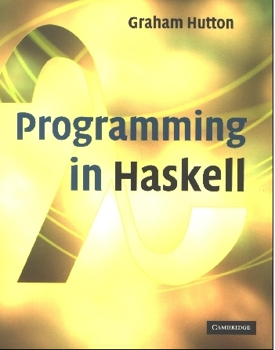
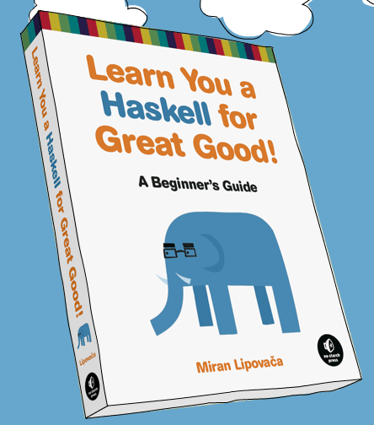
PROGRAMMING IN HASKELL
Odds and Ends, and Type and Data definitions
Based on lecture notes by Graham Hutton
The book “Learn You a Haskell for Great Good”
(and a few other sources)

Slide 2
Conditional Expressions
As in most programming languages, functions can be defined using conditional expressions.
abs :: Int → Int
abs n = if n ≥ 0 then n else -n
abs takes an integer n and returns n if it is non-negative and -n otherwise.

Slide 3
Conditional expressions can be nested:
signum :: Int → Int
signum n = if n < 0 then -1 else
if n == 0 then 0 else 1
Note:
In Haskell, conditional expressions must always have an else branch, which avoids any possible ambiguity issues.

Slide 4
Guarded Equations
As an alternative to conditionals, functions can also be defined using guarded equations.
abs n | n ≥ 0 = n
| otherwise = -n
As previously, but using guarded equations.

Slide 5
Guarded equations can be used to make definitions involving multiple conditions easier to read:
signum n | n < 0 = -1
| n == 0 = 0
| otherwise = 1
Note:
The catch all condition otherwise is defined in the prelude by otherwise = True.

Slide 6
Lambda Expressions
Functions can be constructed without naming the functions by using lambda expressions.
λx → x+x
the nameless function that takes a number x and returns the result x+x.

Slide 7
Note:
The symbol λ is the Greek letter lambda, and is typed at the keyboard as a backslash \.
In mathematics, nameless functions are usually denoted using the  symbol, as in x  x+x.
In Haskell, the use of the λ symbol for nameless functions comes from the lambda calculus, the theory of functions on which Haskell is based.

Slide 8
Lambda expressions are useful when defining functions that return functions as results.
For example:
const :: a → b → a
const x _ = x
is more naturally defined by
const :: a → (b → a)
const x = \_ → x

Slide 9
Lambda expressions can be used to avoid naming functions that are only referenced once.
For example:
odds n = map f [0..n-1]
where
f x = x*2 + 1
can be simplified to
odds n = map (\x → x*2 + 1) [0..n-1]

Slide 10
Sections
An operator written between its two arguments can be converted into a curried function written before its two arguments by using parentheses.
For example:
> 1+2
3
> (+) 1 2
3

Slide 11
This convention also allows one of the arguments of the operator to be included in the parentheses.
For example:
> (1+) 2
3
> (+2) 1
3
In general, if ⊕ is an operator then functions of the form (⊕), (x⊕) and (⊕y) are called sections.

Slide 12
Why Are Sections Useful?
Useful functions can sometimes be constructed in a simple way using sections. For example:
(1+)
- successor function
(1/)
- reciprocation function
(*2)
- doubling function
(/2)
- halving function

Slide 13
Exercise
Consider a function safetail that behaves in the same way as tail, except that safetail maps the empty list to the empty list, whereas tail gives an error in this case. Define safetail using:
(a) a conditional expression;
(b) guarded equations;
(c) pattern matching.
Hint: the library function null :: [a] → Bool can be used to test if a list is empty.

Slide 14
Higher order functions
Last time we started discussing higher order functions, or functions that take other functions are input.
These are heavily useful, and are one of the strengths of Haskell!
Let’s see a few more…

Slide 15
The Foldr Function
A number of functions on lists can be defined using the following simple pattern of recursion:
f [] = v
f (x:xs) = x ⊕ f xs
f maps the empty list to some value v, and any non-empty list to some function ⊕ applied to its head and f of its tail.

Slide 16
For example:
sum [] = 0
sum (x:xs) = x + sum xs
v = 0
⊕ = +
product [] = 1
product (x:xs) = x * product xs
v = 1
⊕ = *
v = True
⊕ = &&
and [] = True
and (x:xs) = x && and xs

Slide 17
The higher-order library function foldr (fold right) encapsulates this simple pattern of recursion, with the function ⊕ and the value v as arguments.
For example:
sum = foldr (+) 0
product = foldr (*) 1
or = foldr (||) False
and = foldr (&&) True

Slide 18
Foldr itself can be defined using recursion:
foldr :: (a → b → b) → b → [a] → b
foldr f v [] = v
foldr f v (x:xs) = f x (foldr f v xs)
However, it is best to think of foldr non-recursively, as simultaneously replacing each (:) in a list by a given function, and [] by a given value.

Slide 19
For example:
sum [1,2,3]
=
foldr (+) 0 [1,2,3]
=
foldr (+) 0 (1:(2:(3:[])))
=
1+(2+(3+0))
=
6
Replace each (:)
by (+) and [] by 0.

Slide 20
For example:
product [1,2,3]
=
foldr (*) 1 [1,2,3]
=
foldr (*) 1 (1:(2:(3:[])))
=
1*(2*(3*1))
=
6
Replace each (:)
by (*) and [] by 1.

Slide 21
Other Foldr Examples
Even though foldr encapsulates a simple pattern of recursion, it can be used to define many more functions than might first be expected.
Recall the length function:
length :: [a] → Int
length [] = 0
length (_:xs) = 1 + length xs

Slide 22
For example:
length [1,2,3]
=
length (1:(2:(3:[])))
=
1+(1+(1+0))
=
3
Replace each (:) by λ_ n → 1+n and [] by 0.
Hence, we have:
length = foldr (λ_ n → 1+n) 0

Slide 23
Now recall the reverse function:
reverse [] = []
reverse (x:xs) = reverse xs ++ [x]
For example:
Replace each (:) by λx xs → xs ++ [x] and [] by [].
reverse [1,2,3]
=
reverse (1:(2:(3:[])))
=
(([] ++ [3]) ++ [2]) ++ [1]
=
[3,2,1]

Slide 24
Hence, we have:
reverse =
foldr (λx xs → xs ++ [x]) []
Finally, we note that the append function (++) has a particularly compact definition using foldr:
Replace each (:) by (:) and [] by ys.
(++ ys) = foldr (:) ys

Slide 25
Why Is Foldr Useful?
Some recursive functions on lists, such as sum, are simpler to define using foldr.
Properties of functions defined using foldr can be proved using algebraic properties of foldr, such as fusion and the banana split rule.
Advanced program optimizations can be simpler if foldr is used in place of explicit recursion.

Slide 26
Other Library Functions
The library function (.) returns the composition of two functions as a single function.
(.) :: (b → c) → (a → b) → (a → c)
f . g = λx → f (g x)
For example:
odd :: Int → Bool
odd = not . even

Slide 27
The library function all decides if every element of a list satisfies a given predicate.
all :: (a → Bool) → [a] → Bool
all p xs = and [p x | x ← xs]
For example:
> all even [2,4,6,8,10]
True

Slide 28
Dually, the library function any decides if at least
one element of a list satisfies a predicate.
any :: (a → Bool) → [a] → Bool
any p xs = or [p x | x ← xs]
For example:
> any isSpace "abc def"
True

Slide 29
The library function takeWhile selects elements from a list while a predicate holds of all the elements.
takeWhile :: (a → Bool) → [a] → [a]
takeWhile p [] = []
takeWhile p (x:xs)
| p x = x : takeWhile p xs
| otherwise = []
For example:
> takeWhile isAlpha "abc def"
"abc"

Slide 30
Dually, the function dropWhile removes elements while a predicate holds of all the elements.
dropWhile :: (a → Bool) → [a] → [a]
dropWhile p [] = []
dropWhile p (x:xs)
| p x = dropWhile p xs
| otherwise = x:xs
For example:
> dropWhile isSpace " abc"
"abc"

