Slide 1
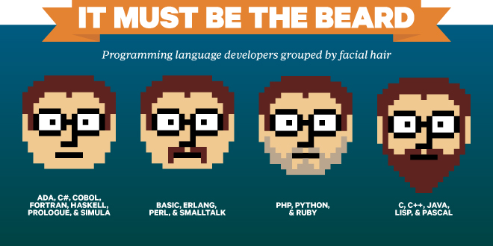
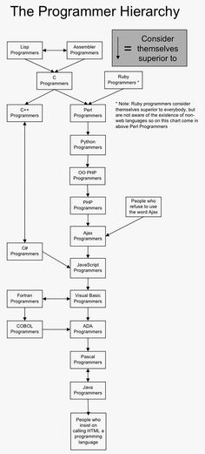
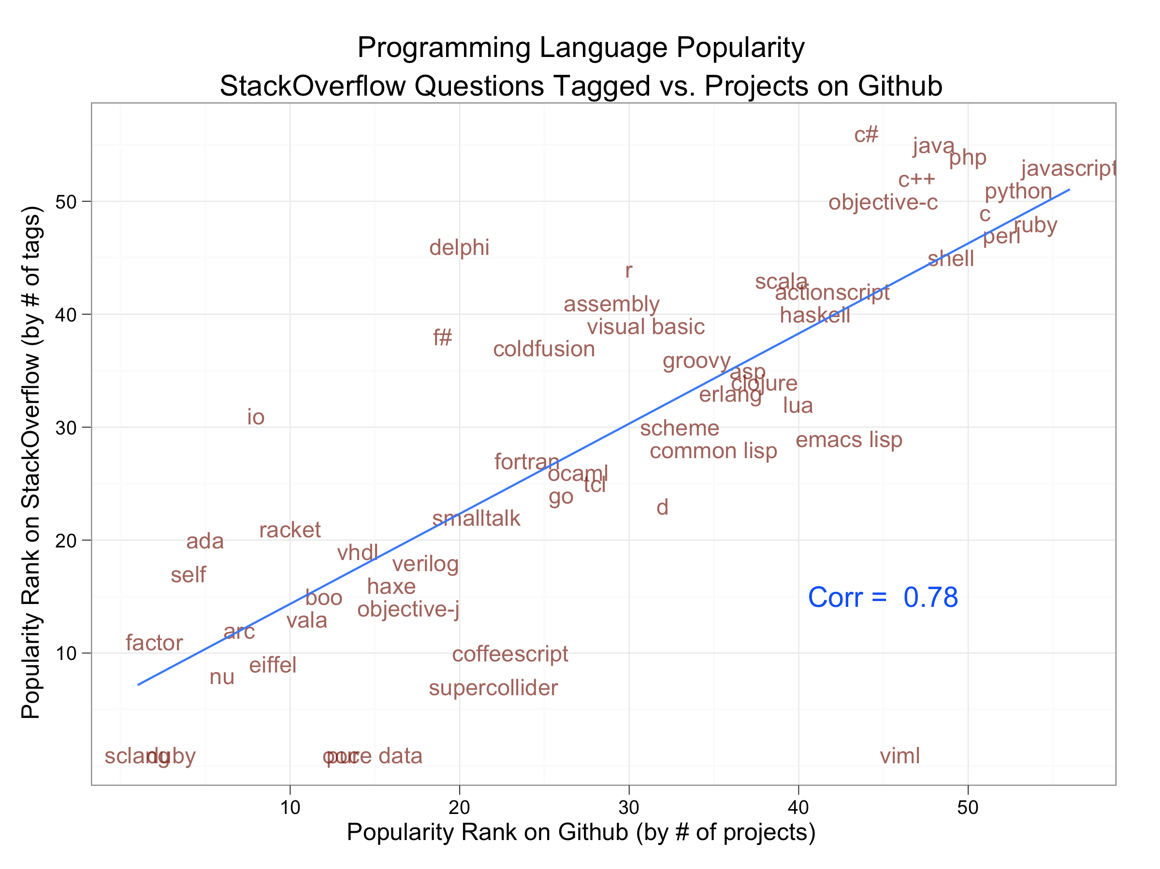
Programming Languages: Some History and Perspective

Slide 2
An overview
Throughout the semester, we’ve seen several different languages and paradigms.
However, it is useful to take a step back and look over the history of programming languages, including which features were introduced when (and why).
Take away message: a good programmer should be unfaithful.

Slide 3
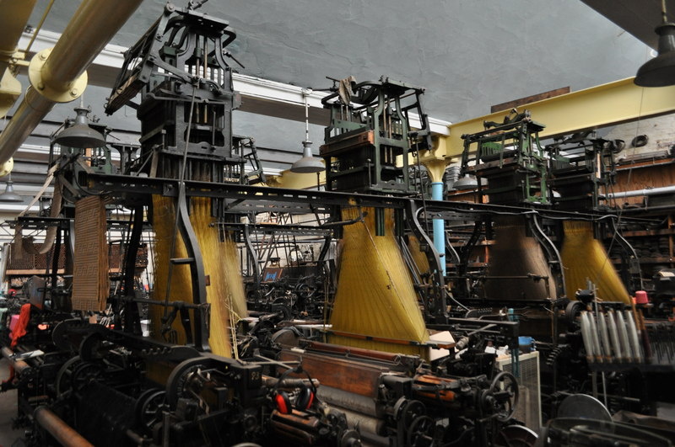
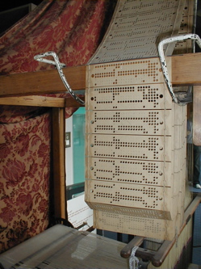
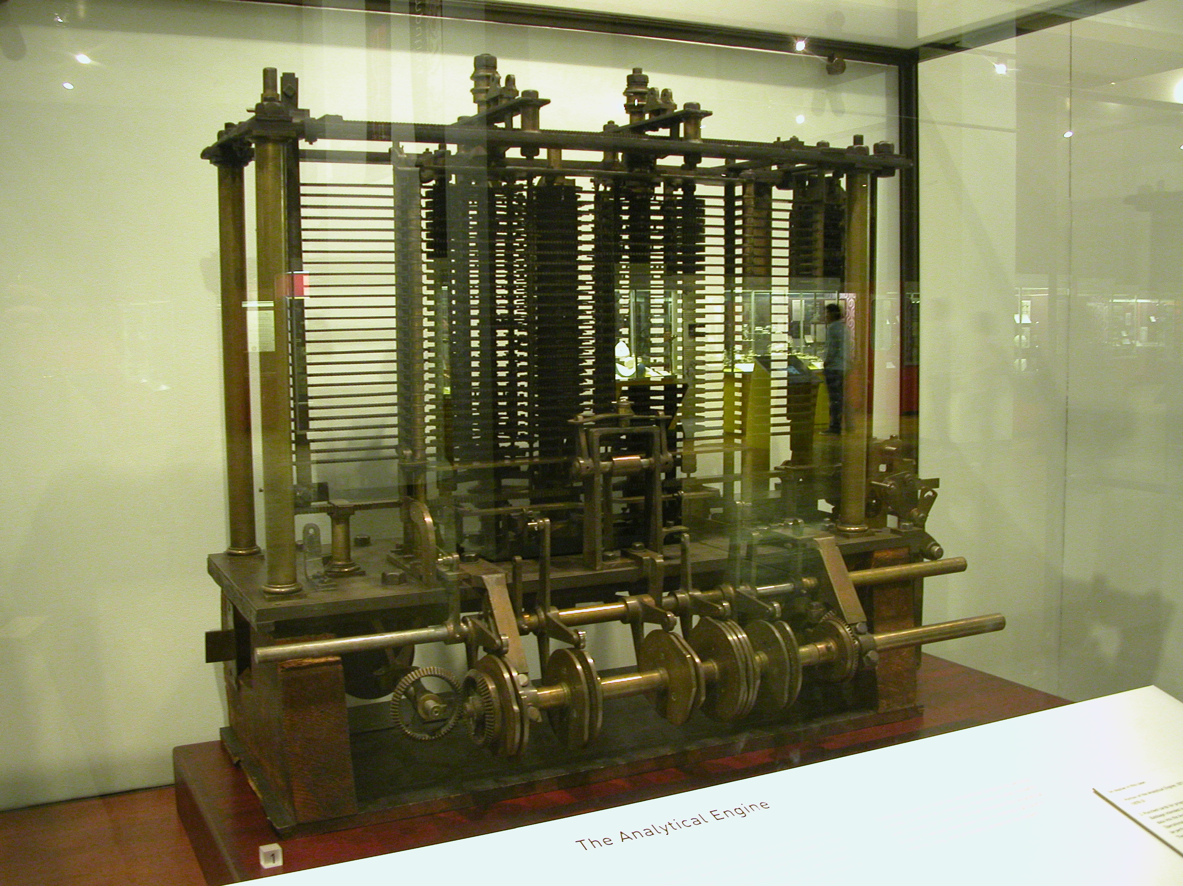
The beginnings
Early example of what we know think of as “programming” include:
Jaquard’s loom, which used
punch cards to assemble textiles
The Analytical Engine, which was
designed by Charles Babbage and
programmed by Ada Lovelace
_x0016_

Slide 4
Early theory
In addition, by the 1930’s and 1940’s, mathematicians were designing the theoretical concepts necessary to model a computer.
The Turing machine: set the basis for von Neumann architecture, as well as the formal analysis of algorithms
Church’s lambda calculus was the precursor of functional programming
Church-Turing thesis: "It was stated ... that 'a function is effectively calculable if its values can be found by some purely mechanical process.' We may take this literally, understanding that by a purely mechanical process one which could be carried out by a machine. The development ... leads to ... an identification of computability with effective calculability"
_x0016_

Slide 5
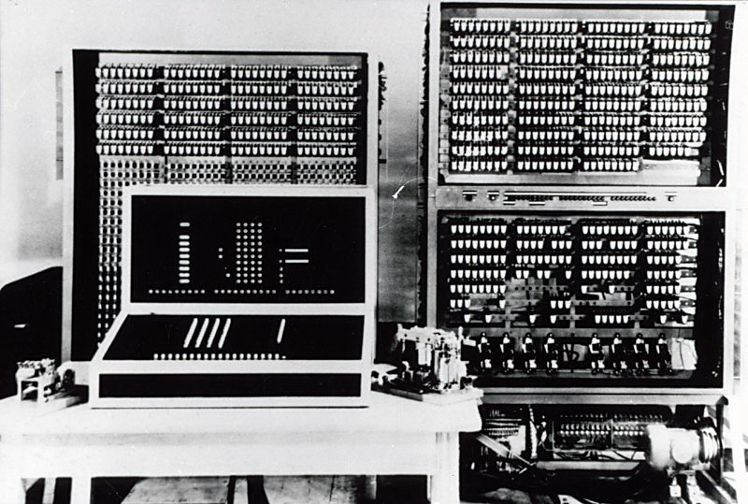
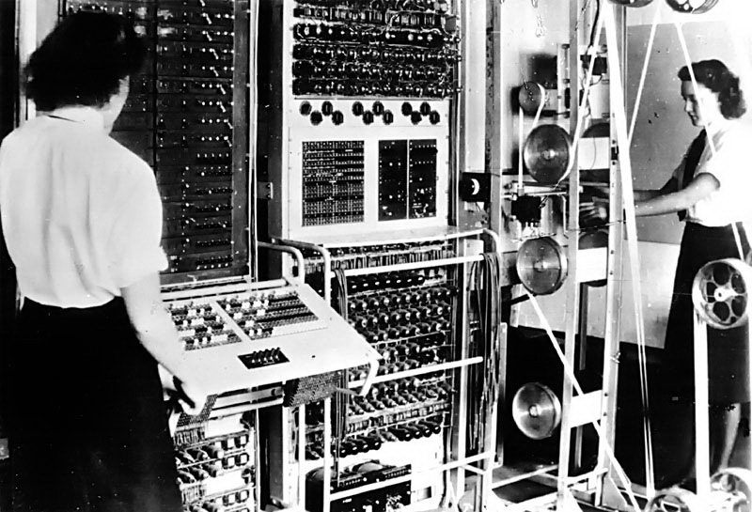
The 1940’s
In the 1940’s, the first prototype calculators were being designed, but no real “programming languages” existed.
Much hardware progress was driven by WW2.

Slide 6
1945: von Neumann
John Von Neumann was working at IAS, and developed two key concepts:
“shared program technique”: hardware should be simple and not need to be hardwired for each program
“conditional control transfer”:
  essentially, the idea of a subroutine, or small block of code that could be jumped to (even multiple times) instead of sequential instructions
  Also, the idea of branching based on logical statements (leading to if’s and loops)
These were designed for the “EDVAC”, a fully developed proposal for a machine architecture (although only theoretical).

Slide 7
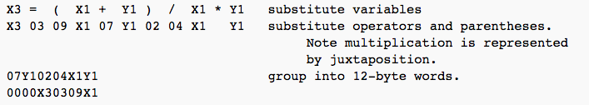
1949: First language
Short code appeared in 1949 – probably the first language for electronic devices
Unlike modern code, each statement represented a mathematical expression (and not a machine instruction).
Programmer had to change statements into 0’s and 1’s by hand
In 1951, Grace Hopper wrote the very first compiler, which did this translation automatically for the programmer

Slide 8
The 1950’s
In the 1950’s, the first massive computers started to appear commercially.
  Each language was specific to a single machine.
  It quickly became clear that these were quite error-prone.
The first “proto-languages” began to appear:
  Grace Hopper completed A-O to allow English-like commands, created for the UNIVAC I, the first commercial business computer, in 1952.
  In 1953, Backus made Speedcode for the IBM 701.
At this point, the focus remained on the problem being solved - the programming languages were not really themselves a focus of study at all.
  (Aside: At this point, “bugs” really were bugs!)

Slide 9
The 1950’s
In the late 1950’s, the first “real” programming languages were designed. The first and most influential 3 were:
  Fortran
  Lisp
  Cobol
Each introduced major influences that have far outlasted the majority of the uses of the language itself.
Tons of debate and development at this point, so let’s look at each one’s features and contributions.

Slide 10
1957: Fortran
Fortran: FORmula TRANslator, designed by Backus et al at IBM (1955-1957, depending on where you look).
Initially aimed at scientific computing, and became the primary language in scientific and technical computing for years.
Introduced variables as well as if, do and goto statements.
Limits: Not so good at I/O, which matters in business computing.
Also has many awkward features, which unfortunately have stuck around for backward compatibility.
Newer versions are still widely used in engineering applications which do lots of array manipulations.

Slide 11
1958: Lisp
LISP: LISt Processor, designed by McCarthy et all at MIT for AI research
Originally had essentially no syntax, but rather had code written in parse trees.
The only type of data was the list, although this changed in later releases.
Based on the concept of computing by evaluating functions. Very good for symbolic computing.
For years, the only language for Artificial Intelligence work. (Prolog is 12 years younger.)
Many dialects, two standards (Scheme, Common Lisp). Nice programming environments.
_x0016_

Slide 12
1958: COBOL
Cobol: COmmon Business Oriented Language, by the Short Range Committee (headed by Admiral Grace Hopper), in 1958
Oriented towards business applications.
Very English-like grammar (relatively speaking), and built like an essay – 4 or 5 major sections that build into a whole.
Strict organization with elaborate data structures, and introduced record types for the first time.
Very poor control structures.
Most common in government (for a very long time).

Slide 13
1960: Algol
The ALGOL60 report was developed in the late 50’s and published in 1960.
This document (and the resulting languages) introduced two innovations:
  Nested block structure, as well as recursion.
  Lexical scoping (as opposed to a global scope)
In addition, BNF was codified as the primary way to parse expressions.
This report was heavily influential on all later (especially imperative) programming languages.
  The original of Pascal, C/C++, and Java.
  Algol itself, ironically, is almost never used anymore except in a text book.

Slide 14
The 1960’s
In 1968, ALGOL 68 was released, which officially implemented the features outlined in the 1960 document.
  In addition, added higher order functions, concurrent and parallel blocks, and automatic type coercion.
  Arguably the most elegant language design.
  Extremely difficult to learn and implement in effectively – often described as “bloated”.
  Completely unused today.
_x0016_

Slide 15
Pascal (in 1968-70)
Originated when Wirth actually walked out of the Algol 68 design committee.
  A conceptually simplified and cleaned-up successor of Algol 60.
Introduced case statement and dynamic variables, as well as improving the “pointer” as a data type.
Not actually intended for widespread use – rather, a great language for teaching structured programming, which was its main purpose.
  An excellent first language to learn: teaches good programming habits.
  It also had great debugging and editing systems.
Its later extensions (for example, Delphi) are full-fledged systems programming packages, as powerful as any Java kit.

Slide 16
The 1960’s: other notables
1964: BASIC
  an easy-to-use language, designed to be the first language for a programmer to learn.
  Somewhat limited, which has been addressed in later versions (which are now much more difficult to use).
1964: PLI
  Combination of Fortran, Algol 60, and Cobol, designed for general purpose use.
  Introduced the concept of event handling.
1967: Simula 67
  An extension of Algol 60 designed for simulation of concurrent processes.
  Introduced the central concepts of object orientation: classes and encapsulation.
  Predecessor of Smalltalk and C++.
_x0016_

Slide 17
C
Developed by Dennis and Ritchie between 1969 and 1973.
Designed to be fast and useful (at the expense of being readable), but clearly draws inspiration from PASCAL in design, since has all of its features.
The implementation language of Unix, and because of this, included advanced features such as forking, dynamic variables, and strong, low level I/O.
A great tool for systems programming and a software development language on personal computers.
Dangerous if not used properly: not recommended to novice programmers, since extremely low level.
_x0016_

Slide 18
Smalltalk: 1972
Designed in Xerox PARC, inspired (due to a bet) by the idea that message passing introduced in Simula could be implemented in “a page of code”.
The purest object-oriented language ever designed - arguably cleaner than Java and much cleaner than C++ (which both came much later).
Comes complete with a graphical interface and an integrated programming environment.
In skilled hands, a powerful tool.
Downside – SLOW. Lots of overhead to manage objects.
Perhaps responsible for the upswing of object orientation, though, which others were paying attention to.

Slide 19
Prolog: 1972
The first logical programming language.
Initially aimed at natural language processing, but has grown since then.
Very powerful:
  Non-deterministic (built-in backtracking).
  Elaborate, flexible pattern matching.
  Associative memory.
  Pattern-directed procedure invocation.
In skilled hands, a very strong tool, but limited applications.
_x0016_

Slide 20
ML: 1973
Stands for Meta-Language
Built a polymorphic type system on top of Lisp
The first statically typed functional programming language (and also uses static scoping).
Not purely functional - a greater use of side-effects than Haskell or others.
Does not use lazy evaluation.
_x0016_

Slide 21
C++: 1980
First language to combine object orientation with systems programming.
  Bjarne Stroustroup called it “C with Classes” – hence C++.
This is a hybrid design, with object orientation added to a completely different base language.
Goal was to keep the speed and power from C but also allow objects.
Complicated syntax, difficult semantics.
Very fashionable, very much in demand.

Slide 22
1980’s overall trends
One notable development (present in modula, Ada, and ML) is the use of modules.
Allowed more focus on large-scale systems.
Also connected well to general programming constructs.
This era saw the complete take-over by the object oriented paradigm.
_x0016_

Slide 23
1980’s overall trends
The concept of RISC architecture also came into being here.
  Main idea: hardware should be designed for compilers, and not for human assembly programmers
  Result: very simplified instruction sets, so that each took fewer cycles, with better pipelining
This movement brought significant focus on (and funding to) the design of aggressive compilation techniques that utilized better and better processor speeds.

Slide 24
1980’s: other languages
1983: Ada
1984: MATLAB
1987: Perl
  The “duct tape” of the internet.
1988: Mathematica
This is also when the design for Haskell took place (actually released in 1990).
_x0016_

Slide 25
1990’s: overall trends
Most of the design in the 90’s focused on internet development.
  Although initially was going to be “interactive TV”.
RAD (rapid application development) became a catchphrase.
  In general, object-oriented with IDE’s and garbage collection.
  Also the beginning of scripting languages.

Slide 26
1990’s: languages
This list goes on and on:
1990: Haskell
1991: Python
1991: HTML
1993: Ruby
1995: Java and Javascript
1995: PHP
_x0016_

Slide 27
Java
A neat, cleaned up, sized-down reworking of the language C++, designed at Sun Microsystems in order to be portable.
Full object orientation (though not as consistent as Smalltalk)
Designed for Internet (well, originally interactive TV) programming, but general-purpose.
It is said (not quite correctly) to be slow.
The real reason it took off was its early integration with the Netscape Navigator web browser, though, combined with other companies ignoring the specific needs of internet development.

Slide 28
Visual Basic
Microsoft also redesigned BASIC into a graphical programming language, Visual Basic, with the effort of bringing programming to non-coders.
These “widgets” build nicely onto other Microsoft products without needing much code.
Took over in the business computing environment, but although full applications are possible, not really its strength.
One of the first full fledged “gui-based” languages, which you see more of now in app development and other arenas (including educational programming).

Slide 29
Current trends: computer versus programmer time
A major theme coming out is the tradeoff between programmer speed versus language speed
  A strong shift has been that as computing and compiler speeds improve, the focus is now on the programmer’s time, in a way that was completely alien even 10 or 20 years ago
Tis domain specific: mobile and game developers still work with more limited resources, and there are big data issues that conflict with this trend
However, still an interesting trend, and it is why the visual languages and things like Python or Ruby are becoming more common in a lot of areas

Slide 30
Current trends: functional programming
This one is a bit ironic – functional programming is FAR from new!
However, it is finally coming into its own in a big way:
  https://cacm.acm.org/magazines/2018/5/227202-using-functions-for-easier-programming/fulltext
As a stand-alone language, the tradeoffs are understood and well studied.
The interesting developments these days are in the way functional ideas are bleeding into the more dominant languages. This is the origin of:
  Automatic garbage collection
  Static typing and richer type systems
  Formal verification and correctness of systems

Slide 31
Current trends: concurrency
Distributed and concurrent programming continue to dominate, largely due to multiprocessor hardware and distributed computing.
Actually originally developed out of telephone system, since a fundamental issue there also.
Many extensions or revisions to older languages in order to build features in.
C# and Java probably dominate in monitor usage, since those are built in fundamentally.
Erlang probably uses the message passing model most extensively in industry.
Haskell is starting to grow in this arena as well, in a more limited way.
_x0016_

Slide 32
Current trends: security
Adding security and reliable verification to older languages.
The damage done by C and its inheritors is lasting and prominent! In addition, more of a focus on user I/O (especially on the web) means that new vulnerabilities are found.
Most languages provide support for security features, but must be implemented and used properly.

Slide 33
Current trends: open source
Open source design philosophy: here, Python and Ruby are good newer examples.
In contrast, most original languages were designed either in a company or government, or in academia (which then often started a company).
Constant struggle for support, since many companies prefer proprietary technology, but the strength of some of these languages is clear.

Slide 34
Current trends: mobile computing
In just the past few years, the mobile computing platform has taken over.
Few “new” principles here, but a greater focus on limited resource programming, with a very different permissions model.
Each platform generally only supports development in one language, leading to a greater degree of specialization.
Not clear where this will end…

Slide 35
Current trends
Educational initiatives: Alice and Scratch stand out.
Mobile development of intro programming concepts is also a new and exciting direction, with huge demand.
Emphasis is on fun, easy to learn languages with immediate applications, which (due to modern processing power) can actually be used to solve real problems.
These even tie in with issues of recruitment and retention, since many complain that the “standard” CS curriculum is designed to help students fail.
Given how new computer science is, not clear where the educational platform will end.

Slide 36
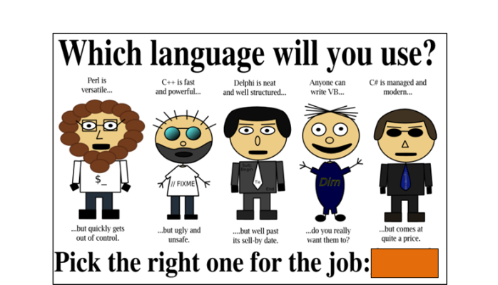
Course recap:

