Slide 1
NFAs, scanners, and flex

Slide 2
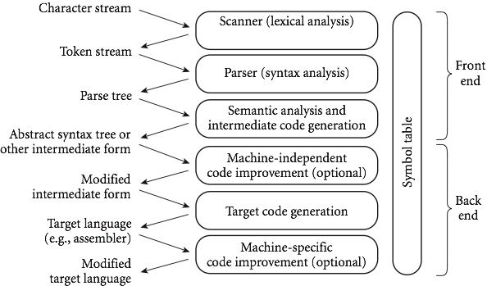
Recap
We’re looking at compilers:

Slide 3
So far:
Focusing on scanning, the top level
Scanning is recognizing a regular language
Connected to DFAs and NFAs, which we saw a bunch of the last 2 classes
Today:
Coding scanners
Flex, a c-style scanner
Later this week: parsing and CFGs, which are stronger than DFAs/scanning

Slide 4
More on why do we care?
You may ask: why do we care about regular expressions, DFAs and NFAs?
Well, in terms of defining a scanner, we usually start with regular expressions.
We then need a DFA (since NFAs are harder to code).
However, getting from a regular expression to a DFA in one step is difficult.
Instead, programs convert to an NFA, and THEN to a DFA.
Somewhat un-intuitively, this winds up being easier to code.

Slide 5
Constructing NFAs
The construction process for NFAs is pretty easy.
Recall how a regular expression is defined:
A single character or ε
Concatenation
An “or”
Kleene star
So all we need to do is show how to do each of these in an NFA (and how to combine them)

Slide 6
Constructing NFAs
Easy first step: What is the NFA for a single character, or for the empty string?
Now: what if I have NFAs for 2 regular expressions, and want to concatenate?

Slide 7
Constructing NFAs
A bit harder: what about an “or” or Kleene star?

Slide 8
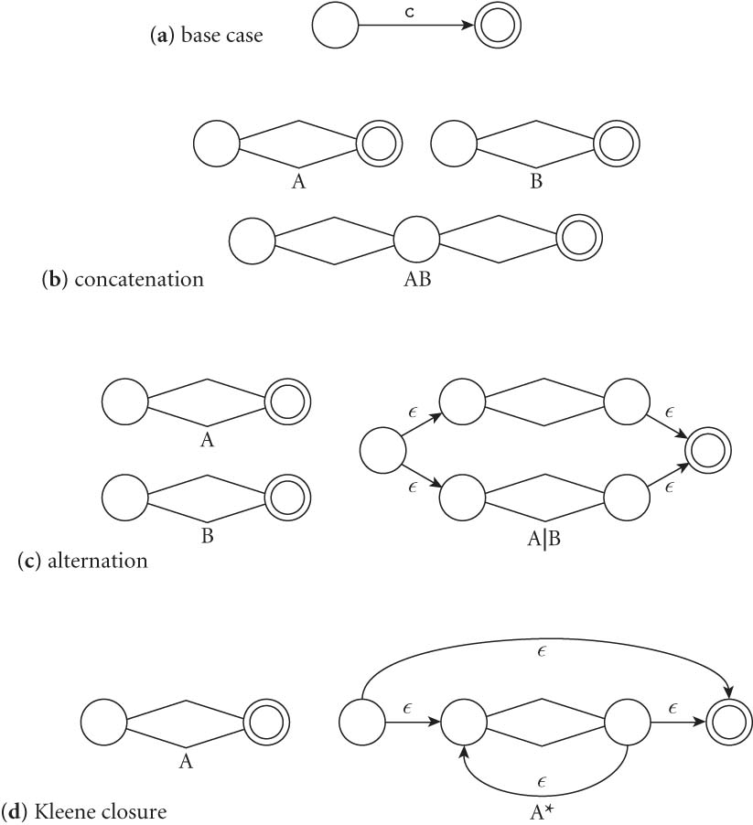
Constructing NFAs
Final picture (2.7 in book):

Slide 9
An example: decimals
Let d = [0-9], then decimals are: d* (.d | d. ) d*

Slide 10
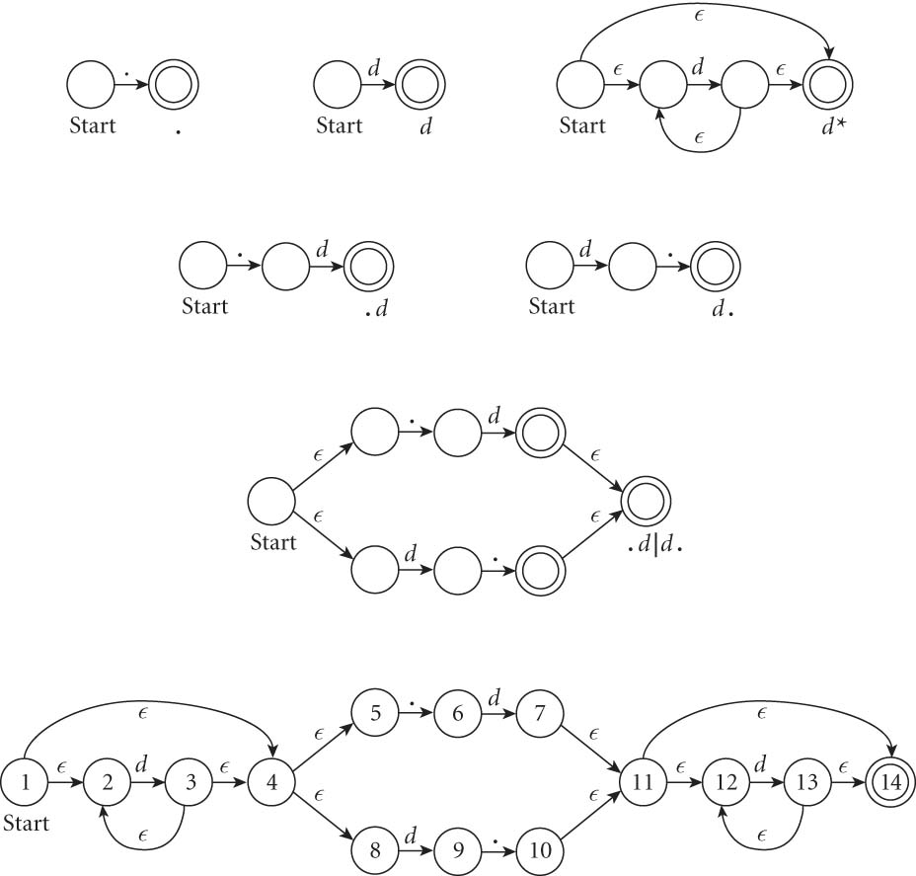
An example: decimals
Let d = [0-9], then decimals are: d* (.d | d. ) d*

Slide 11
From NFAs to DFAs
Next, a scanning program needs to go from this NFA to a DFA
Mainly because “guessing” the right transition if there are multiple ones is really hard to code
Much easier to convert to DFA, even though it can get bigger.
(Side note: how much bigger?)
Let’s go back to our decimal example on the board…

Slide 12
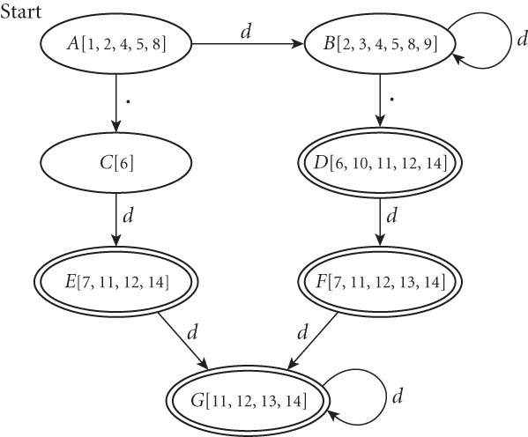
From NFAs to DFAs
If we automate this conversion on our last NFA (of decimals), we get:

Slide 13
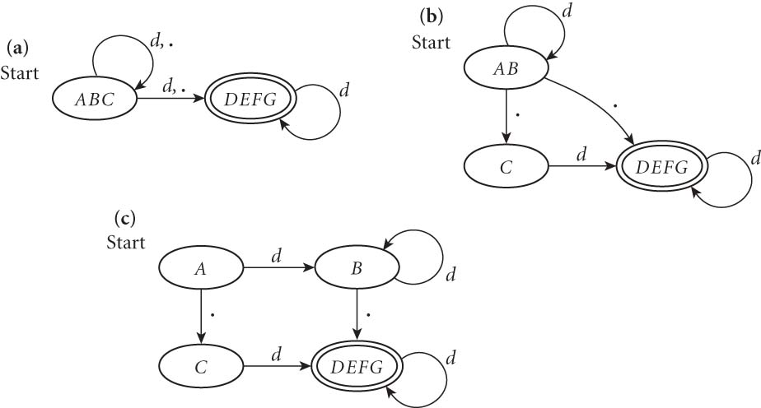
Minimizing DFAs
In addition, scanners take this final DFA and minimize.
(We won’t do this part by hand – I just want you to know that the computer does it automatically, to speed things up later.)

Slide 14
Coding DFAs (scanners)
Then, given a DFA, code can be implemented in 2 ways:
A bunch of if/switch/case statements
A table and driver
Both have merits, and are described further in the book.
We’ll mainly use the second route in homework, simply because there are many good tools out there.

Slide 15
Scanners
Writing a pure DFA as a set of nested case statements is a surprisingly useful programming technique
though it's often easier to use perl, awk, sed
for details see Figure 2.11
Table-driven DFA is what lex and scangen produce
lex (or really flex) does this in the form of C code – this will be an upcoming homework
scangen makes these in the form of numeric tables and a separate driver (for details see Figure 2.12)

Slide 16
lex & flex
lex is a tool to generate a scanner
written by Mike Lesk and Eric Schmidt
not really used anymore
Flex: fast lexical analyzer generator
free and open source alternative
our software of choice this semester – on hopper, as well as the lab machines

Slide 17
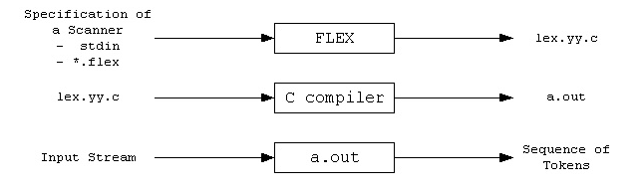
Flex overview
First, FLEX reads a specification of a scanner either from an input file *.lex, or from standard input, and it generates as output a C source file lex.yy.c.
Then, lex.yy.c is compiled and linked with the "-lfl" library to produce an executable a.out.
Finally, a.out analyzes its input stream and transforms it into a sequence of tokens.

Slide 18
Flex intro (cont)
Flex reads given input files or standard input, and tokenizes the input according to the rules you specify
As output, it generates a function yylex()
(This is why you use –lfl option, so that it links to the flex runtime library)
When you run the final executable, it analyzes input for occurrences of regular expressions
If found, executes the matching C code
Also can track states, to mimic a DFA

