Slide 1

Chapter 12 :: Logic Languages
Based on Programming Language Pragmatics
Michael L. Scott
And other online sources (see links on schedule page)
Copyright © 2009 Elsevier

Slide 2
Prolog: Recap
A logical language, based on predicates.
Often described as a language where you tell the computer what to do, and NOT how to do it.
Can lead to surprisingly concise code for surprisingly difficult problems – but can also have surprisingly bad runtimes!
Last time: predicates, and other basic structures
Copyright © 2009 Elsevier

Slide 3
Using prolog
Let’s try it, for those who haven’t used prolog. Log into hopper (just use ssh – no gui needed).
Backup – find online swi-prolog editor, which is what I’ll do.
Other option: use lab machines, or download local copy of gprolog.
Type “gprolog”
Now type (into a document called firstexample.pl):
likes(mary,food).
likes(mary,beer).
likes(mary,movies).
likes(john,wine).
likes(john,mary).
Type “prolog”, then “consult(‘firstexample.pl’) or just “[firstexample].” to load the predicates in your document.
Type “listing.” to get all the current facts.
Copyright © 2009 Elsevier

Slide 4
Using prolog
Now try a few simple facts:
| ?- likes(mary,food).
true .
| ?- likes(john,wine).
true .
| ?- likes(john,food).
false .
| ?- likes(mary,X).
Copyright © 2009 Elsevier

Slide 5
Using prolog: an exercise
How do you add the following facts? (Note: add these to your file, and use “reconsult” to reload if you edit the file in another window but keep gprolog active.)
1. Bob likes wine and beer.
2. John likes anything Mary likes.
3. John likes anyone who likes beer.
4. John likes anyone who likes themselves.
How would you query at the prompt to find everything that John likes? (Note that John’s list should be big at this point!)
(Email me your document/solution at the end of class)
Copyright © 2009 Elsevier

Slide 6
Prolog
To run a Prolog program, one asks the interpreter a question
This is done by stating a theorem - asserting a predicate - which the interpreter tries to prove
If it can, it says yes
If it can't, it says no
If your predicate contained variables, the interpreter prints the values it had to give them to make the predicate true.
Copyright © 2009 Elsevier

Slide 7
Prolog
The interpreter works by what is called BACKWARD CHAINING
It begins with the thing it is trying to prove and works backwards looking for things that would imply it, until it gets to facts
It is also possible in theory to work forward from the facts trying to see if any of the things you can prove from them are what you were looking for - that can be very time-consuming
Fancier logic languages use both kinds of chaining, with special smarts or hints from the user to bound the searches
Copyright © 2009 Elsevier

Slide 8
Prolog
The predicate you ask for is the interpreter's original GOAL
In an attempt to SATISFY that goal, it looks for facts or rules with which the goal can be UNIFIED
Any variables that do not yet have values but which correspond to constants or to variables with values in the other clause get INSTANTIATED with that value
Anyplace where uninstantiated variables correspond, those variables are identified with each other, but remain without values
Copyright © 2009 Elsevier

Slide 9
Prolog
The interpreter starts at the beginning of your database (this ordering is part of Prolog, NOT of logic programming in general) and looks for something with which to unify the current goal
If it finds a fact, great; it succeeds
If it finds a rule, it attempts to satisfy the terms in the body of the rule depth first
This process is motivated by the RESOLUTION PRINCIPLE, due to Robinson:
It says that if C1 and C2 are Horn clauses, where C2 represents a true statement and the head of C2 unifies with one of the terms in the body of C1, then we can replace the term in C1 with the body of C2 to obtain another statement that is true if and only if C1 is true
Copyright © 2009 Elsevier

Slide 10
Prolog: Resolution and Unification
Example:
takes(jane, cs344).
takes(jane, math266).
takes(alice, phil205).
takes(alice, cs344).
classmates(X,Y) :- takes(X,Z), takes(Y,Z).
Now, let X be jane and Z be cs344, we can replace the first term on righthand side of the last clause (C1) with the (empty) body of the first clause above (C2), giving:
classmates(jane, Y) :- takes(Y, cs344).
This is essentially pattern matching. Associating X with jane and Z with cs344 is called unification, and the variables are said to be instantiated.
Copyright © 2009 Elsevier

Slide 11
Prolog: Resolution and unification
So unification in prolog is applying the resolution principle, and pattern matching things into appropriate spots.
Unification rules:
A constant only unifies with itself
Two structures unify if they have the same functor and arity, and the corresponding arguments unify recursively
A variable unifies with anything. If the other thing has a value, then the variable is instantiated. If the other thing is an uninstantiated variable, then the two are associated so that later values will be shared.
Copyright © 2009 Elsevier

Slide 12
Variables and unification
Unification can be defined as follows:
Two terms unify if they are the same term or if they contain variables that can be uniformly instantiated with terms in such a way that the resulting terms are equal.
But there’s a lot of subtlety here, and this is a powerful concept.
A simple example – consider the following two predicates:
vertical(line(point(X,Y),point(X,Z))).
horizontal(line(point(X,Y),point(Z,Y))).
Essentially, just defining the concept of horizontal and vertical lines.
Copyright © 2009 Elsevier

Slide 13
Prolog: Equality
Equality is defined in terms of unifiability.
Example: =(A,B)succeeds if and only if A and B can be unified
Example:
?- a = a.
Yes
?- a = b.
No
?- foo(a,b) = foo(a,b).
Yes
?- X=a.
X = a;
No
Copyright © 2009 Elsevier

Slide 14
Prolog: Equality
Equality with variables is a bit different; this unifies the variables without actually instantiating them.
Example:
?- A = B
A = B
?- A = B, A = x, B = Y.
A = x
B = x
Y = x
Copyright © 2009 Elsevier

Slide 15
Using prolog: another exercise
I want you each to start a genealogical database to use for the in class exercises.
My file: lists my kids, me, my parents, and my grandparents
Some queries to try:
Confirm a parent relationship such as parent(erin, grace)
Find someone's parent such as parent(X, jesse)
Find someone's children such as parent(susan, X)
List all parent-children such as parent(X,Y)
Copyright © 2009 Elsevier

Slide 16
Using prolog: another exercise
Then, try a compound query, like:
?- parent(X,grace),female(X)
Or experiment with ordering. Do these give the same answer?
?- parent(X, someone), female(X).
?- female(X), parent(X, someone).
Finally, you can use the same predicate to find ancestors:
?- parent(X, someone), parent(GP, X).
Write some queries to grandmothers and grandfathers.
Copyright © 2009 Elsevier

Slide 17
Variables and unification
A simple example – consider the following two predicates:
vertical(line(point(X,Y),point(X,Z))).
horizontal(line(point(X,Y),point(Z,Y))).
What can we do with this?
?- vertical(line(point(1,1),point(1,3))).
true.
?- vertical(line(point(1,1),point(3,2))).
false.
?- horizontal(line(point(1,1),point(2,Y))).
Y = 1.
?- horizontal(line(point(2,3),P)).
P = point(_G277, 3).
Copyright © 2009 Elsevier

Slide 18
Unification behind the scenes
Another example:
loves(vincent,mia).
loves(marcellus,mia).
jealous(A,B):- loves(A,C), loves(B,C).
Query
?- jealous(X,Y).
The only way to unify this query is using the third rule, and there are two ways to do this.
Either way, Y gets bound to mia, but then there are 4 possible solutions.
Copyright © 2009 Elsevier

Slide 19
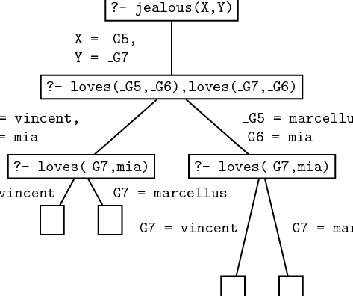
Unification behind the scenes
Copyright © 2009 Elsevier

Slide 20
Recursion
We actually saw some recursive definitions last time, but let’s look a little closer at one.
child(anne,bridget).
child(bridget,caroline).
child(caroline,donna).
child(donna,emily).
descend(X,Y) :- child(X,Y).
descend(X,Y) :- child(X,Z), descend(Z,Y).
This final rule allows the “child” relationship to chain indefinitely when unifying – which is the correct notion to use for descendants!
Copyright © 2009 Elsevier

Slide 21
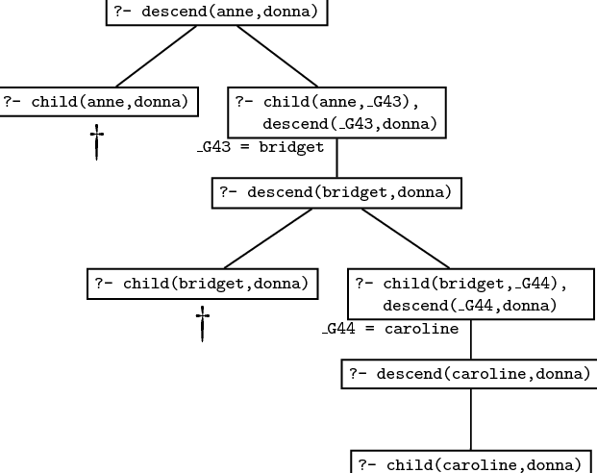
Recursion
Unification then searches the database:
Copyright © 2009 Elsevier

Slide 22
Recursion
Note that order can matter! If I change the two rules:
descend(X,Y) :- child(X,Y).
descend(X,Y) :- child(X,Z), descend(Z,Y).
If I swap the two rules, it will still work correctly.
However, if I change the second to be:
descend(X,Y) :- descend(Z,Y), child(X,Z).
Then infinite loops will abound, since Prolog will attempt to go down an infinitely long tree of descends.
(We’ll see more on this later.)
Copyright © 2009 Elsevier

Slide 23
Prolog: Lists
Lists are useful enough that prolog has built in support.
Structure: [] is the empty list, and . is a built in concatenation (like : in Haskell). So a list is:
.(a, .(b, .(c, [])))
Can also be written with “tail” structure:
[a, b, c]
[a | [b,c]]
[a, b | [c]]
[a, b, c | []]
Copyright © 2009 Elsevier

Slide 24
Prolog: Lists
A demo:
?- [X|Y]=[[],dead(z),[2,[b,c]],[],Z].
X = []
Y = [dead(z),[2,[b,c]],[],Z]
Note: Z stayed unbound – some systems will represent this as _7800 in the last spot and then say Z = _7800.
Otherwise, variables bind as we expect.
Lists don’t have to be of same “type”, for any sense of type.
Copyright © 2009 Elsevier

Slide 25
Prolog: Lists
This pattern matching is both handy and powerful:
?- [X1,X2,X3,X4|Tail] =
[[], dead(z), [2, [b, c]], [], Z].
X1 = [],
X2 = dead(z),
X3 = [2, [b, c]],
X4 = [],
Tail = [Z].
Copyright © 2009 Elsevier

Slide 26
Prolog: Lists
List predicates:
member(X, [X | _]).
member(X, [_ | T]) :- member(X,T).
sorted([]).
sorted([_]).
sorted([A, B | T]) :- A =< B,
sorted([B | T]).
Copyright © 2009 Elsevier

Slide 27
Prolog: Lists
Even crazier:
append([], A, A).
append([H | T], A, [H | L]) :-
append(T, A, L).
Now using it (note – prolog already has it coded!):
?- append([a, b, c], [d, e], L).
L = [a, b, c, d, e]
?- append(X, [d, e], [a, b, c, d, e]).
X = [a, b, c]
?- append([a, b, c], Y, [a, b, c, d, e]).
Y = [d, e]
Copyright © 2009 Elsevier

Slide 28
Exercise: Lists
Write a predicate second(X,List) which checks if X is the second element of List.
Write a predicate swap12(List1,List2) which checks if List1 is identical to List2, except with the first two elements exchanged.
Note: do this just like last time! Start a file and try to think about making list-based predicates.
Check last few examples to get some ideas.
(Email these to me as usual.)
Copyright © 2009 Elsevier

Slide 29
Prolog
Arithmetic: The '=' operator determines whether its operands can be unified ?- A = 37. A = 37 yes ?- 2 = 2. yes Math operators are functors (structure names), not functions ?- (2+3) = 5 no
Copyright © 2009 Elsevier

Slide 30
Prolog
For math we use the built-in operator is ?- is(X, 1+2). X = 3 yes ?- X is 1+2. X = 3 yes % LHS of 'is' must be as-yet uninstantiated ?- 1+2 is 4-1. no % RHS of 'is' must already be instantiated ?- X is Y. <error>
Copyright © 2009 Elsevier

Slide 31
Prolog
When it attempts resolution, the Prolog interpreter pushes the current goal onto a stack, makes the first term in the body the current goal, and goes back to the beginning of the database and starts looking again
If it gets through the first goal of a body successfully, the interpreter continues with the next one
If it gets all the way through the body, the goal is satisfied and it backs up a level and proceeds
Copyright © 2009 Elsevier

Slide 32
Prolog
If it fails to satisfy the terms in the body of a rule, the interpreter undoes the unification of the left hand side (this includes uninstantiating any variables that were given values as a result of the unification) and keeps looking through the database for something else with which to unify (This process is called BACKTRACKING)
If the interpreter gets to the end of database without succeeding, it backs out a level (that's how it might fail to satisfy something in a body) and continues from there
Copyright © 2009 Elsevier

Slide 33
Prolog: backtracking
We can visualize backtracking search as a tree in which the top-level goal is the root and the leaves are facts (see Figure 11.1 - next 2 slides)
The children of the root are all the rules and facts with which the goal can unify
The interpreter does an OR across them: one of them must succeed in order for goal to succeed
The children of a node in the second level of the tree are the terms in the body of the rule
The interpreter does an AND across these: all of them must succeed in order for parent to succeed
The overall search tree then consists of alternating AND and OR levels
Copyright © 2009 Elsevier

Slide 34
Prolog - backtracking
A simple example we started with last time:
rainy(seattle).
rainy(rochester).
cold(rochester).
snowy(X) :- rainy(X), cold(X).
Suppose we then type in:
snowy(C)
How does prolog attempt to resolve?
Copyright © 2009 Elsevier

Slide 35
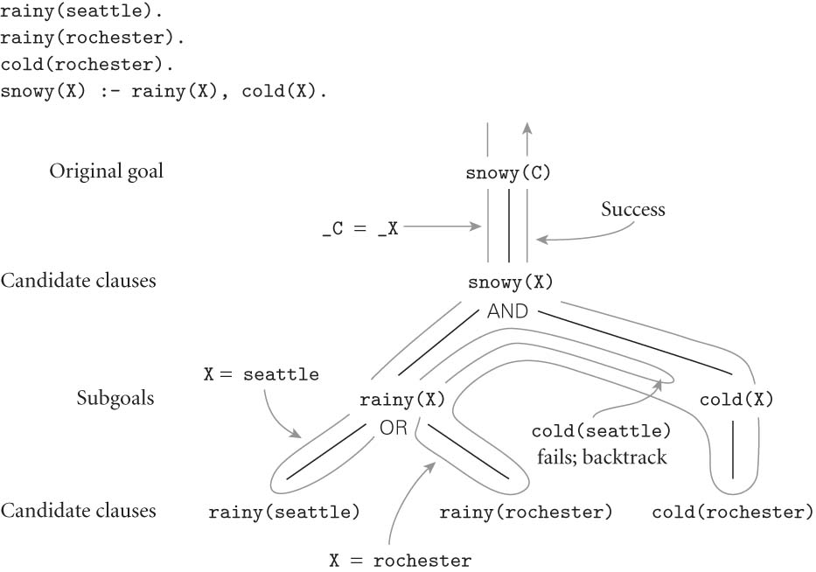
Prolog
FIGURE 11.1
Copyright © 2009 Elsevier

