Slide 1
Prolog
Based on: Chapter 12 of PLP
“Seven languages in seven weeks”
Various links (see schedule page)

Slide 2
Last time
Started genealogy database, to give concrete example
Hopefully got a sense of syntax
Today: dive in to more complex structures
Note: again, some examples for you to work out, so email me AT THE END OF CLASS with some proof of your work
Working with a partner is fine if you don’t have a computer, but be sure to give these a try yourself later! No substitute for actual programming…

Slide 3
Variables and unification
A simple example – consider the following two predicates:
vertical(line(point(X,Y),point(X,Z))).
horizontal(line(point(X,Y),point(Z,Y))).
What can we do with this?
?- vertical(line(point(1,1),point(1,3))).
true.
?- vertical(line(point(1,1),point(3,2))).
false.
?- horizontal(line(point(1,1),point(2,Y))).
Y = 1.
?- horizontal(line(point(2,3),P)).
P = point(_G277, 3).
Copyright © 2009 Elsevier

Slide 4
Unification behind the scenes
Another example:
loves(vincent,mia).
loves(marcellus,mia).
jealous(A,B):- loves(A,C), loves(B,C).
Query
?- jealous(X,Y).
The only way to unify this query is using the third rule, and there are two ways to do this.
Either way, Y gets bound to mia, but then there are 4 possible solutions.
Copyright © 2009 Elsevier

Slide 5
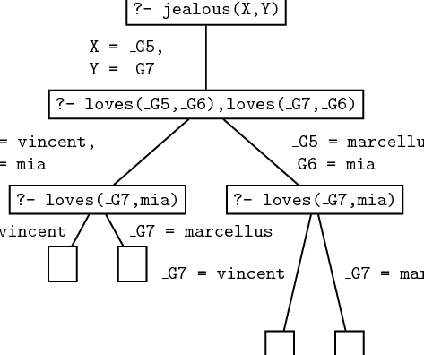
Unification behind the scenes
Copyright © 2009 Elsevier

Slide 6
Recursion
We actually saw some recursive definitions last time, but let’s look a little closer at one.
child(anne,bridget).
child(bridget,caroline).
child(caroline,donna).
child(donna,emily).
descend(X,Y) :- child(X,Y).
descend(X,Y) :- child(X,Z), descend(Z,Y).
This final rule allows the “child” relationship to chain indefinitely when unifying – which is the correct notion to use for descendants!
Copyright © 2009 Elsevier

Slide 7
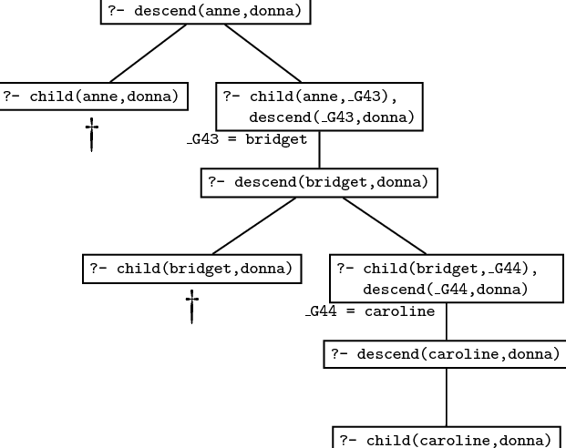
Recursion
Unification then searches the database:
Copyright © 2009 Elsevier

Slide 8
Recursion
Note that order can matter! If I change the two rules:
descend(X,Y) :- child(X,Y).
descend(X,Y) :- child(X,Z), descend(Z,Y).
If I swap the two rules, it will still work correctly.
However, if I change the second to be:
descend(X,Y) :- descend(Z,Y), child(X,Z).
Then infinite loops will abound, since Prolog will attempt to go down an infinitely long tree of descends.
(We’ll see more on this later.)
Copyright © 2009 Elsevier

Slide 9
An exercise
Pull up your genealogy database, and add the predicate to find descendants (see previous slide), but using the parent predicate (since we didn’t make a child one).
Then, test your predicate. Do they work, or do you see infinite loops even for simple queries like: descend(erin,grace).?

Slide 10
Prolog: Lists
Lists are useful enough that prolog has built in support.
Structure: [] is the empty list, and . is a built in concatenation (like : in Haskell). So a list is:
.(a, .(b, .(c, [])))
Can also be written with “tail” structure:
[a, b, c]
[a | [b,c]]
[a, b | [c]]
[a, b, c | []]
Copyright © 2009 Elsevier

Slide 11
Prolog: Lists
A demo:
?- [X|Y]=[[],dead(z),[2,[b,c]],[],Z].
X = []
Y = [dead(z),[2,[b,c]],[],Z]
Note: Z stayed unbound – some systems will represent this as _7800 in the last spot and then say Z = _7800.
Otherwise, variables bind as we expect.
Lists don’t have to be of same “type”, for any sense of type.
Copyright © 2009 Elsevier

Slide 12

Prolog: Lists
This pattern matching is both handy and powerful:
?- [X1,X2,X3,X4|Tail] =
[[], dead(z), [2, [b, c]], [], Z].
X1 = [],
X2 = dead(z),
X3 = [2, [b, c]],
X4 = [],
Tail = [Z].
Copyright © 2009 Elsevier

Slide 13
Prolog: Lists
List predicates:
member(X, [X | _]).
member(X, [_ | T]) :- member(X,T).
sorted([]).
sorted([_]).
sorted([A, B | T]) :- A =< B,
sorted([B | T]).
Copyright © 2009 Elsevier

Slide 14
Prolog: Lists
Even crazier:
append([], A, A).
append([H | T], A, [H | L]) :-
append(T, A, L).
Now using it (try these– prolog already has append coded!):
?- append([a, b, c], [d, e], L).
L = [a, b, c, d, e]
?- append(X, [d, e], [a, b, c, d, e]).
X = [a, b, c]
?- append([a, b, c], Y, [a, b, c, d, e]).
Y = [d, e]
Copyright © 2009 Elsevier

Slide 15
List exercise
First, write a simple list predicate second(X,List) which checks if X is the second element of List.
Note: this will look recursive! Look back at how we did member, sorted or append.

Slide 16
List exercise
Now, add the following to your genealogy file:
ancestor(A,D,[A]) :- parent(A,D).
ancestor(A,D,[X|Z]) :-
parent(X,D),
ancestor(A,X,Z).
Now test a few ways. I did:
ancestor(jesse,erin,X).
ancestor(erin,jesse,X).
ancestor(clarice,jesse,X).
ancestor(X,jesse,Y).

Slide 17
Prolog
Arithmetic: The '=' operator determines whether its operands can be unified ?- A = 37. A = 37 yes ?- 2 = 2. yes Math operators are functors (structure names), not functions ?- (2+3) = 5 no
Copyright © 2009 Elsevier

Slide 18
Prolog
For math we use the built-in operator is ?- is(X, 1+2). X = 3 yes ?- X is 1+2. X = 3 yes % LHS of 'is' must be as-yet uninstantiated ?- 1+2 is 4-1. no % RHS of 'is' must already be instantiated ?- X is Y. <error>
Copyright © 2009 Elsevier

Slide 19
Exercise: Arithmetic and Lists
Define a 2-place predicate increment that holds only when its second argument is an integer one larger than its first argument. For example, increment(4,5) should hold true, but increment(4,6) should not.
Define a 3-place predicate sum that holds only when its third argument is the sum of the first two arguments. For example, sum(4,5,9) should hold, but sum(4,6,12) should not.
If you have time: Write a predicate addOne whose first argument is a list of integers, and whose second argument is the list of integers obtained by adding 1 to each integer in the first list. For example, the query:
?- addone([1,2,7,2],X).
should give
X = [2,3,8,3].
(Add these to your email too)
Copyright © 2009 Elsevier

Slide 20
Prolog
When it attempts resolution, the Prolog interpreter pushes the current goal onto a stack, makes the first term in the body the current goal, and goes back to the beginning of the database and starts looking again
If it gets through the first goal of a body successfully, the interpreter continues with the next one
If it gets all the way through the body, the goal is satisfied and it backs up a level and proceeds
Copyright © 2009 Elsevier

Slide 21
Prolog
If it fails to satisfy the terms in the body of a rule, the interpreter undoes the unification of the left hand side (this includes uninstantiating any variables that were given values as a result of the unification) and keeps looking through the database for something else with which to unify (This process is called BACKTRACKING)
If the interpreter gets to the end of database without succeeding, it backs out a level (that's how it might fail to satisfy something in a body) and continues from there
Copyright © 2009 Elsevier

Slide 22
Prolog: backtracking
We can visualize backtracking search as a tree in which the top-level goal is the root and the leaves are facts (see Figure 11.1 - next 2 slides)
The children of the root are all the rules and facts with which the goal can unify
The interpreter does an OR across them: one of them must succeed in order for goal to succeed
The children of a node in the second level of the tree are the terms in the body of the rule
The interpreter does an AND across these: all of them must succeed in order for parent to succeed
The overall search tree then consists of alternating AND and OR levels
Copyright © 2009 Elsevier

Slide 23
Prolog - backtracking
A simple example we started with last time:
rainy(seattle).
rainy(rochester).
cold(rochester).
snowy(X) :- rainy(X), cold(X).
Suppose we then type in:
snowy(C)
How does prolog attempt to resolve?
Copyright © 2009 Elsevier

Slide 24
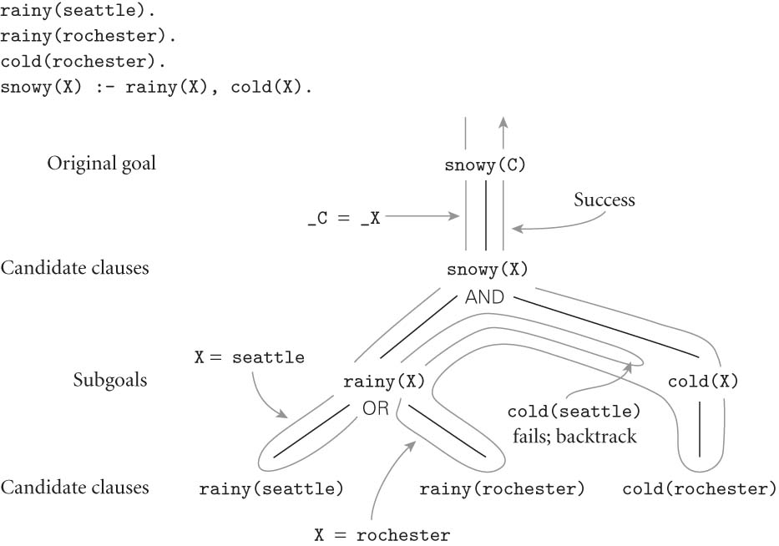
Prolog
FIGURE 11.1
Copyright © 2009 Elsevier

Slide 25
Prolog: Path Example
Be careful of ordering!
Consider this example describing paths in graphs:
edge(a, b). edge(b,c). edge(c,d).
edge(d, e). edge(b, e). edge(d, f).
path(X, X).
path(X, Y):- edge(Z, Y), path(X, Z).
If the two terms on the last clause were reversed, the program would be less efficient. Why?
If we were to flip order of the last 2 clauses, things get even worse!
Copyright © 2009 Elsevier

Slide 26
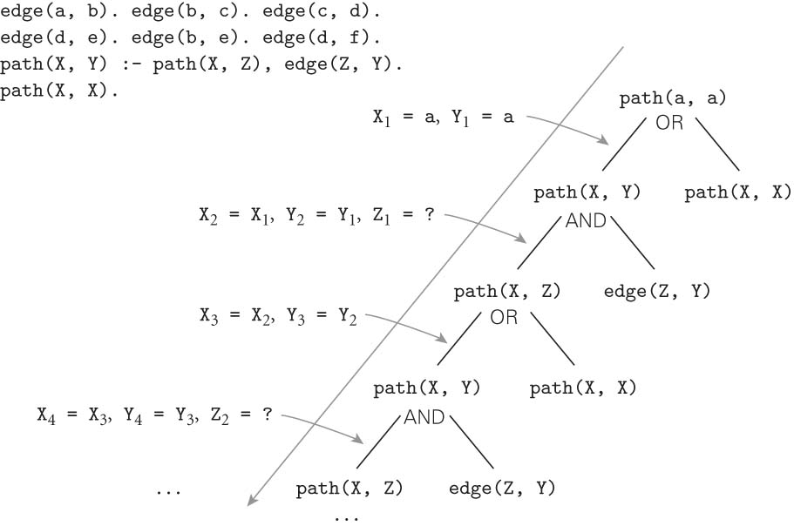
Prolog: Path Example cont.
If we were to flip order of the last 2 clauses, things get even worse! Figure 11.2:
Copyright © 2009 Elsevier

Slide 27
Prolog
PROLOG IS NOT PURELY DECLARATIVE
The ordering of the database and the left-to-right pursuit of sub-goals gives a deterministic imperative semantics to searching and backtracking
Changing the order of statements in the database can give you different results
It can lead to infinite loops
It can certainly result in inefficiency
Copyright © 2009 Elsevier

