Slide 1
Prolog
Based on: Chapter 12 of PLP
“Seven languages in seven weeks”
Various links (see schedule page)

Slide 2
Last time
Lists
More on unificaiton
Homework for prolog is posted, due Wednesday after break
We’ll finish prolog Wednesday of this week, so have time

Slide 3

Imperative Control Flow
Some options in Prolog actually alter the flow of control. Recall this example:: member(X, [X | _]). member(X, [_ | T]) := member(X,T).
If a given atom a is in the list n times, the the goal ?- member(a,L)can succeed n times.
This can be very inefficient in some cases, since we may have some other goal to satisfy that could fail:
prime_candidate(X) := member(X, candidates),
prime(X).
(Here, if a is in the list of candidates more than once, we’ll waste time checking for it that number of times, when we already “know” that prime(a) will just fail.)
Copyright © 2009 Elsevier

Slide 4
Control flow - the cut
We can save time by cutting off all future searches for a after the first time it is found: member(X, [X | _]) :- !. member(X, [_ | T]) := member(X,T).
The cut is the ! on the right hand side. This says that if X is the head of L, we should not attempt to unify member(X,L)with the left-hand side of the second rule. Essentially, the cut forces us to commit to the first rule only.
Copyright © 2009 Elsevier

Slide 5
Control flow - \=
Another option is to force the first element of the list to not be equal to X in the second rule: member(X, [X | _]) :- !. member(X, [H | T]) := X \= H, member(X,T).
The statement X \= H is equivalent to the statement \+(X = H). In essence, \+ is a bit like a not (which is how it is written in some versions of Prolog).
Copyright © 2009 Elsevier

Slide 6
Control flow - back to the cut
One really interesting use of ! is as an equivalent to if-then-else statements: statement := condition, !, then_part.
statement := else_part.
Here, the cut commits us to the first part if condition is true, which means we will never go to the second rule.
However, if the condition comes back as false (i.e. no derivation is found to make it true), then we’ll move onto the second rule and try to find if it can be satisfied.
Copyright © 2009 Elsevier

Slide 7
Control flow - the fail predicate
The fail predicate always fails.
It can be quite useful to force certain actions. For example, the \+ can be implemented using fail and !: =\+(X=H) :- (X=H), !, fail.
It can also be used to generate a type of “looping” behavior. As an example, recall our append code:
append([], A, A).
append([H | T], A, [H | L]) :-
append(T, A, L).
If we write append(A,B,L) where L is instantiated but A and B are not, we can use this to generate possible lists.
Copyright © 2009 Elsevier

Slide 8
Control flow - the fail predicate
If we write append(A,B,L) where L is instantiated by A and B are not, we can use this to generate possible lists:
print_lists(L) :-
append(A,B,L), write(A),
write(‘ ‘), write(B),
nl, fail.
The output if we call print_lists([a, b, c]) will be:
[] [a, b, c]
[a] [b, c]
[a, b] [c]
[a, b, c] []
No
Copyright © 2009 Elsevier

Slide 9
Looping and unbounded generators
The following generates all of the natural numbers:
natural(1).
natural(N) :- natural(M), N is M+1.
We can then use this to print out the first n numbers:
my_loop(N) := natural(I),
write(I), nl,
I = N, !.
So long as I is less than N, the equality predicate will fail and backtracking will pursue another alternative for natural. If I is equal to N, then the cut will execute, committing us to the final value of I and terminating this loop.
Copyright © 2009 Elsevier

Slide 10
Looping and unbounded generators
This programming idiom - an unbounded generator with a test-cut terminator - is know as generate-and-test.
This combination is generally used with side effects, such as I/O or modification of the database.
For example, we could use such a construct to add values to the database until some threshold is met.
Copyright © 2009 Elsevier

Slide 11
I/O in prolog
Prolog provides several I/O predicates, such as:
write and nl for output, read for input
see and tell can redirect input and output to different files.
get and put read individual characters.
consult and reconsult add database clauses from a file, so that they don’t have to be entered by hand.
Copyright © 2009 Elsevier

Slide 12
Database Manipulation
Prolog is homoiconic: it can represent itself (like Scheme).
It can also modify itself:
?- rainy(X)
X = seattle ;
X = rochester ;
No
?- assert(rainy(syracuse)).
Yes
?- retract(rainy(rochester)).
Yes
?- rainy(X)
X = seattle ;
X = syracuse ;
No
Copyright © 2009 Elsevier

Slide 13
Additional predicates
The goal functor(T, F, N) succeeds if and only if T is a term with functor F and arity N:
?- functor(foo(a,b,c), foo, 3).
Yes
?- functor(foo(a,b,c), F, N).
F = foo
N = 3
?- functor(T, foo, 3).
T = foo(_10, _37, _24)
The goal arg(N, T, A) succeeds if and only if its first two arguments are instantiated, N is a number, and A is the Nth argument of T:
?- arg(3, foo(a,b,c), A).
A = c
Copyright © 2009 Elsevier

Slide 14
Using arg and functor
We can use these together to create an arbitrary term:
?- functor(T, foo, 3), arg(1, T, a), arg(2, T, b), arg(3, T, c)
T = foo(a, b, c)
We can also use =.. for this:
?- T =.. [foo, a, b, c]
T = foo(a,b,c)
?- foo(a,b,c) =.. [F, A1, A2, A3]
F = foo
A1 = a
A2 = b
A3 = c
Copyright © 2009 Elsevier

Slide 15
Dynamic goals
Taken together, we can attempt to satisfy goals that are created at run-time only:
param_loop(L, H, F) :- natural(I), I >= L,
G =.. [F, I], call(G), I=H, !.
Then calling:
?- param_loop(5, 10, write).
5678910
Yes
Copyright © 2009 Elsevier

Slide 16
An example for the HW: DFAs
As a final example, prolog is also really good and simulating DFAs and NFAs.
We’ll talk about DFAs, but NFAs are your homework!
My example: taken from
https://www.cpp.edu/~jrfisher/www/prolog_tutorial/2_14.html
Things to note:
This prints for you!
The transition function takes an input and moves along an “arrow”
For NFAs, your job will be to add multiple possible transitions and empty transitions
Copyright © 2009 Elsevier

Slide 17
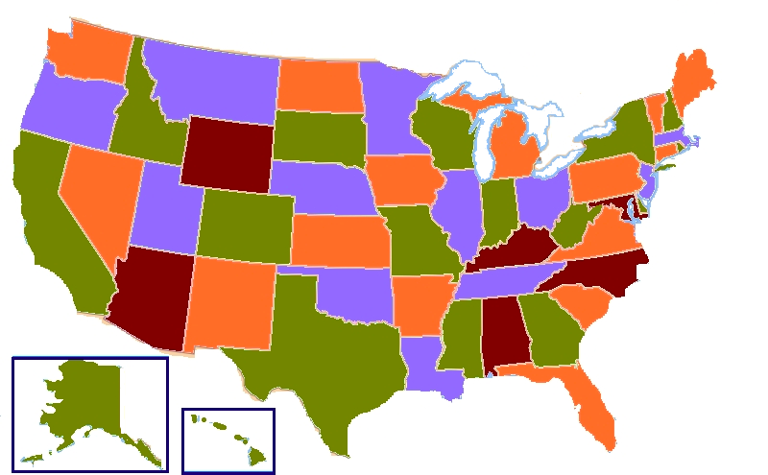
Another example to recap
Consider 4 coloring a map.
Classical example of an NP-Hard problem, so the best we can hope for is exponential time.
NOT easy to code in many languages:
http://www.cplusplus.com/forum/general/123813/
https://handcraftsman.wordpress.com/2015/06/21/four-coloring-a-graph-of-u-s-states-with-python-and-a-ga/
http://www.sanfoundry.com/java-program-graph-coloring-algorithm/
Copyright © 2009 Elsevier

Slide 18
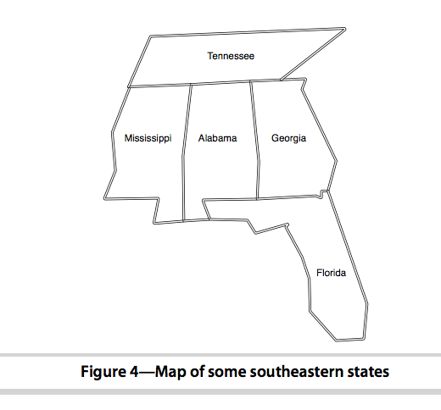
Prolog – 3 coloring:
Let’s try a small example of this in prolog
Extending bigger is easy, since will just need more predicates for neighbors
Base assertions will just be that colors need to be different, and neighbors can’t be the same
See code on webpage
Copyright © 2009 Elsevier

Slide 19
Prolog – 4 coloring:
There are also other ways to do this, that pull in more logic (which we’ll be talking about today).
See (for example):
https://bernardopires.com/2013/10/try-logic-programming-a-gentle-introduction-to-prolog/
https://www.cpp.edu/~jrfisher/www/prolog_tutorial/2_1.html
Let’s dive more into these logical constructs today, and then come back to these examples
Copyright © 2009 Elsevier

