Slide 1
Prolog
Based on: Chapter 12 of PLP
“Seven languages in seven weeks”
Various links (see schedule page)

Slide 2

My favorite example
It is worth reiterating that prolog is NOT really a traditional language which executes statements in a von Neumann-like way.
Prolog does provide some mechanisms for this, but they can be very inefficient (especially if you’re not used to the language).
sort(L1, L2) := permutation(L1, L2), sorted(L2).
permutation([], []).
permutation(L, [H | T]) :-
append(P, [H | S], L),
append(P, S, W),
permutation(W,T).
If this looks confusing, don’t worry. We’re essentially saying L2 is a sorted version of L1 if it’s a permutation of L1 and it is sorted.
This version takes exponential time. Why?
Copyright © 2009 Elsevier

Slide 3
Sorting: quicksort
Implementing something like quick sort is possible:
quicksort([], []).
quicksort([A, L1], L2) :- partition(A, L1, P1, S1),
quicksort(P1, P2), quicksort(S1, S2),
append(P2, [A | S2], L2).
partition(A, [], [], []).
partition(A, [H | T], [H | P], S) :- A >= H, partition(A, T, P, S).
partition(A, [H | T], [P], [H | S]) :- A =< H, partition(A, T, P, S).
Copyright © 2009 Elsevier

Slide 4
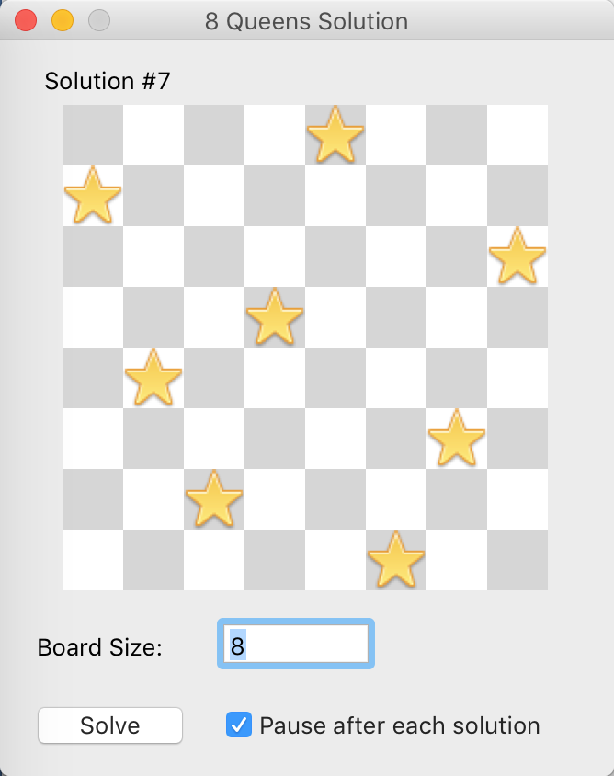
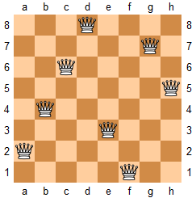
Another example: queen’s challenge
Set n queens on an n by n chess board so that no queen can “take” any other

Slide 5
Implementing it
When can a queen “take” another?
Diagonal
Vertical
Horizontal
So: at most one per row (or column)
Would then need to check if they are diagonal from each other

Slide 6
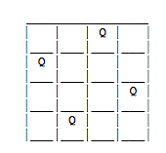
So: use lists
We’ll represent a board as a list, where position i will be the location of the queen in row I
Example: [3,1,4,2]
How to check diagonals?
(Note: simple math trick…)

Slide 7
Solution:
/* prolog tutorial 2.11 Chess queens challenge puzzle */
perm([X|Y],Z) :- perm(Y,W), takeout(X,Z,W).
perm([],[]).
takeout(X,[X|R],R).
takeout(X,[F|R],[F|S]) :- takeout(X,R,S).
solve(P) :-
perm([1,2,3,4,5,6,7,8],P),
combine([1,2,3,4,5,6,7,8],P,S,D),
all_diff(S),
all_diff(D).
combine([X1|X],[Y1|Y],[S1|S],[D1|D]) :-
S1 is X1 +Y1,
D1 is X1 - Y1,
combine(X,Y,S,D).
combine([],[],[],[]).
all_diff([X|Y]) :- \+member(X,Y), all_diff(Y).
all_diff([X]).

Slide 8
Solution:
| ?- [chess].
P = [5,2,6,1,7,4,8,3] ? ;
P = [6,3,5,7,1,4,2,8] ? ;
…
| ?- setof(P,solve(P),Set), length(Set,L).
L = 92
Set = [[1,5,8,6,3,7,2,4],[1,6,8,3,7,4,2,5],[1,7,4,6,8,2,5,3],[1,7,5,8,2,4,6,3],[2,4,6,8,3,1,7,5],[2,5,7,1,3,8,6,4],….

Slide 9
Conclusions
Bigger examples are everywhere online
I really like the Sudoku example in your recommended text (you can find this chapter online for free, in fact), but it was really too long for class.
First used for language processing, but good also for games, web analysis, AI, scheduling, and other things.
Often really found in a larger applications, not solo.
Weaknesses:
Not general purpose – definitely a niche language.
Computationally intensive, so not good on big data.
Can be hard to manage recursion (even more so than functional).
Copyright © 2009 Elsevier

Slide 10
Conclusions
Two major steps:
Build a knowledge base
Compile this base and ask questions
Core computation is unification, as opposed to variables or functions.
Serious learning curve! We’ve only tasted it briefly, so use this cautiously.
Lots of people say this takes years to get good at, but finding places it can be applied can make life much easier.
My takeaway for you: some models of computation are just very different, but have their unique strengths.
Copyright © 2009 Elsevier

