Slide 1
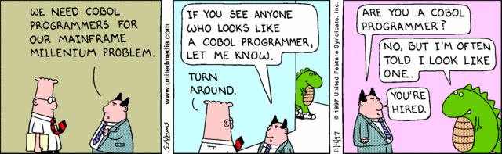
Programming in COBOL

Slide 2
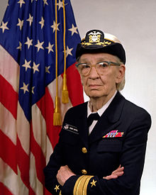
COBOL Origins
Developed in 1959-1960; latest standard was released in 2002
Heavy investment from the government and accounting industry, with significant legacy code
Created to be the ultimate “portable” language for data processing
Academics were not interested in business applications, so designed from the ground up for businessmen

Slide 3
COBOL Today
It’s still around!
A 2013 Gartner Business Computing report states that 200 times more transactions are processed using COBOL every day than there are google or youtube searches made
Still runs (somewhere) in more than 70% of the world’s business
You interact with a COBOL based business application an average of at least 7 times per day
Design-wise, COBOL applications tend to be huge (millions of lines of code), which may be why they often stick around

Slide 4
COBOL Features
Simple, English-like syntax:
Rather than y=x; say Move x to y
Weakly typed
No pointers, user defined types, or user defined functions (at least initially, although some have been retrofitted)
Data types are very “structure-like”: can have numeric, alphanumeric (strings), and alphabetic base types, and records formed from these types
Hierarchical in structure: almost like an essay, each program has 4 main divisions with subordinate elements in each
Some compilers require all 4 to be present, but some only require two

Slide 5
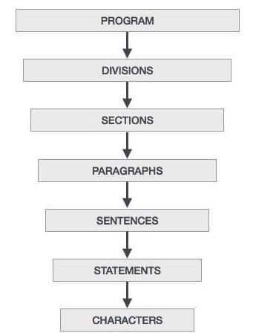
COBOL Elements

Slide 6
The Divisions
Part 1: Identification division (required)
Supplies information about the program to the programmer and compiler
Part 2: Environment division
Used to describe the environment in which program should run
Part 3: Data division
Provides description of the data items the program will process
Part 4: Procedure division (required)
Contains code used to manipulate the data

Slide 7
Basic format
Each line is 80 characters long (a “coding sheet”):
Lines 1-6 are for line numbers
Line 7 is an indicator: * means comment, - means continuation, and / indicates form feed
Lines 8-11, or Area A: All divisions, sections, paragraphs, etc., begin here
Lines 12-72, or Area B: All COBOL statements
Lines 73-80: Identification area (as needed by programmer)

Slide 8
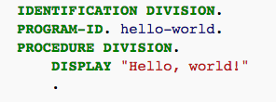
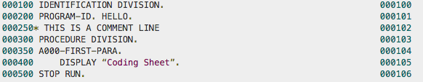
Sample programs: Hello world

Slide 9
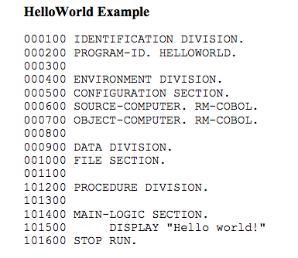
Sample programs: Hello world

Slide 10
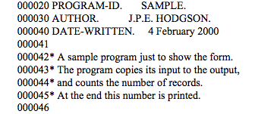
Identification Division
Mandatory, since it is how the program is identified
PROGRAM-ID is the only mandatory part
Also often contains AUTHOR, DATE-WRITTEN, and comments to describe content

Slide 11
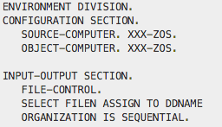
Environment Division
Used to specify input and output files to the program
2 sections:
Configuration: information about system on which program is written and executed
Input-Output: information about the files to be used

Slide 12
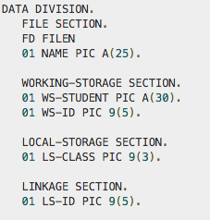
Data Division
Defines the variables. 4 sections:
File section: define record structure
Working-storage section: declare temporary variables and file structures
Local-storage section: Similar to above, but variables allocated and initialized with every program execution
Linkage section: describes data names received from external program

Slide 13
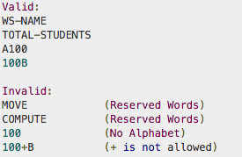
More on data division: names
Data Names: defined here and used in the procedure division (next) for actual commands
Some strict rules about what is allowed:

Slide 14
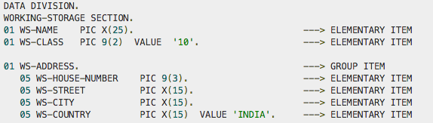
More on data division: level number
Level number is used to specify the level of data in a record – differentiates between elementary items and group items
Elementary items can’t be divided further
Group items consist of one or more elementary item(s)

Slide 15
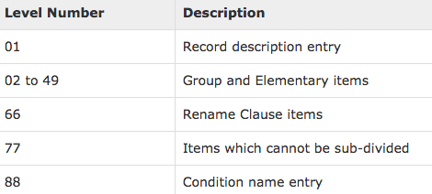
More on data division: level number
Level number is used to specify the level of data in a record – differentiates between elementary items and group items
Elementary items can’t be divided further
Group items consist of one or more elementary item(s)

Slide 16
More on data division: level number
Level number is used to specify the level of data in a record – differentiates between elementary items and group items
Elementary items can’t be divided further
Group items consist of one or more elementary item(s)

Slide 17
More on data division: pic clauses
Picture clauses can be used to define the following items:
Data types: can be numeric, alphabetic, or alphanumeric
Sign: + or – (for numeric data)
Decimal point position (for numeric data), so not included in the data
Length: defines number of bytes used by data item
So in the previous example:
9 means numeric data, A means alphabetic, X means alphanumeric
V is the implicit decimal, S is sign, P is assumed decimal

Slide 18
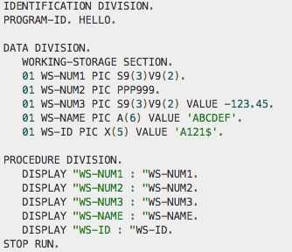
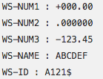
More on data division: pic clauses

Slide 19
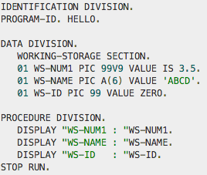

More on data division: value clauses
These are optional clauses to initialize data items

Slide 20
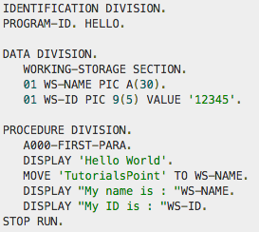
Procedure Division
Describes the logic of the program
Consists of executable statements using variables defined in data division
Paragraph and section names here are user defined
There must be at least one statement, and last is usually STOP RUN or EXIT PROGRAM

Slide 21
Actions in the procedure division
I/O:
ACCEPT verb gets data from the OS or the user
DISPLAY verb prints out
INITIALIZE is the verb used to initialize values
Puts 0’s or spaces, depending on base type
REPLACING term can be used to initialize to the given replacing value

Slide 22
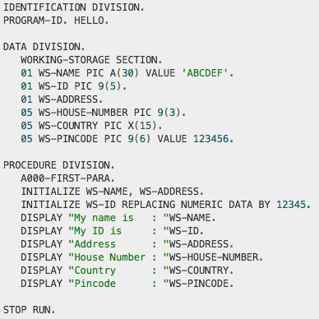
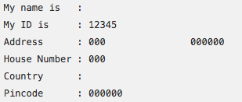
Actions in the procedure division

Slide 23

Actions in the procedure division
The MOVE verb copies source data to a specified destination
Works on both elementary and group data items
For group, use MOVE CORR
MOVE(x:l) copies starting at x and for length l
If destination is shorter, will add zeroes or spaces to fill out
The ADD verb adds (not much to say)
SUBTRACT subtracts, but can be used in fun ways

Slide 24
Actions in the procedure division
COMPUTE lets you do more arithmetic expressions:
COMPUTE VAR = (OTHERVAR1 * OTHERVAR2) – OTHERVAR3
REDEFINES is used to define storage with a different data description
RENAMES gives a different name to an existing data item
USAGE specifies the OS in which the format date is stored

Slide 25
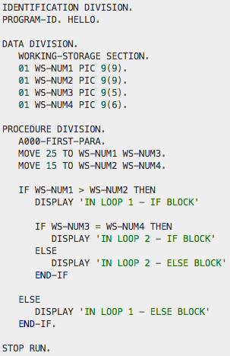

COBOL control structures

Slide 26
COBOL features:
Report writer is a declarative process that creates reports (from the data division)
Programmer just specifies the report layout and the data required to produce it
No formatting, page breaks, etc, to worry about

Slide 27
COBOL criticisms
Criticisms: Not a very structured paradigm
Dijkstra: "The use of COBOL cripples the mind; its teaching should, therefore, be regarded as a criminal offense.”
GOTOs were a big part of COBOL, leading to “spaghetti code”
Have now been replaced with PERFORMs, which promote more modular programming
Not very modular: hard to restrict data access, and no way to pass parameters
Newer version have added some of these things
Intended to be portable, but as of 2001, over 300 dialects
Very verbose – over 300 reserved keywords

Slide 28
COBOL on linux
If you’d like to play – download GNU COBOL compiler:
See here: https://medium.com/@yvanscher/7-cobol-examples-with-explanations-ae1784b4d576
Or more examples: http://www.csis.ul.ie/cobol/examples/default.htm

Slide 29
COBOL takeaway
Keep in mind, I was told that this language was “dead” over 20 years ago, and I’ve found articles from the 70s that say the same thing
But:
Businesses reuse COBOL applications that were written decades ago on new platforms like .NET or JVM.
The language itself is portable with data types and structures which enable developers to write applications that can be ported to new platforms with minimal or no change.
COBOL has been able to adapt to change: each new enterprise platform which emerges has had COBOL applications deployed there.

