Slide 1

Chapter 10 :: Object Orientated Programming
Programming Language Pragmatics
Michael L. Scott
Copyright © 2009 Elsevier

Slide 2
Object-Oriented Programming
Control or process abstraction is a very old idea (subroutines!), though few languages provide it in a truly general form (Scheme comes close)
Data abstraction is somewhat newer, though its roots can be found in Simula67
  An Abstract Data Type is one that is defined in terms of the operations that it supports (i.e., that can be performed upon it) rather than in terms of its structure or implementation
  After discussion in chapters 6 and 7 about variable equivalence, this should make more sense in context!
Copyright © 2009 Elsevier

Slide 3
Object-Oriented Programming
Why abstractions?
  easier to think about - hide what doesn't matter
  protection - prevent access to things you shouldn't see
  plug compatibility
    replacement of pieces, often without recompilation, definitely without rewriting libraries
    division of labor in software projects
Copyright © 2009 Elsevier

Slide 4
Object-Oriented Programming: origins
Statics allow a subroutine to retain values from one invocation to the next, while hiding the name in-between
  This ties closely to type and scope: when variables exist and how to invoke them when they are not local or global
  Important precursor to object orientation
Copyright © 2009 Elsevier

Slide 5
Object-Oriented Programming: origins
Modules allow a collection of subroutines to share some static variables
Module types then allow the programmer to instantiate multiple instances or a given abstraction
Finally, classes allow the programmer to define families of related abstractions
Module types and classes actually allow the module to BE the abstract type, rather than just providing functionality
Copyright © 2009 Elsevier

Slide 6
Module types: more detail
Module types allow the module to be the abstract data type - you can declare
a bunch of them
  This is generally more intuitive
    It avoids explicit object parameters to many operations
    One minor drawback: If you have an operation
    that needs to look at the innards of two different types, you'd define both types in the same manager module in Modula-2
    In C++ you need to make one of the classes (or some of its members) "friends" of the other class
Copyright © 2009 Elsevier

Slide 7
Object-Oriented Programming
Objects add inheritance and dynamic method binding
Simula 67 introduced these, but didn't have data hiding
The 3 key factors in OO programming:
  Encapsulation (data hiding)
  Inheritance
  Dynamic method binding
Copyright © 2009 Elsevier

Slide 8
Encapsulation and Inheritance
Visibility rules
  Public and Private parts of an object declaration/definition
  2 reasons to put things in the declaration
    so programmers can get at them
    so the compiler can understand them
  At the very least the compiler needs to know the size of an object, even though the programmer isn't allowed to get at many or most of the fields (members) that contribute to that size
    That's why private fields have to be in declaration
Copyright © 2009 Elsevier

Slide 9
Encapsulation and Inheritance
Classes (C++)
C++ distinguishes among
  public class members
    accessible to anybody
  protected class members
    accessible to members of this or derived classes
  private
    accessible just to members of this class
A C++ structure (struct) is simply a class whose members are public by default
C++ base classes can also be public, private, or protected
Copyright © 2009 Elsevier

Slide 10
Encapsulation and Inheritance
Classes (C++)
Example:
class circle : public shape { ...
anybody can convert (assign) a circle* into a shape*
class circle : protected shape { ...
only members and friends of circle or its derived classes can convert (assign) a circle* into a shape*
class circle : private shape { ...
only members and friends of circle can convert (assign) a circle* into a shape*
Copyright © 2009 Elsevier

Slide 11
Initialization and Finalization
In Section 3.2, we defined the lifetime of an object to be the interval during which it occupies space and can hold data
  Most object-oriented languages provide some sort of special mechanism to initialize an object automatically at the beginning of its lifetime
    When written in the form of a subroutine, this mechanism is known as a constructor
    A constructor does not allocate space, though.
  A few languages provide a similar destructor mechanism to finalize an object automatically at the end of its lifetime
Copyright © 2009 Elsevier

Slide 12
Initialization and Finalization
Issues
choosing a constructor: often need multiple
references and values
  If variables are references, then every object must be created explicitly - appropriate constructor is called
  If variables are values, then object creation can happen implicitly as a result of elaboration
execution order
  When an object of a derived class is created in C++, the constructors for any base classes will be executed before the constructor for the derived class
garbage collection
Copyright © 2009 Elsevier

Slide 13
Dynamic Method Binding
Virtual functions in C++ are an example of dynamic method binding
  you don't know at compile time what type the object referred to by a variable will be at run time
Simula also had virtual functions (all of
which are abstract)
In Smalltalk, Eiffel, Modula-3, and Java all member functions are virtual
Copyright © 2009 Elsevier

Slide 14
Dynamic Method Binding
Note that inheritance does not remove the need for generics
  You might think: hey, I can define an abstract list class and then derive int_list, person_list, etc. from it, but the problem is you won’t be able to talk about the elements because you won't know their types
  That's what generics are for: abstracting over types
Java doesn't have generics, but it does have (checked) dynamic casts
Copyright © 2009 Elsevier

Slide 15
Dynamic Method Binding
Data members of classes are implemented just like structures (records)
  With (single) inheritance, derived classes have extra fields at the end
  A pointer to the parent and a pointer to the child contain the same address - the child just knows that the struct goes farther than the parent does
Copyright © 2009 Elsevier

Slide 16
Dynamic Method Binding
Non-virtual functions require no space at run time; the compiler just calls the appropriate version, based on type of variable
  Member functions are passed an extra, hidden, initial parameter: this (called current in Eiffel and self in Smalltalk or Python)
C++ philosophy is to avoid run-time overhead whenever possible – this is sort of the legacy from C
  Languages like Smalltalk have (much) more run-time support
Copyright © 2009 Elsevier

Slide 17
Dynamic Method Binding
Virtual functions are the only thing that requires any trickiness (Figure 9.3)
  They are implemented by creating a dispatch table (vtable) for the class and putting a pointer to that table in the data of the object
  Objects of a derived class have a different dispatch table
    In the dispatch table, functions defined in the parent come first, though some of the pointers point to overridden versions
    You could put the whole dispatch table in the object itself
      That would save a little time, but potentially waste a LOT of space
Copyright © 2009 Elsevier

Slide 18
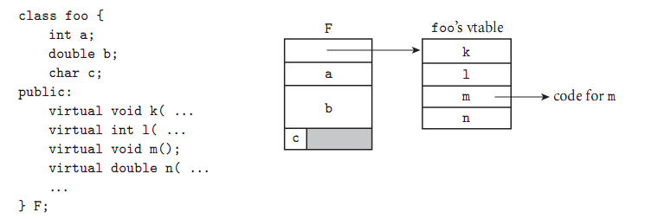
Dynamic Method Binding
Figure 9.3 Implementation of virtual methods. The representation of object F begins with the address of the vtable for class foo. (All objects of this class will point to the same vtable.) The vtable itself consists of an array of addresses, one for the code of each virtual method of the class. The remainder of F consists of the representations of its ﬁelds.
Copyright © 2009 Elsevier

Slide 19
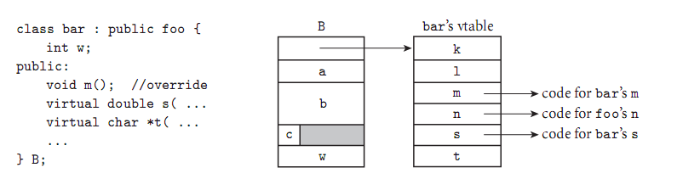
Dynamic Method Binding
Figure 9.4 Implementationof single inheritance. As in Figure 9.3, the representation of object B begins with the address of its class’s vtable. The ﬁrst four entries in the table represent the same members as they do for foo, except that one —m— has been overridden and now contains the address of the code for a different subroutine. Additional ﬁelds of bar follow the ones inherited from foo in the representation of B; additional virtual methods follow the ones inherited from foo in the vtable of class.
Copyright © 2009 Elsevier

Slide 20
Multiple Inheritance
In C++, you can say
class professor : public teacher, public researcher {
...
}
Here you get all the members of teacher and all the members of researcher
  If there's anything that's in both (same name and argument types), then calls to the member are ambiguous; the compiler disallows them
Copyright © 2009 Elsevier

Slide 21
Multiple Inheritance
Virtual base classes: In the usual case if you inherit from two classes that are both derived from some other class B, your implementation includes two copies of B's
data members
That's often fine, but other times you want a single copy of B
  For that you make B a virtual base class
  (Probably have seen this – consider the base Object class in Java)
Copyright © 2009 Elsevier

Slide 22
Object-Oriented Programming
Anthropomorphism is central to the OO paradigm - you think in terms of real-world objects that interact to get things done
Many OO languages are strictly sequential, but the model adapts well to parallelism as well
Strict interpretation of the term
  uniform data abstraction - everything is an object
  inheritance
  dynamic method binding
Copyright © 2009 Elsevier

Slide 23
Object-Oriented Programming
Smalltalk is the canonical object-oriented language
  It has all three of the characteristics listed above
  It is based on the thesis work of Alan Kay at Utah in the late 1960’s
  It went through 5 generations at Xerox PARC, where Kay worked after graduating
  ANSI Smalltalk is the current standard (from 1998)
  Took 2nd place for “most loved programming language” in StackOverflow survey last year
Copyright © 2009 Elsevier

Slide 24
Object-Oriented Programming
Other languages are described in what follows:
Modula-3
  single inheritance
  all methods virtual
  no constructors or destructors
Copyright © 2009 Elsevier

Slide 25
Object-Oriented Programming
Ada 95
  tagged types
  single inheritance
  no constructors or destructors
  class-wide parameters:
    methods static by default
    can define a parameter or pointer that grabs the object-specific version of all methods
      base class doesn't have to decide what will be virtual
  notion of child packages as an alternative to friends
Copyright © 2009 Elsevier

Slide 26
Object-Oriented Programming
Java
  interfaces, mix-in inheritance
  alternative to multiple inheritance
    basically you inherit from one real parent and one or more interfaces, each of which contains only virtual functions and no data
    this avoids the contiguity issues in multiple inheritance above, allowing a very simple implementation
  all methods virtual
Copyright © 2009 Elsevier

Slide 27
Object-Oriented Programming
Recap of languages:
Smalltalk is really pretty purely object-oriented
C++ can be used in an object-oriented style, but it’s arguable that it is a pure object-based design. Why?
  Note that simple types are not classes
  Has subroutines outside of classes
  C-style functionality provides major loopholes that pure OO languages wouldn’t allow
    Type casting, garbage collection, etc.
Copyright © 2009 Elsevier

Slide 28
Object-Oriented Programming: takeaway
Encapsulation: implementation details are hidden behind a simple interface
Inheritance: new abstractions can be defined as extensions or refinements or existing ones (and gets features automatically)
Dynamic method binding: new abstraction can display new behavior even when used in a context that expects the old behavior
Best current examples: probably Ruby and Smalltalk
Copyright © 2009 Elsevier

